Slide 1
Lesson 2:
The Climate of the Mediterranean World
From
Wayne
Jackson’s
book

Slide 2
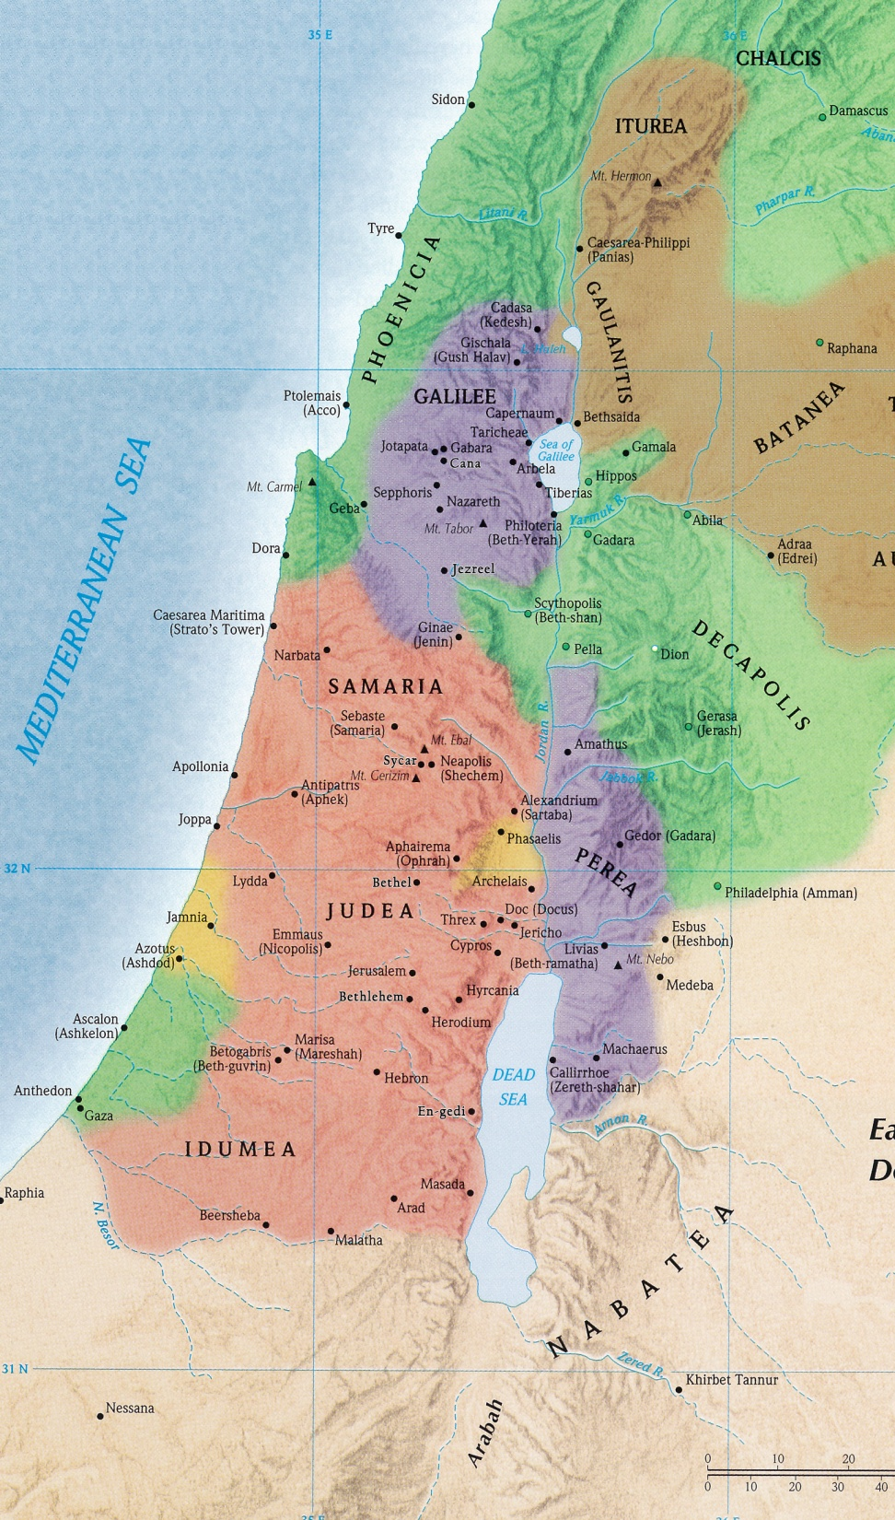
The Climate
Temperature
Palestine has a rather temperate climate
Jerusalem comparable to New Orleans & Houston
Avg yearly temp is 65 degrees
Seldom above 90 in summer or below 40 in winter
Avg temps in January
Avg temps in August
~90
upper 70s
mid-70s
mid-70s
upper 50s
mid-50s
mid-40s
mid-40s

Slide 3
The Climate
60”
Rainfall
Directly related to location relative to Med Sea, latitude & topographical features
Avg annual rainfalls
General sparseness of moisture
60-70% of precipitation evaporates
10-25% is absorbed for agricultural purposes
Therefore, the dews (~250 nights/year) extremely important for certain crops
24-36”
30”
20-28”
4”
22”
2”
12”

Slide 4
The Climate
Rainfall
Rainfall is generally seasonal
“Former rains” (Hos. 6:3) – start in mid to late October
“Latter rains” (Hos. 6:3) – between April & early May
After these is hot, dry season
Dry: “My moisture was changed as with the drought of summer” (Psa. 32:4, ASV).
Rainy: “You water its ridges abundantly, You settle its furrows; You make it soft with showers, You bless its growth…They drop on the pastures of the wilderness, And the little hills rejoice on every side” (Psa. 65:10-12).
The planting & harvesting seasons correspond with moisture changes (cf. James 5:7)

Slide 5
The Climate
Winds
Winds closely associated with its climatic conditions
A flux & flow wind pattern
Hot air rises from eastern desert during the day, drawing in cooler breezes from the Med
At night, as the desert cools more quickly than water of the Med, winds are drawn westward
The north wind brings cold conditions (Job 37:9) and rain (Prov. 25:23).
The south winds are variable
May be whirlwinds (Isa. 21:1; Zech. 9:14)
May be gentle breezes (Acts 27:13)
May bring scorching heat (Luke 12:55)

Slide 6
The Climate
Winds
The eastern winds from the Arabian desert are hot, dry and sometimes quite strong (Job 1:19; Amos 4:9), withering the vegetation (Jas. 1:11).
The west wind, off the Med, is called (in Arabic) the “father of rain” (cf. 1 Kgs. 18:44-45; Luke 12:54).
Gentle in summer
Can be gales in winter

Slide 7
The Climate
How We Can Better Understand the Bible
Winter & Baby Jesus
When Jesus was born in Bethlehem, the Bible says, “Now there were in the same country shepherds living out in the fields, keeping watch over their flock by night” (Luke 2:8).
Remember that the avg temperatures in that area would have been mid-40s in winter and mid-70s in summer.
Those who claim that Jesus was born on December 25 have a problem.
On December 25, in the Western highlands of Judea, it would have been in the mid-40s at best, if not cooler at night.
Shepherds did not keep their sheep in the field at night during those cold winters.
Therefore, the Bible and known climate conditions make it obvious that Jesus was not born on December 25.

Slide 8
The Climate
How We Can Better Understand the Bible
Dew & Unity
“Behold, how good and how pleasant it is For brethren to dwell together in unity!” (Psa. 133:1).
“It is like the dew of Hermon, Descending upon the mountains of Zion” (Psa. 133:3).
Mt. Hermon is 9,000 ft high and snow-capped year-round
Even in warmest months, water vapors flow in at high altitudes over the land
When the water vapors meet with the cold air from snow of Hermon, condensation leads to heavy dews in the region, “as if heavy rain had fallen.”
What a gracious gift in a country that is generally so parched in the summer.
And, what an apt illustration for the preciousness of a spirit of unity among brethren!

Slide 9
The Climate
How We Can Better Understand the Bible
Baal & Rain
When the Israelites entered Canaan, the land was saturated with Baal worship.
Baal was the god of the storms, controller of the rain; hence, the god of fertility.
He was called “Lord of heaven and earth” and “rider on the clouds”
Limestone monument from mid-second millennium B.C. depicts Baal with a lightning bolt in his hand
Elijah’s conflict with the prophets of Baal was to determine the identity of the true God

Slide 10
The Climate
How We Can Better Understand the Bible
Baal & Rain
Elijah confronted king Ahab, a Baal worshiper:
“As the Lord God of Israel lives, before whom I stand, there shall not be dew nor rain these years, except at my word” (1 Kgs. 17:1).
Baal, “the god of weather,” had his water cut off!
When Elijah met the prophets of Baal on Mt. Carmel, Baal, with his lightning bolt, could not ignite the sacrifice (cf. 1 Kgs. 18:25ff).
In contrast, Elijah’s sacrifice, drenched with water, was consumed by fire from heaven.
Elijah ascended Carmel and prayed for rain – “the sky became black with clouds and wind, and there was a heavy rain” (18:45).
Baal worship & Palestinian weather conditions help us see deeper into this account.

Slide 11
The Climate
How We Can Better Understand the Bible
Wind & Warning
To separate the grain from the chaff, a wooden shovel/fan was used.
As cool breezes flowed in from the Med, the farmer tossed the grain into the air.
The lighter chaff would be blown away by these western winds.

Slide 12
The Climate
How We Can Better Understand the Bible
Wind & Warning
Jeremiah warned rebellious Judah of impending “great destruction” that would come upon her “because of the evil of [her] doings” (Jer. 4:3-4).
“At that time it will be said to this people and to Jerusalem, ‘A dry wind of the desolate heights blows in the wilderness toward the daughter of My people—Not to fan or to cleanse—A wind too strong for these will come for Me; Now I will also speak judgment against them’” (Jer. 4:11-12)
The wind that would come was not the gentle Med breeze from the west, but the “dry wind of the desolate heights” (i.e., off the desert and tableland to the east).
It was not the beneficial “winnowing” wind, but the stifling desert blast. It was strong and destructive (cf. Ex. 14:21; Job 27:21; Isa. 27:8; Psa. 48:7; Ezek. 27:26).

Slide 13
The Climate
How We Can Better Understand the Bible
Wind & Obedience
Not long after the journey across the sea began, Jesus fell asleep in the stern of the boat and a storm came.
The storm “came down on the lake” (Luke 8:23).
It was “a great windstorm/tempest” (Mark 4:37; Matt. 8:24).
“The waves beat into the boat” (Mark 4:37).
The boat was “filling with water” and they “were in jeopardy” (Luke 8:23).

Slide 14
The Climate
How We Can Better Understand the Bible
Wind & Obedience
The storm “came down.”
When the cold currents of air from snow-capped Mt. Hermon rush down the narrow gorges of the Galilean hills into the deep depression of the Jordan Valley, and colliding with the warm air rising from the surface of the water, violent whirlwinds can suddenly whip the sea into a frenzy.
Matthew uses the Greek word seismos, meaning “shaking storm”
Luke uses the Greek word lailaps, meaning “tempest, whirlwind”
Thayer: lailaps “is never a single gust, nor a steadily blowing wind, however violent, but a storm breaking forth from black thunder-clouds in furious gusts, with floods of rain, and throwing everything topsy-turvy”

Slide 15
The Climate
How We Can Better Understand the Bible
Wind & Obedience
Christ “kept on sleeping” (Matt. 8:24, imperfect tense)
How could one possibly keep on sleeping under these conditions?
Jesus was exhausted; His long day’s work had drained Him
He had absolute confidence in Him who controls the elements
His rest could be sweet in the knowledge that “He who keeps you will not slumber” (Psa. 121:3).
The miracle: Jesus “arose and rebuked the wind, and said to the sea, ‘Peace, be still!’ And the wind ceased and there was a great calm” (Mark 4:39).
The wind was immediately stilled and the sea was glassy calm.
Normally, even after a storm is over, the billows roll for hours.
“Who can this be? For He commands even the winds and water, and they obey Him!” (Luke 8:25).

Slide 16
The Climate
How We Can Better Understand the Bible
Storm & Calendar
On voyage in Acts 27, they spent “much time” in Fair Havens (9).
Paul advised them not to leave Fair Havens, for “sailing was now dangerous because the Fast was already over” (27:9).
The “Fast” was the Jewish Day of Atonement, which would have occurred in early October that year.
According to Luke, this was the dangerous season on the Mediterranean.
Citing an ancient source, F.F. Bruce notes that the hazardous sailing season was from September 14 to November 11; after that, all navigation on the open sea ceased for the winter.
Paul’s advice was rejected. They sailed on and finally wrecked at Melita.

Slide 17
The Climate
How We Can Better Understand the Bible
God carefully coordinated many of the events in the Bible with the climatic conditions
Studies in the Life of Christ by R.C. Foster has a great chapter.
The three great Jewish festivals required by the law (Passover, Pentecost & Tabernacles), during which the nation was required to come up to the central place of worship, all coincided with the dry seasons of the land.
Jesus’ teaching in the dead of winter was under the shelter of Solomon’s porch in the temple, where there would be protection from the rain and hail so frequent at this time (cf. John 10:22)

