Slide 1
Lesson 4:
Clothing in the Ancient World
From Wayne Jackson’s book

Slide 2
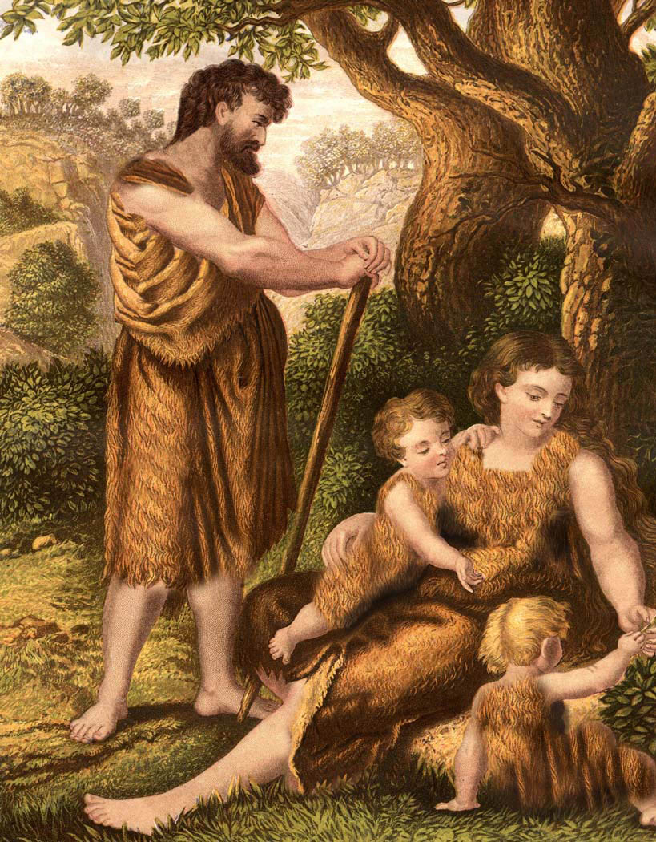

Clothing in Ancient World

Slide 3
Clothing in Ancient World
Animal hides
  Used for clothing throughout human history
    Esau’s skin compared to “hairy garment” (Gen. 25:25)
    Elijah likely wore a “garment of hair” held secure by a leather belt (cf. 2 Kgs. 1:8 ASVfn)

Slide 4
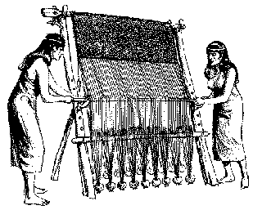
Clothing in Ancient World
Flax
  Grown in Egypt (Ex. 9:31) and Canaan (Josh. 6:2) was of the earliest textile fabrics made into linen (cf. Prov. 31:13-14)
    When Joseph was made ruler in Egypt, he was clothed in “fine linen” (Gen. 41:42)
    The attire of the Jewish priests was of linen (Ex. 28:6, 15; 39:27-29; cf. Ezek 44:17-18)
    Used symbolically for the righteous acts of the saints in Rev. 19:8

Slide 5
Clothing in Ancient World
Wool
  Manufactured from the fleece of sheep and goats
    Wives of Israel wove clothing for their families (Ex. 35:24; Prov. 31:13)
    Wool was sold and traded in ports such as Tyre (Ezek. 27:15)
    Tribute was even paid using wool (2 Kgs. 3:4)
  Wool could be washed white (Isa. 1:18)
    Or dyed various colors (cf. Heb. 9:19)
  Jews were forbidden to wear a garment containing a mixture of wool & linen (Deut. 22:11).

Slide 6
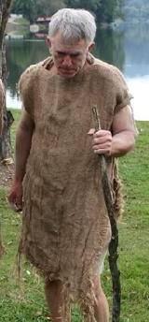

Clothing in Ancient World
Sackcloth
  Strong, rough cloth woven from the long hair of the Oriental goat or camel
  Most often, sackcloth was used in times of mourning and penitence

Slide 7
Clothing in Ancient World
Sackcloth
  Most often, sackcloth was used in times of mourning and penitence
    Jacob when believed Joseph was dead (Gen. 37:34)
    David commanded to mourn death of Abner (2 Sam. 3:31)
    When Ahab heard prophetic doom of Jezebel, he put on and lay in sackcloth as a token of repentance (1 Kgs. 21:27) – his contrition was short-lived
    Jonah preached repentance to Nineveh, and their response was reflected in wearing sackcloth (Jonah 3:5-6)
    The prophets sometimes wore sackcloth as a symbol of their message of repentance (Isa. 20:2; Zech. 13:4)
    John the Immerser wore a “raiment of camel’s hair” (i.e., a coarse garment woven from camel’s hair), setting him apart from the regal apparel of softness (cf. Matt. 3:4; 11:8).

Slide 8
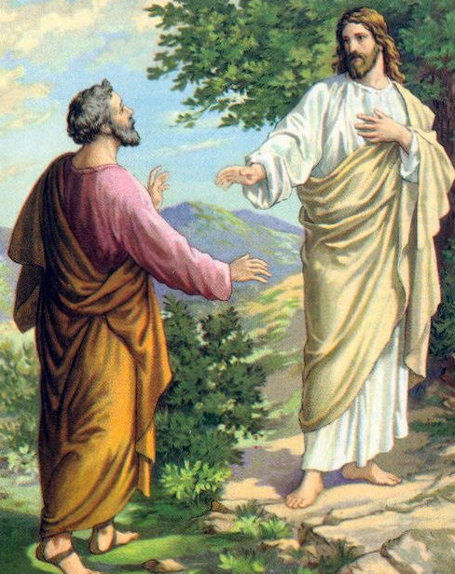
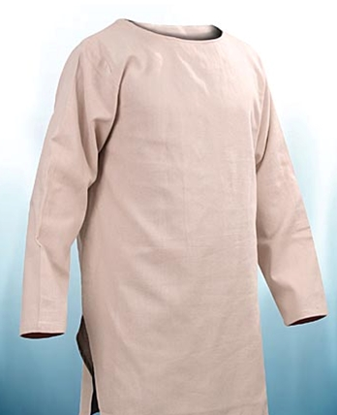
Clothing in Ancient World
Undergarment
  Jewish men normally wore an undergarment, outer robe, belt, sandals & sometimes a hat
  The undergarment was a tunic of light material (linen or wool) worn next to the skin.
  The undergarment came down to the knees or ankles
  To be clad only in this undergarment was to be considered naked (cf. 1 Sam. 19:24; John 21:7)

Slide 9
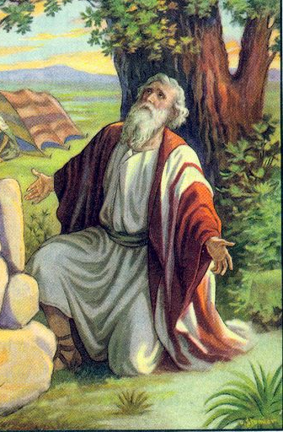
Clothing in Ancient World
Outer Garment
  A man’s outer garment (called a coat, robe or mantle) was a square or rectangular piece of cloth wrapped around the body or thrown over the shoulders

Slide 10
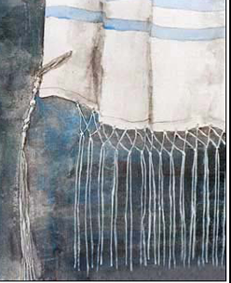
Clothing in Ancient World
Outer Garment
  The Jews attached “fringes” to the edges of the mantles
    The “fringes” reminded them of the precepts of the Law (cf. Num. 15:38-39; Deut. 22:12)
    The Pharisees were accustomed to enlarging these “borders” in order to attract attention to themselves (Jesus rebuked, Matt. 23:5).

Slide 11
Clothing in Ancient World
Outer Garment
  Outer mantles sometimes used as “sacks” to carry items
    When the Jews left Egypt, they took their kneading-troughs “bound up in their clothes upon their shoulders” (Ex. 12:34; cf. 2 Kgs. 4:39)
    The hollow formed by the upper part of this loose garment was called one’s “bosom” (a large pocket secured by the belt)
      Just before Israel went into captivity, God warned that He would recompense their iniquities “into their bosom” (Isa. 65:5), filled with punishment (cf. Jer. 32:18; Psa. 79:12).
      “Give, and it will be given to you: good measure, pressed down, shaken together, and running over will be put into your bosom” (Luke 6:38) – symbolic of going to market where merchant fills one’s sack to complete capacity (cf. Ruth 3:15)

Slide 12
Clothing in Ancient World
Outer Garment
  Jesus stressed the conciliatory attitude to characterize His disciples
    “If anyone wants to sue you and take away your tunic [chiton, inner garment], let him have your cloak [himation, outer raiment] also” (Matt. 5:40)
      In this passage, Jesus is referring to a legal process—the claimant is supposed to claim the inner garment (the less costly). The defendant is to be willing to let him have the more valuable one too.
    “And from him who takes away your cloak [himation, outer raiment], do not withhold your tunic [chiton, inner garment] either” (Luke 6:29)
      In this passage, Jesus is referring to an act of violence, and there is no mention of going to law. So the outer garment is the first one to be seized.

Slide 13
Clothing in Ancient World
Outer Garment
  The soldiers who crucified Jesus took his “garments” (plural), likely both the inner and outer apparel.
    The outer mantle was divided between the four soldiers
    The undergarment, the tunic (ASVfn), was seamless, hence, the soldiers cast lots for it (John 19:23-24) – a fulfillment of prophecy (Psa. 22:18)
    Josephus wrote of the robe of the high priest
      It “was not composed of two pieces, nor was it sewed together upon the shoulders and sides, but it was one long vestment so woven as to have an aperture for the neck…” (Antiquities, III, vii, 4).
      Was this (speculation) a divine suggestion that Christ was about to enter into His role as our high priest (cf. Heb. 4:14-15)?

Slide 14
Clothing in Ancient World
Girdle/Belt
  Used to secure either the undergarment or outer garment
    Might be made of woven linen (the “band” for Aaron’s ephod, Ex. 28:8) or of leather (John the Baptist wore, Matt. 3:4)
    Girdle could be a square or triangle cloth, folded to make a strip about 4” wide
    Might be fastened with a buckle/clasp or tied in a knot
    Might contain a slit to hold coins, an inkhorn or perhaps a dagger
    Sometimes women made these girdles and sold to neighboring merchants (cf. Prov. 31:24)

Slide 15
Clothing in Ancient World
Girdle/Belt
  God instructed Jeremiah to purchase a linen girdle (Jer. 13:1-11)
    Not to be put in water (washed) but worn until it became filthy
    Later, Jeremiah was told to go to the Euphrates & hide the belt in a rock crevice
    Eventually, he was sent to retrieve the girdle and found it “marred” and “profitable for nothing”
    Meaning: “After this manner I will mar the pride of Judah, and the great pride of Jerusalem.”
      God had chosen Israel & Judah to cleave to Him, like the girdle was wrapped to cleave to Jeremiah
      As the symbolic belt decayed and became unfit for use, so God would reject these apostate people.

Slide 16
Clothing in Ancient World
Girdle/Belt
  When a man was preparing for vigorous activity, he would lift his outer robe and secure it with the girdle, giving his legs greater mobility for running, working, etc.
    After Job had repeatedly complained that God was persecuting him (by all the difficulties that had entered his life), the Lord humbled Job with a grueling series of questions about the earth and its creatures.
      God prefaced His examination with a warning: “Gird up now thy loins like a man” (Job 38:3; 40:7).
      In other words, “Job, get ready for a contest!”

Slide 17
Clothing in Ancient World
Girdle/Belt
  During the last supper which Jesus ate with His disciples, the Lord arose from the table, laid aside his “garments” (plural—the outer robe and perhaps the girdle that secured it).
    He “took a towel and girded Himself” (John 13:4)
    Assuming the role of a servant (cf. 1 Sam. 25:41), He washed the disciples’ feet, thus teaching a powerful lesson in humility (cf. 13:14-16).
    No doubt Peter had this vivid scene in mind when he later wrote: “Yes, all of you be submissive to one another, and be clothed with humility, for ‘God resists the proud, But gives grace to the humble’” (1 Pet. 5:5; cf. 2 Pet. 1:13).

Slide 18
Clothing in Ancient World
Footware
  The poorest of people often went barefooted, though most folks had footware
  When they went indoors, they went barefooted
    Sinful woman wept at Jesus’ feet and wiped His feet with her hair and kissed them (Luke 7:36ff)
    Hospitable practice to provide one’s visiting guest with water for washing his feet
    How very crude for Simon the Pharisee to criticize the women who “washed” Jesus’ feet with her tears, when he had not even provided Jesus with plain water for that chore (Luke 7:44).

Slide 19
Clothing in Ancient World
Footware
  Since servants usually performed the task of feet-washing (cf. 1 Sam. 25:41), no question as to what lesson the Master was teaching when He washed His disciples’ feet (John 13:16).
    The path to greatness was through servitude
  Certain widows were not qualified for the “enrollment” unless they had “washed the saints’ feet” (1 Tim. 5:9-10)
    In other words, these older women already had a distinguished record of showing concerned hospitality for the Lord’s people

