Slide 1

Heaven
Wednesday Night Bible Study
Palm Beach Lakes church of Christ

Slide 2
Lesson 2
Inside Heaven

Slide 3
Two Main Goals:
1. To lead us to a greater desire to be in Heaven with our God.
2. To gain a true, Biblical understanding of Heaven.

Slide 4
First Point
There is only one expert on
the topic of heaven, and that
is God.

Slide 5
Second Point
The only true perception of
Heaven is what God reveals to us
through His Holy word.

Slide 6
Modern Views of Heaven
Postmodernist - No distinct view of Heaven because all views are correct.
Postmodernism preaches tolerance as the highest virtue. Therefore, there is no
one objective way to go to Heaven.
(studyjesus.com)

Slide 7
Modern Views of Heaven
Postmodernism
Truth is manufactured, not revealed.
Denies the reality of absolute truth.
Delights in the seed of doubt.
Loves the “cultural argument”
All truths are relative and subjective. No truth can claim to superior or exclusive.
Christianity is viewed as an enemy.
The only real sin is being controlling, exclusive,
or judgmental.

Slide 8
Modern Views of Heaven
Postmodernism
Christianity claims to be exclusive. John 14:6, Acts 4:12
There is a broad and narrow way. Matt. 7: 13-14
Wise and foolish man. Matt. 7:24- 27
Belief in Jesus as the Messiah. John 8:24
Repentance and perishing Luke 13: 3, Acts 17:30
One true Gospel. Galatians 1: 6-9
The exclusive statements from Ephesians 4: 4-6
( Phil Sanders – Affirming The Faith. Feb. 23, 2008)

Slide 9
Inside Heaven
What is heaven like to you?
Beautiful or drab?
Crowded or empty?
Stagnant or busy?

Slide 10
Inside Heaven
Three heavens mentioned in the Bible
1. Home of the birds “firmament” 2 Cor. 12:2
2. Home of the stars, the “heavens” Gen. 1:6
3. Home of God. Heb. 12:22, Rev. 3:12

Slide 11
Inside Heaven
Heaven is a real, actual place. John 14:2
Heaven has inhabitants right now.

Slide 12
Our God In Heaven
To understand what it is like in heaven, you
have to have an understanding of the nature
of God.
God is love 1 John 4:8
God is merciful Psalm 136:1
Omnipotent
-God can not lie Titus 1:2
-God can not deny Himself 2 Timothy 2:13
Omniscient
Omnipresent

Slide 13
Our Father In Heaven
Heaven is the home of God.
God chose the word “father” to describe
Himself.
Guidance
Counsel
Security
Affection
Authority

Slide 14
Our Father In Heaven
Heaven is the home of God.
God is our Father.
1 John 3:2, 2 Cor. 6:17-18, Gal. 3:26-27
And heaven is His home.
Deut. 26:15, Eccl. 5:2, Daniel 2:28, Matt. 5:45, 48

Slide 15
Jesus, Our Savior
Heaven is the home of Jesus Christ
Light of the world - John 8:12
The resurrection and the life - John 11: 25
The way, the truth, and the life - John 14:6
Jesus is there – John 6: 38, Col. 3:1-2, Heb. 9:24
Is that comforting to you?

Slide 16
Angels
Angels are in heaven.
Myriads of angels.
They praise God.
Matthew 22:30

Slide 17
The Home of Heroes
Abraham, Isaac, Jacob,
Enoch and Noah.
Moses, Gideon, Samson, David,
Samuel, Elijah, and Elisha.
Shadrach, Meshach, & Abed-Nego.
Daniel.
(Matthew 8:11, Hebrews 11)

Slide 18
The Home of Heroes
The Christian Age:
John the Baptist Matt. 11:11
Stephen Acts 6:3-8
Paul 2 Tim. 4:7-8
Peter 1 Peter 1:3-4
2 Peter 3:10-12
And a multitude of others.

Slide 19
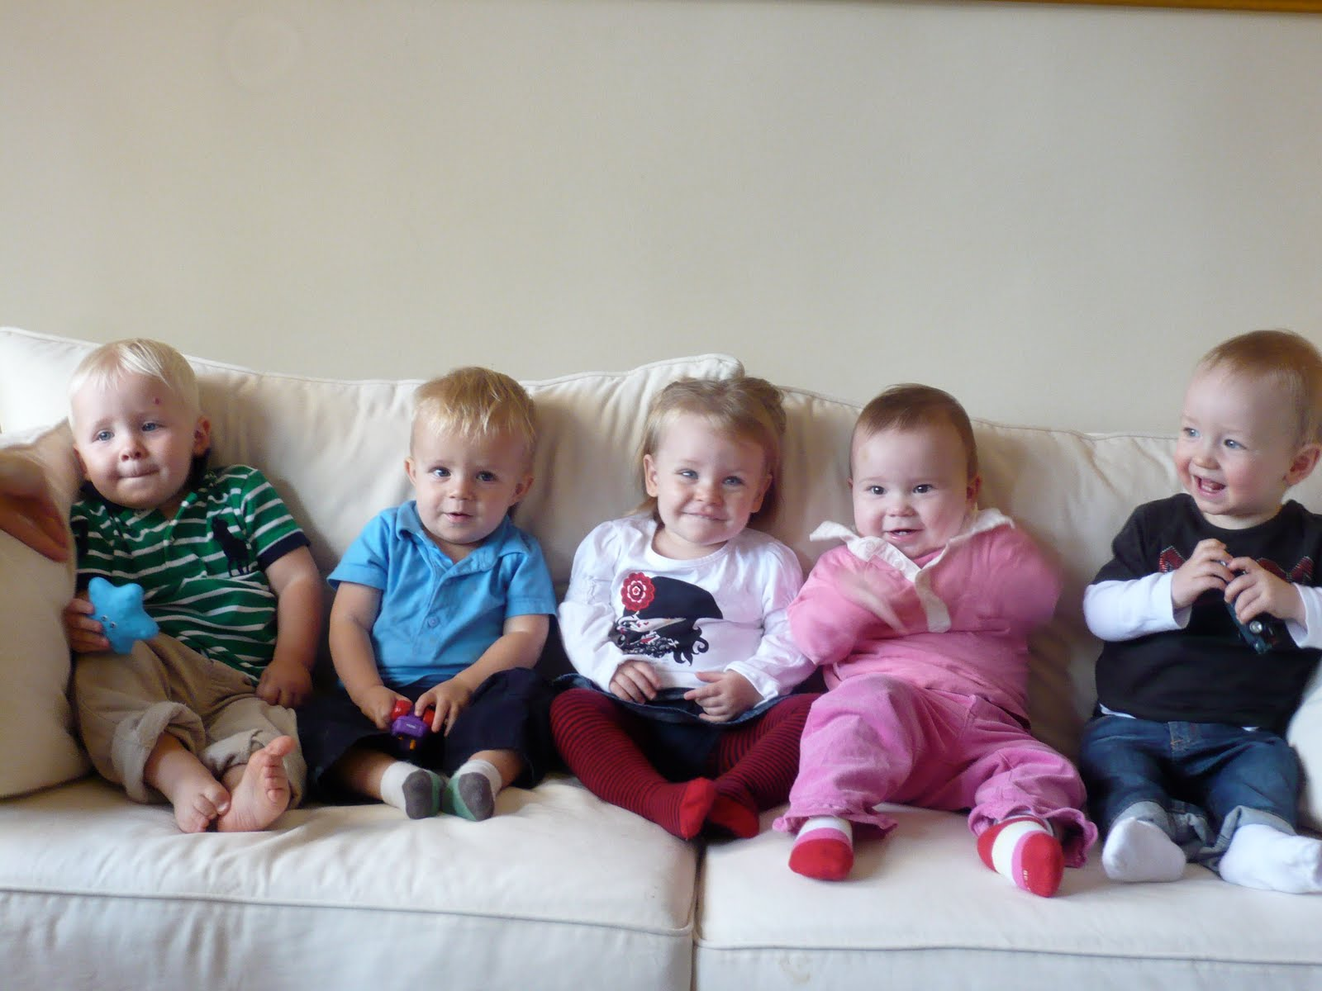
Heaven Is a Home for Children
David’s family – 2 Sam. 12:23, Psalm 23:6
Become like little children - Matt. 18: 1-4
Not born with sin - Ezekiel 18:20
Spiritually innocent - Revelation 21:27

Slide 20
Heaven is the home of books
The Word of God will be in heaven
1 Peter 1:25
The Lamb’s Book of Life-
Rev. 21:15, 21:27; Exodus 32:30-33;
Hebrews 12:23; Psalm 69:28; 1 Cor. 6:9;
Philippians 4:3; Revelation 3:5

Slide 21
Heaven Is a “New” Home
Happiness - Isaiah 65: 17-19
Place of worship – Isaiah 66: 22-23
Home of the righteous – 2 Peter 3:13
God’s presence – Revelation 21: 1- 4
Nothing corruptible - 1 Cor. 15: 51-53
“Behold, I make all things new.”
Revelation 21: 5

Slide 22
Heaven Is a Home of Glory
A bride adorned for her husband-
Rev. 21:2 , Matt. 25:34, John 14:1-3
Tabernacle of God… with men.
Revelation 21:3-5
Great city of God.
Revelation 21: 9-27

Slide 23
What Won’t Be In Heaven
Separation - 1Cor . 15: 51- 57, 1 Thess 4: 17
Sin -Revelation 21:27, 1 Cor. 6:9, Gal 5:19-20
Sadness & Sorrow- Revelation 21:4

Slide 24
Awesome Discussion Questions and Interesting Remarks
Who are your Biblical heroes?
How do we know little children will be in heaven?
What has God promised to take away?
What can you take away from this lesson?
What do you think about the description
of heaven?

