Slide 1

Heaven
Wednesday Night Bible Study
Palm Beach Lakes church of Christ

Slide 2
Lesson 7
Laying Up Treasures In Heaven

Slide 3
What We Have Learned
The thief on the cross was forgiven
There is a waiting place called Hades.
The English word, Hell, can be confusing.
Our citizenship is in heaven.
Jesus said we are not of this world.
The kingdom of God is the church
There is only one kingdom

Slide 4
What We Have Learned
The true nature of the kingdom of God
We should never doubt because of the of
the actions of others.
The true church would have certain
characteristics.
Having weak members is one of them.
1 Corinthians 12:22

Slide 5
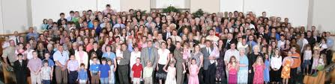
The Second Coming
God
Jesus delivers His church, kingdom,
church of Christ

Slide 6
The Second Coming
God
His body

Slide 7
The Second Coming
Don’t try to separate Jesus from
the body.
Jesus is the head of the church.
Ephesians 1: 22-23
“And He put all things under His feet,
and gave Him to be head over all things to the
church, which is His body, the fullness of Him
who fills all in all.”

Slide 8
The Second Coming
Those not in the Lord’s church
Hell, Lake of Fire, Eternal Punishment

Slide 9
Laying Up Treasures
What is a treasure?
: something very valuable (such as money, jewels, gold or silver ) that is hidden or kept safe.
: something that is very special, important, or valuable.
: a person who is greatly loved or valued especially because of being helpful.

Slide 10
Laying Up Treasures
Treasures on earth
Treasures in heaven
Matthew 6:19-21

Slide 11
Laying Up Treasures
We will be judged by Jesus Christ
2 Corinthians 5:9,10
We will be judged by the Word.
John 12: 48-50
James 1: 21-25
Hebrews 4:1-2
1 Thessalonians 2:13

Slide 12
Laying Up Treasures
Jesus commands us to lay up treasure in heaven.
But while we’re here on earth, we can't see our treasures in heaven.
So how can we tell how we are doing?
It is easy for us to be mistaken.
We are likely to be influenced by the world's system of rewards.
But it won't be the world giving out the rewards!

Slide 13
The World’s System of Reward
The world tends to reward ability.
The world tends to reward results.
You produce, you get paid.
Those with greater ability have a great advantage…
… though Ecclesiastes 9:11 indicates that ability does not guarantee results.

Slide 14
The World’s System of Reward
The world tends to reward ability.
The world tends to reward results.
The world rewards the things that the world values.
For example, large salaries go to entertainment & sports celebrities.
Large salaries go to CEOs of large corporations

Slide 15
The World’s System of Reward
The world tends to reward ability.
The world tends to reward results.
The world rewards the things that the world values.
Even when corrupted by favoritism, the rewards are still results-oriented.
If you are loyal to those in power, you will be rewarded.

Slide 16
God’s System of Reward
God certainly cares about results…
… but these are not under our control.
… we must leave results in God’s hands.
God certainly cares about loyalty…
… but this is a loyalty to who God truly is.
… not a loyalty against truth
Remember God’s rebuke to Job’s friends.
Job 42:7-9

Slide 17
God’s System of Reward
God’s way is faithfulness
Luke 16:10-12 Be trustworthy
1 Corinthians 15:58 Stand firm
Ecclesiastes 9:10 Be diligent
Ecclesiastes 11:6 Work hard

Slide 18
God’s System of Reward
God rewards what He cares about
Matthew 6:33 Seek first the kingdom
Matthew 25:37-40 Caring for others

Slide 19
God’s Reward Is Independent of Our Abilities
Luke 21:1- 4 What a widow gave
Matthew 25:14-30
Rewarding a faithful servant

Slide 20
God’s System of Reward
God cares about results.
God cares about loyalty.
God rewards faithfulness.
God wants us to labor vigorously.
God rewards what He cares about.
God's reward is independent of our abilities.

Slide 21
Moth and Rust Matthew 6:19-21
¹⁹ “Do not lay up for yourselves treasures on earth, where moth and rust destroy and where thieves break in and steal; ²⁰ but lay up for yourselves treasures in heaven, where neither moth nor rust destroys and where thieves do not break in and steal. ²¹ For where your treasure is, there your heart will be also.

Slide 22
Materialism
Principles from 1 Timothy
1st principle – Remember things are only temporary. 1 Tim. 6:6-7
2nd principle- Only seek necessities and wait for he rest. 1 Tim. 6:8
3rd principle – Avoid a desire to be rich.
1 Tim. 6:9-10

Slide 23
Materialism
Romans 12:2 “Do not be conformed to this world, but be transformed by the renewing of your mind, that you may prove what is that good and acceptable and perfect will of God.”
Jesus taught us that we are not of this
world. John 18:36

Slide 24
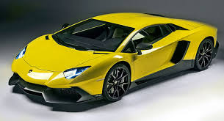
Taking a Look At That New Car
Some day a new car will be old
Someday this car will be in a junk yard
Someday it will be sold for scrap

Slide 25
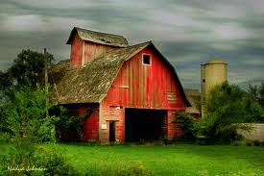
Materialism
Building Bigger Barns
Luke 12: 16-21

Slide 26
Materialism
Learning to be satisfied, content.
The Apostle Paul talks about himself.
“Not that I speak in regard of need, for I have learned that in what ever state I am, to be content”
Philippians 4:11

Slide 27
Discontentment Can Lead to Sin
There are sins associated with being
discontent.
Jealousy Murmuring
Envy Complaining
Bitterness
Contentment is not related to outside
circumstances.

Slide 28
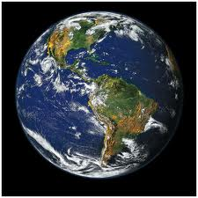
Words of Warning
“What profit is it to a man if he gains the whole world , and loses his soul? Or what will a man give in exchange for his soul?”
Matthew 16:26

Slide 29
Awesome Discussion Questions and Interesting Remarks
How can we fight our own materialism?
Is it easier to talk to people about God
with people that “have with-out?”
Like in a third world country.
3. What can discontentment lead to?

