Slide 1

Heaven
Wednesday Night Bible Study
Palm Beach Lakes church of Christ

Slide 2
Lesson 8
Is Being A Good Person Enough?

Slide 3
Coming Up Soon
Lesson 9 Revive My Longing For Heaven
Lesson 10 The Road To Heaven
Lesson 11 Once Saved, Always Saved and Heaven
Lesson 12 Heaven and Searching For Truth

Slide 4
What We Have Learned
The thief on the cross was forgiven
Learn to be content
Our citizenship is in heaven.
Materialism is bad
Lay up treasures in heaven
Jesus is our judge
The kingdom of God is the church
There is only one kingdom, church

Slide 5
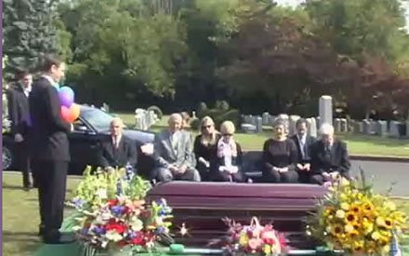
Is Being A Good Person Enough?
No one wants a “good man” to be
anywhere other than heaven.

Slide 6
Is Being A Good Person Enough?
“I believe non- believers are going to the same place as the rest of us and God does not frown on them for not believing. Nobody is perfect in God’s eyes so therefore nobody is better or worse, we are all the same”
www.ted.com

Slide 7
Is Being A Good Person Enough?
"What I believe in is that if I live my life as well as I can, that I will be rewarded. I don't presume to have knowledge of what happens after I die. But I feel very strongly that whether the reward is in the here and now or in the hereafter, the aligning myself to my faith and my values is a good thing. When I tuck in my daughters at night and I feel like I've been a good father to them, and I see in them that I am transferring values that I got from my mother and that they're kind people and that they're honest people, and they're curious people, that's a little piece of heaven.” - Famous elected official

Slide 8
Is Being A Good Person Enough?
“I would love to believe that when I die I will live again, that some thinking, feeling, remembering part of me will continue. But much as I want to believe that, and despite the ancient and worldwide cultural traditions that assert an afterlife, I know of nothing to suggest that it is more than wishful thinking. ”
Famous 20th century scientist

Slide 9
Is Being A Good Person Enough?
“One day we’re all going to die, and God is going to judge us, our good and bad deeds. If the bad out weighs the good, you go to hell; if the good out weighs the bad, you go to heaven”
Famous boxer

Slide 10
Is Being A Good Person Enough?
The most common held religious belief
in America is, “If you are a good person,
you’ll go to heaven when you die.”
(Allen Webster, Is Being a Good Person Good Enough?)

Slide 11

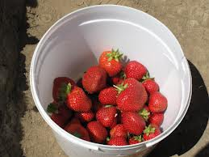
Is Being A Good Person Enough?
Question
Is the basis of judgment going to be
“the good out weighs the bad?“
This is “Bucket Religion”

Slide 12
What’s wrong with bucket religion?
It takes Christ out of the judgment seat and puts us into control.
It is not a Biblical teaching.
It eliminates the blood that was paid
on Calvary for our sins.
4. It eliminates the need for a savior.

Slide 13
Is Being A Good Person Enough?
God wants everyone to go to heaven
1 Timothy 2:4
2 Peter 3:9
John 3:16
Revelation 21:13

Slide 14
Is Being A Good Person Enough?
The nature of God is that He is good
Matthew 19:17
And He wants us to be like Him.
1 Peter 1:15-16

Slide 15
Goodness
“Good” is found 720 times in the Bible.
248 times in the New Testament.
Jesus was good. Matthew 20:15, Acts 10:38
Jesus is the Good Shepherd
Good works glorifies the Father. Matt. 5:16
Do good to those that hate us. Matt. 5:44
Over come evil with good. Romans 12: 21
Do good to all men. Galatians 6:10

Slide 16
Is Being A Good Person Enough?
The rich young ruler asked our question?
“Now behold, one came to Him, “Good Teacher, what good thing shall I do that I may have eternal life?”
Matthew 19:16

Slide 17
Is Being A Good Person Enough?
Most world religions are ethically
based. You find moral teachings and
the principles for being a “good person”
“The Believing Men, and The Believing
Women, they support each other and command
what is right and forbid what is wrong”
(Qur’an 9:71)

Slide 18
Is Being A Good Person Enough?
Most world religions are ethically
based. You find moral teachings and
the principles for being a “good person”
“Serenity of mind, good heartedness, silence, self- control, purity of nature, - these are called the mental austerity”
The Gita, Chapter XVII, 16

Slide 19
Is Being A Good Person Enough?
Most world religions are ethically
based. You find moral teachings and
the principles for being a “good person”
“True love is born of understanding”
Buddha

Slide 20
Is Being A Good Person Enough?
Our Lord answers the rich young ruler.
Matthew 19: 17-22
-No one is good, but One.
-Keep my commandments
-The ruler’s soul is not satisfied
-The rich young ruler had one thing
to over come, which he couldn’t.

Slide 21
Our Good Might Not Be Good
Isaiah 55:8 God’s way and God’s thoughts
Luke 16: 15 “highly esteemed among men.”
-Abortionist see abortion as good because
it gives women the freedom of choice.
-Gays pronounce their relationships as good,
but God sees it as an abomination.
Romans 1: 18-27

Slide 22
Our Good Is Not Enough
We have our own thoughts on goodness
“good boy”
“good girl”
“good man”
-Gracious under difficult circumstances
-Likeable, has high morals, nice and
thoughtful of others.

Slide 23
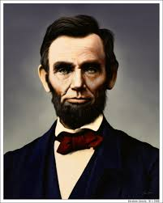
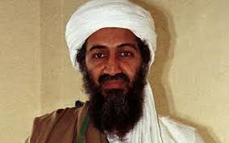
Our Good Is Not Enough
We all have pretenses about people.
Good Man Bad Man

Slide 24
Our Good Is Not Enough
What does the Bible say
1 Kings 8:46 No one
Romans 3: 10-23 None righteous
1 John 1:8 We can deceive ourselves

Slide 25
Our Good Is Not Enough
Being good does not cancel out sin.
“God be merciful to me a sinner”
Luke 18:13

Slide 26
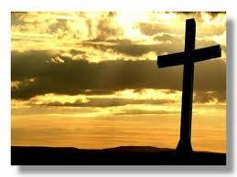
We can not save ourselves
No matter how good we are, we do not
deserve to be saved.
Titus 3: 5-6

Slide 27
We Cannot Save Ourselves
God’s wisdom found a way for us.
We are justified in the sight of God
because of what Jesus did for us.
Ephesians 1:7 Forgiveness
Hebrews 9:22 Blood is shed
Romans 6:6 Crucified with Christ

Slide 28
We Cannot Save Ourselves
-We can not find merit in our selves.
-We can not justify ourselves.
-We can not redeem ourselves.
-But, we can obey commandments
from a loving, living God.

Slide 29
We Cannot Save Ourselves
True sacrifice to our God
“The sacrifices of God are a broken spirit, A broken and a contrite heart- These, O God You will not despise”
Psalm 51:17

Slide 30
Conclusions
God is good all the time.
God expects us to be good as we follow Him.
We must obey Him and His word
The pathway to heaven has been laid out.

Slide 31
Awesome Discussion Questions and Interesting Remarks
What did Jesus do to give us eternal life?
What does God expect from us?
What do you take away from this lesson?

