Slide 1
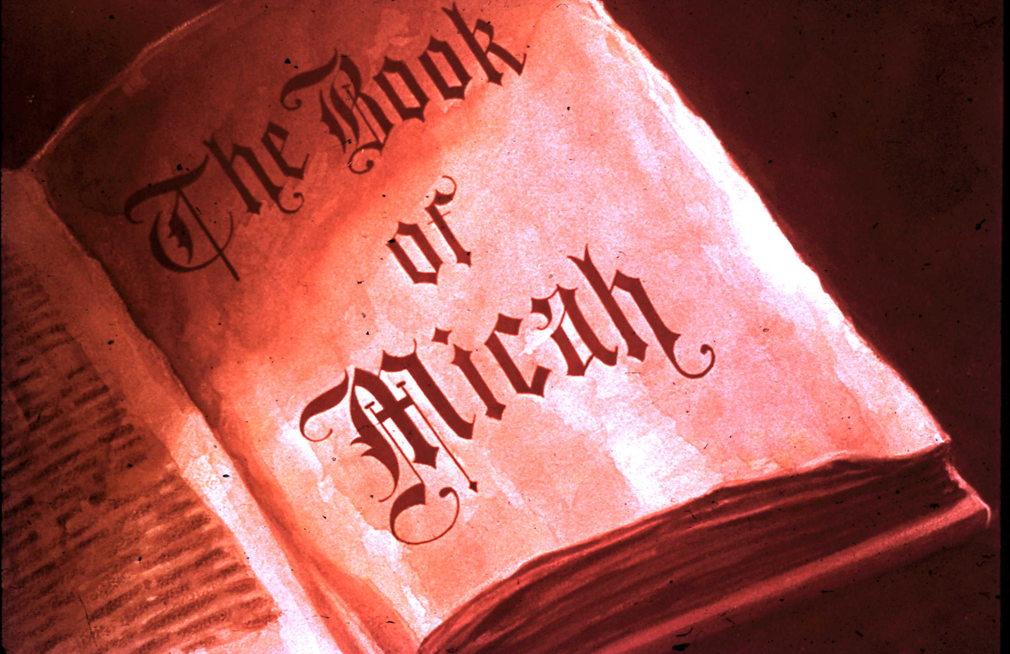

Slide 2
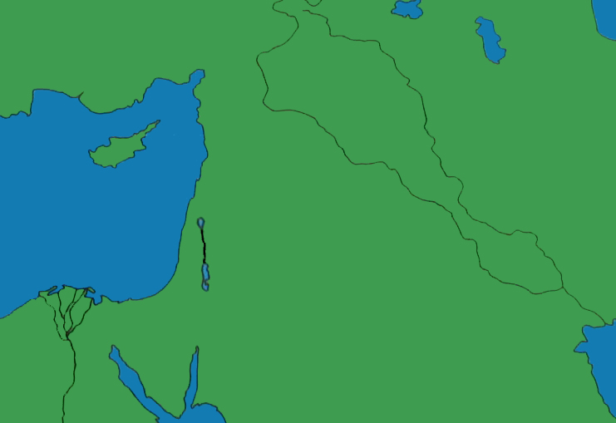
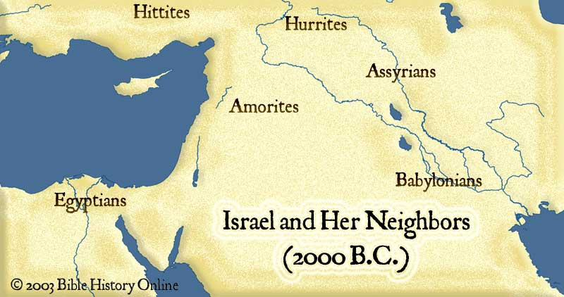
Haggai, Zechariah & Malachi
Nineveh
Jonah
Prophets to North
Hosea, Amos & Jonah
north
Hosea & Amos
Babylon
Daniel &
Ezekiel
South b/f North Fell
Isaiah & Micah
South b/f Fall
Nahum
Habakkuk
Zephaniah
Jeremiah
Unknown Time: Joel & Obadiah

Slide 3
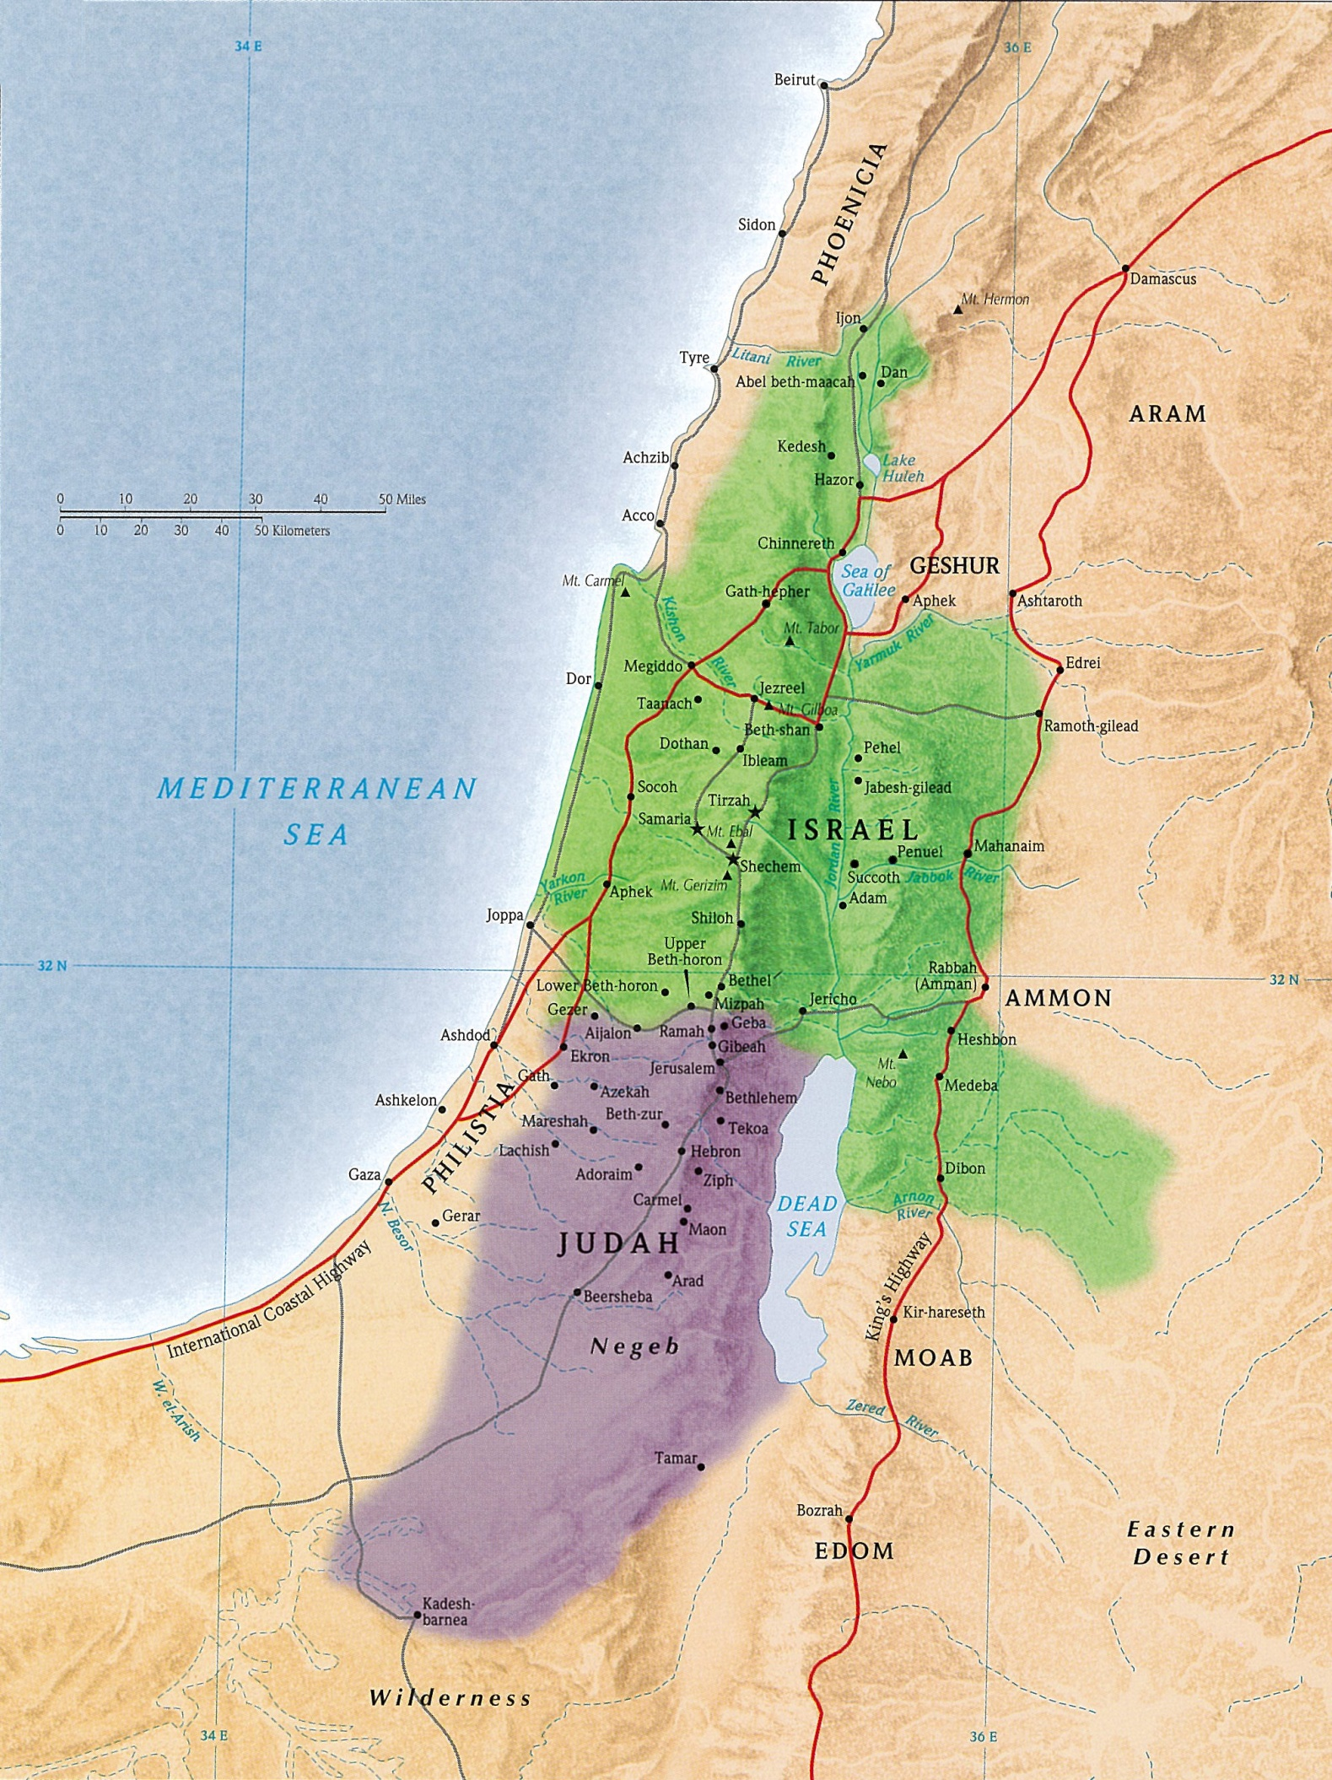
Writing Prophets to the Northern Kingdom
Hosea, Amos & Jonah (Who Preached to Nineveh)

Slide 4
Writing Prophets to the Southern Kingdom Before the Northern Kingdom Fell
Isaiah & Micah
Writing Prophets to the Southern Kingdom Before It Fell
Nahum, Habakkuk, Zephaniah, Jeremiah
Writing Prophets of Unknown Time
Joel & Obadiah

Slide 5
Writing Prophets in Babylonian Captivity
Ezekiel & Daniel
Writing Prophets During the Return from Captivity
Haggai, Zechariah, Malachi

Slide 6
Names Used for the Northern Kingdom in the Prophets
Israel
Samaria
Ephraim
Names Used for the Southern Kingdom in the Prophets
Judah
Jerusalem
Zion

Slide 7
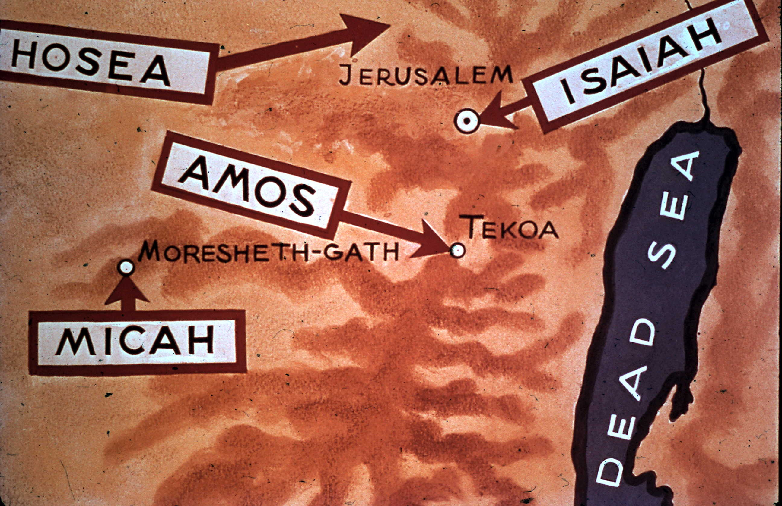
Micah Prophesied To
The Southern Kingdom, Judah (Before the Northern Kingdom Fell)

Slide 8
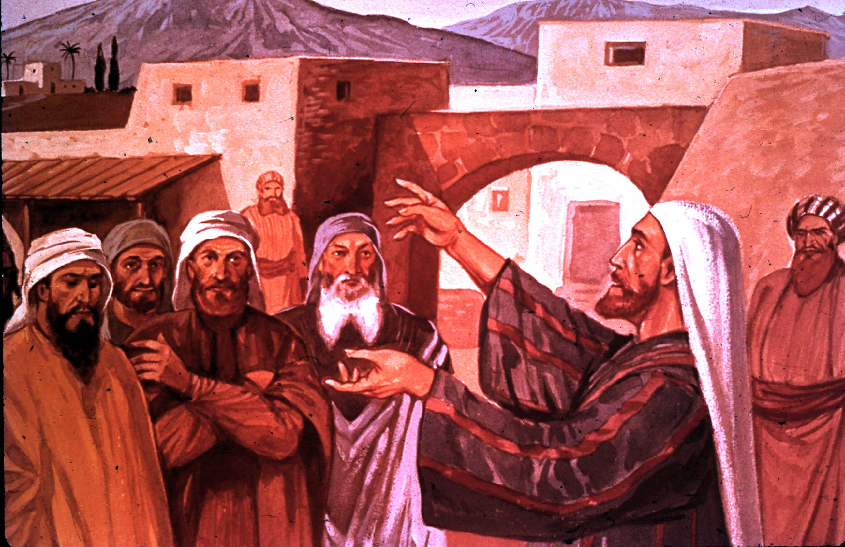
Location & Time of the Messianic Kingdom Prophesied By Micah
The Last Days in Jerusalem (Zion)

Slide 9
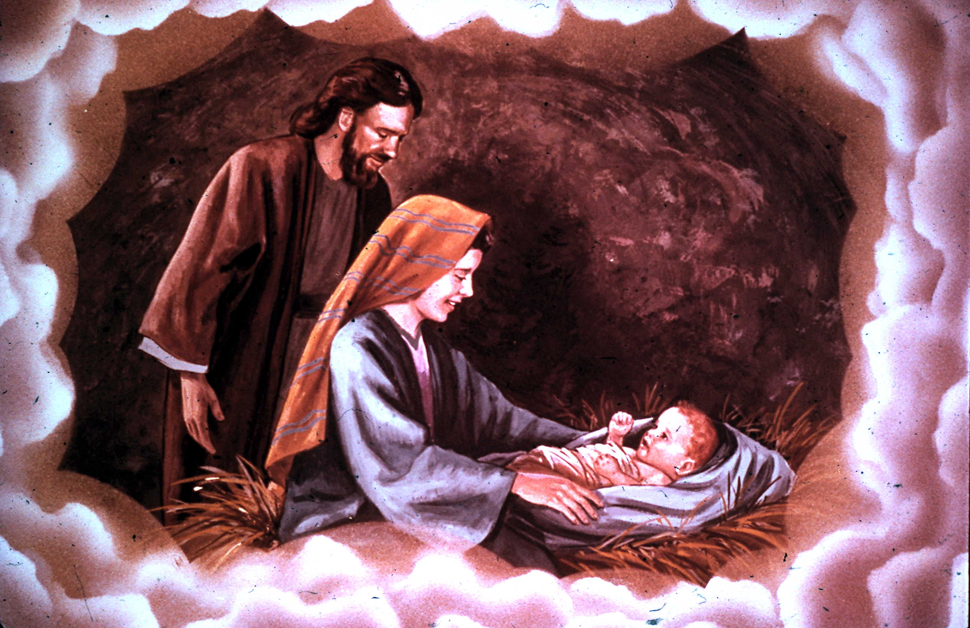
The Birth City of Jesus Prophesied By Micah
Bethlehem

Slide 10
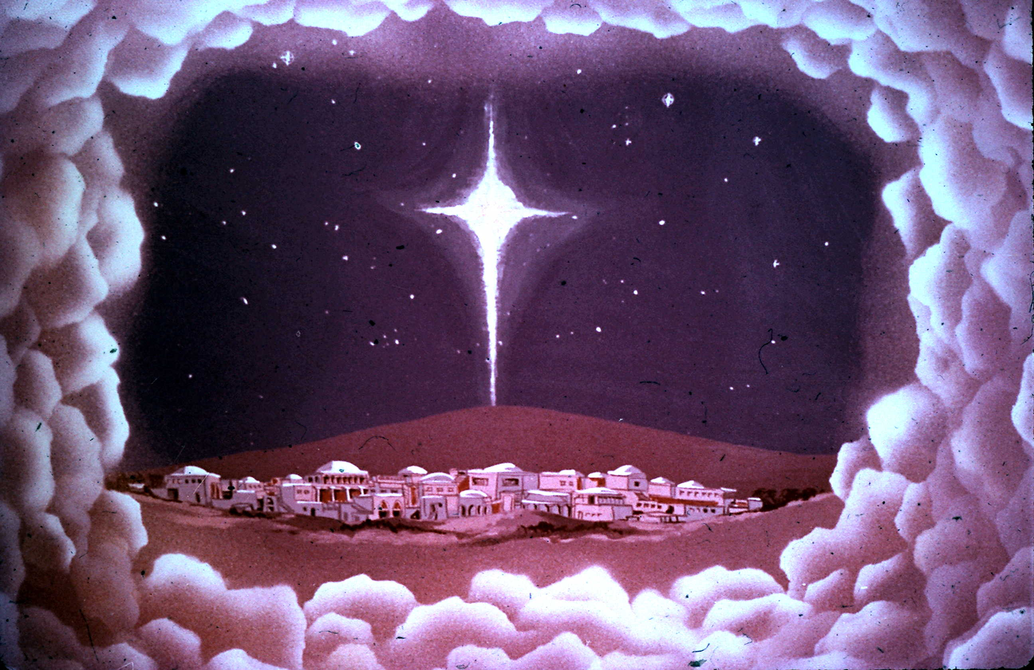
Micah's Prophecy About the Birthplace of Jesus
Micah 5:2

Slide 11
Main Theme of the Book of Micah
The Lord Requires Judah to Do Justly, Love Mercy & Walk Humbly with God

