Slide 1

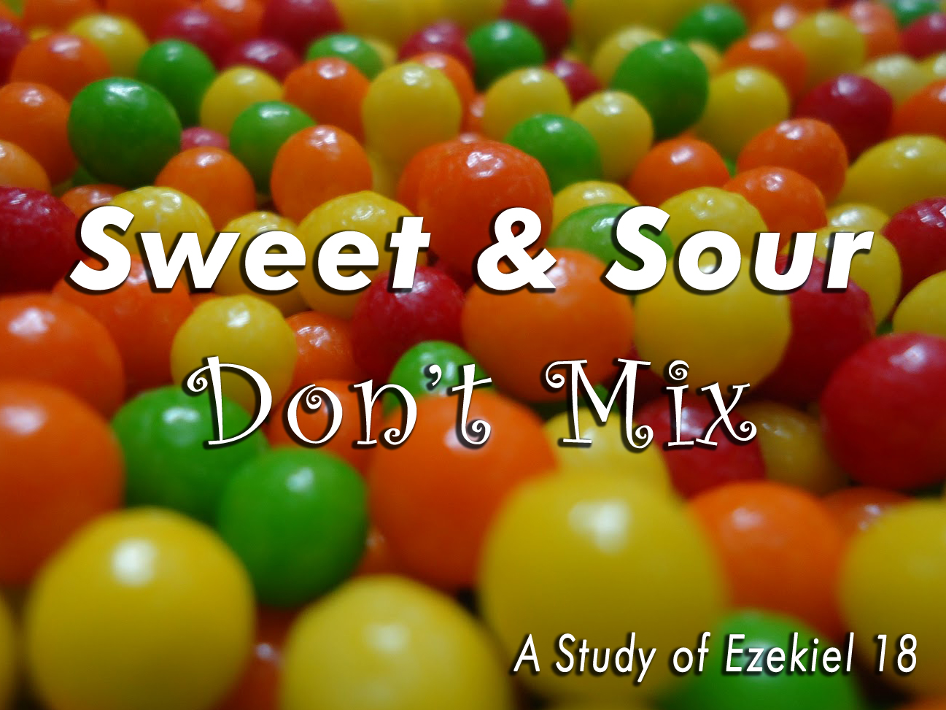
.

Slide 2
Sour Grapes:
The Doctrines of Men
Many influential men have perpetuated false teachings
Teachings classified as “false” = not according to Scripture
Numerous false teachings about salvation of one’s soul
  Total Depravity: each child born inherits (and is damned by) the sins of parents & Adam
  Unconditional Election: a person has no control over own soul’s salvation
  Predestination: the number of saved is fixed & cannot be altered
  Irresistible Grace: one cannot repel heaven’s pre-determination to save him (or to damn him)
  Perseverance of the Saints: once a person is saved, he can never be lost

Slide 3
Sweet Truth #1:
We Each Have Personal Responsibility Before God
God Sees & Cares for Each Soul Individually
  “All souls are Mine” (v. 4)
  Each person is a separate entity before God
    The soul of the father
    The soul of the son
God Holds Each Soul Accountable Individually
  “The soul who sins shall die” (v. 4)
  The emphasis is on the individual soul itself
  “Die” has to do with separating oneself from the source of all life
    Sin brings “spiritual death” (Gen. 2:17; Rom. 6:23; Isa. 59:2)
    Banishment from the presence of God

Slide 4
Sweet Truth #1:
We Each Have Personal Responsibility Before God
God Does Not Hold Anyone Accountable for Sins of Others
  God sees a “just man” individually (18:5-9)
  God sees an “abominable son” individually (18:10-13, 18)
  God sees a “faithful grandson” individually (18:14-17)
Each Person Is Accountable to God for What He/She Does
  “Because the son has done” (18:19)
  “Shall not bear the guilt of” another (18:20)
  “The righteousness of the righteous shall be upon” the righteous
  “The wickedness of the wicked shall be upon” the wicked

Slide 5
Sweet Truth #2:
We Each Have Our Own Free Will Before God
Each Person Has Freedom from God to Choose His Path
  The choice to be wicked is a choice
  The choice to be righteous is a choice
  The choice to sin is a choice (sin is a choice)

Slide 6
Sweet Truth #2:
We Each Have Our Own Free Will Before God
Each Person Has Freedom from God to Change His Path
  No person is locked into a life of sin
    He can “turn from all his sins he has committed” (18:21)
    He can “keep” and “do” what God commands (18:21)
    He shall live and not die (18:21)
    None of his transgressions will be remembered against him (18:22)
    God’s pleasure is in the wicked turning from his ways (18:23)
  No person is locked into a life of righteousness
    He can “turn away from his righteousness” (18:24)
    He can “commit iniquity” and do “all the abominations” (18:24)
    He shall not live; he shall die (18:24)
    All the righteousness he has done will not be remembered (18:24)
    He is guilty of the sins he has committed (18:24)

Slide 7
Sweet Truth #2:
We Each Have Our Own Free Will Before God
God’s Way of Freedom Is the Only Fair Way
  God allows U-turns (that is fair).
  The man who dies, dies “because of the iniquity he has done” (18:26)
  The man who lives, lives because he did “lawful and right” (18:27-28)
  God is fair! More than fair!
    He allows man to choose his path
    He allows man to change his path
    The end result for each man is based on his own actions/choices

Slide 8
Sweet Truth #3:
God Calls All to Repent for He Wants All to Be Saved
God Will Judge Each Person “According to His Ways” (18:30; cf. Rom. 14:12)
God Pleads with Each Person to “Repent, and Turn” (18:30) – He’s fair!
God Offers Each Person “A New Heart and a New Spirit” (18:31)
God Does Not Want Any Person to Perish (18:31-32, 23; cf. 2 Pet. 3:9)
Therefore, Turn & Live! (18:32) – Before it is too late!
  Repent & be baptized tonight (Acts 2:38) – Choice is yours!

