Slide 1
2 Corinthians 4:1-7

Slide 2
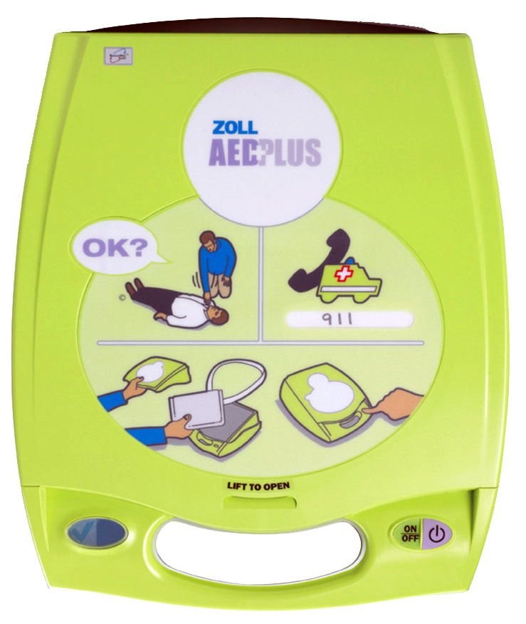
CPR
  Sin brings forth death (Jas. 1:15; Rom. 6:23)
  The Gospel CPR can bring someone back from spiritual death (2 Tim. 1:10)
  YOU HAVE the GOSPEL CPR! You’re rich!

Slide 3

Cure
  Sin infects and affects every accountable person (Rom. 3:23; 5:6; 7:19-25)
  The Gospel Cure provides the remedy for the infectious disease of sin (Isa. 53:5; 1 Pet. 2:24)
  YOU HAVE the GOSPEL CURE! You’re rich!

Slide 4
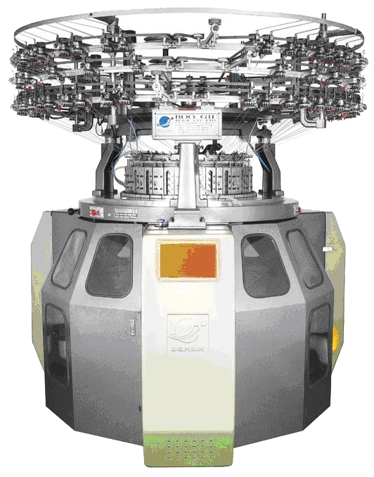
Converter
  The Gospel Converter can completely revamp and change someone’s life around (Rom. 1:16 + 2 Cor. 3:18)
  YOU HAVE the GOSPEL CONVERTER!
  You’re rich!

Slide 5
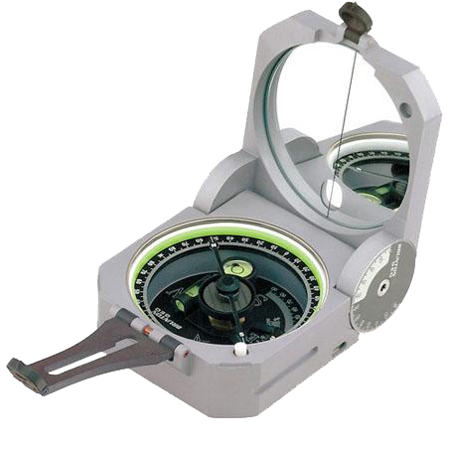
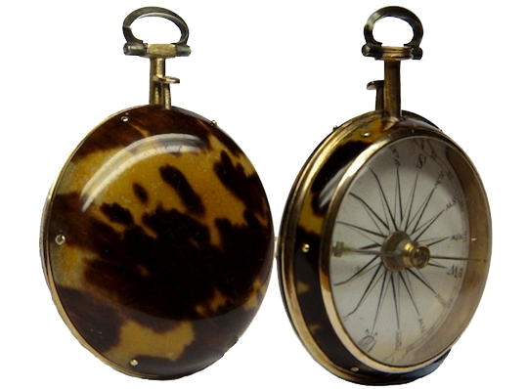
Compass
  The Gospel Compass always points to heaven, shows the right direction to go and lights the way (2 Thess. 2:13-14; 3:3-5; 2 Cor. 4:4; Ps. 119:105)
  YOU HAVE the GOSPEL COMPASS! You’re rich!

Slide 6

Counselor
  The Gospel Counselor provides comfort (Rom. 15:4; 1 Th. 4:18), peace (Rom. 10:15; Eph. 6:15), reassurance (Col. 1:23), encouragement (1 Cor. 14:31), guidance (Psa. 73:24); etc.
  The Gospel Counselor shows what’s right, what’s wrong, how to get right, how to stay right (2 Tim. 3:16)
  YOU HAVE the GOSPEL COUNSELOR!
  You’re rich!

Slide 7
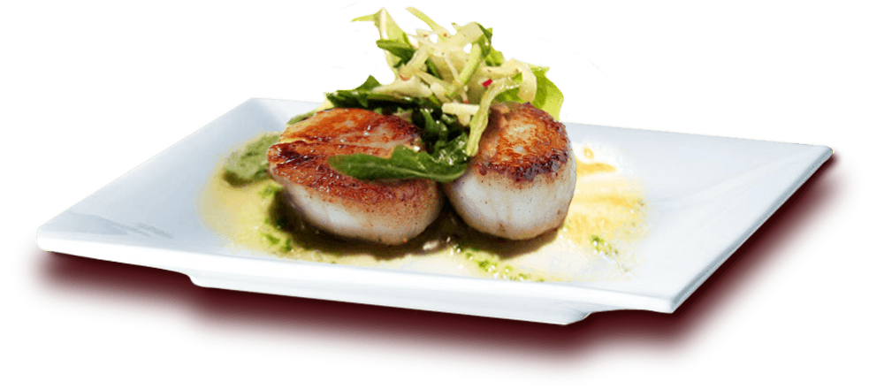
Cuisine
  The Gospel Cuisine offers abundance of nourishment, food, milk, meat (1 Pet. 2:1-3; 1 Cor. 9:23; Heb. 3:1; 5:13; Heb. 6:4, 5)
  YOU HAVE the GOSPEL CUISINE! You’re rich!
Crème brûlée of foie gras with Tonga beans
Tartar of Kobe beef with Imperial Beluga caviar and Belons oyster
Mousseline of pattes rouges crayfish with morel mushroom infusion
Tarte Fine with scallops and black truffle
Lobster Osso Buczco
Ravioli with guinea fowl and burrata cheese, veal reduction
Saddle of lamb “Léonel“
Supreme of pigeon en croute w/ cèpes mushroom sauce & cipollotti
Veal cheeks with Périgord truffles
Imperial gingerbread pyramid w/ caramel & salted butter ice-cream

Slide 8
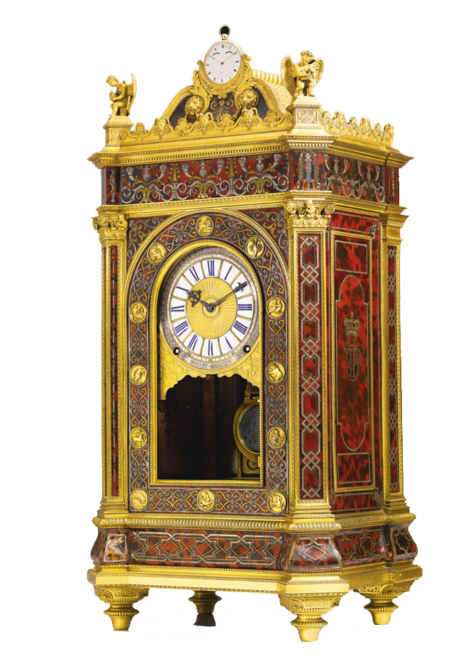
Clock
  The Gospel Clock teaches you that time is fleeting and uncertain (Job 14:1-2; Psa. 39:5; 89:47; 102:112)
  The Gospel Clock tells you when to do things (Heb. 3:7, 13, 15; 4:7; 2 Cor. 6:2; Acts 22:16)
  YOU HAVE the GOSPEL CLOCK! You’re rich!

Slide 9
The Gospel Richly Saves When Obeyed
  Believe Jesus is God’s Son – Acts 16:31
  Repent of your sins – Acts 3:19
  Confess your faith in Jesus – Romans 10:9-10
  Be baptized into Christ – Galatians 3:27
    God will wash away your sins – Acts 22:16
    God will add you to His church – Acts 2:47
    God will write your name in heaven – Heb. 12:23
  Walk faithfully with the Lord – 1 John 1:7

