Slide 2
If a brother/sister has “something against” me:
  I need to take notice
  I need to be concerned
  I need to see it as a barrier to God
  I need to take immediate responsibility
  I need to go and seek reconciliation

Slide 3
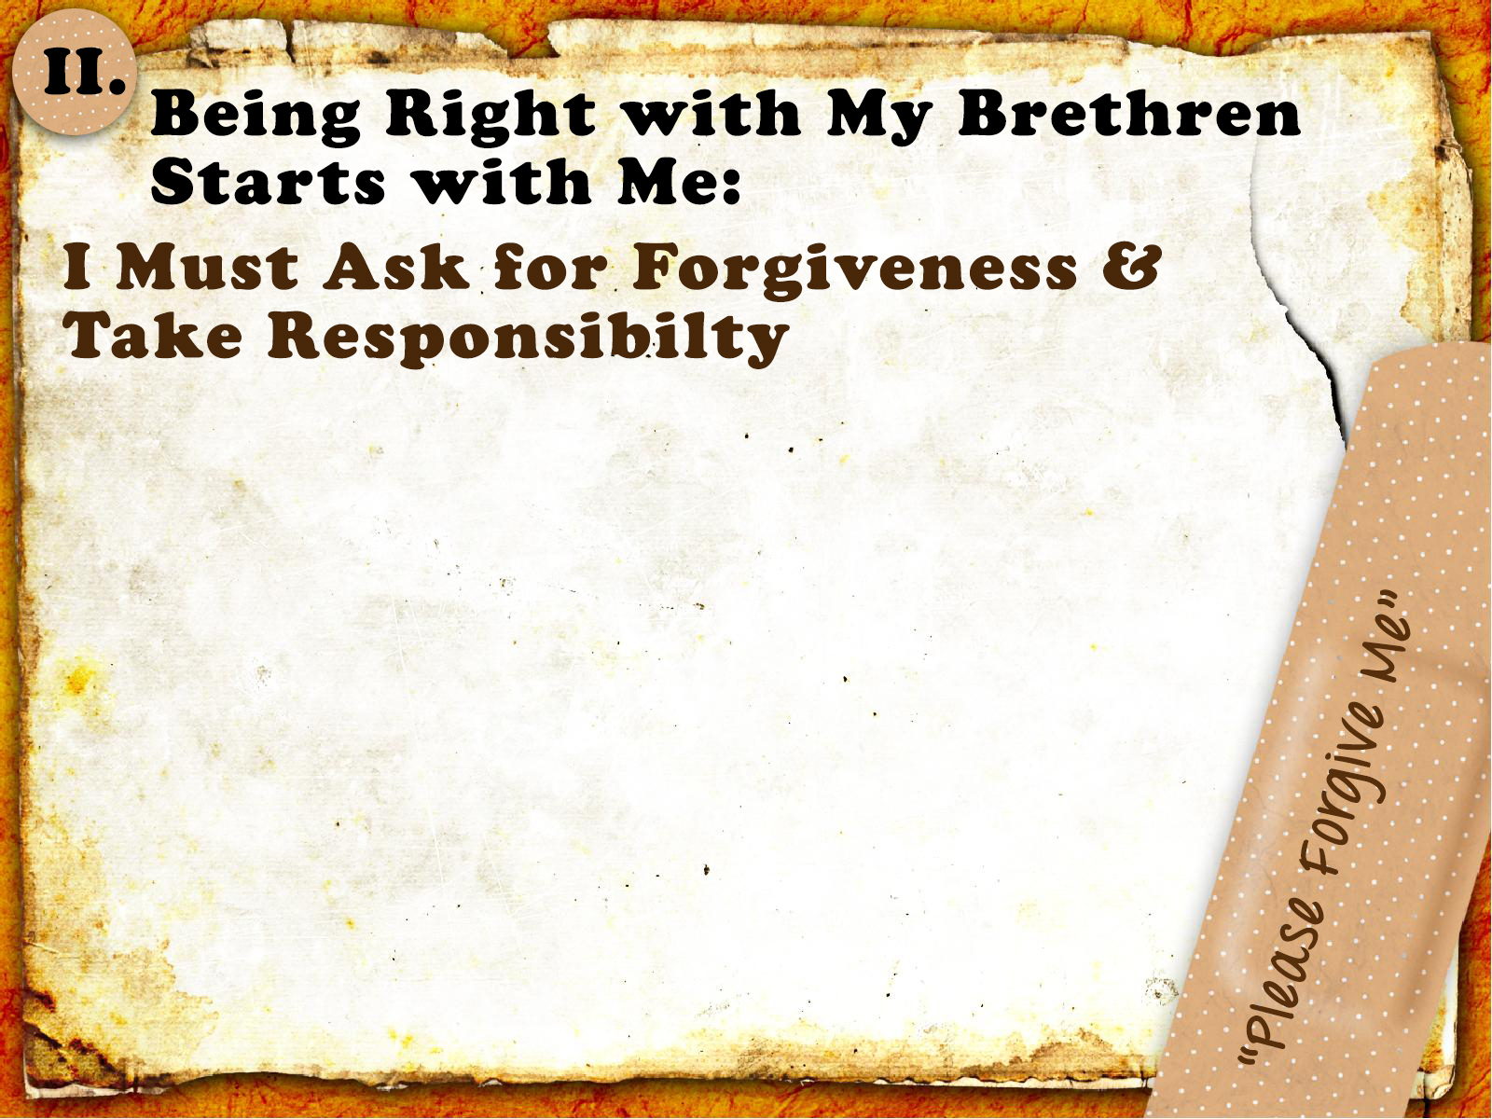
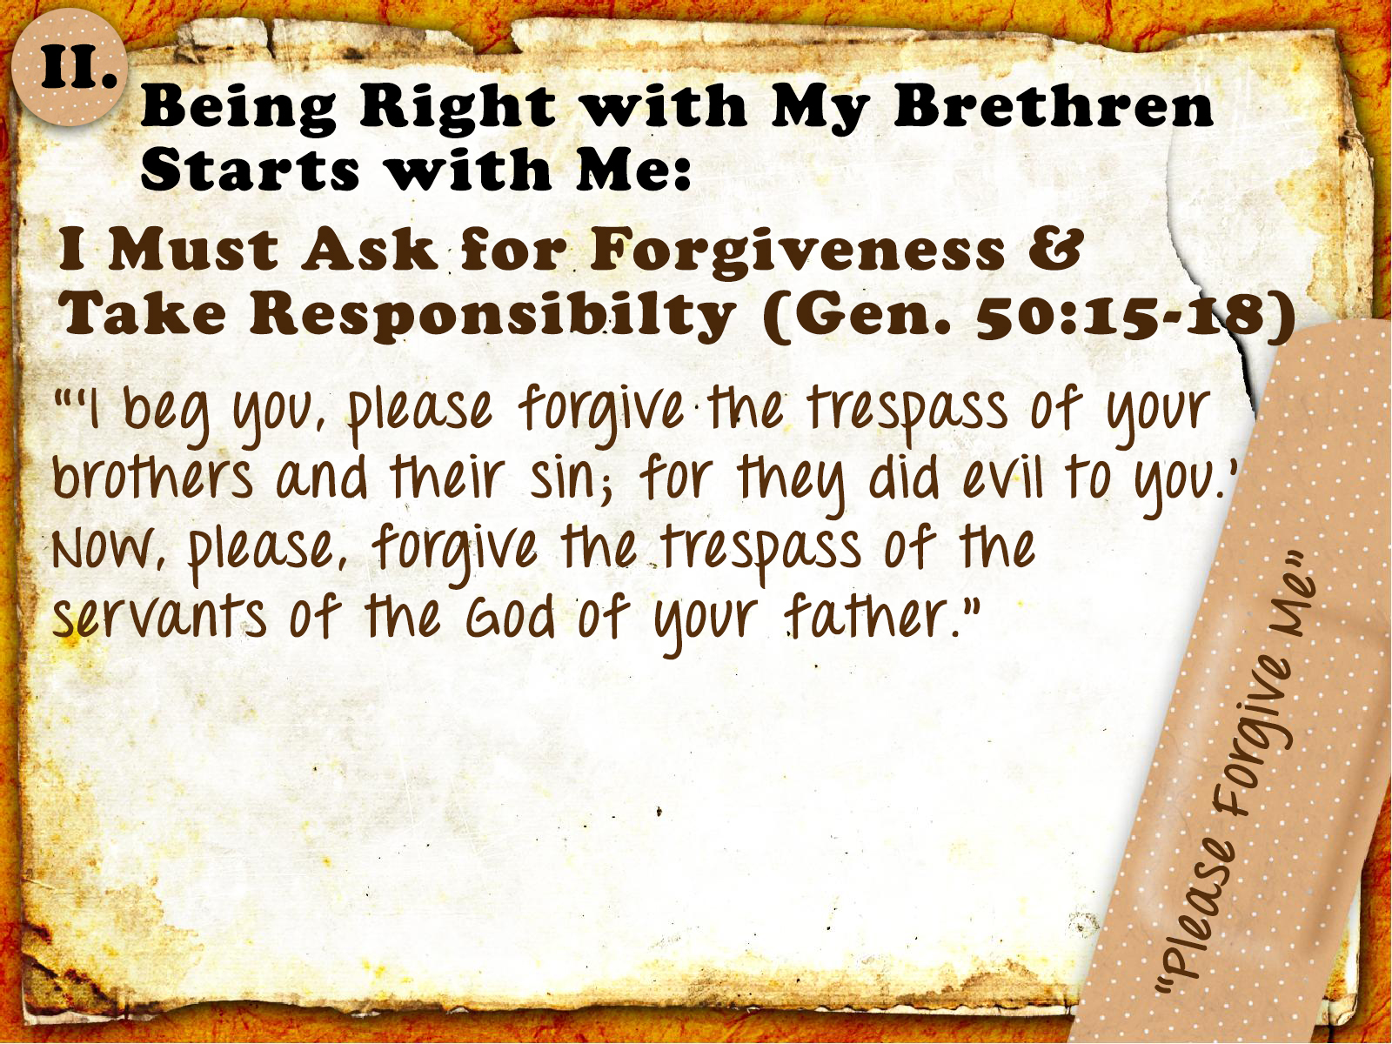
I Must Be Proactive (cf. v. 15)
  Realize the passing of time is not the same as asking for forgiveness
  (cf. Matt. 5:23-24)

Slide 4
I Must Be Earnest
  Do all you can to bring about peace
  (Rom. 12:18; 14:19; Heb. 12:14-15)

Slide 5
I Must Be Respectful
  Agape love is kind, not arrogant and does not behave rudely (1 Cor. 13:4-7)

Slide 6
I Must Be Accountable
  Acknowledge the wrong and take full responsibility for it (Jas. 5:16)

Slide 7
I Must Be Personal
  Acknowledge the personal nature of the hurt (Matt. 18:15; Rom. 14:13)

Slide 8
I Must Be Humble
  Rid yourself of pride and clothe yourself with the Christ-like quality of humility
  (1 Pet. 5:5; Phil. 2:3-5)

Slide 9
I Must Be Proactive
I Must Be Earnest
I Must Be Respectful
I Must Be Accountable
I Must Be Personal
I Must Be Humble

Slide 10
Believe Jesus is God’s Son – John 8:24
Repent of your sins and turn to God – Luke 13:3
Confess your faith in Jesus – Romans 10:9
Be immersed into Christ – Mark 16:16
  God will forgive all of your sins – Acts 22:16
  God will add you to His church – Acts 2:47
  God will enroll you in heaven – Hebrews 12:23
Walk faithfully with Him – 1 John 1:7

