Slide 2
Jonah Had Some Serious Problems
He had an attitude problem (4:1-3)
  He was displeased with God – watch your attitude!
  He was full of “I’s” and “me’s” – watch your attitude!
  Before God and my fellow man, I need to be humble (Psa. 144:3)
He had an anger problem (4:1, 4, 9)
  He got angry when God didn’t do something he wanted (4:1-4)
  He got angry when God did something he didn’t want (4:6-9)
  I need to be more reflective & rational, and less reactive & resentful (Col. 3:1-2-3-4-5-6-7-8-9-10-11-12-13-14-15-16-17)
He had an arrogance problem (4:5-9)
  He was happy when God spared him (4:6)
  He was haughty when God dared to teach him (4:7-9)
  When it comes to God’s will, I must ask,
  “Am I wrong? Could I be wrong?” (Acts 23:1; 26:9-11)

Slide 3
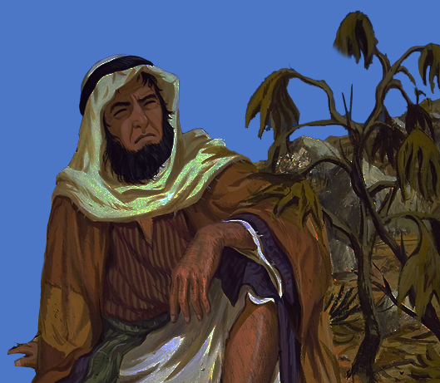
God Had Some Valuable Lessons
Lesson #1: Learn to BE like God – Be merciful! (4:1-9)
  God spared Nineveh
  God spared the sailors
  God spared Jonah
  Mercy is the natural byproduct of:
  The Golden Rule (Matt. 7:12), a forgiving heart (Psa. 86:1-7; Jas. 2:13), and conforming to the image of Christ (Heb. 2:17; Jas. 5:11)
Lesson #2: Learn to SEE like God – See souls! (4:10-11)
  God saw the nasty wickedness of Nineveh (1:2), as did Jonah
  God saw the new works of Nineveh (3:10), as did Jonah
  God saw the lost souls of Nineveh in need of mercy, but Jonah did not
  God saw the parallel between the plant & the people, but Jonah didn’t
  God sees people as more valuable than any plant or thing. Do you?

Slide 4
God Longs for Every Soul to Be Saved
By believing Jesus is God’s Son – Acts 16:31
By repenting of sin and turning to God – Acts 17:30
By confessing your faith in Jesus – Matthew 10:32
By being immersed into Christ – Galatians 3:27
  God will forgive all of your sins – Acts 22:16
  God will add you to His church – Acts 2:47
  God will register you in heaven – Hebrews 12:23
By living faithfully – 1 Corinthians 15:58

