Slide 1
Introduction to First Peter
1 Peter 1:1-5

Slide 2
1 Peter, an apostle of Jesus Christ, To the pilgrims of the Dispersion in Pontus, Galatia, Cappadocia, Asia, and Bithynia,
2 elect according to the foreknowledge of God the Father, in sanctification of the Spirit, for obedience and sprinkling of the blood of Jesus Christ: Grace to you and peace be multiplied.
3 Blessed be the God and Father of our Lord Jesus Christ, who according to His abundant mercy has begotten us again to a living hope through the resurrection of Jesus Christ from the dead,
4 to an inheritance incorruptible and undefiled and that does not fade away, reserved in heaven for you,
5 who are kept by the power of God through faith for salvation ready to be revealed in the last time.
1 Peter 1:1-5

Slide 3
Key People:
Peter
Mark
Silvanus (Full name for Silas)
Pilgrims dispersed
Key Places:
Location of those dispersed
Location of place of writing: Babylon

Slide 4
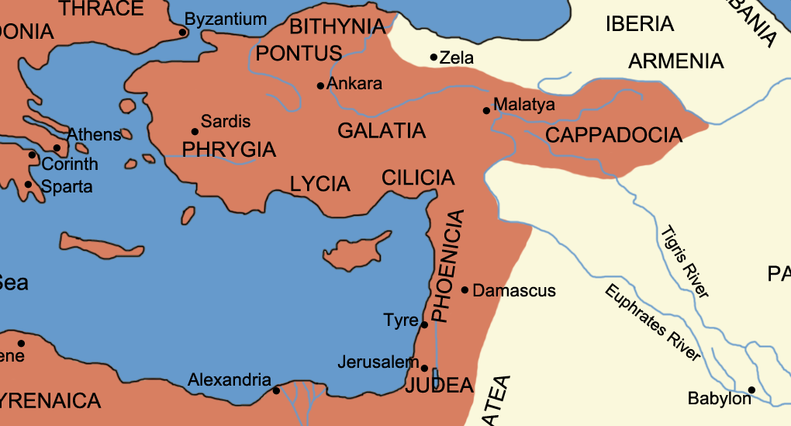
ASIA
1 Peter, an apostle of Jesus Christ, To the pilgrims of the Dispersion in Pontus, Galatia, Cappadocia,
Asia, and Bithynia, 1 Pet. 1:1

Slide 5
ASIA
1 Peter, an apostle of Jesus Christ, To the pilgrims of the Dispersion in Pontus, Galatia, Cappadocia,
Asia, and Bithynia, 1 Pet. 1:1

Slide 6
Key People:
Peter
Mark
Silvanus (Full name for Silas)
Pilgrims dispersed
Key Places:
Location of those dispersed
Location of place of writing: Babylon
Key Words/Concepts
Deity (God, Jesus, Lord, Christ, Spirit) 119 times in 105 verses
Pilgrims/Aliens/Sojourners
False teachers
Submission/serving

Slide 7
1 Peter, an apostle of Jesus Christ, To the PILGRIMS of the Dispersion in Pontus, Galatia, Cappadocia, Asia, and Bithynia,
2 ELECT according to the FORKNOW-ledge of God the Father, in SANTIFI-cation of the Spirit, for obedience and sprinkling of the blood of Jesus Christ: GRACE to you and PEACE be multiplied.
3 Blessed be the God and Father of our Lord Jesus Christ, who according to His abundant MERCY has BEGOTTEN us again to a living HOPE through the resurrection of Jesus Christ from the dead,
4 to an INHERITENCE incorruptible and undefiled and that does not fade away, RESERVED in heaven for you,
5 who are KEPT by the power of God through faith for salvation READY to be revealed in the last time.
1 Peter 1:1-5

