Slide 2
Sin Is a DISEASE
  Psa. 41:4; Isa. 1:6
Sin Is DECEPTIVE (Heb. 3:13)
  Makes wrong look right (Prov. 14:12; Acts 26:9)
  Makes ugly look attractive (Gen. 3:6; 2 Pet. 2:20-22)
  Makes slavery look like liberty (John 8:34; 2 Pet. 2:19)
  Makes misery look satisfying (Lk. 15:11-32; Heb. 11:25)
  Makes death look like life (Ezek. 18:20; Jas. 1:13-15)
Sin Is DEBILITATING (Heb. 12:1)
  Some sins easily beset, entangle, encircle, surround us
  Sin keeps us from being who we need to be!
  Sin keeps us from doing what we need to do!
  Sin keeps us from going where we need to go!

Slide 3
Sin Is DESTRUCTIVE
  To your body (1 Cor. 6:18-20)
  To your home (Gen. 19; Matt. 14:3-12)
  To your congregation (1 Cor. 1-16; Rev. 3:14-22)
  To your community or nation (Prov. 14:34; 11:11)
Sin Is DIVISIVE
  Earthly separation from God (Isa. 59:1-2; Jas. 4:4)
  Eternal separation from God (Mt. 25:31-46; 2 Th. 1:7-9)
Sin Is DEADLY
  Results in physical death (1 Cor. 15:22; Rom. 5:12)
  Results in spiritual death (Jas. 1:13-15; 5:20; Rom. 6:23)
  Results in eternal death (Rev. 21:8; 20:14-15; 2:11)

Slide 4
Sin Is DEFEATABLE
  With God’s Viewpoint
    SIN caused Christ to die (2 Cor. 5:21)
    SIN alone will keep you out of heaven (Rev. 21:27)
    SIN is seen by God as a putrefying sore (Isa. 1:6), dirty garment
    (Rev. 3:4), corrupting body (Matt. 23:27), vomit (2 Pet. 2:20-22)
  With God’s Word
    Put it in your heart and you’ll triumph (Psa. 119:11; 1 John 2:1)
    Jesus triumphed over temptation with the Word (Matt. 4:1-11)
    We need to read it, study it, write it, memorize it & quote it!
  With God’s Help
    Help to triumph over sin is only a prayer away!
    In prayer, we petition God for deliverance (Matt. 6:13)
    In prayer, we put on God’s armor to withstand the devil (Eph. 6:13, 18)
    In prayer, we plead regularly and frequently (1 Th. 5:17; Col. 4:2; Lk. 18:1)
  God gives us:
    The strength (Phil. 4:13), the way of escape (1 Cor. 10:13), the perfect example (Matt. 4:1-11), the promise of full forgiveness (1 John 1:8-10)
    When we separate ourselves from sin (2 Cor. 6:17) and put it off (Col. 3:8)

Slide 5
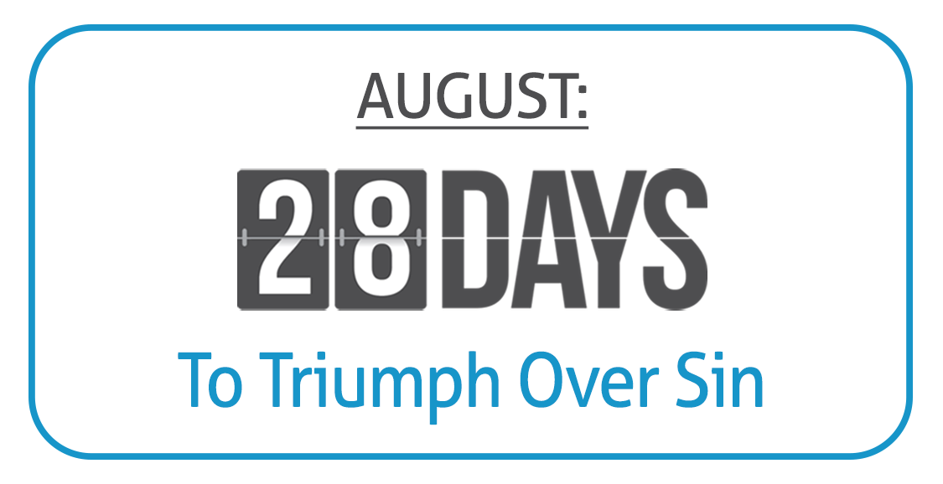
GOAL: Intentionally,
consistently and
successfully target a
specific sin or spiritual
weakness in your life,
and work (with God’s
help) on eradicating it
from your life.
Examine yourself. Do a personal introspection.
  Ask yourself, “What am I struggling with the most? What is my besetting sin(s), that is constantly plaguing me?”
  Identify the #1 sin with which you struggle, or your TOP TWO.
Intensely pray about it each day at least 2-3 (or 5-6) times.
  “Lord, please help me with this! I cannot do this without Your help!”
  Contemplate the Divine attribute highlighted each day.
Mediate upon and memorize a specific Bible verse(s).
  Recite this verse multiple times each day.
  Handwrite this verse each day.
  Quote this verse out loud every time you’re tempted in this area.

Slide 6
Believe Jesus is God’s Son – Acts 16:31
Repent of your sins and turn to God – Acts 3:19
Confess your faith in Jesus Christ – Romans 10:9
Be immersed into Christ – Acts 2:38
  God will forgive all of your sins – Acts 22:16
  God will add you to His church – Acts 2:47
  God will enroll you in heaven – Hebrews 12:23
Walk faithfully with Him – 1 John 1:7

