Slide 1


Slide 2
LORD, MOLD ME!
“Lord, I want to live within Thy will!”
(Matt. 7:21; 1 John 2:17; Heb. 10:9; Eph. 5:17)
“Mold me & make me after Thy will, not mine!”
(Rom. 13:14; John 5:30; 6:38)
“I yield! I submit! I wait!”
(Jer. 18:1-4; Isa. 64:8; 40:31; Psa. 27:14; Jas. 4:7)

Slide 3
LORD, FORGIVE ME!
“Lord, I want to be in Thy presence!”
(Psa. 27:4 vs. Isa. 59:2)
“Search me, try me, forgive me!”
(Psa. 139:23-24; 51:1-19)
“I humbly bow in Thy presence!”
(1 Pet. 5:6; Luke 18:13; Psa. 51)

Slide 4
LORD, HELP ME!
“Lord, I pray for Thy power!”
(Psa. 62:11-12; 147:1-11)
“Help me! Heal me! I’m spiritually weary!”
(Psa. 46:1-3, 10-11; Heb. 13:6)
“I trust! I need! I pray! I beg!”
(Psa. 71:9-12; 18:1-2; 28:7; 2 Tim. 1:12)

Slide 5
LORD, USE ME!
“Lord, I want to be Thy dwelling!”
(1 Cor. 6:19-20; Rom. 8:9-11; Rev. 3:20; Jn. 14:23)
“Take me! Live in me! Use me!”
(Rom. 6:13; 12:1; Phil. 1:20)
“I want you! I want others to see you in me!”
(Gal. 2:20; Matt. 5:16; Eph. 5:18+Col. 3:16)

Slide 6
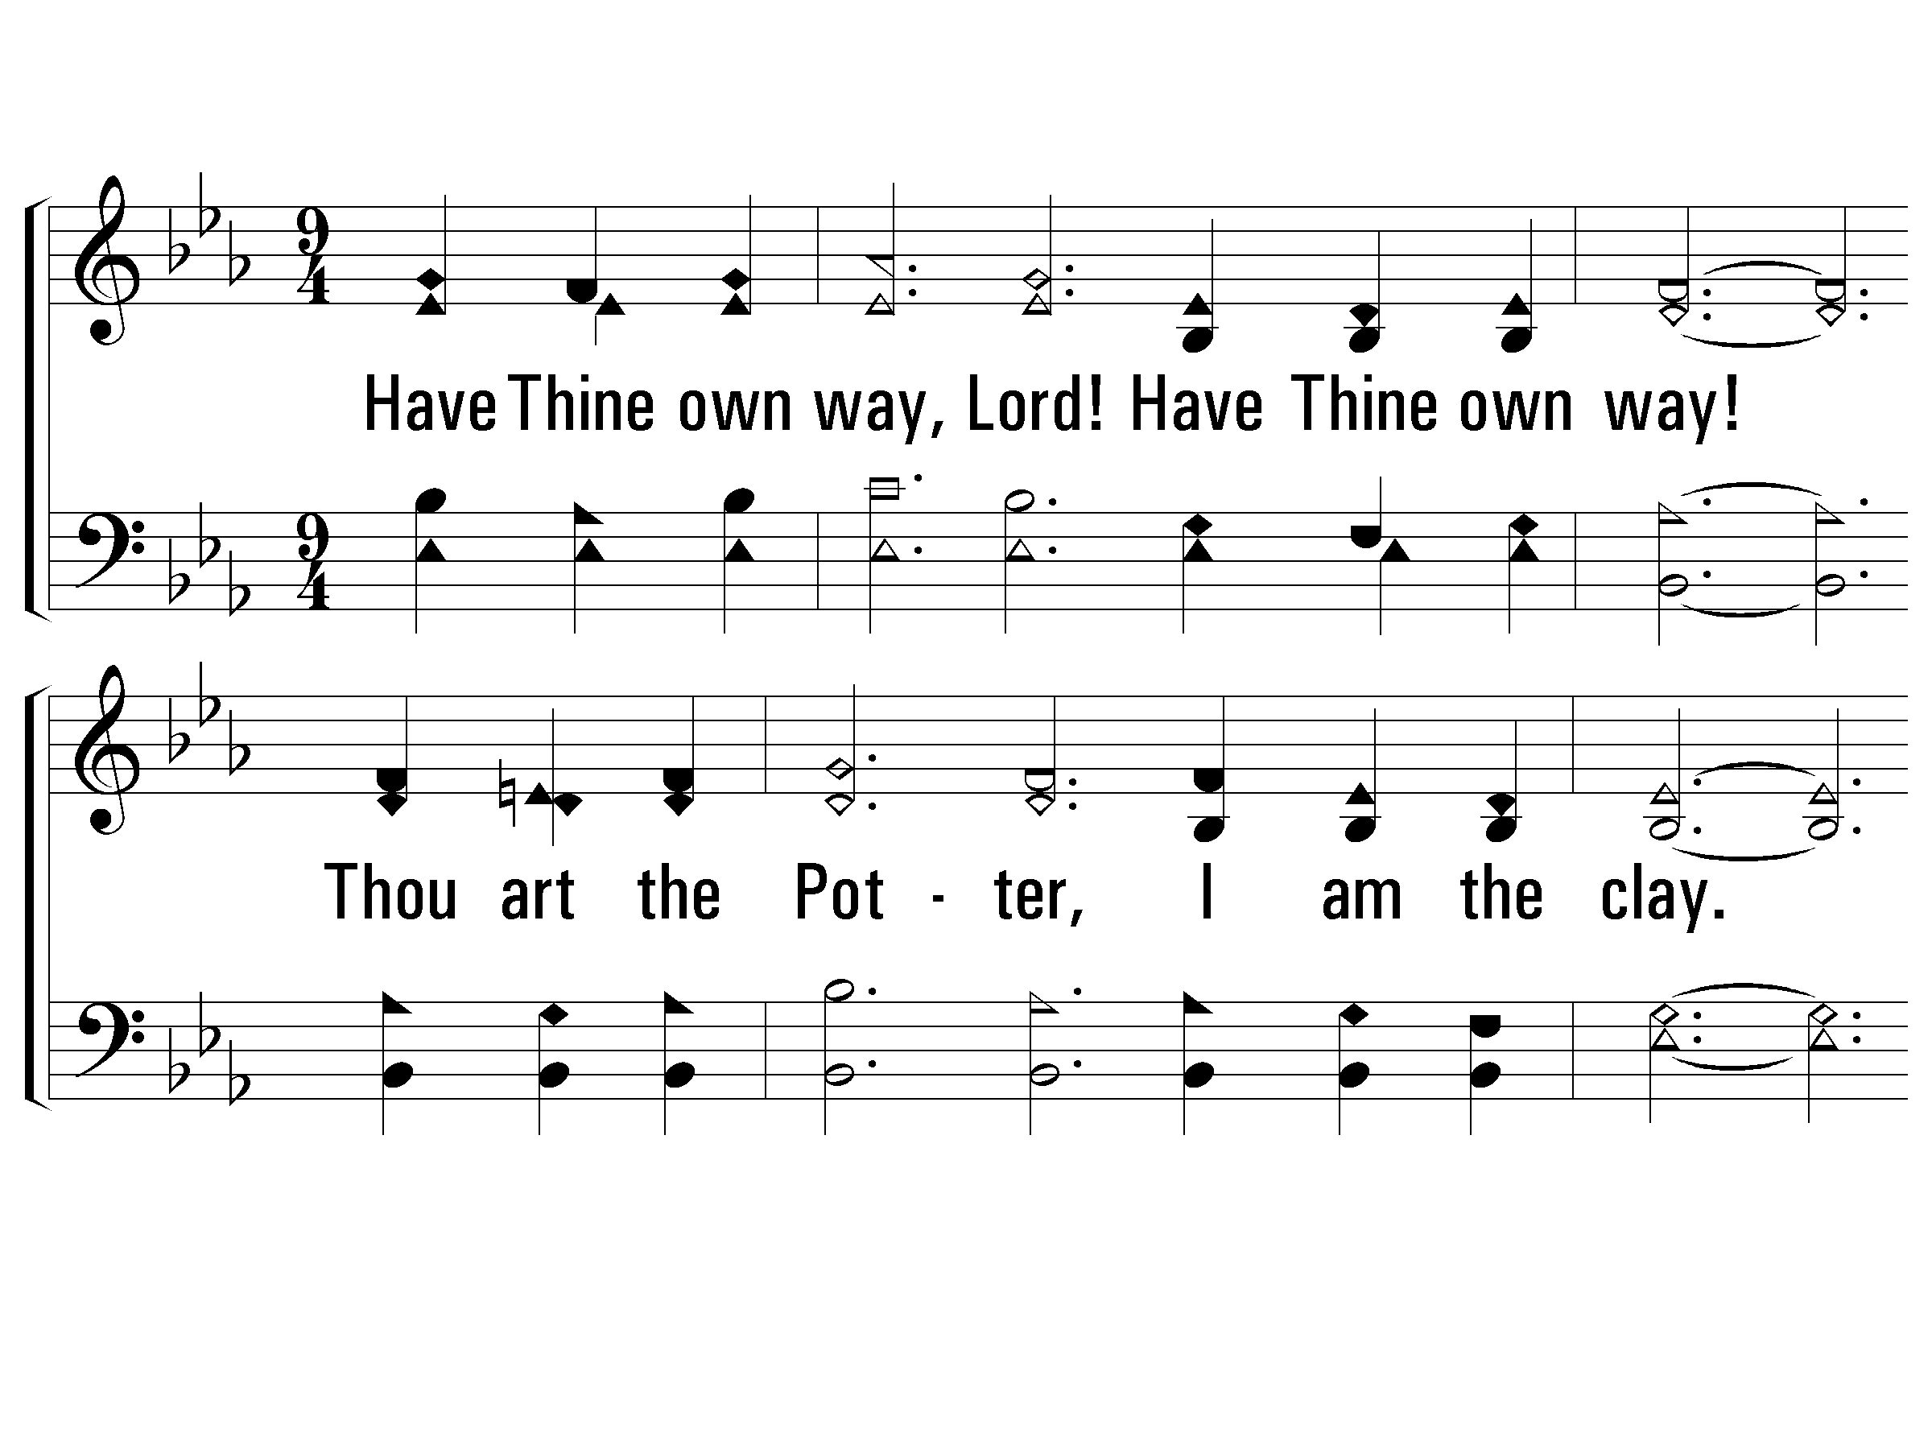
Verse 1 Lord, Mold Me!
#197 – Have Thine Own Way, Lord
1.
Have Thine own way, Lord!
Have Thine own way!
Thou art the Potter,
I am the clay.
Mold me and make me
After Thy will,
While I am waiting,
Yielded and still.

Slide 7
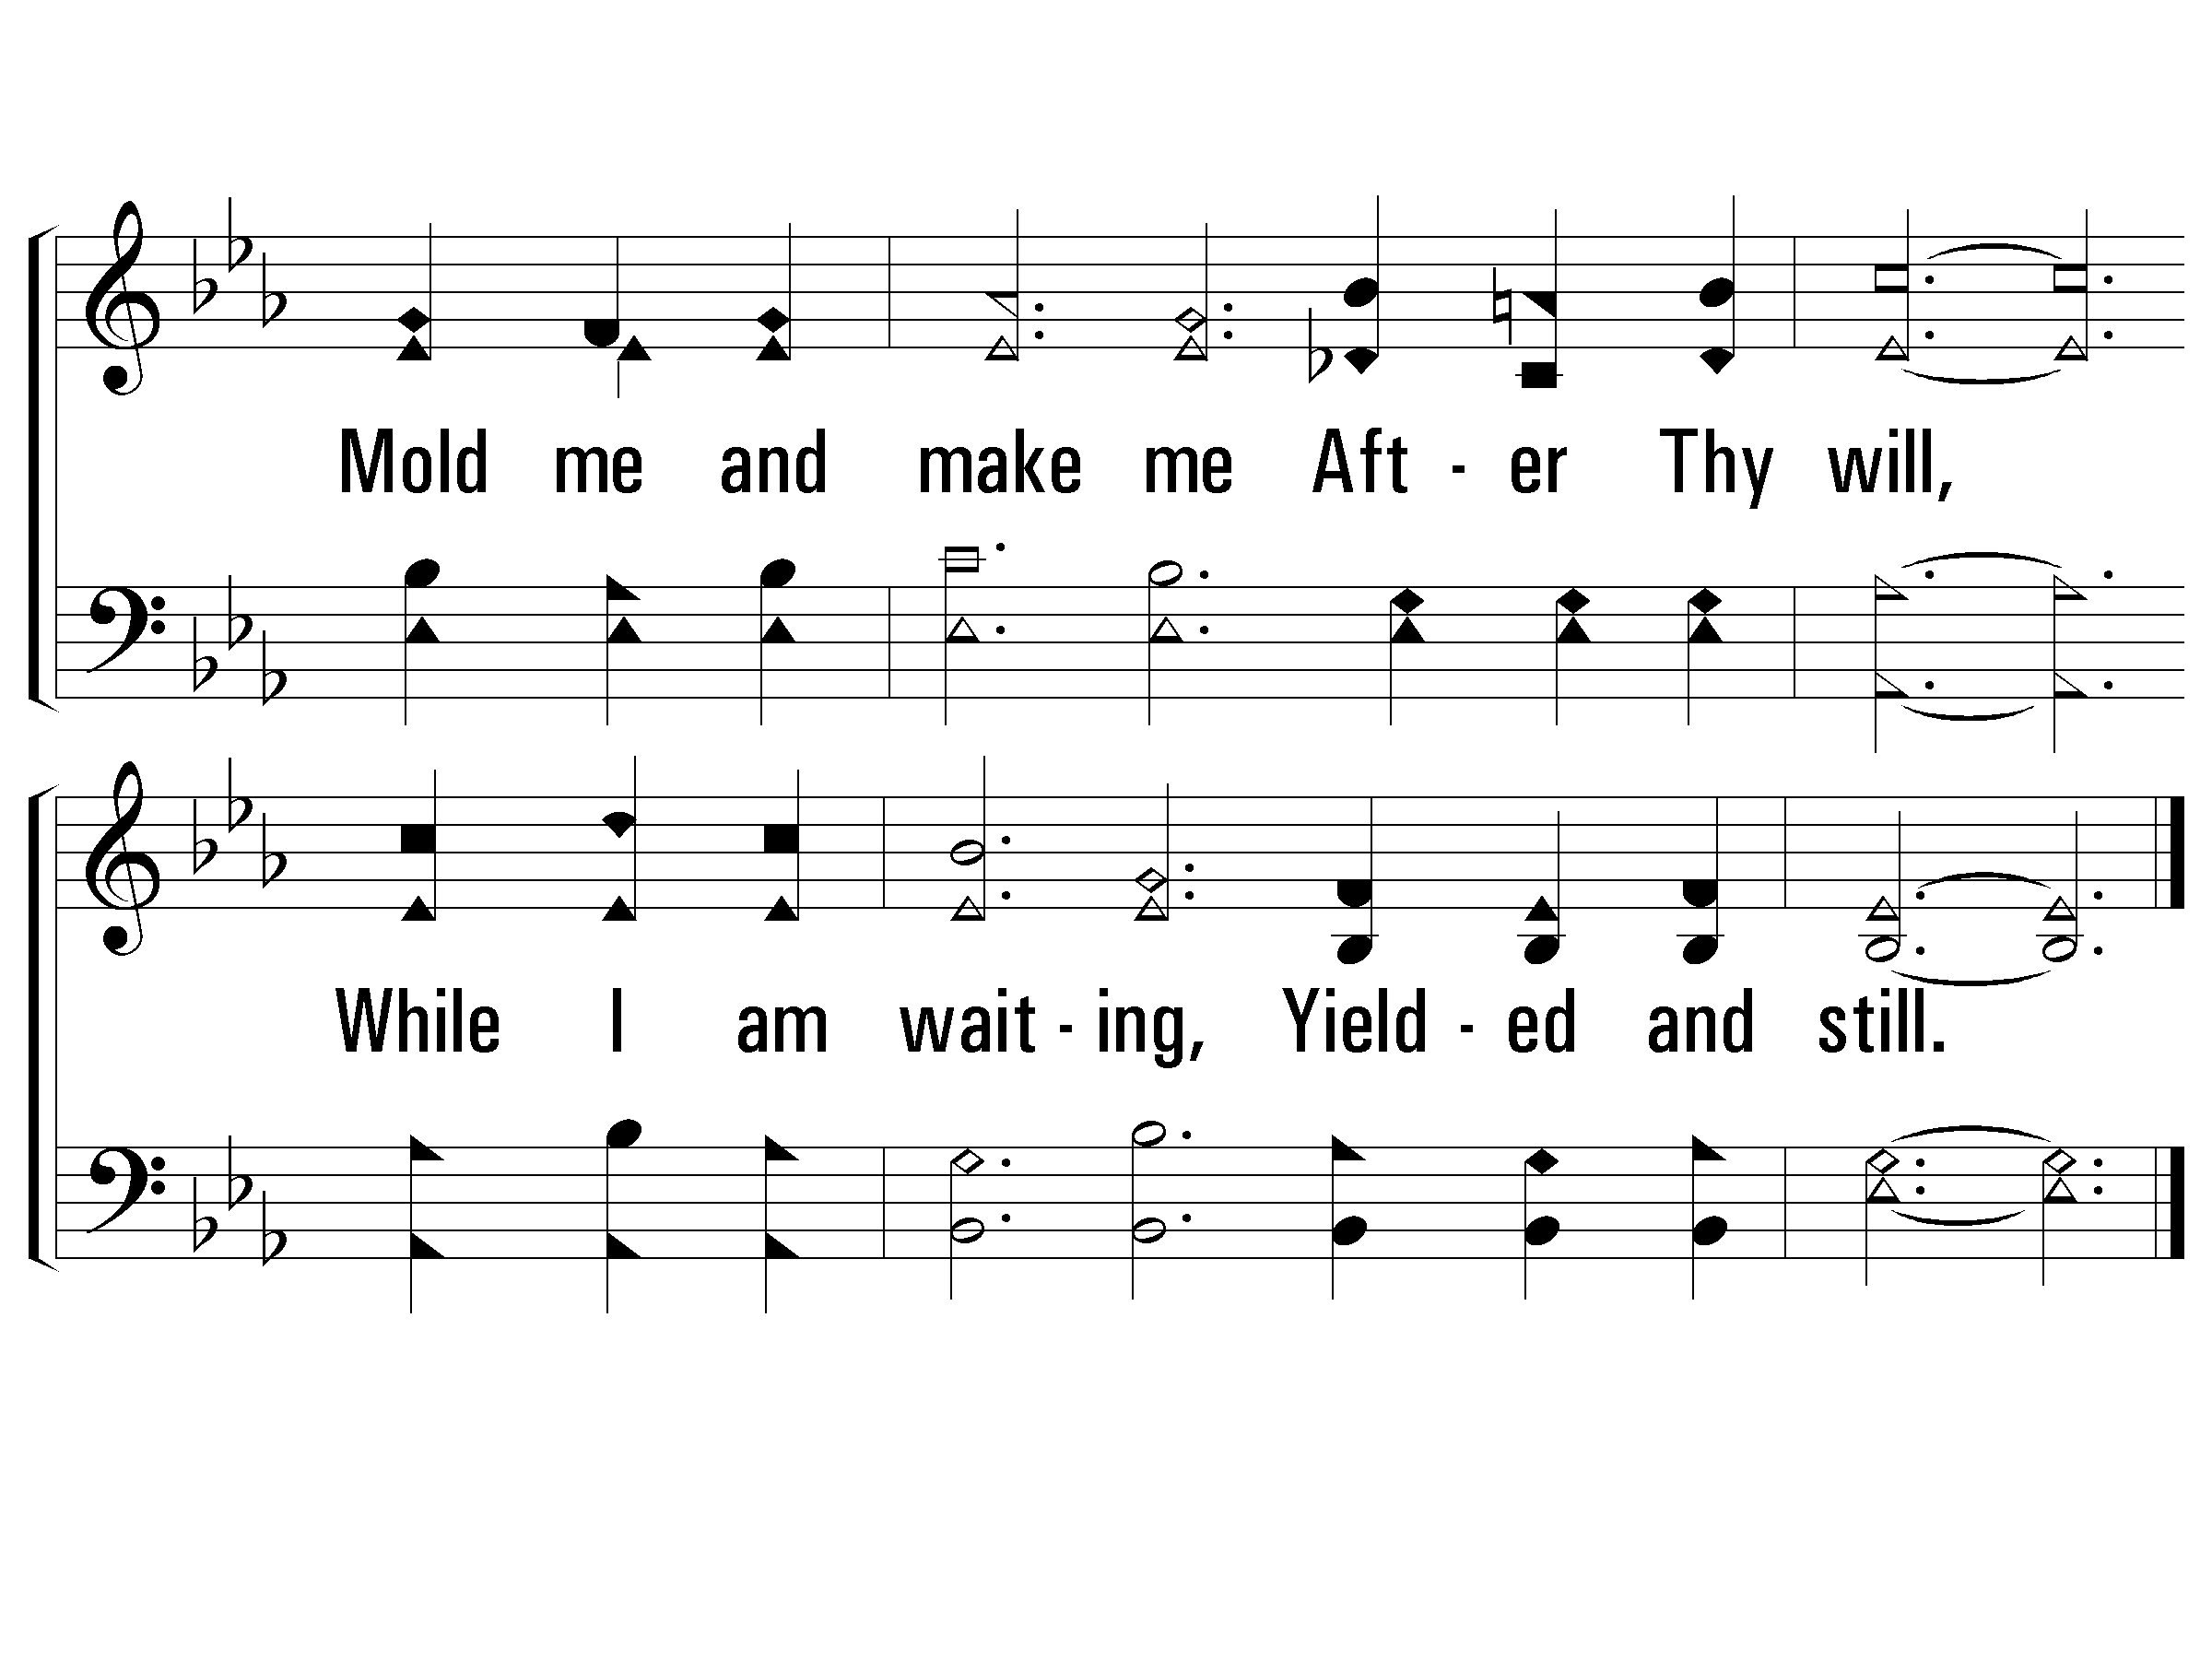
Verse 1 Lord, Mold Me!
#197 – Have Thine Own Way, Lord

Slide 8
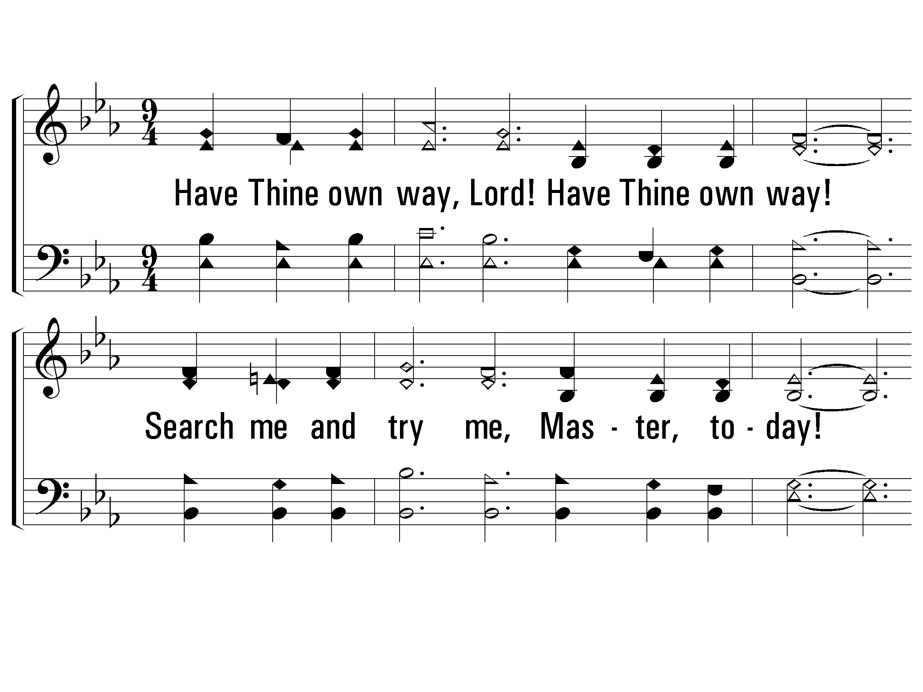
Verse 2 Lord, Forgive Me!
#197 – Have Thine Own Way, Lord
2.
Have Thine own way, Lord!
Have Thine own way!
Search me and try me,
Master, to-day!
Whiter than snow, Lord,
Wash me just now,
As in Thy presence
Humbly I bow.

Slide 9
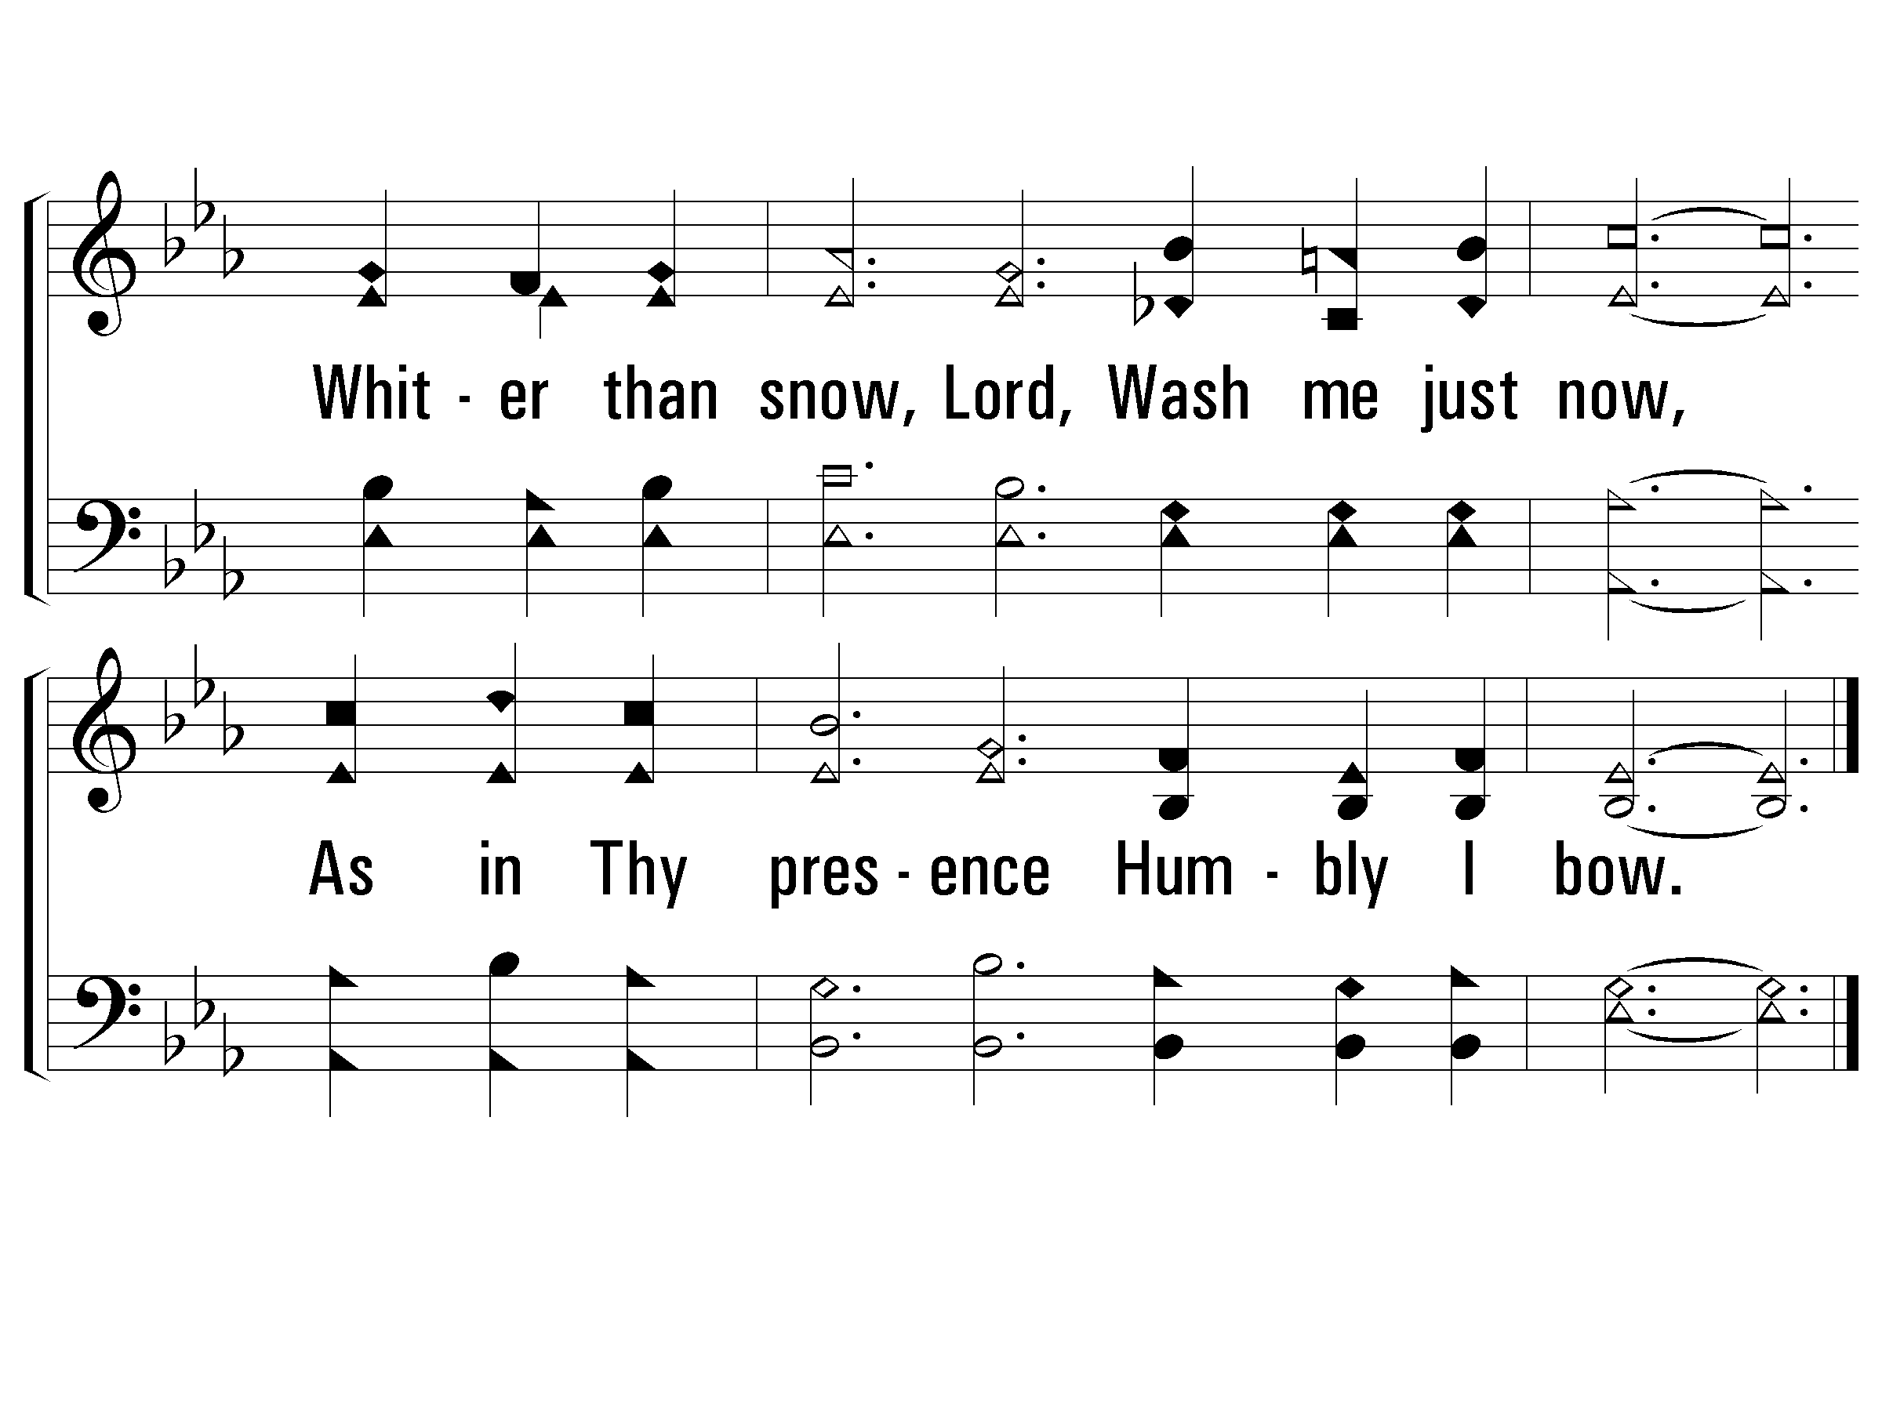
Verse 2 Lord, Forgive Me!
#197 – Have Thine Own Way, Lord

Slide 10
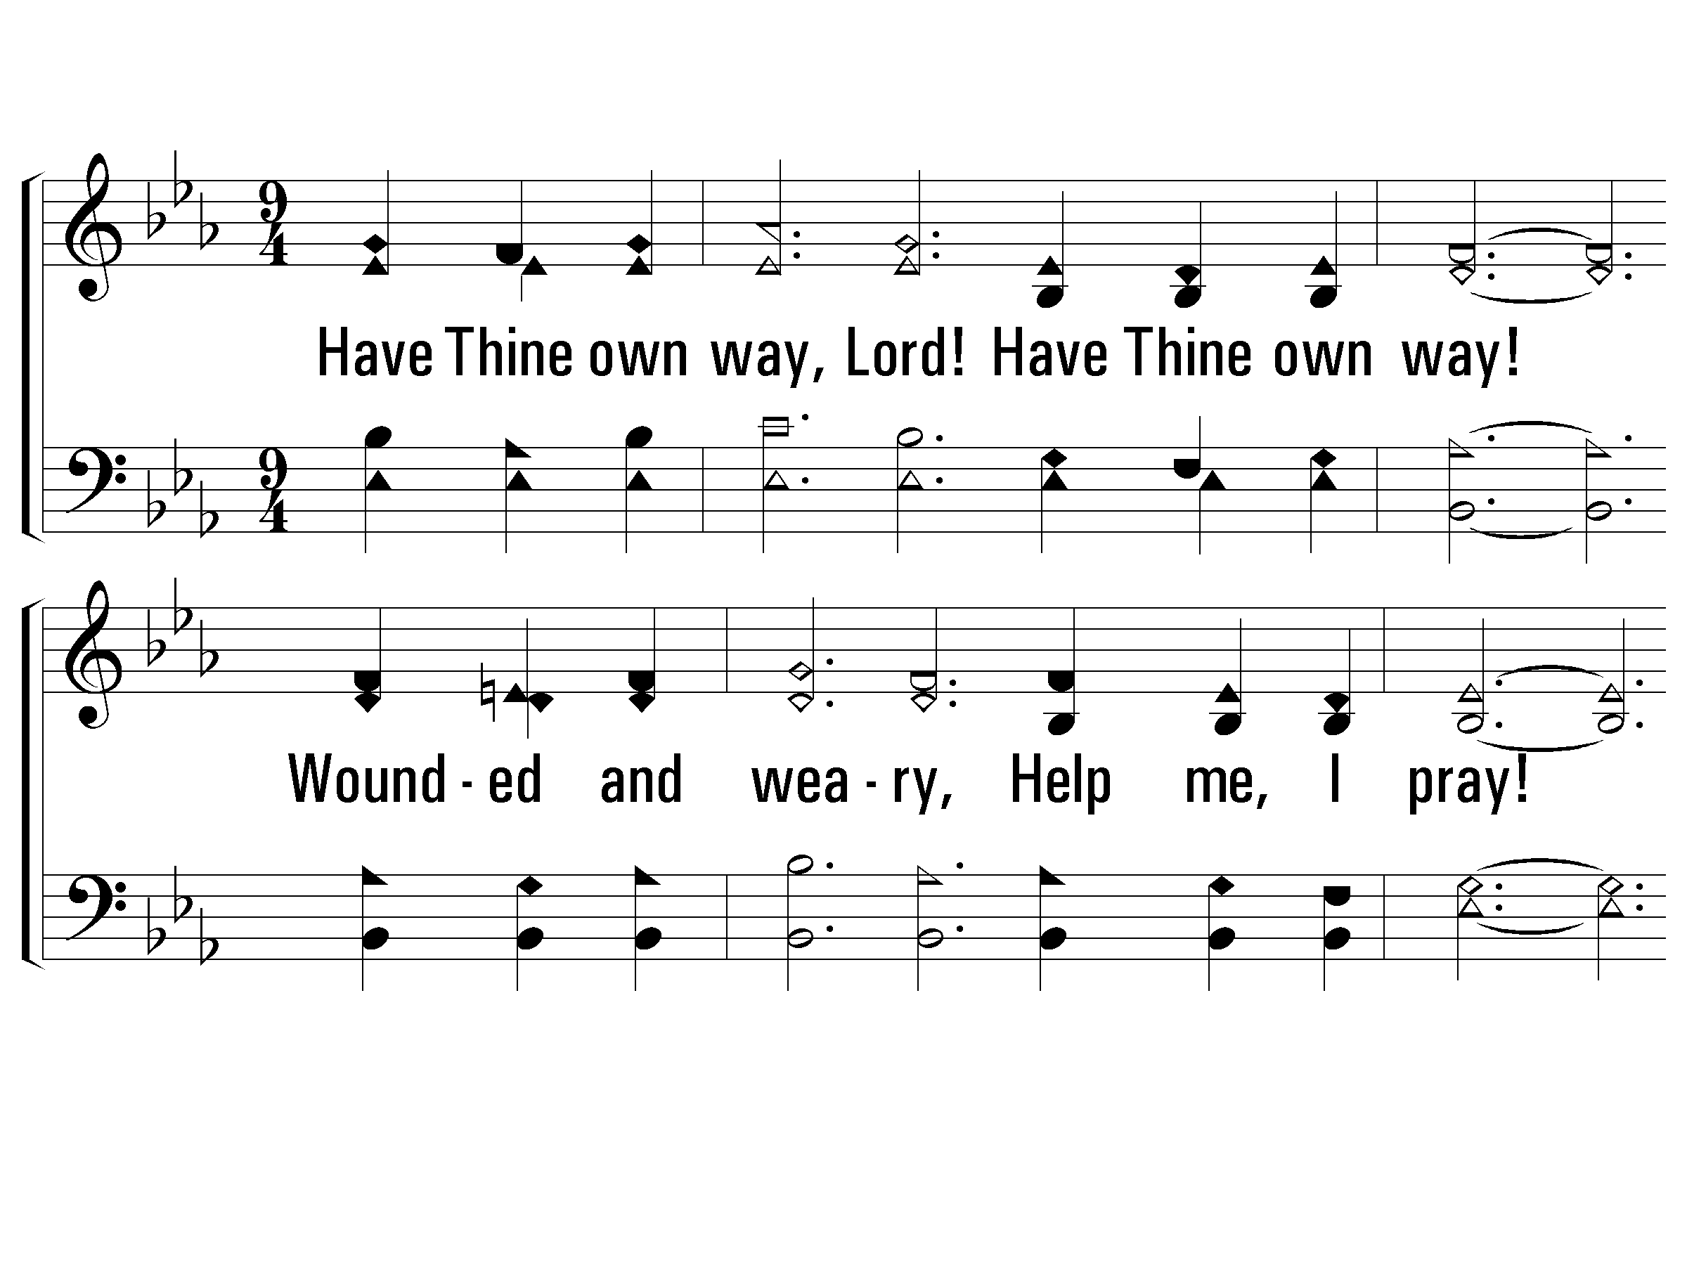
Verse 3 Lord, Help Me!
#197 – Have Thine Own Way, Lord
3.
Have Thine own way, Lord! Have Thine own way!
Wounded and weary, Help me, I pray!
Power, all power Surely is Thine!
Touch me and heal me, Savior divine.

Slide 11
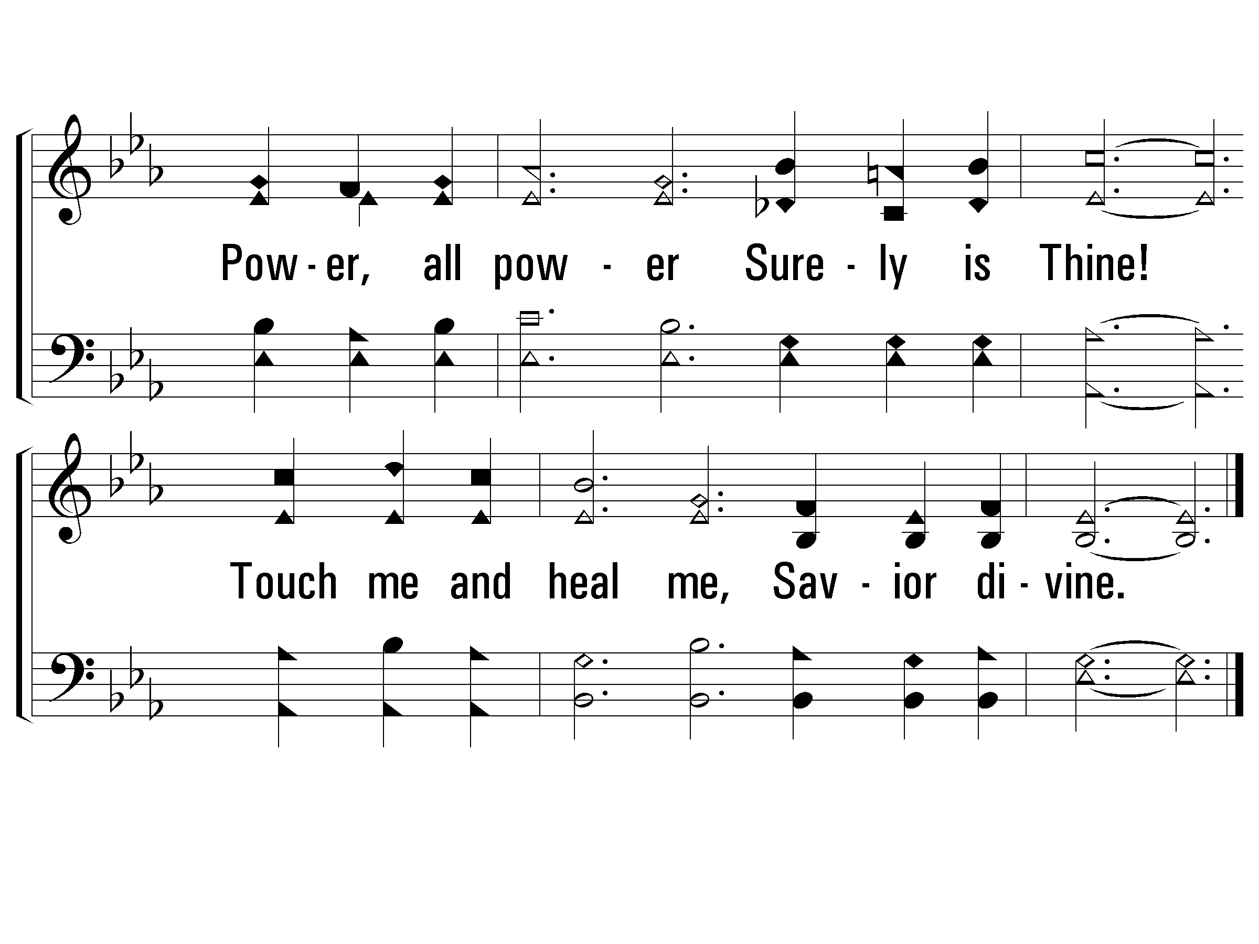
Verse 3 Lord, Help Me!
#197 – Have Thine Own Way, Lord

Slide 12
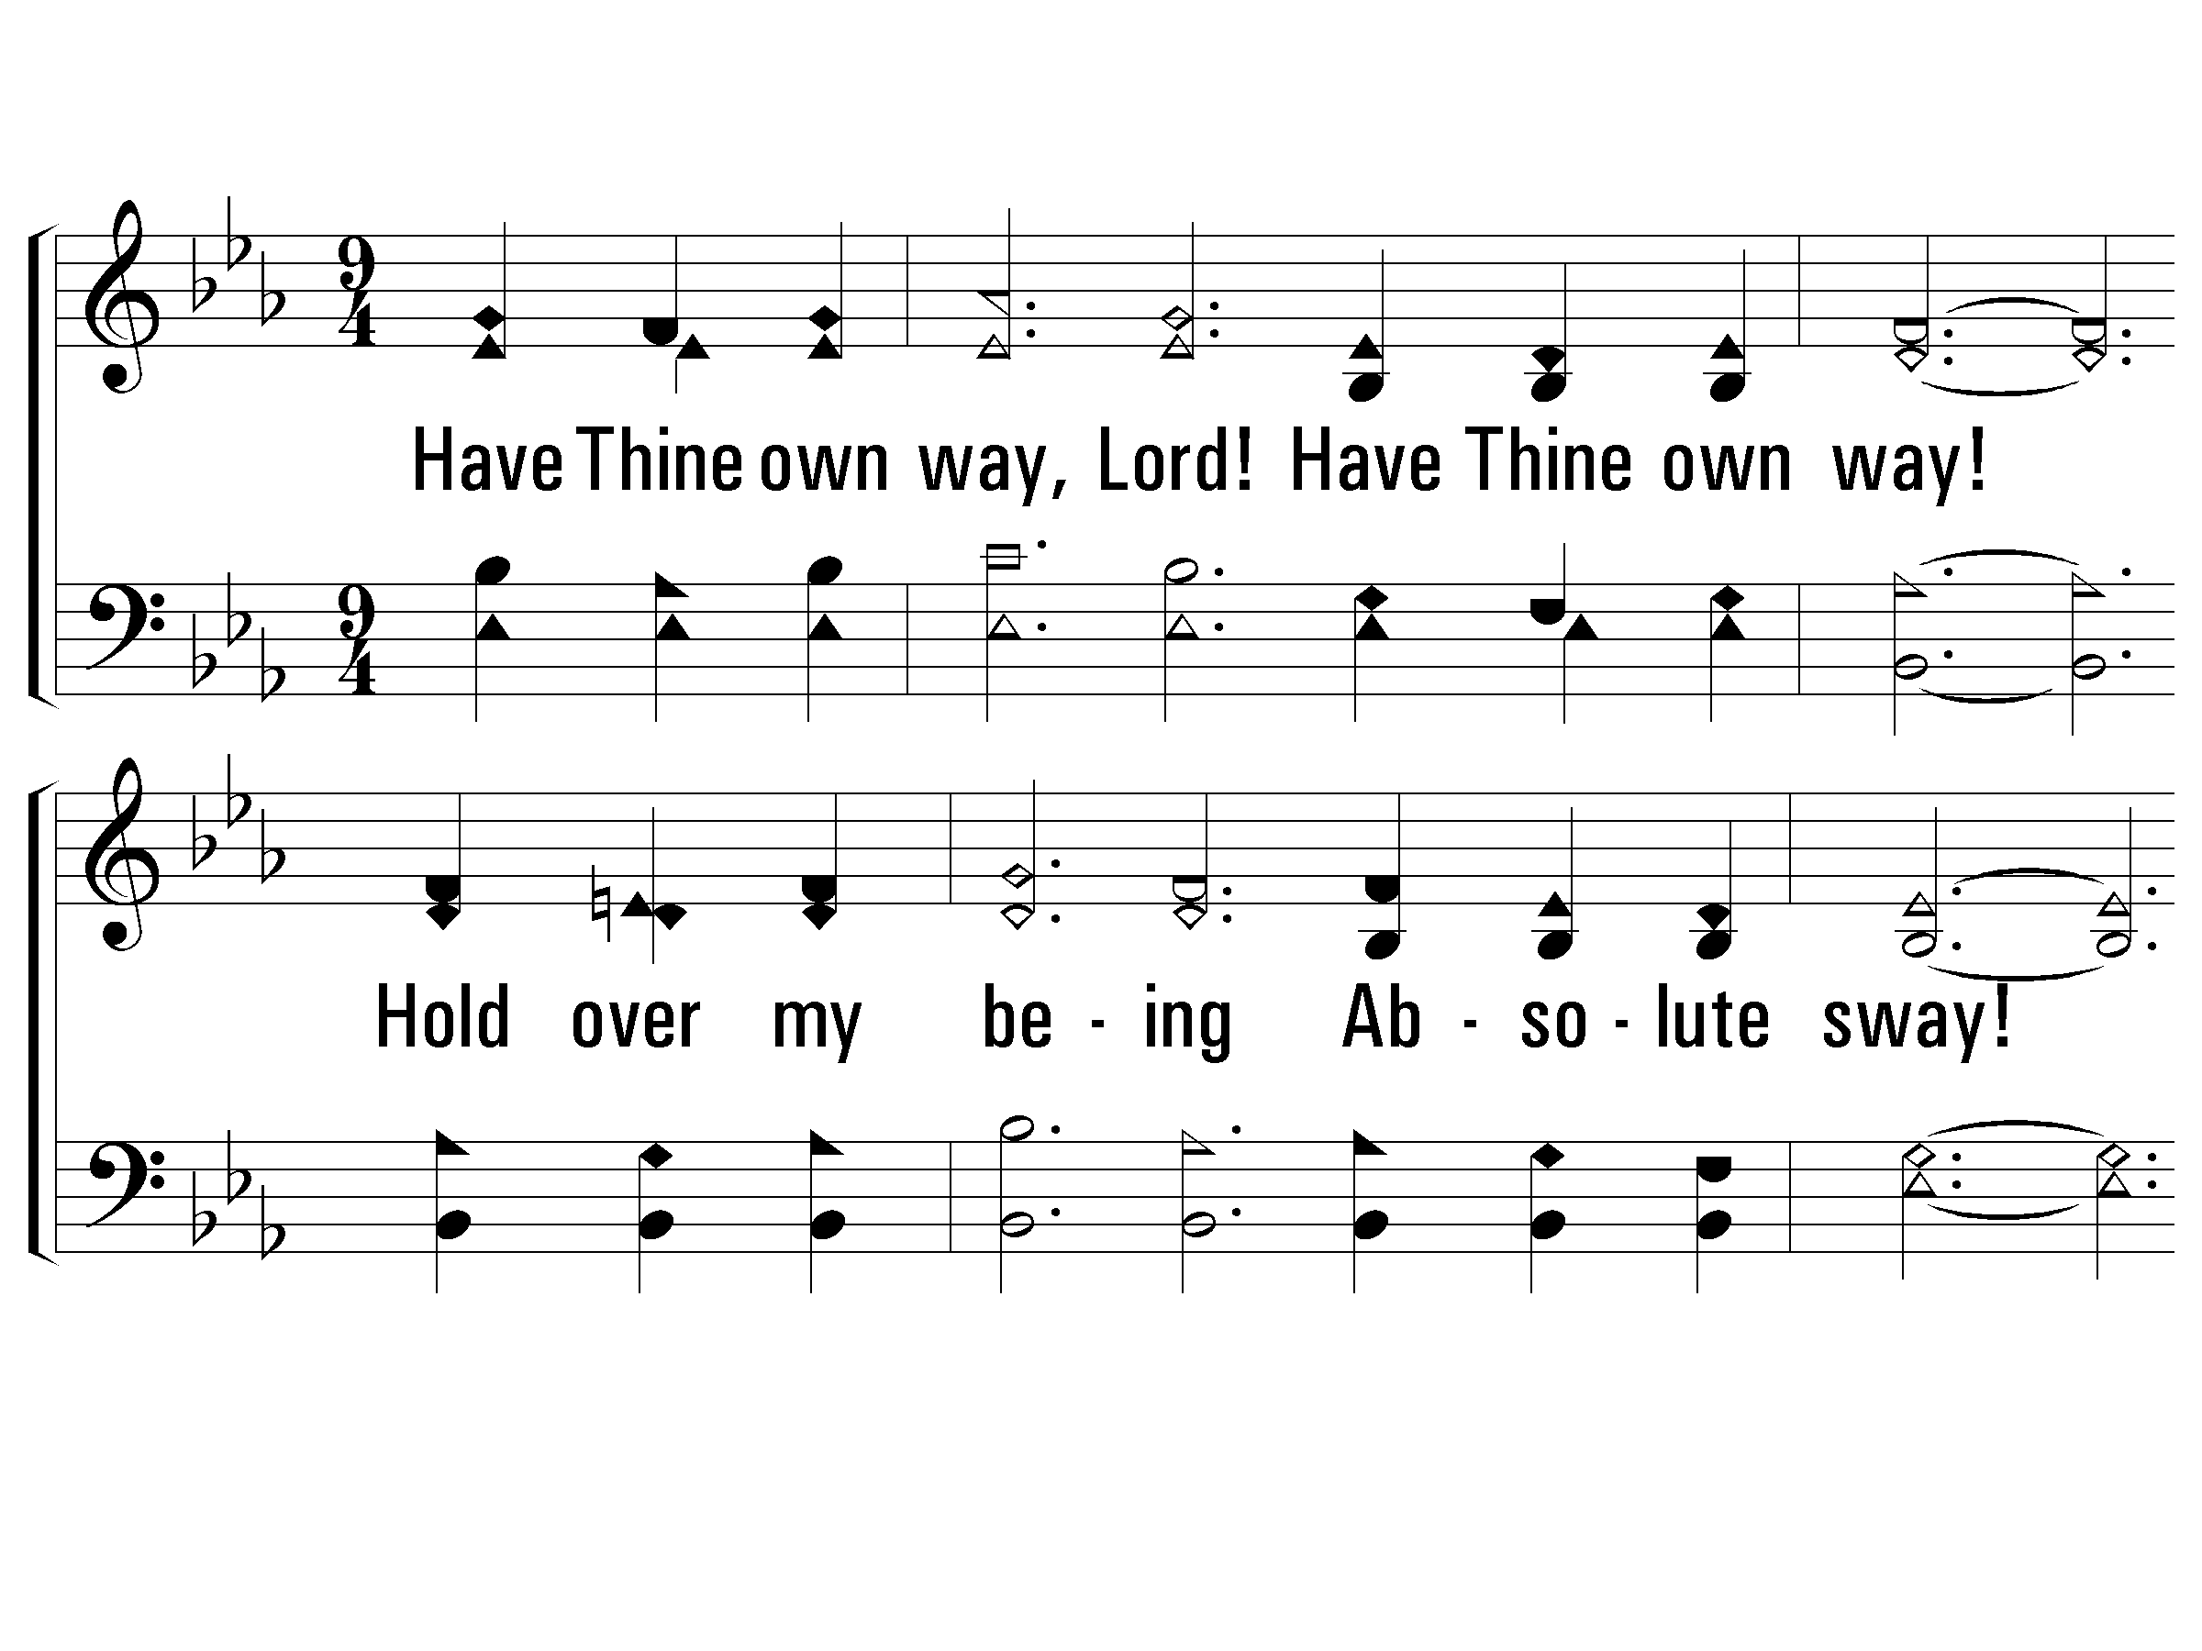
Verse 4 Lord, Use Me!
#197 – Have Thine Own Way, Lord
4.
Have Thine own way, Lord!
Have Thine own way!
Hold over my being
Absolute sway!
Fill with Thy Spirit
Till all shall see
Christ only, al-ways,
Living in me!

Slide 13
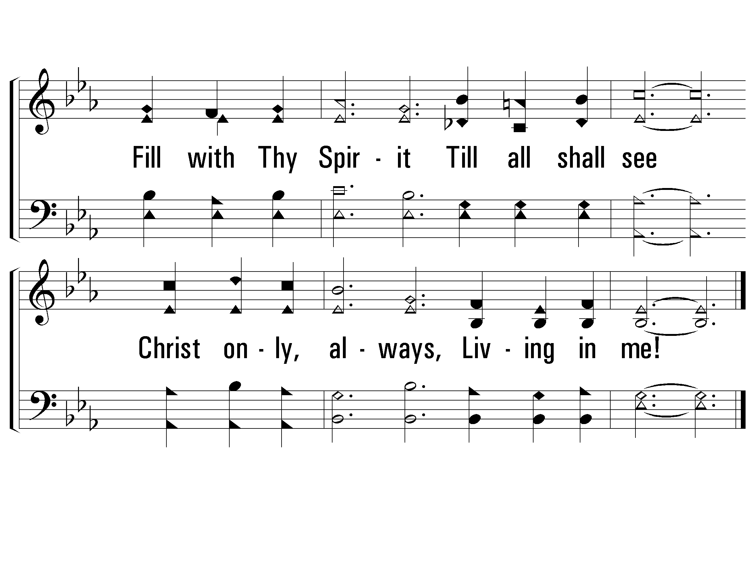
Verse 4 Lord, Use Me!
#197 – Have Thine Own Way, Lord

Slide 14
Have You Submitted to the Lord’s Way?
Believe Jesus is God’s Son – John 20:30-31
Repent of your sins and turn to God – Acts 2:38
Confess your faith in Jesus – Matthew 10:32
Be immersed into Christ – Mark 16:16
  God will forgive all of your sins – Acts 22:16
  God will add you to His church – Acts 2:47
  God will enroll you in heaven – Hebrews 12:23
Yield yourself in service to the Lord – Rom. 6:13-18

