Slide 1
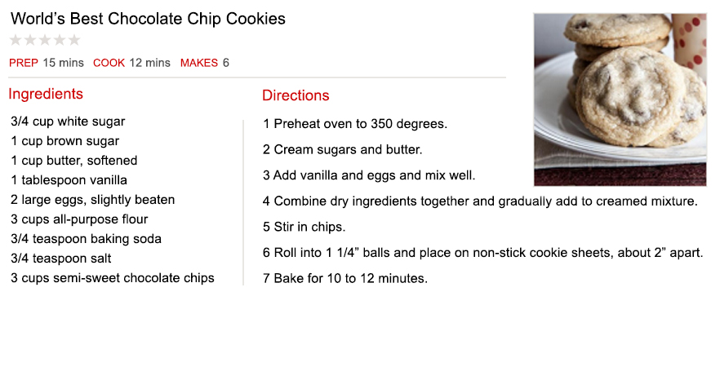
GATHER ALL RELEVANT INFORMATION
All Relevant Ingredients: NO More, NO Less, NO Different, NO Substitutes.
All Relevant Instructions: Steps to take. Actions to engage. Order to proceed.

Slide 2
HANDLE THE GATHERED INFORMATION CORRECTLY
Draw Conclusions Only Based Upon Complete Information
Let All the Information (As a Whole) Explain Itself
Follow the Directions, As Written
Proceed in Proper Order

Slide 3
HANDLE THE GATHERED INFORMATION CORRECTLY
Do Not Change Anything (+, −, Substitute) or Interject Personal Opinions
Keep in Context
Determine the One Intended Meaning and the Outcome Expected

Slide 5
The ORGANIZATION of the Lord’s Church
GATHER ALL RELEVANT EVIDENCE: INFORMATION AND INSTRUCTIONS
Jesus Christ is the ONLY head of the church (Eph. 5:23; Matt. 28:18)
Organization instructions only given to local congregations (Ac. 14:23; Tit. 1:5)
Local congregation to be overseen by elders (1 Pet. 5:1-4; Acts 14:23)
Elders are the bishops and pastors of the church (Acts 20:28; 1 Pet. 5:1-2)
Eldership only has authority “among” own congregation (Acts 20:28; 1 Pet. 5:1-2)
Eldership is to be a plurality of men (Acts 14:23; 1 Pet. 5:1)
Elders are to be men (1 Tim. 3:1-7)
Elders are to be Scripturally married (1 Tim. 3:2)
Elders are to have faithful children (Tit. 1:6)
Elders are to fulfill all divine qualifications (1 Tim. 3:1-7; Tit. 1:5-9)

Slide 6
The ORGANIZATION of the Lord’s Church
GATHER ALL RELEVANT EVIDENCE: INFORMATION AND INSTRUCTIONS
Local congregation to be served by deacons (1 Tim. 3:10; Phil. 1:1)
Deacons are special servants in the church with specified duties (1 Tim. 3:13)
Deacons only hold position “among” own congregation (Acts 6:3)
Deacons are to be men (1 Tim. 3:12)
Deacons are to be Scripturally married (1 Tim. 3:12)
Deacons are to be the leaders of their home and children (1 Tim. 3:12)
Deacons are to fulfill all divine qualifications (1 Tim. 3:8-13)
Local congregation needs an evangelist to preach the gospel (2 Tim. 4:5)
Local congregation to be made up of active, faithful Christians (1 Cor. 12:12-27; Heb. 13:17 + Eph. 4:16; Heb. 10:19-26; Rom. 12:1-21; 1 Cor. 15:58)

Slide 7
The ORGANIZATION of the Lord’s Church
HANDLE THE GATHERED EVIDENCE CORRECTLY (2 Tim. 2:15)
Draw conclusions only based upon complete information (cf. Mt. 22:29-32)
Let all the evidence (as a whole) explain itself (Psa. 119:160)
Follow the directions, as written (Jas. 1:22-25)
Proceed in proper order (Col. 3:17)
Do not change anything (adding, subtracting or substituting) or interject personal opinions (Rev. 22:18-19; Gal. 1:8-9)
Keep in context (cf. Luke 20:37)
Determine the one intended meaning of the text and the outcome expected (2 John 9-11; Rev. 22:18-19)

Slide 8
The WORSHIP of the Lord’s Church
GATHER ALL RELEVANT EVIDENCE: INFORMATION AND INSTRUCTIONS
Worship is to be directed toward God (the true audience) (Matt. 4:10)
Worship is to come from the heart (John 4:24; 1 Cor. 14:15)
Worship is to be done in truth (John 4:24; Col. 3:16-17)
The church is to worship on first day of the week (Acts 20:7; 1 Cor. 16:1-2)
Male members are to lead the worship (1 Tim. 2:8-12; 1 Cor. 14:34-35)

Slide 9
The WORSHIP of the Lord’s Church
GATHER ALL RELEVANT EVIDENCE: INFORMATION AND INSTRUCTIONS
The church is to worship through preaching of God’s Word (Acts 20:7)
The church is to worship through giving of means (1 Cor. 16:1-2)
The church is to worship through praying (Acts 2:42)
The church is to worship through the Lord’s Supper every Sunday (Acts 20:7; 1 Cor. 11:17-34; Mark 14:22-25; Matt. 26:27)
The church is to worship through congregational singing (Eph. 5:19; Col. 3:16)

Slide 10
The WORSHIP of the Lord’s Church
HANDLE THE GATHERED EVIDENCE CORRECTLY (2 Tim. 2:15)
Draw conclusions only based upon complete information (cf. Mt. 22:29-32)
Let all the evidence (as a whole) explain itself (Psa. 119:160)
Follow the directions, as written (Jas. 1:22-25)
Proceed in proper order (Col. 3:17)
Do not change anything (adding, subtracting or substituting) or interject personal opinions (Rev. 22:18-19; Gal. 1:8-9)
Keep in context (cf. Luke 20:37)
Determine the one intended meaning of the text and the outcome expected (2 John 9-11; Rev. 22:18-19)

Slide 11
God’s Plan for SALVATION from Sin
GATHER ALL RELEVANT EVIDENCE: INFORMATION AND INSTRUCTIONS
Sin is the result of personal choice, not inherited (Ezek. 18:20; 1 John 3:4)
Sin results in separation from God (Isa. 59:1-2; Rom. 6:23)
Salvation from sin is needed by all (Rom. 1:18; 2 Thess. 1:8-9)
Salvation from sin is available to all (1 Tim. 2:4, 6; Tit. 2:11; Rom. 1:16)
Salvation from sin requires a personal response (John 12:48; Rev. 3:20)
Salvation from sin requires obedience to the will of God (Heb. 5:9; Matt. 7:21)
Salvation from sin has same requirements for all people (Ac. 10:34-35; 17:30)

Slide 12
God’s Plan for SALVATION from Sin
GATHER ALL RELEVANT EVIDENCE: INFORMATION AND INSTRUCTIONS
Salvation from sin requires faith in Jesus Christ (John 3:16; 8:24; 20:30-31)
Salvation from sin requires repentance from sin (Acts 2:38; 3:19; 17:30)
Salvation from sin requires confession of faith (Matt. 10:32-33; Rom. 10:9-10)
Salvation from sin requires immersion into Christ (Mark 16:16; Acts 2:38; 22:16; Gal. 3:27; 1 Pet. 3:21)
Salvation from sin requires faithful living unto death (Rev. 2:10; 1 John 1:7)

Slide 13
God’s Plan for SALVATION from Sin
HANDLE THE GATHERED EVIDENCE CORRECTLY (2 Tim. 2:15)
Draw conclusions only based upon complete information (cf. Mt. 22:29-32)
Let all the evidence (as a whole) explain itself (Psa. 119:160)
Follow the directions, as written (Jas. 1:22-25)
Proceed in proper order (Col. 3:17)
Do not change anything (adding, subtracting or substituting) or interject personal opinions (Rev. 22:18-19; Gal. 1:8-9)
Keep in context (cf. Luke 20:37)
Determine the one intended meaning of the text and the outcome expected (2 John 9-11; Rev. 22:18-19)

