Slide 1
The Book of Ruth
Palm Beach Lakes
May-July, 2023
Dan Jenkins

Slide 2
Genealogy of Ruth
18 Now these are the generations of Pharez: Pharez begat Hezron,
19 And Hezron begat Ram, and Ram begat Amminadab,
20 And Amminadab begat Nahshon, and Nahshon begat Salmon,
21 And Salmon begat Boaz, and Boaz begat Obed,
22 And Obed begat Jesse, and Jesse begat David.
Ruth 4:18-22

Slide 3
List of Names and Places in Ruth
Bethlehem-Judah
Moab
Elimelech & Naomi
Mahlon & Chilion
Orpah & Ruth
No longer Naomi, but Mara
Boaz
Obed, Jesse, David

Slide 4
The Beginning of the Story of Ruth
1 Now it came to pass in the days when the judges ruled . . . Ruth 1:1

Slide 5
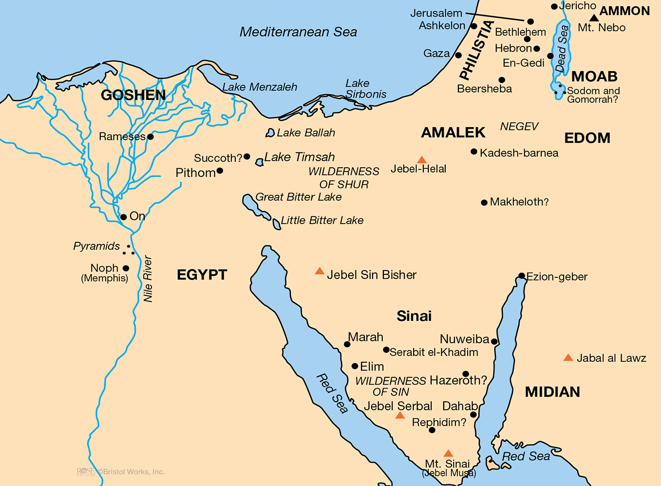

Slide 6
Background Study of the Book
From Moses, the Exodus to the Promised Land

Slide 8
Events at Mt. Sinai
One Year at Mt. Sinai
Mt. Sinai

Slide 9
Events at Mt. Sinai
Giving of Law
Golden Calf
Building Tabernacle
First Numbering
One Year at Mt. Sinai
Mt. Sinai

Slide 10
Events at K-Barnea
Twelve spies sent out
Returned 40 days later
Land of milk & honey
Evil report by ten
Lack of faith
Mt. Sinai

Slide 11
Events at K-Barnea
Twelve spies sent out
Returned 40 days later
Land of milk & honey
Evil report by ten
Lack of faith
God’s response
Mt. Sinai

Slide 12
Return to K-Barnea
Forty years later
Wandering & deaths
Mt. Sinai

Slide 13
Background Study of the Book
From Moses, the Exodus to the Promised Land
Entrance to the Promised Land to Judges & Ruth

Slide 14
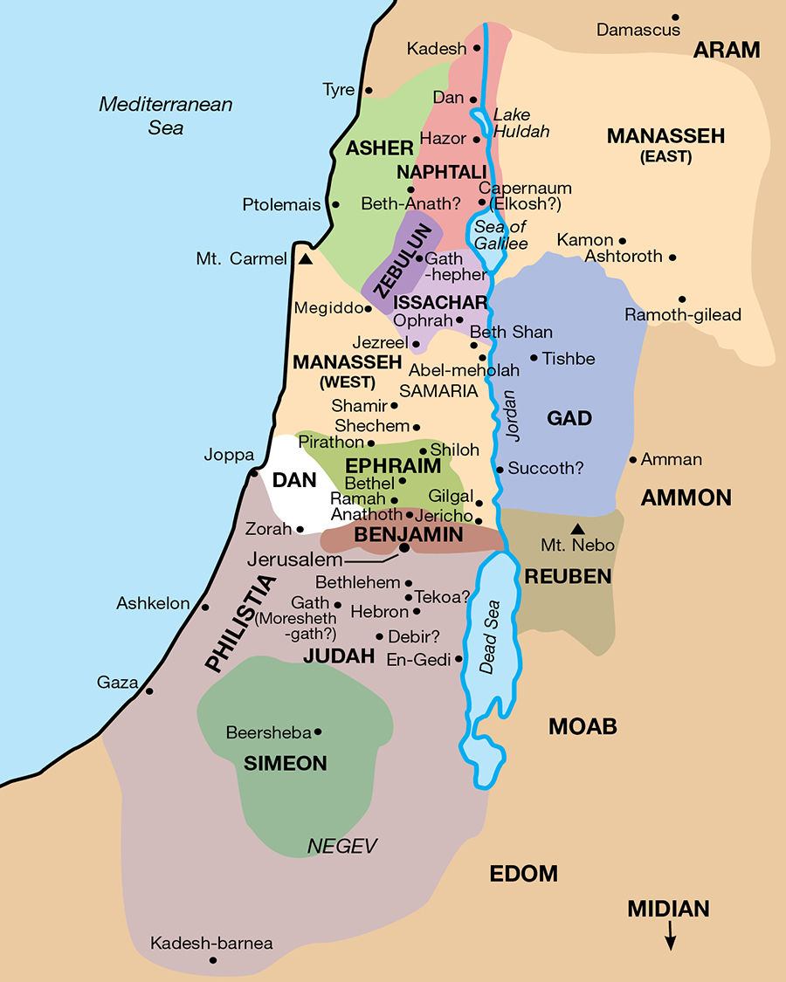
Kadesh-Barnea to Jordan
Moses captures East Bank
Request by Gad, Reuben and half of tribe of Manasseh
Deuteronomy speeches

Slide 15
Kadesh-Barnea to Jordan
Moses captures East Bank
Request by Gad, Reuben and half of tribe of Manasseh
Deuteronomy speeches
Death of Moses at Mt. Nebo
Mt. Nebo

Slide 16
The Beginning of the Story of Ruth
1 Now it came to pass in the days when the judges ruled, that there was a famine in the land. And a certain man of Bethlehem-judah went to sojourn in the country of Moab, he, and his wife, and his two sons.
2 And the name of the man was Elimelech, and the name of his wife Naomi, and the name of his two sons Mahlon and Chilion, Ephrathites of Bethlehem-judah. And they came into the country of Moab, and continued there.
3 And Elimelech Naomi's husband died; and she was left, and her two sons.
4 And they took them wives of the women of Moab; the name of the one was Orpah, and the name of the other Ruth: and they dwelled there about ten years.
5 And Mahlon and Chilion died also both of them; and the woman was left of her two sons and her husband. Ruth 1:1-5

Slide 17
Naomi
Married Elimelech
Two Sons born
Moved to Moab
Bethlehem
MOAB

Slide 19
Background Study of the Book
From Moses, the Exodus to the Promised Land
Entrance to the Promised Land to Judges & Ruth
List of Names and Places in Ruth
Date of the Book
Causes of Famine
God and Widows

