Slide 1


Slide 2
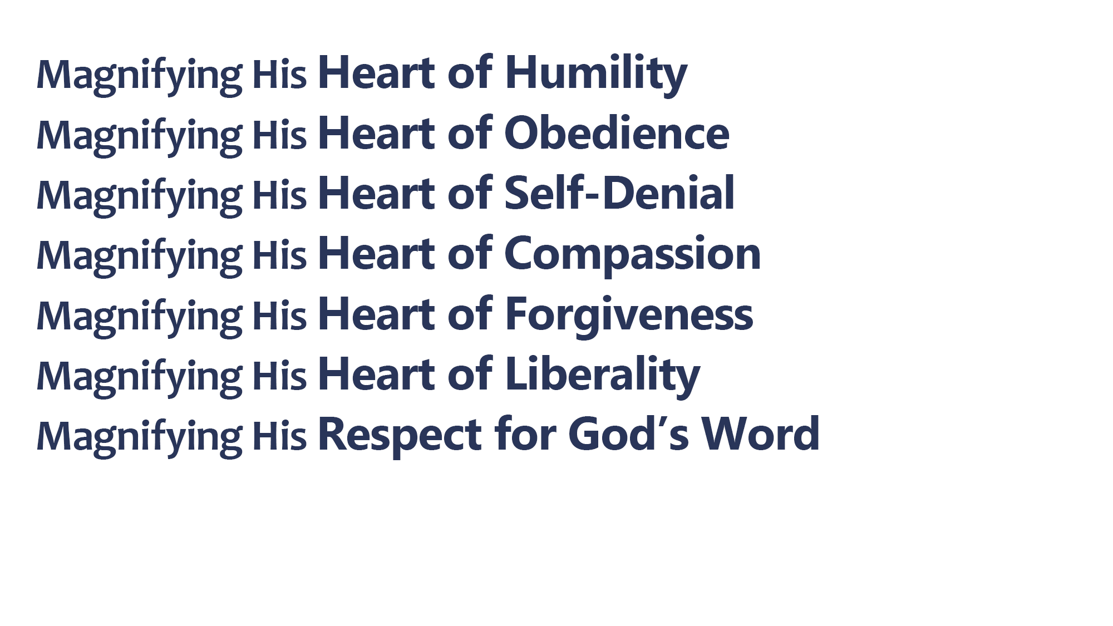
Christ was humble (Phil. 2:3-8; John 13:1-13)
Paul magnified the humility of Christ (1 Cor. 3:7; 15:9; 2 Cor. 12:11; Eph. 3:8)
I must magnify the humility of Christ (Matt. 5:3; 18:4; 23:12; John 13:14-17; Jas. 4:10)

Slide 3
Christ was obedient (Phil. 2:8; Heb. 5:8; 10:9; Luke 2:49, 51; John 4:34;
6:38-40)
Paul magnified the obedience of Christ (Acts 26:19; 27:23)
I must magnify the obedience of Christ (Heb. 5:9; 1 Pet. 1:14, 22)

Slide 4
Christ denied Himself (Matt. 8:20; 26:39, 42, 44)
Paul magnified the self-denial of Christ (Gal. 2:20; Phil. 2:17; 3:4-9)
I must magnify the self-denial of Christ (Luke 9:23-25; 14:25-33)

Slide 5
Christ was compassionate (Matt. 9:35-36; 14:14-16; 15:32; 20:34; Luke 7:13)
Paul magnified the compassion of Christ (Phil. 1:7-8; Rom. 9:1-3; 10:1; 2 Cor. 2:4)
I must magnify the compassion of Christ (Luke 10:33; Gal. 6:1-10; 1 Pet. 3:8; Col. 3:12)

Slide 6
Christ was forgiving (Matt. 9:1-8; 18:27; 26:28; Luke 23:34; Col. 1:14; 2:13)
Paul magnified the forgiveness of Christ (Acts 14:19-20; 2 Cor. 2:10; 2 Tim. 4:11)
I must magnify the forgiveness of Christ (Matt. 6:14-15; 18:33-35; Eph. 4:32)

Slide 7
Christ gave liberally (2 Cor. 9:8; John 15:13; 1 John 3:16)
Paul magnified the liberality of Christ (2 Cor. 12:15; 1 Thess. 2:8; 2 Cor. 1:6)
I must magnify the liberality of Christ (2 Cor. 8:5; 9:6-7; Acts 20:35)

Slide 8
Christ respected God’s Word (John 12:48-50; 14:10; 16:13; Matt. 4:4; 7:21; 15:1-9)
Paul magnified Christ’s respect for God’s Word (1 Cor. 2:1-16; 14:37; 2 Tim. 3:14-17)
I must magnify Christ’s respect for God’s Word (Matt. 7:21; Gal. 1:9; Rev. 22:18-19)

Slide 9
Believe Jesus is the Son of God – Mark 16:16
Repent of your sins and turn toward God – 2 Peter 3:9
Confess your faith in Jesus Christ – Matthew 10:32
Be baptized into Christ – 1 Peter 3:21
  God will forgive all of your sins – Acts 2:38
  God will add you to His church – Acts 2:47
  God will register you in heaven – Hebrews 12:23
Faithfully magnify Christ in your body – Philippians 1:19-21

