Slide 1
One Lost Soul
Dan McLeod | Bible Class: Sunday, August 25, 2024

Slide 2
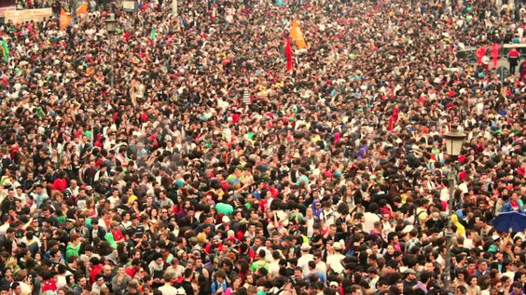

Slide 3
Matthew 28:18–20 ¹⁸ And Jesus came and spoke to them, saying, “All authority has been given to Me in heaven and on earth. ¹⁹ Go therefore and make disciples of all the nations, baptizing them in the name of the Father and of the Son and of the Holy Spirit, ²⁰ teaching them to observe all things that I have commanded you; and lo, I am with you always, even to the end of the age.” Amen.

Slide 4
One Lost Soul
Dan Winkler’s lunchtime lessons this past March
Mt 28:18-20
All one must do is open our eyes (seeing they do not see, hearing they do not hear) –Friends, Family members, coworkers, people we meet, strangers, people who come to our door, neighbors
Who is responsible to teach these lost souls?
What does it take to reach them?
How can we decide if we should reach out?
What do we say?
What if they ridicule us or reject us or throw stones at us?

Slide 5
Seeking the Lost
Luke 11:5–10 (NKJV)
⁵ And He said to them, “Which of you shall have a friend, and go to him at midnight and say to him, ‘Friend, lend me three loaves; ⁶ for a friend of mine has come to me on his journey, and I have nothing to set before him’; ⁷ and he will answer from within and say, ‘Do not trouble me; the door is now shut, and my children are with me in bed; I cannot rise and give to you’? ⁸ I say to you, though he will not rise and give to him because he is his friend, yet because of his persistence he will rise and give him as many as he needs.
⁹ “So I say to you, ask, and it will be given to you; seek, and you will find; knock, and it will be opened to you. ¹⁰ For everyone who asks receives, and he who seeks finds, and to him who knocks it will be opened.

Slide 6
Cost of Discipleship
Luke 14:25–33 (NKJV)
²⁵ Now great multitudes went with Him. And He turned and said to them, ²⁶ “If anyone comes to Me and does not hate his father and mother, wife and children, brothers and sisters, yes, and his own life also, he cannot be My disciple. ²⁷ And whoever does not bear his cross and come after Me cannot be My disciple. ²⁸ For which of you, intending to build a tower, does not sit down first and count the cost, whether he has enough to finish it—²⁹ lest, after he has laid the foundation, and is not able to finish, all who see it begin to mock him, ³⁰ saying, ‘This man began to build and was not able to finish.’ ³¹ Or what king, going to make war against another king, does not sit down first and consider whether he is able with ten thousand to meet him who comes against him with twenty thousand? ³² Or else, while the other is still a great way off, he sends a delegation and asks conditions of peace. ³³ So likewise, whoever of you does not forsake all that he has cannot be My disciple.

Slide 7
Motive
Luke 15:1–8 ¹ Then all the tax collectors and the sinners drew near to Him to hear Him. ² And the Pharisees and scribes complained, saying, “This Man receives sinners and eats with them.” ³ So He spoke this parable to them, saying:
⁴ “What man of you, having a hundred sheep, if he loses one of them, does not leave the ninety-nine in the wilderness, and go after the one which is lost until he finds it? ⁵ And when he has found it, he lays it on his shoulders, rejoicing. ⁶ And when he comes home, he calls together his friends and neighbors, saying to them, ‘Rejoice with me, for I have found my sheep which was lost!’ ⁷ I say to you that likewise there will be more joy in heaven over one sinner who repents than over ninety-nine just persons who need no repentance.
Parable of the Lost Coin
⁸ “Or what woman, having ten silver coins, if she loses one coin, does not light a lamp, sweep the house, and search carefully until she finds it?

Slide 8
Reapers-Parable of the Tares
Matthew 13:24–31 (NKJV)
²⁴ Another parable He put forth to them, saying: “The kingdom of heaven is like a man who sowed good seed in his field; ²⁵ but while men slept, his enemy came and sowed tares among the wheat and went his way. ²⁶ But when the grain had sprouted and produced a crop, then the tares also appeared. ²⁷ So the servants of the owner came and said to him, ‘Sir, did you not sow good seed in your field? How then does it have tares?’ ²⁸ He said to them, ‘An enemy has done this.’ The servants said to him, ‘Do you want us then to go and gather them up?’ ²⁹ But he said, ‘No, lest while you gather up the tares you also uproot the wheat with them. ³⁰ Let both grow together until the harvest, and at the time of harvest I will say to the reapers, “First gather together the tares and bind them in bundles to burn them, but gather the wheat into my barn.” ’ ”

Slide 9
Jesus Explains the Parable of the Tares
Matthew 13:36–44
³⁶ Then Jesus sent the multitude away and went into the house. And His disciples came to Him, saying, “Explain to us the parable of the tares of the field.”
³⁷ He answered and said to them: “He who sows the good seed is the Son of Man. ³⁸ The field is the world, the good seeds are the sons of the kingdom, but the tares are the sons of the wicked one. ³⁹ The enemy who sowed them is the devil, the harvest is the end of the age, and the reapers are the angels. ⁴⁰ Therefore as the tares are gathered and burned in the fire, so it will be at the end of this age. ⁴¹ The Son of Man will send out His angels, and they will gather out of His kingdom all things that offend, and those who practice lawlessness, ⁴² and will cast them into the furnace of fire. There will be wailing and gnashing of teeth. ⁴³ Then the righteous will shine forth as the sun in the kingdom of their Father. He who has ears to hear, let him hear!

Slide 10
May I tell you a true story?
Tuvalu – who knows where this place is?

Slide 11
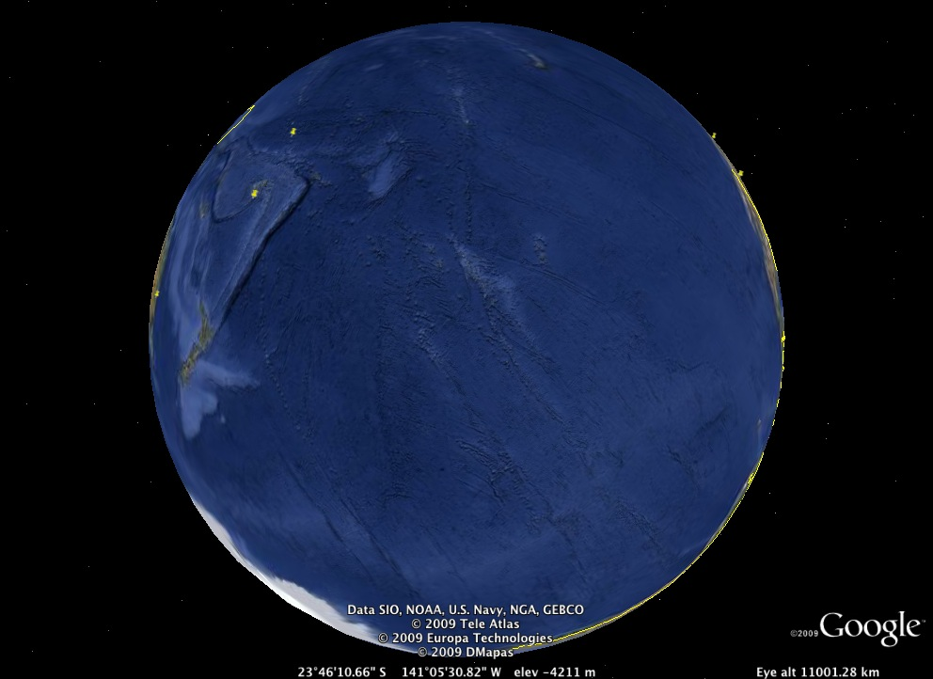
The Vast Pacific Ocean
32% of the Earths Surface
Over 60 Million Square Miles
Larger than all the Earth’s land area combined
More than 25,000 Islands
Over 12,000 miles East/West

Slide 12

Tuvalu

Slide 13
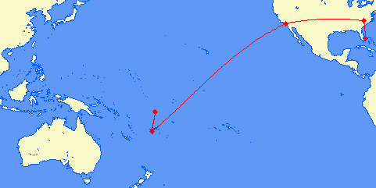
Total Flight distance 8879 mi

Slide 14
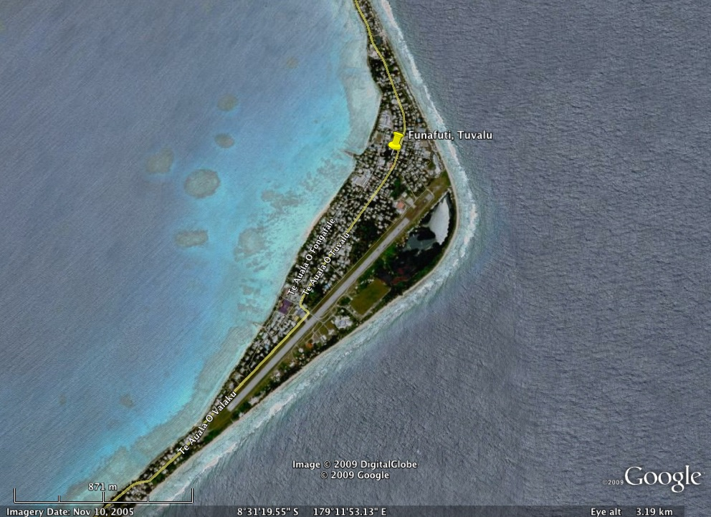
One Runway
2 flights Weekly
27 Passenger Turboprop
2 hrs from Fiji
12 Islands
9000 population
6000 on Funafuti

Slide 15

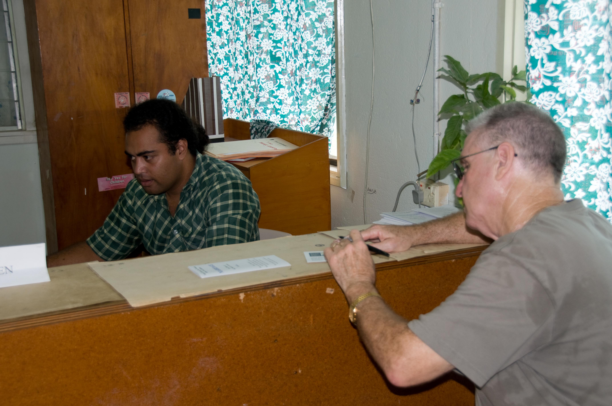
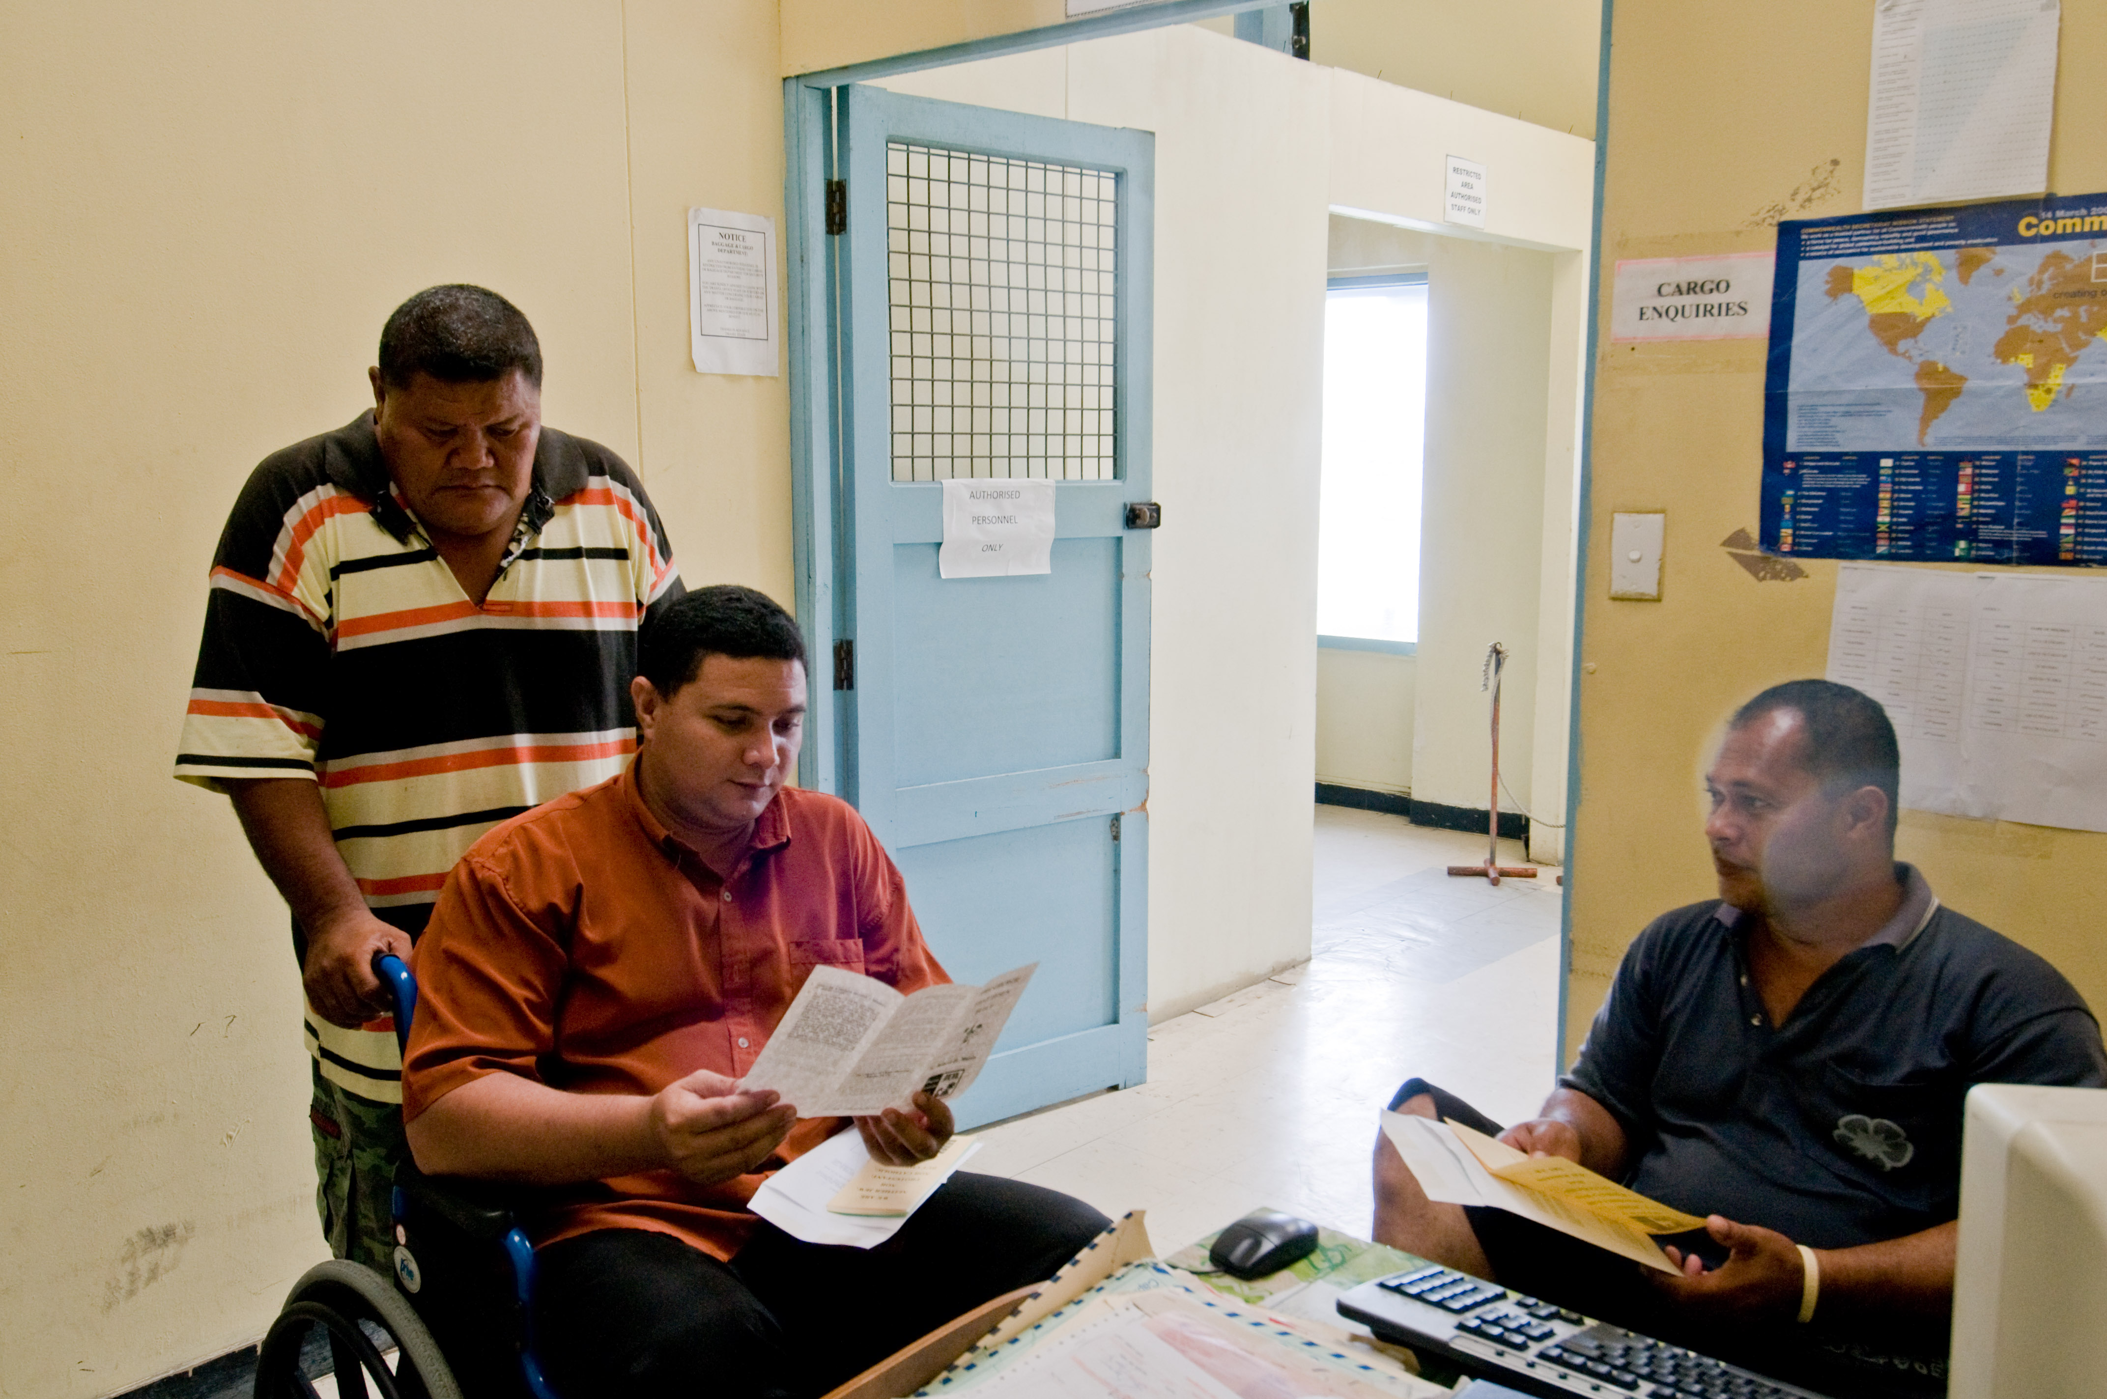
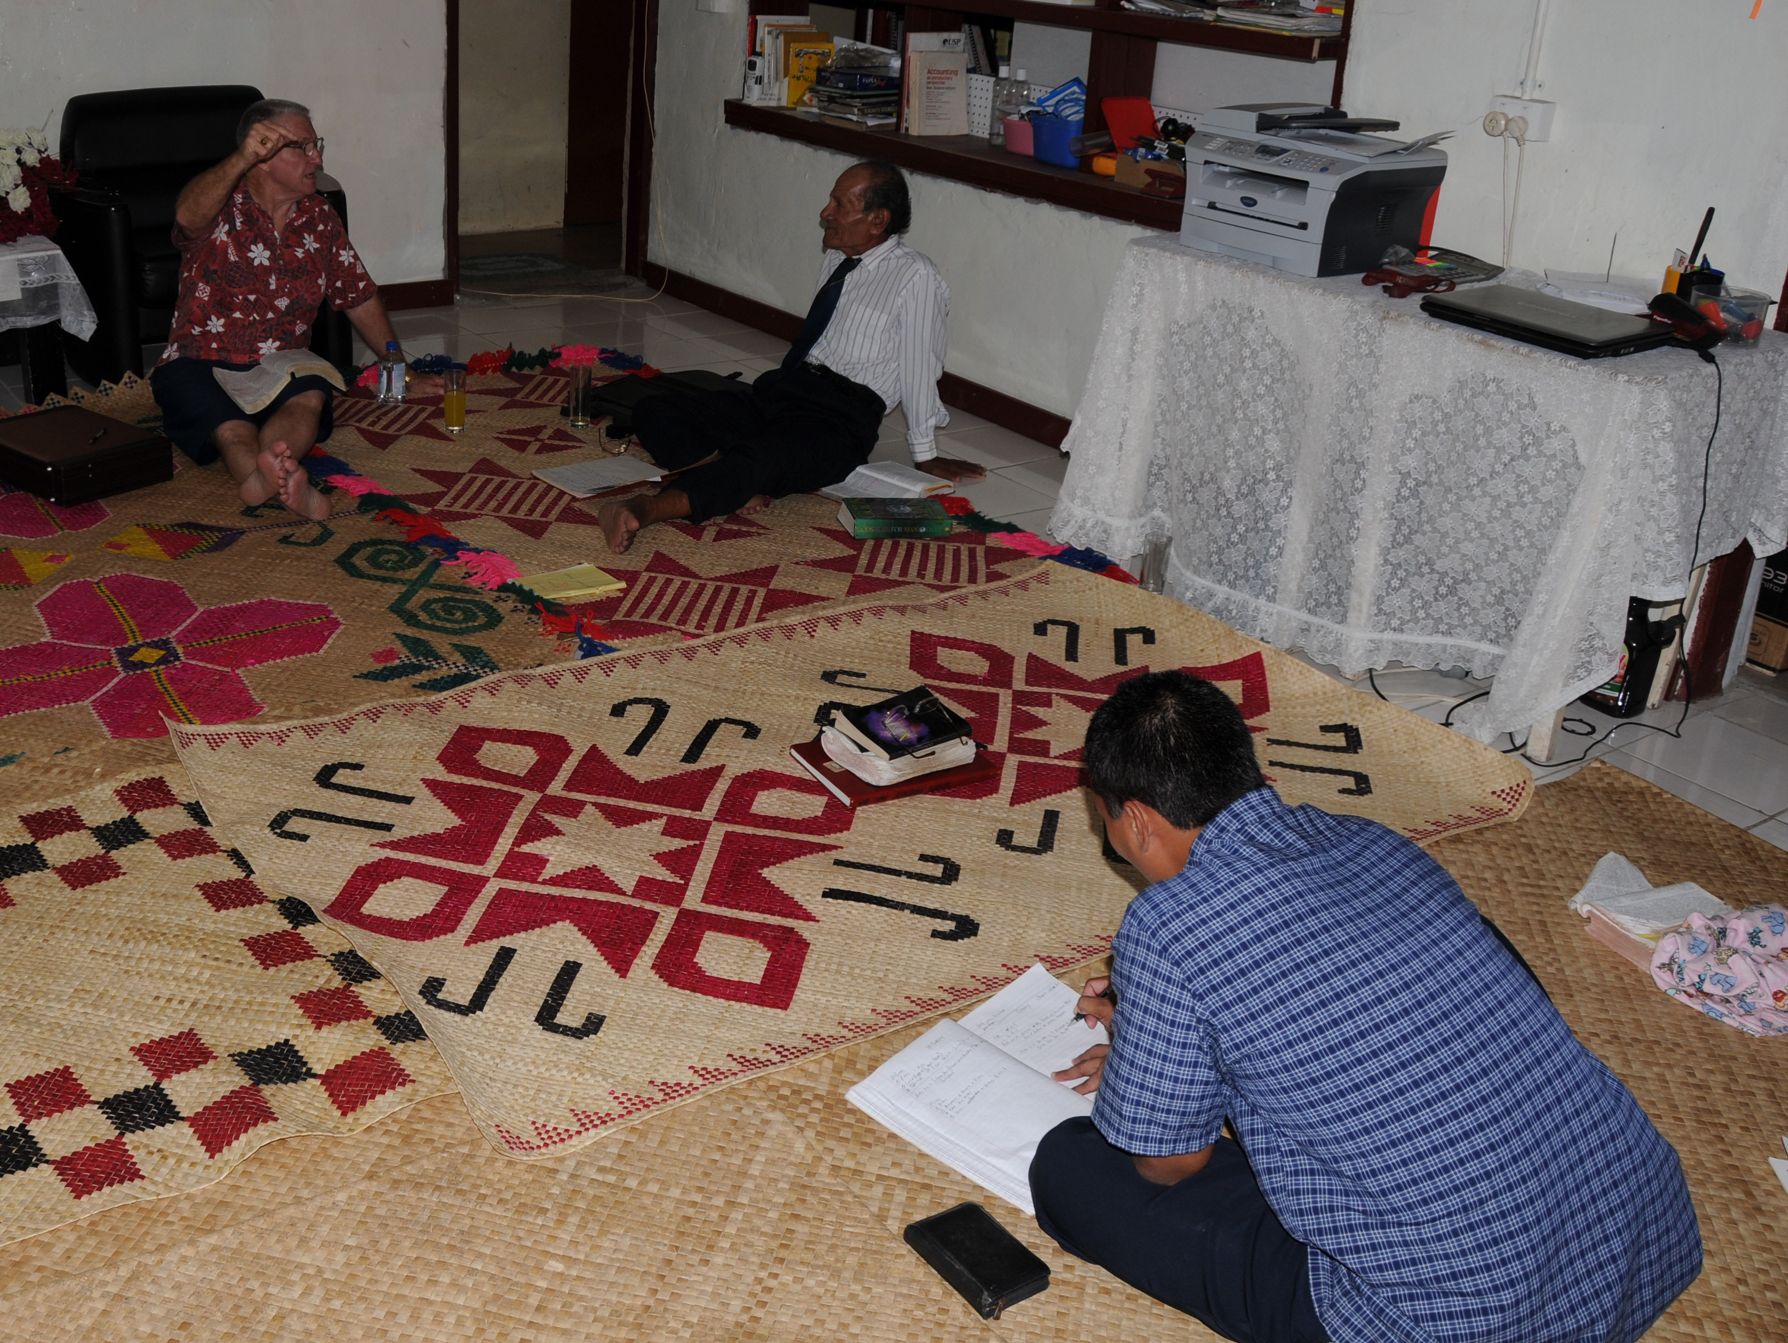
Radio
Teaching
Tracts
Bible Study

Slide 16
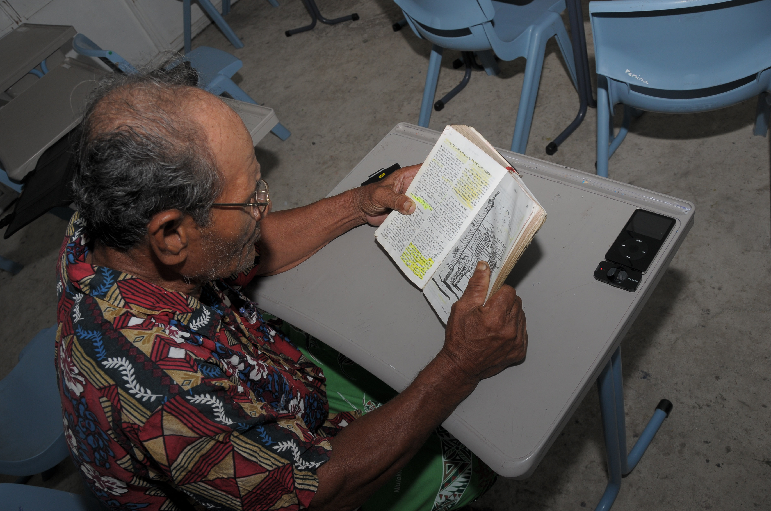
Aliesi

Slide 17

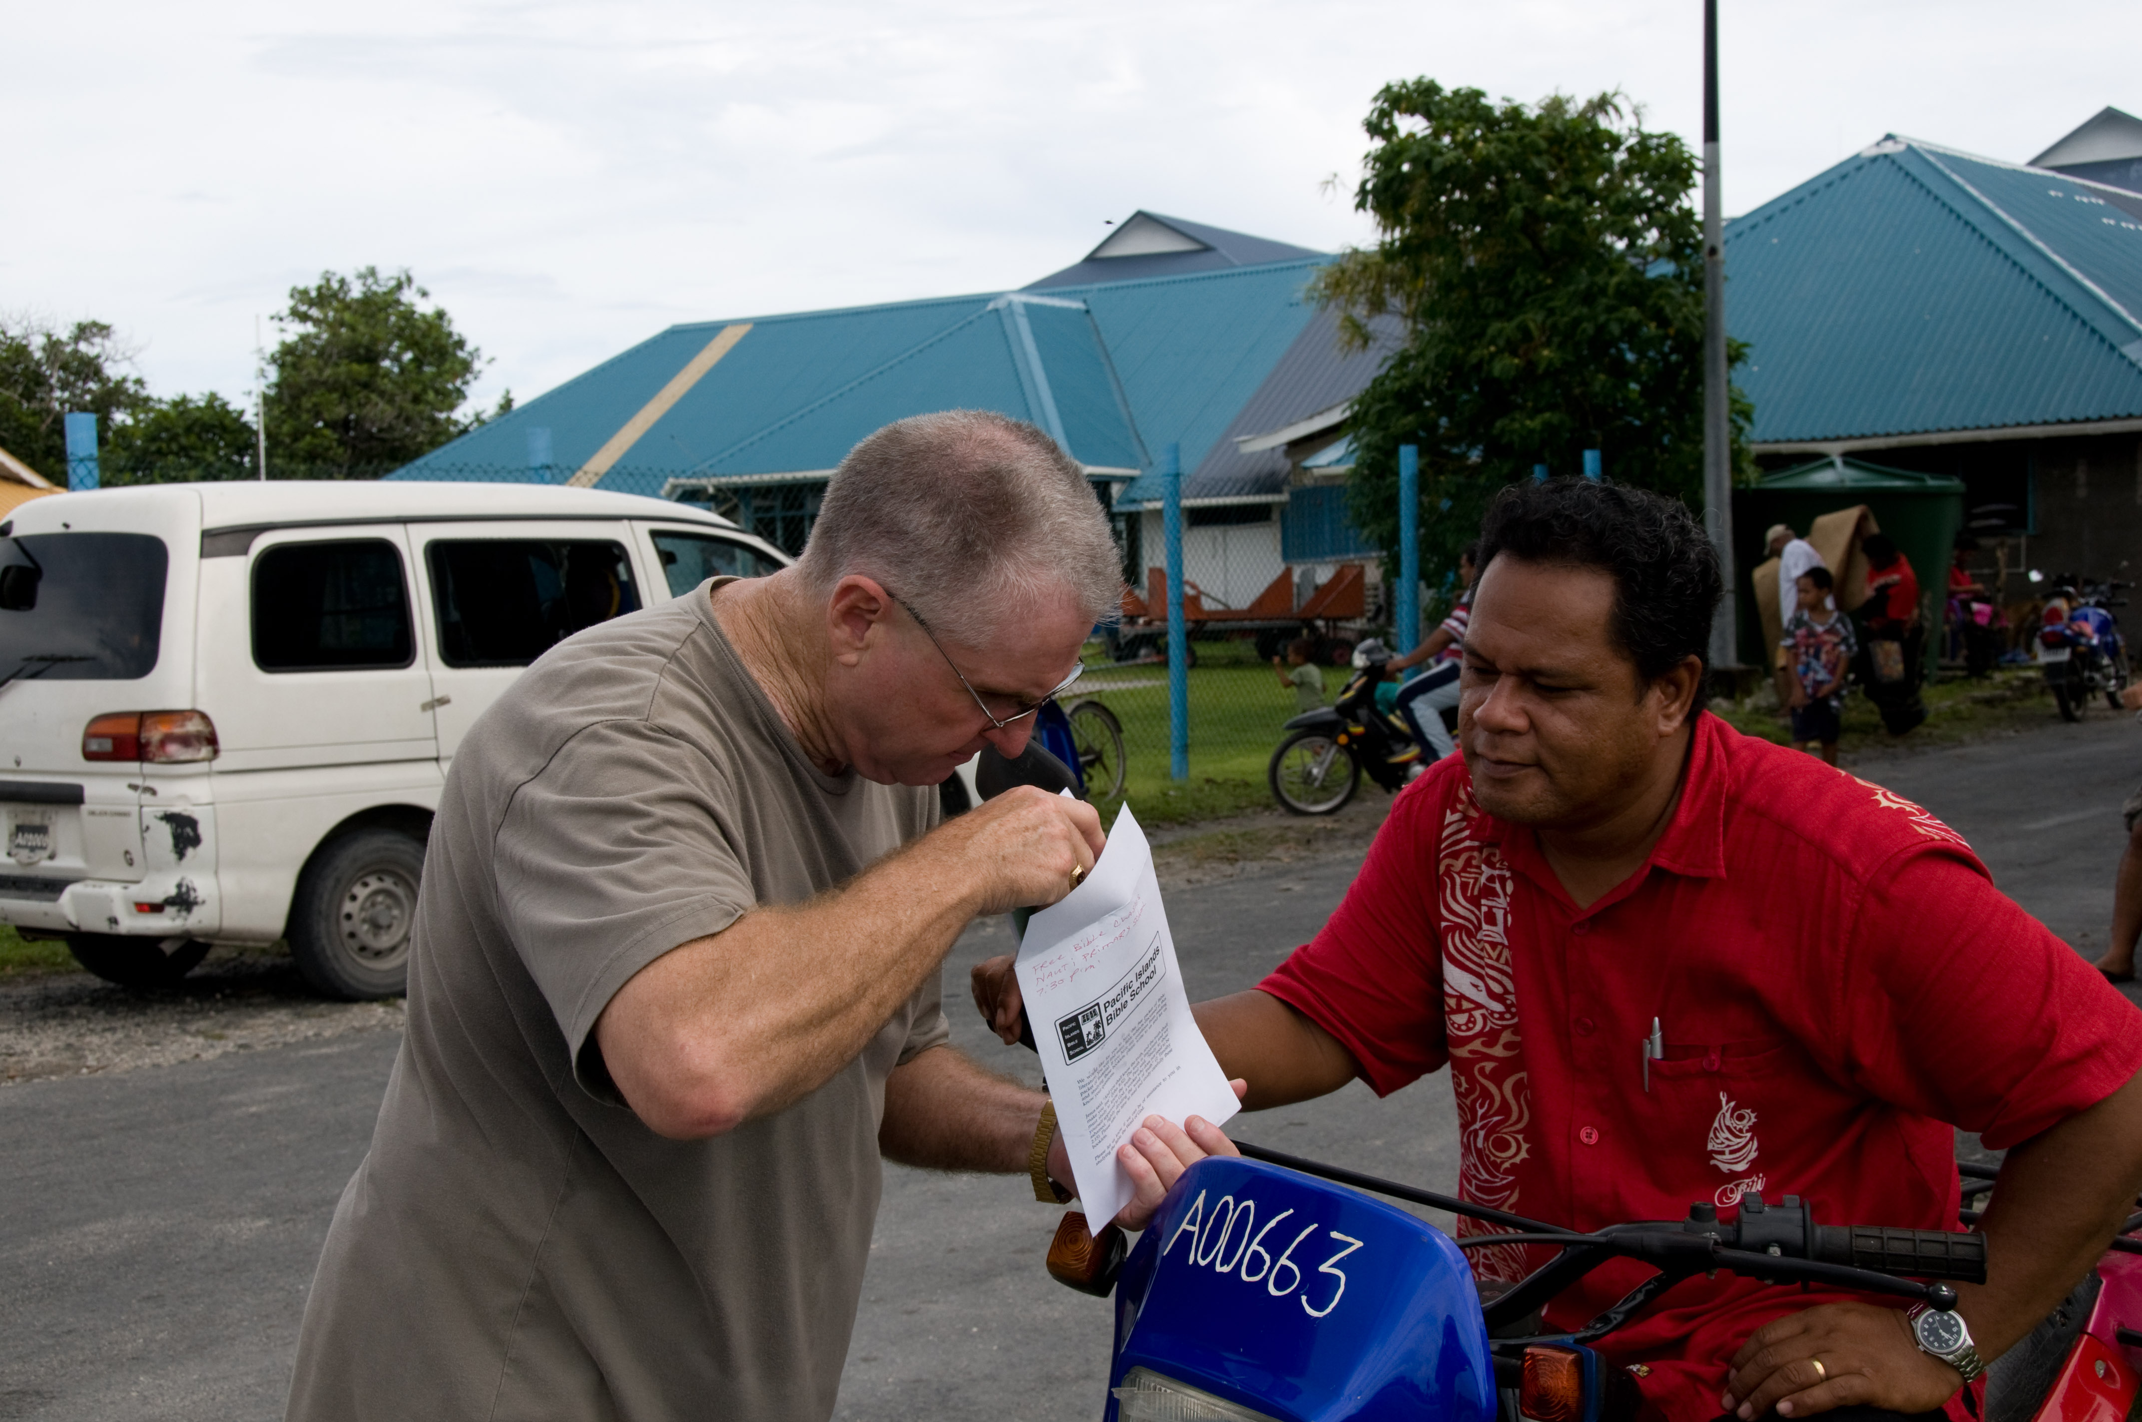

Slide 18

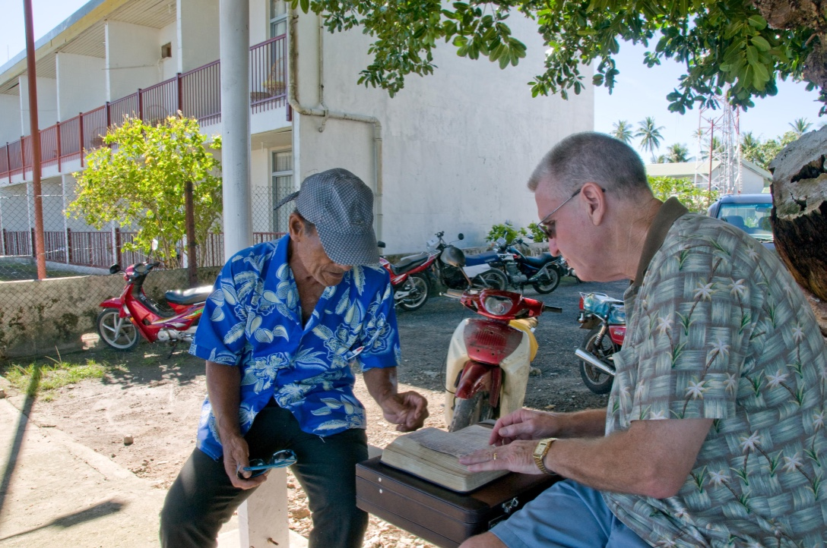

Slide 19
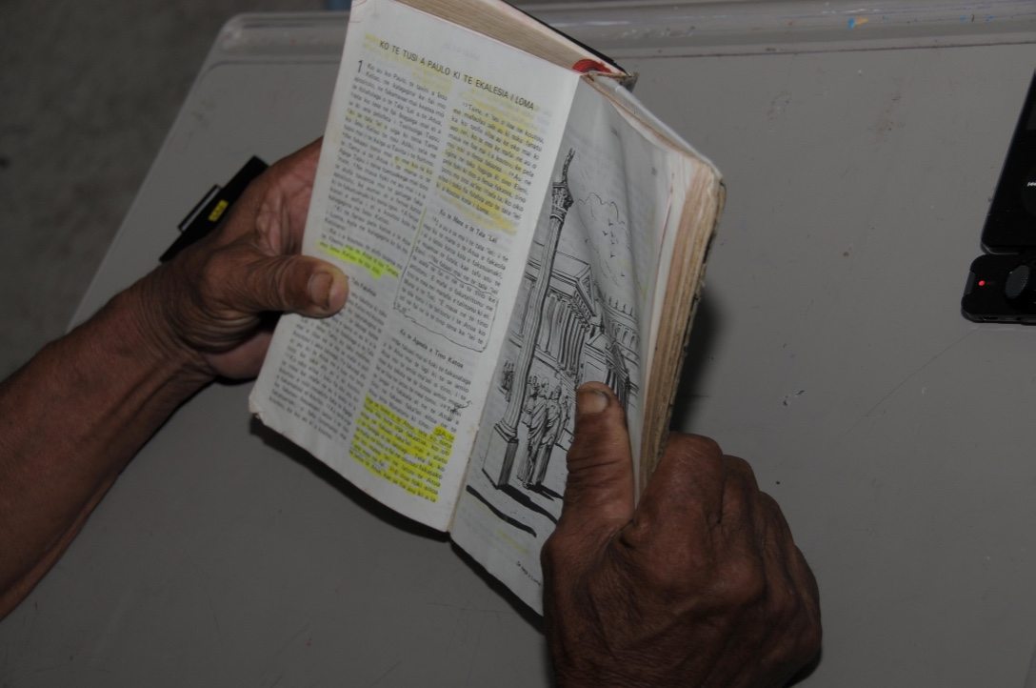

Slide 20
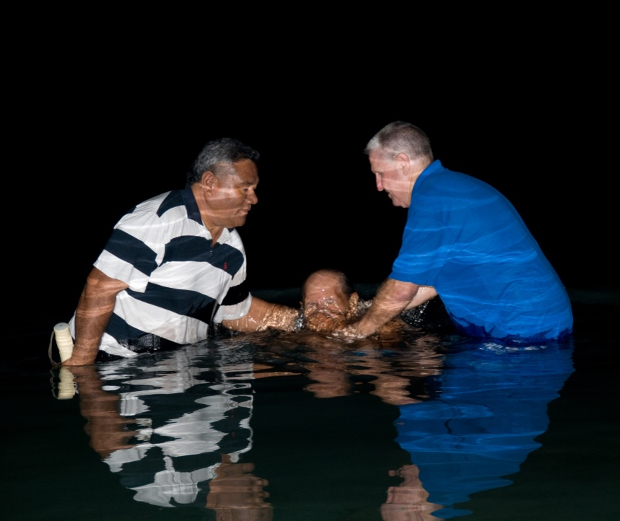
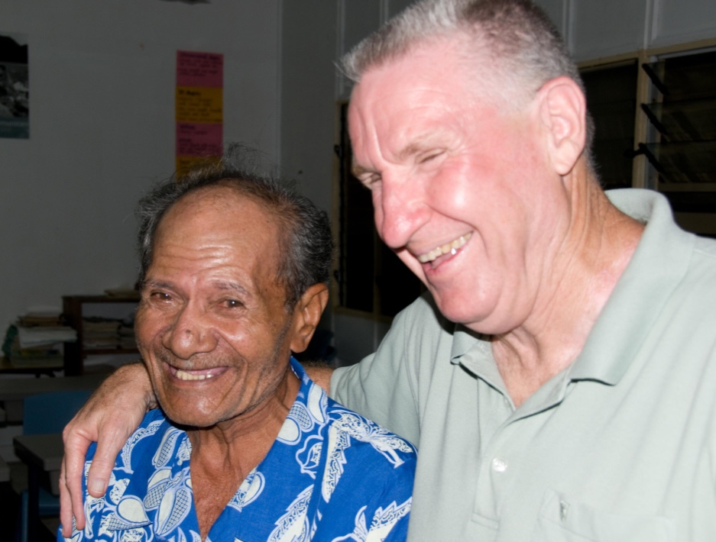
One Saved Soul
Aliesi was seeking the Truth!

Slide 21

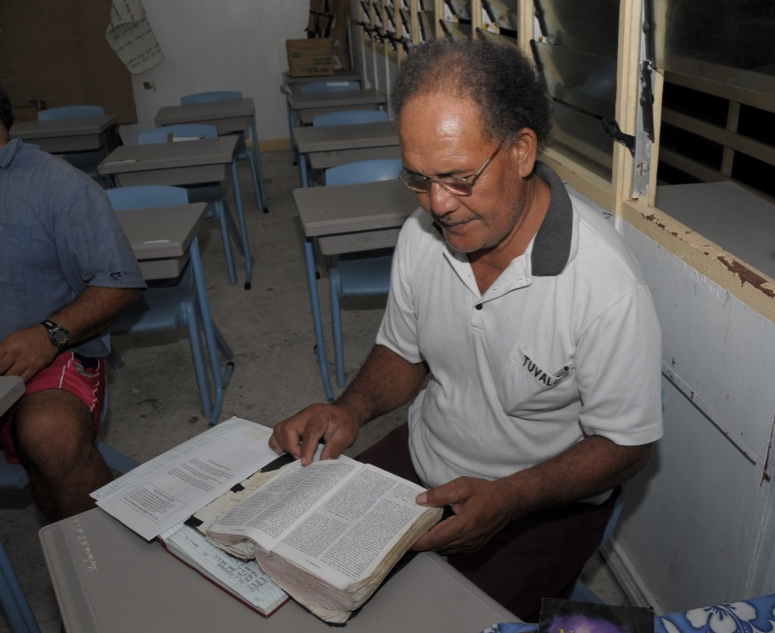

Slide 22
Aliesi passed from this world about 2 years ago.
He was unable to walk in his last days and had to crawl on the floor to answer his door.
His last words to Brother Palau were
Thank you for teaching me the truth!

Slide 23
What am I willing to do to reach
One Lost Soul ?

Slide 24
Most Importantly! What will we hear on Judgement Day?
Matthew 25:21–23
²¹ His lord said to him, ‘Well done, good and faithful servant; you were faithful over a few things, I will make you ruler over many things. Enter into the joy of your lord.”
OR
Matthew 25:26
²⁶ “But his lord answered and said to him, ‘You wicked and lazy servant, you knew that I reap where I have not sown, and gather where I have not scattered seed.
³⁰ And cast the unprofitable servant into the outer darkness. There will be weeping and gnashing of teeth.’

