Slide 1

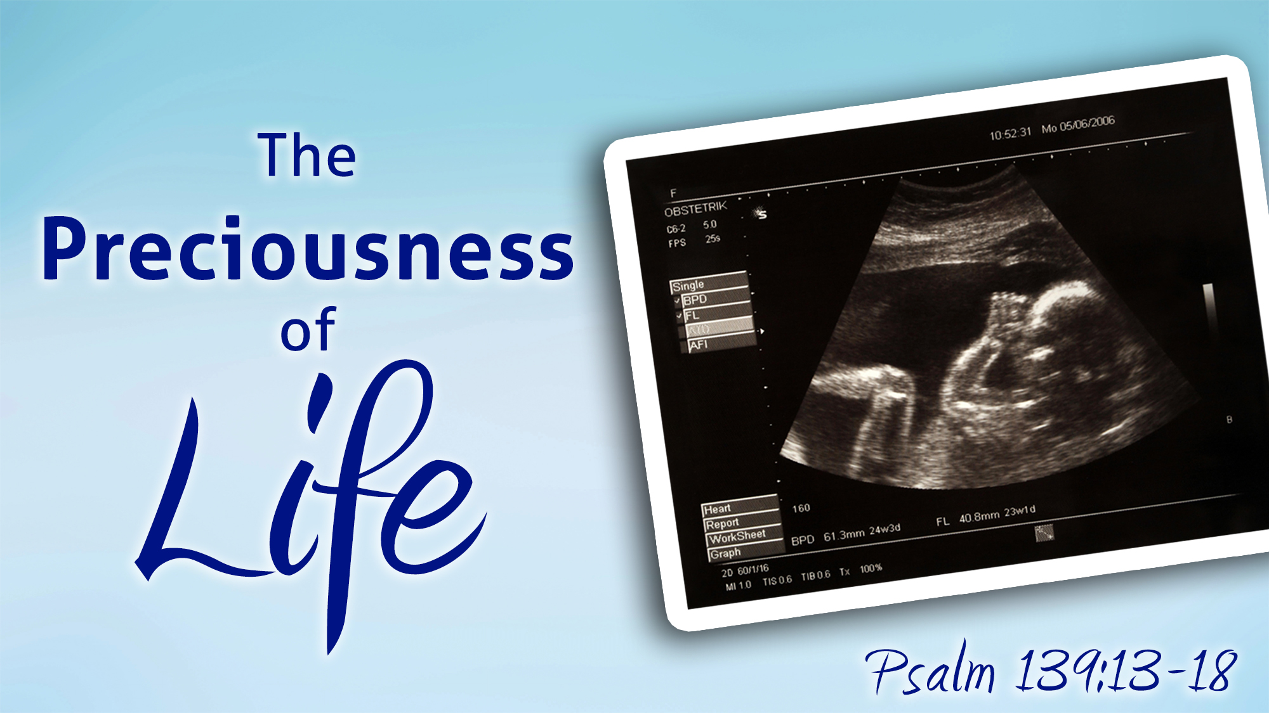
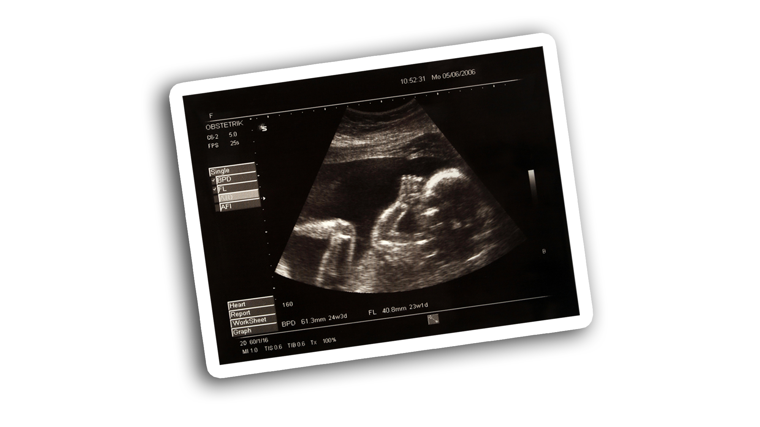



Slide 2
EVERY human life from conception is formed in the IMAGE OF GOD (Gen. 1:26-27; Zech. 12:1)
The being inside the womb is the same as the being outside the womb = LIVING BABY (Luke 1:41, 44 + Luke 2:12, 16; 18:15; cf. Gen. 25:22-24 + 22:20)
The “life” in the womb is given its own “LIFE” with its own “BLOOD” (Lev. 17:11)
The life in the womb has a personal IDENTITY TO GOD (Jer. 1:5)
Shedding innocent blood in the womb is an ABOMINATION TO GOD (Prov. 6:16-17)
God’s law of punishment for murdering an unborn baby in the Old Testament was “LIFE FOR LIFE” (Ex. 21:22-23; cf. Gen. 25:24-26; Rom. 15:4)

Slide 3
“FORMED my inward parts” (v. 13)
“to create by bringing into being”
“KNITTED me in my mother’s womb” (v. 13)
“to weave together, to shape, to knit together” (cf. Job 10:11)
“MADE…fearfully and wonderfully” (v. 14)
“to make a distinction; the moment when something initiated becomes effective”
“MADE…my frame, not hidden” (v. 15)
“to be made by God’s hands” in the womb (cf. Psa. 119:73; Job 31:15)
“INTRICATELY WOVEN in the lowest parts of earth” (v. 15)
“to embroider, weave colored thread, do needle-point embroidery” (cf. Ex. 26:36; 27:16; 28:39)
“FASHIONED my days” (v. 16)
“to form, mold,” as a potter with clay (cf. Isa. 29:16; 44:2, 24; 49:5; Jer. 18:4, 6; 1:5; Zech. 12:1)
Day 16
Day 18
Day 21
Week 4
Week 5
Week 6
Week 7
Week 8
Week 9
Week 10
Week 11
Week 12
Week 13
Week 14
Week 15
Week 16
Week 18
Week 20
Week 22
Week 24
Week 26
Week 28
Day 1

Slide 4
God is at work in the womb!
To David, the thought of life in the womb and of God at work there was/is:
Praiseworthy (v. 14) + Wonderful (v. 14) + Marvelous (v. 14) + Precious (v. 17)
Our substance and our days are written in His book from conception (v. 16)
Let us never be ashamed of God’s truth (2 Tim. 1:12; Mark 8:38)
Let us never be ashamed to speak and defend God’s truth (Rom. 1:15-16)
Let us never allow this world to condition our hearts and minds away from God and His precious, simple, unchanging truth (Rom. 12:2)
Let us never allow political leanings, action groups, media personalities, celebrities, etc. to condition our minds to believe that abortion can EVER be justified in ANY way or at ANY time (Gal. 5:19-21)

Slide 5
Believe Jesus is the Son of God – John 1:12
Repent of your sins and turn toward God – Luke 13:3
Confess your faith in Jesus Christ – Romans 10:9
Be baptized into Christ – Galatians 3:26-27
God will forgive all of your sins – Acts 2:38
God will add you to His church – Acts 2:47
God will enroll you in heaven – Hebrews 12:23
Live as a faithful child of God – Revelation 2:10

