Slide 2
Prioritize heavenly THINGS, like God does
(Col. 3:1-4)
  Focus on Heavenly vs. Earthly
Prioritize heavenly PLEASURES, like God does
(Heb. 13:16; Psa. 5:4; 69:30-31; 149:4)
  Focus on Godly vs. Fleshly
See STUFF through the Eternal Lens!

Slide 3
Sometimes we see “evil” against us while God sees “good” (Gen. 50:20)
  Trust God’s providence
Sometimes we see “suffering” while God sees “glory” (2 Co. 4:17-18; Ro. 8:18)
  Tough it out for God’s sake
Sometimes we see “obstacles” while God sees “doors” (Col. 4:3)
  Take advantage of God’s opportunities
See SITUATIONS through the Eternal Lens!

Slide 4
God looks beyond the surface, the exterior, the face, the skin, the attitude (1 Sam. 16:7)
God sees a person – with a heart, feelings, hurts, needs, wants, ambitions
God sees a soul
  A soul that is made in the image of God (Gen. 1:27)
  A soul that will live forever, in one of two places (Matt. 10:28)
  A soul that can determine his/her eternity (Matt. 16:26; Heb. 10:39)
We must ASSUME every soul we see is lost and needs the gospel (1 John 5:19)
We must ACKNOWLEDGE that we are accountable for every lost soul (Ezek. 33:1-9)
We must ACCEPT the responsibility to go and teach (Mark 16:15; Matt. 28:18-20)
We must ACT (Acts 8:4; 1 John 5:3)
See SOULS through the Eternal Lens!

Slide 5



Be here on Sunday nights (Jan. 12, 19, 26)

Slide 6


Slide 7


Slide 8


Slide 9


Slide 10


Slide 11


Slide 12


Slide 13


Slide 14


Slide 15


Slide 16


Slide 17
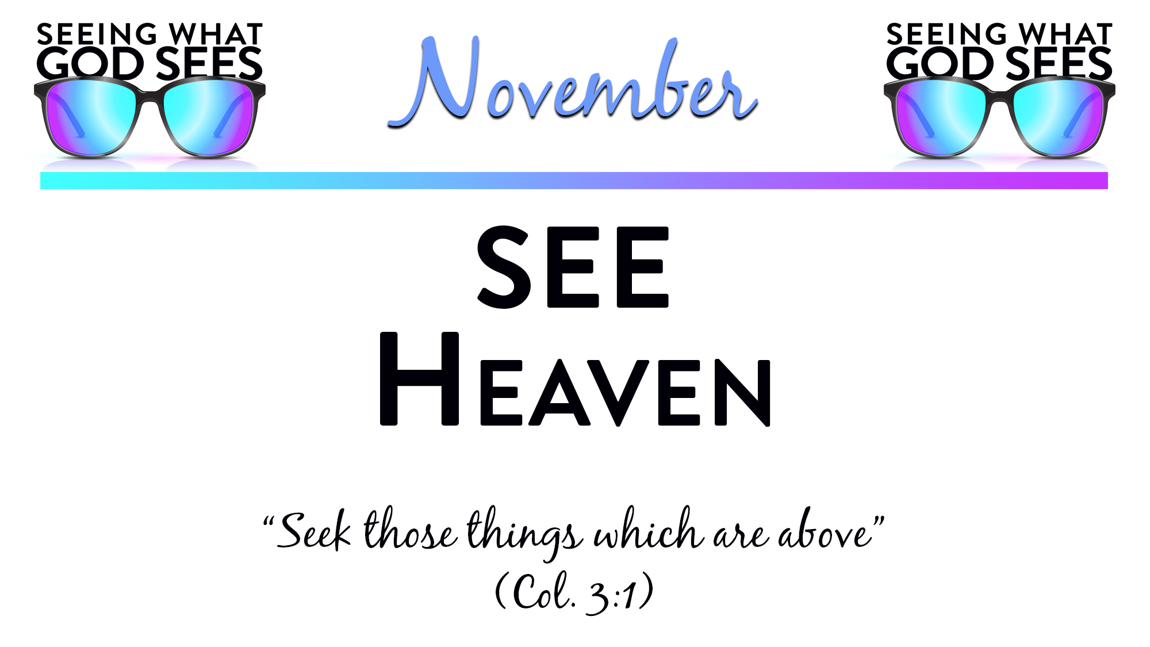

Slide 18


Slide 20
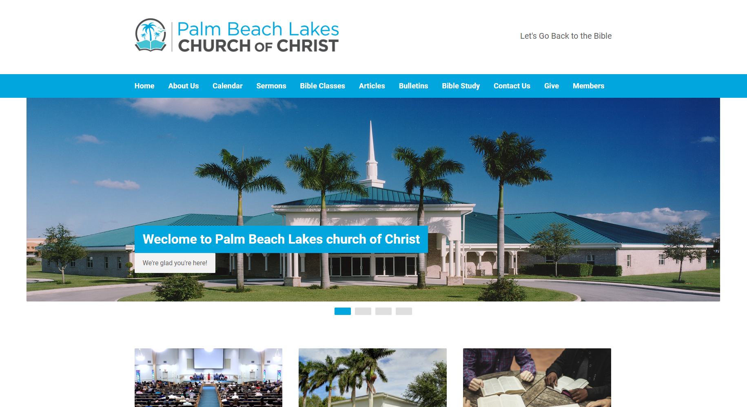
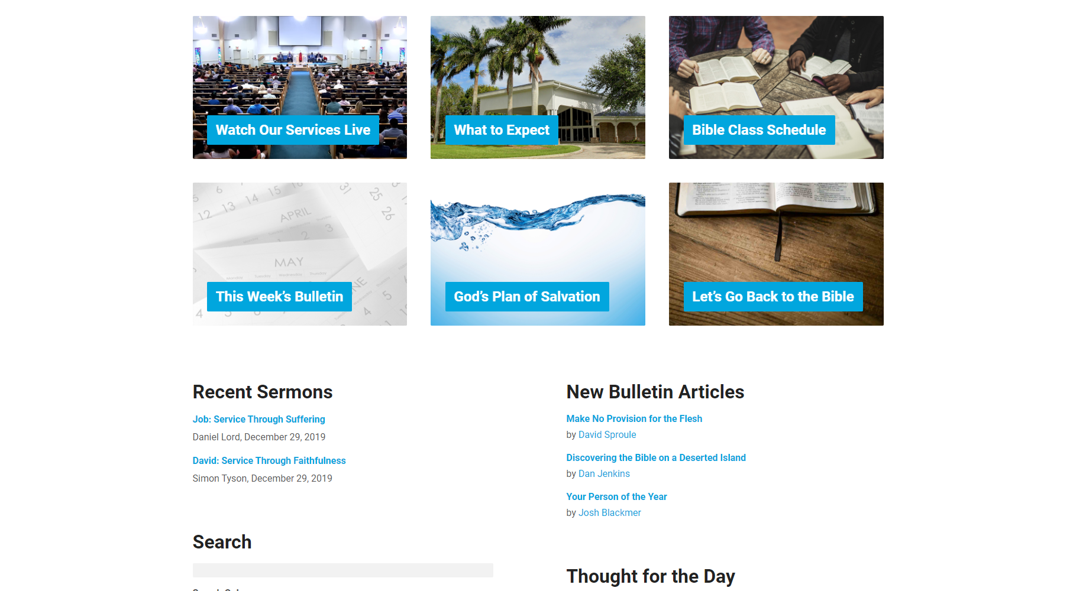
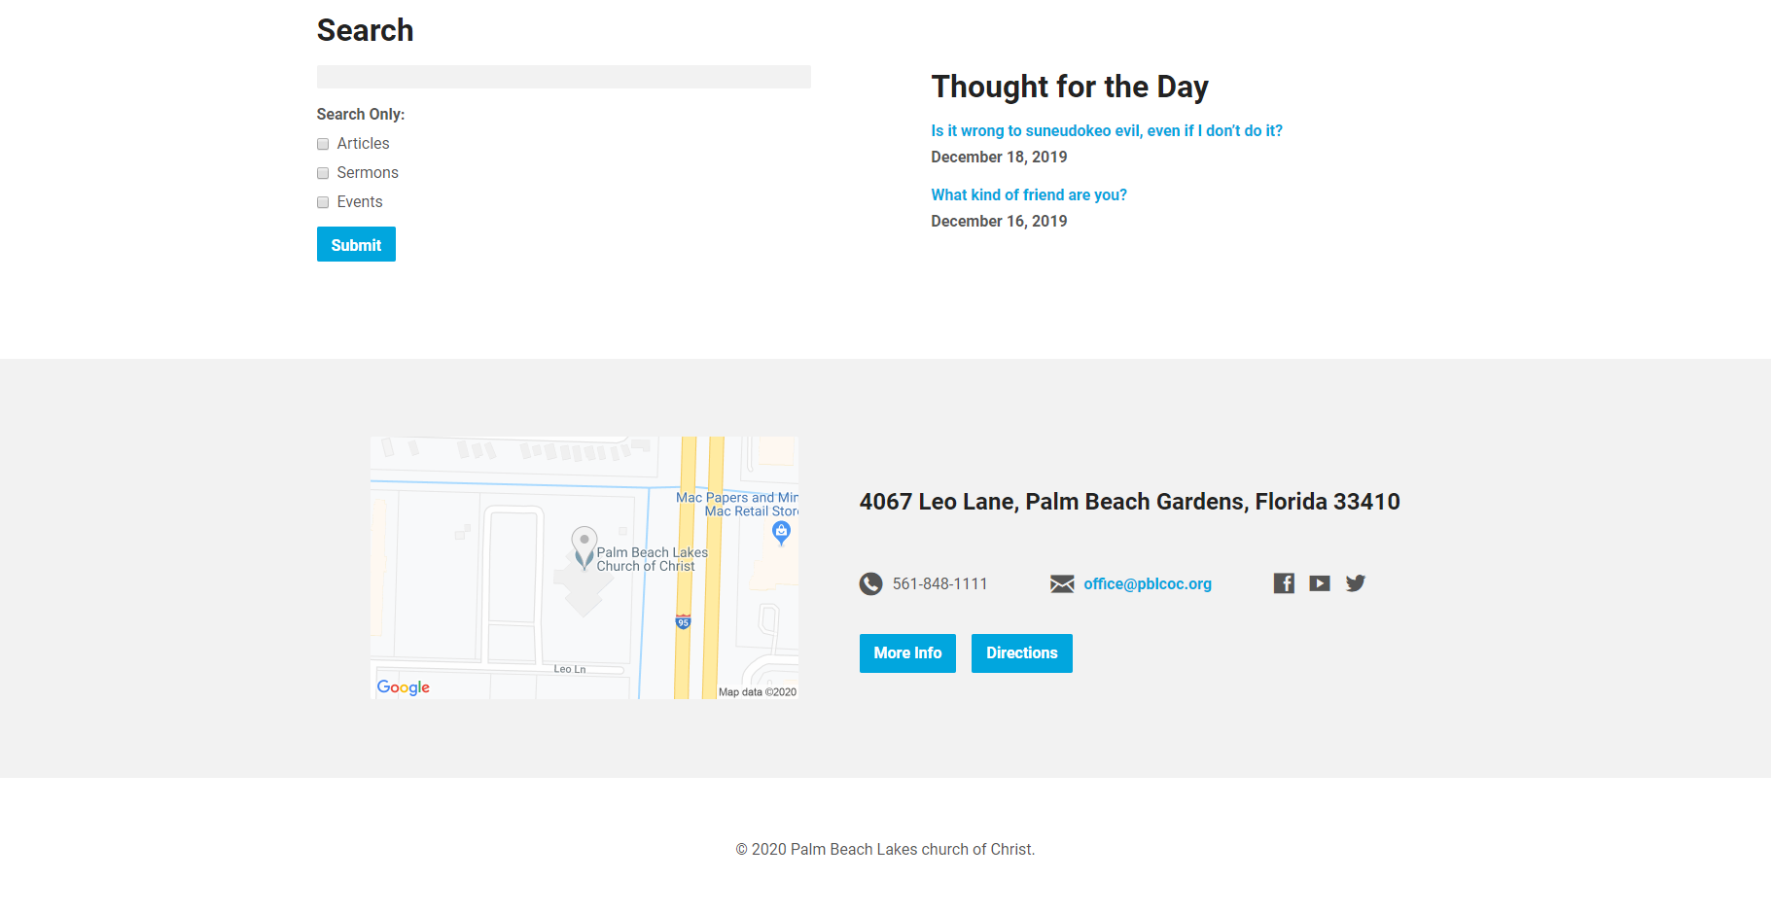

Slide 21
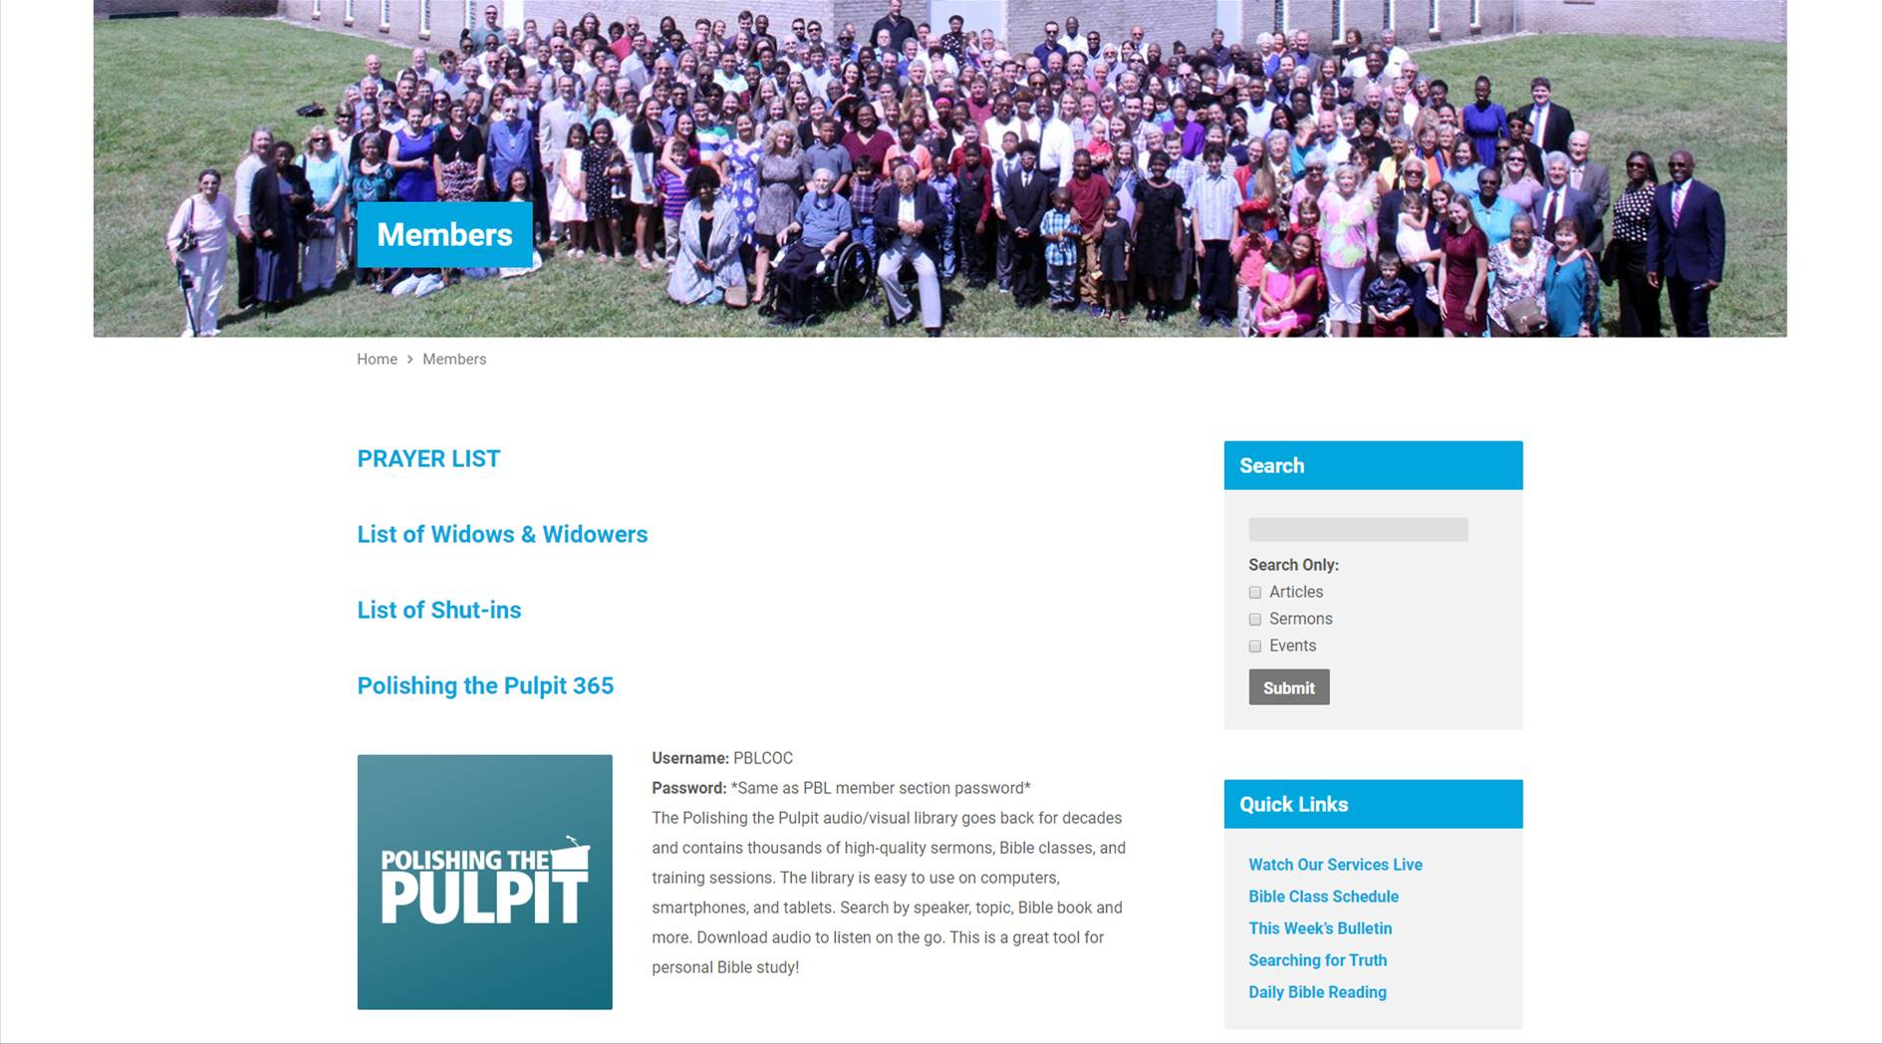

Slide 22
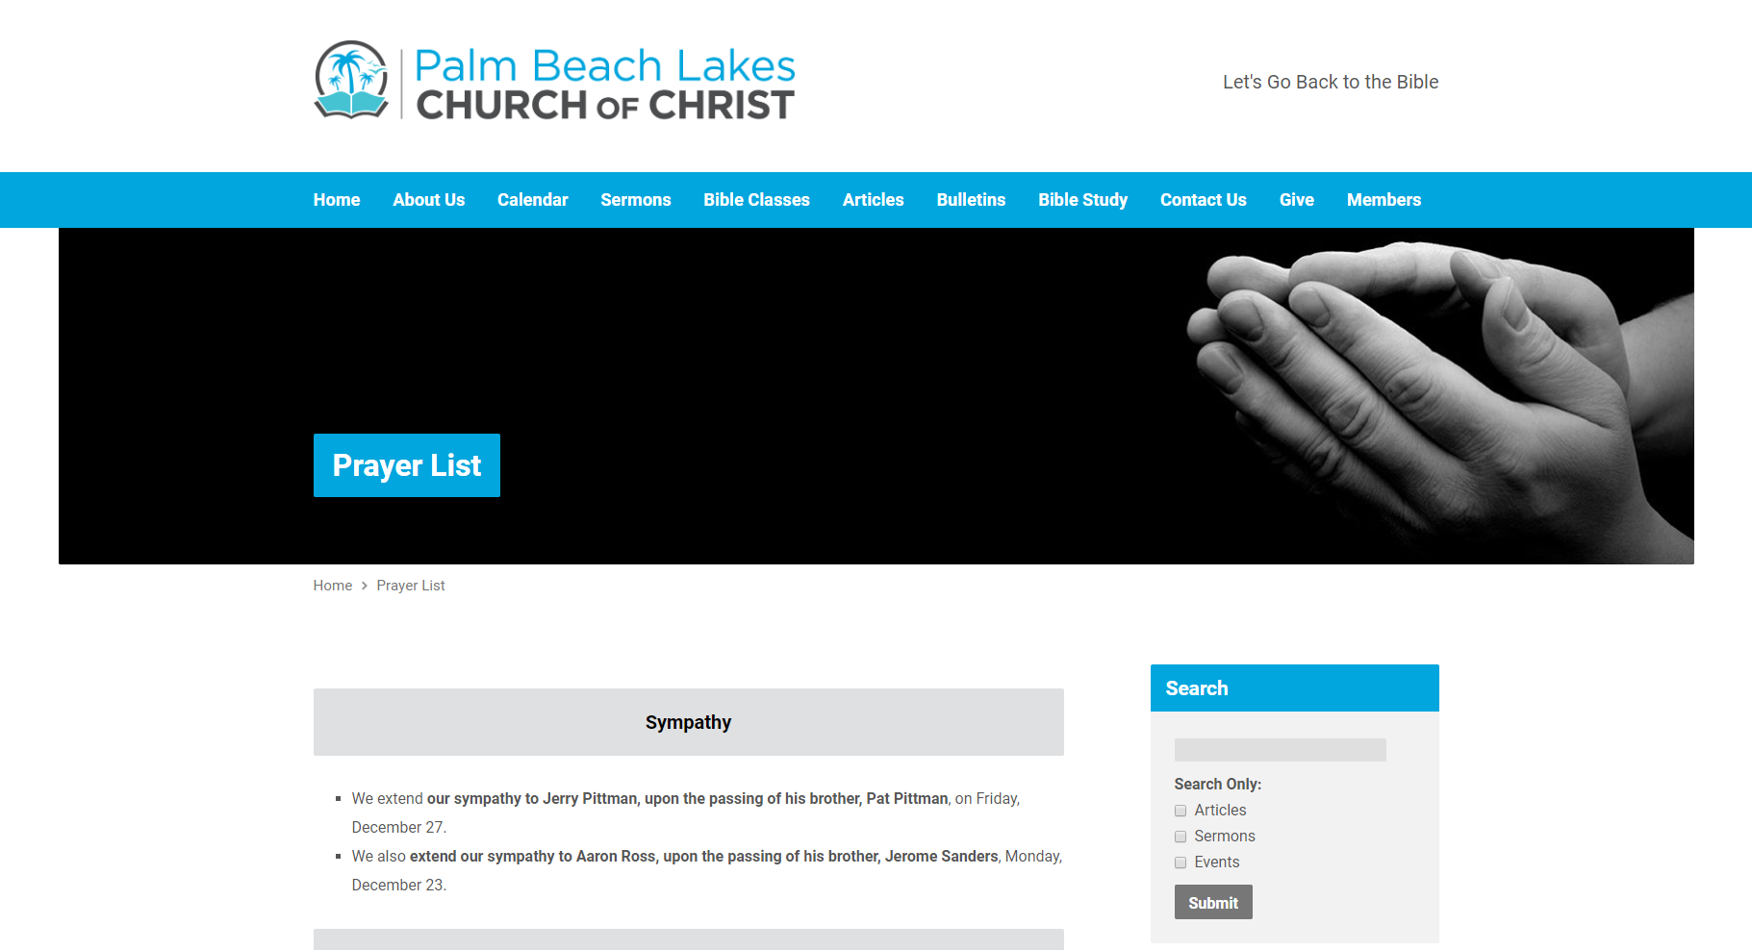
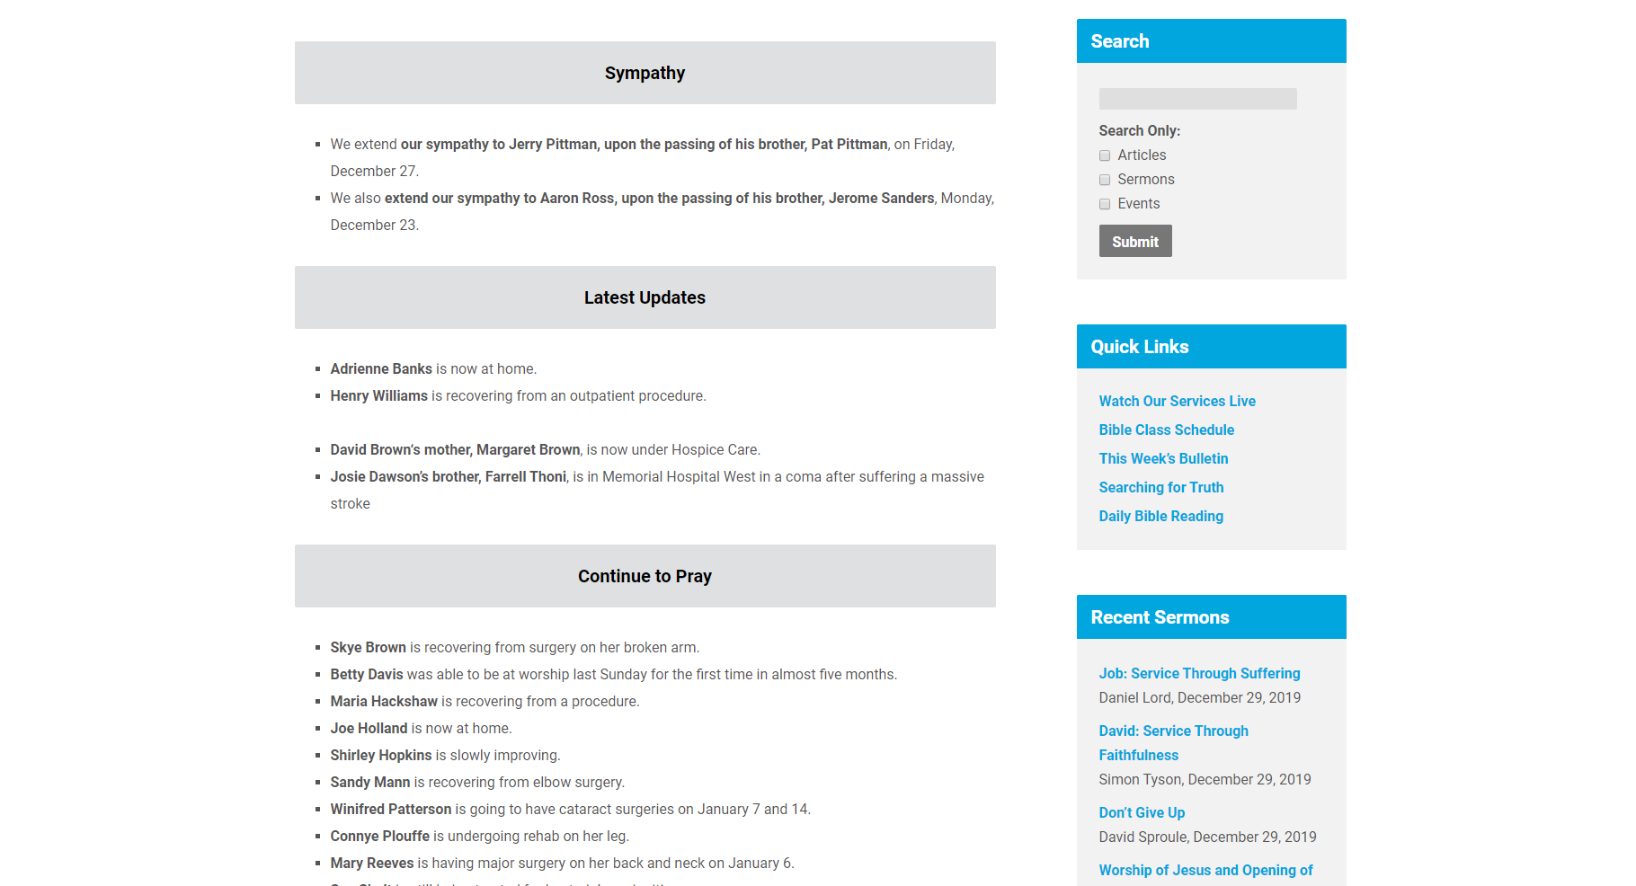
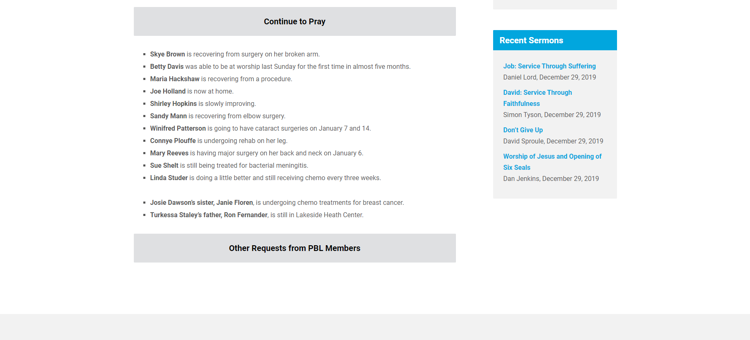

Slide 24
Believe Jesus is God’s Son – Acts 16:31
Repent of your sins and turn to God – Acts 3:19
Confess your faith in Jesus Christ – Acts 8:36-38
Be immersed into Christ – Mark 16:16
  God will forgive all of your sins – Acts 2:38
  God will add you to His church – Acts 2:47
  God will register you in heaven – Hebrews 12:23
Live faithfully for Him each day – Revelation 2:10

