Slide 2
Began in Acts 13:1 (in the city of Antioch of Syria)
Ended in Acts 14:28 (in the city of Antioch of Syria)
Approximate Travel Dates = 47-49 A.D.
Estimated Mileage = 1,400 miles
Known Travel Companions = Barnabas and John Mark (13:3-5, 13)
Most of the cities on this journey were in the region of Galatia
On a Bible map, you can trace Paul’s journey and learn Bible geography

Slide 3
Began in Acts 13:1 (in the city of Antioch of Syria)
Ended in Acts 14:28 (in the city of Antioch of Syria)
Paul preached the word of God in synagogues (13:5, 14; 14:1)
Paul defended the word against falsehood and deceit (13:7-11)
Paul worked miracles by the power of God (13:11; 14:3)
Paul preached that man’s only hope was through Christ’s resurrection (13:30-41)
Paul strove to keep the spotlight and credit off of him and on God (14:11-17, 27)
Those converted on this journey had “believed” (13:12, 48; 14:1, 23; cf. 13:39)
  But nowhere does it say they were saved by faith only (14:1+14:2; cf. 16:33-34; Heb. 3:18-19)
Paul returned to the new converts to strengthen and encourage them (14:21-22)
Paul appointed elders in every congregation of the Lord’s church (14:23)
Paul reported about the work of God and the open doors of opportunity (14:27)
The gospel is not designed for the “weak-minded” (13:7-12)
It’s ok to move on when someone won’t hear the gospel (13:51; cf. 14:19-20)

Slide 4
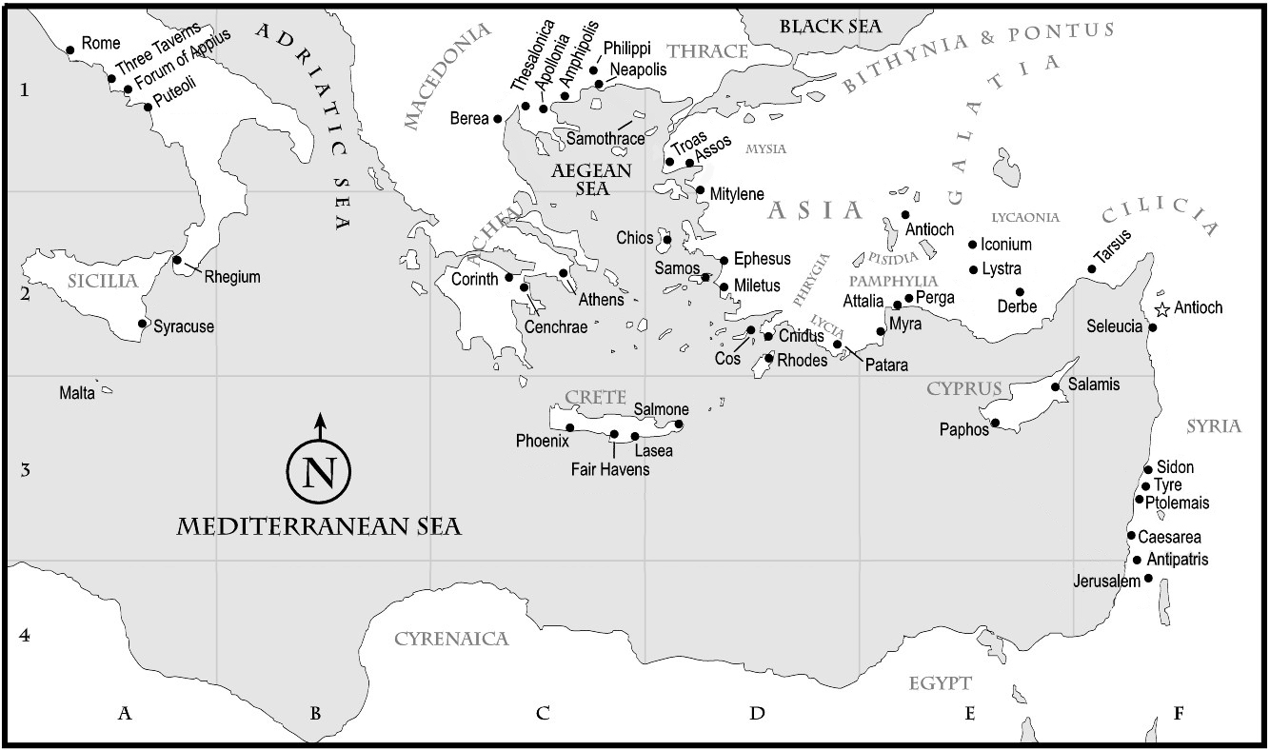

Slide 5
