Slide 1
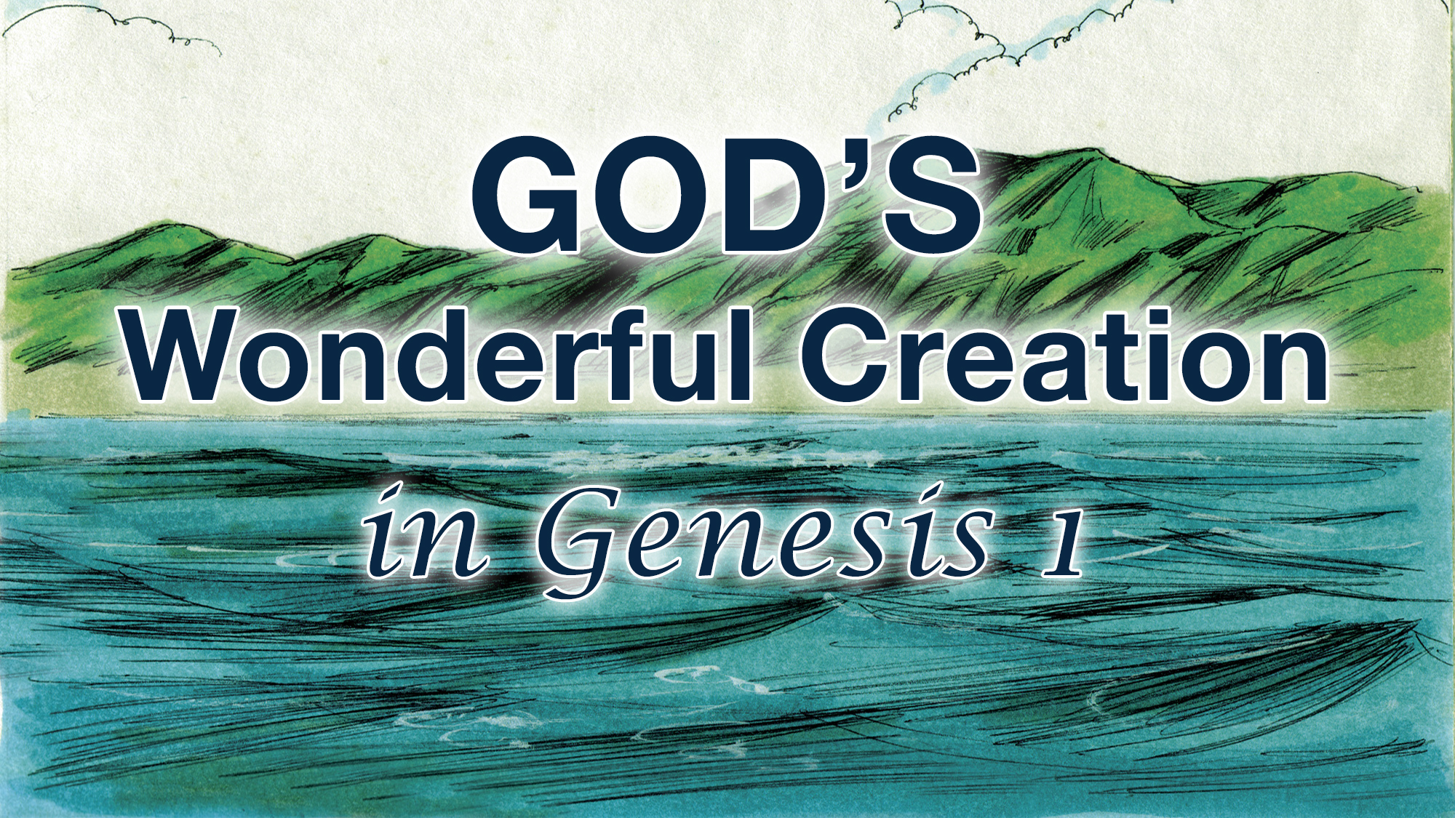

Slide 2


Slide 3
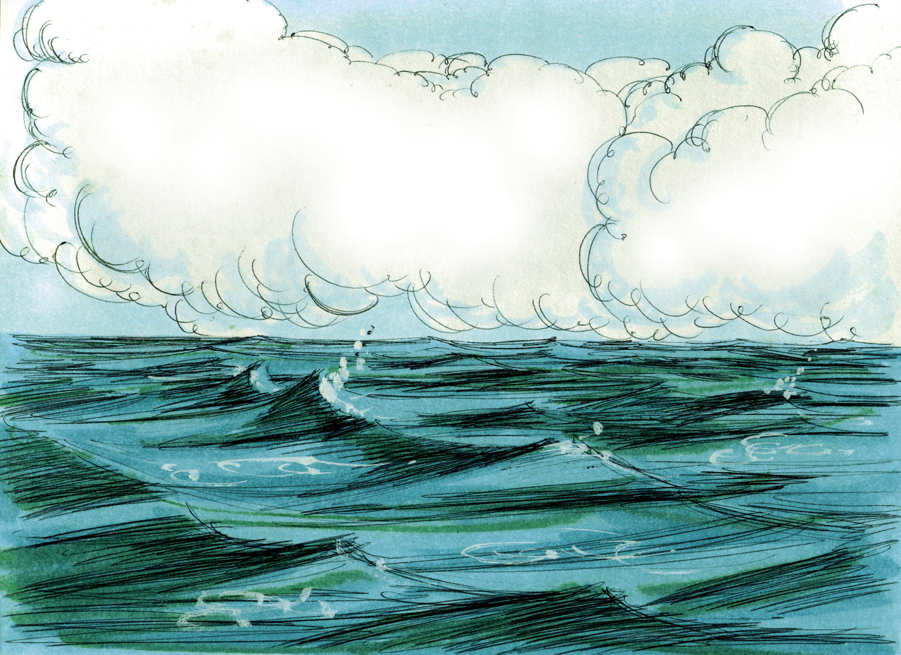

Slide 4
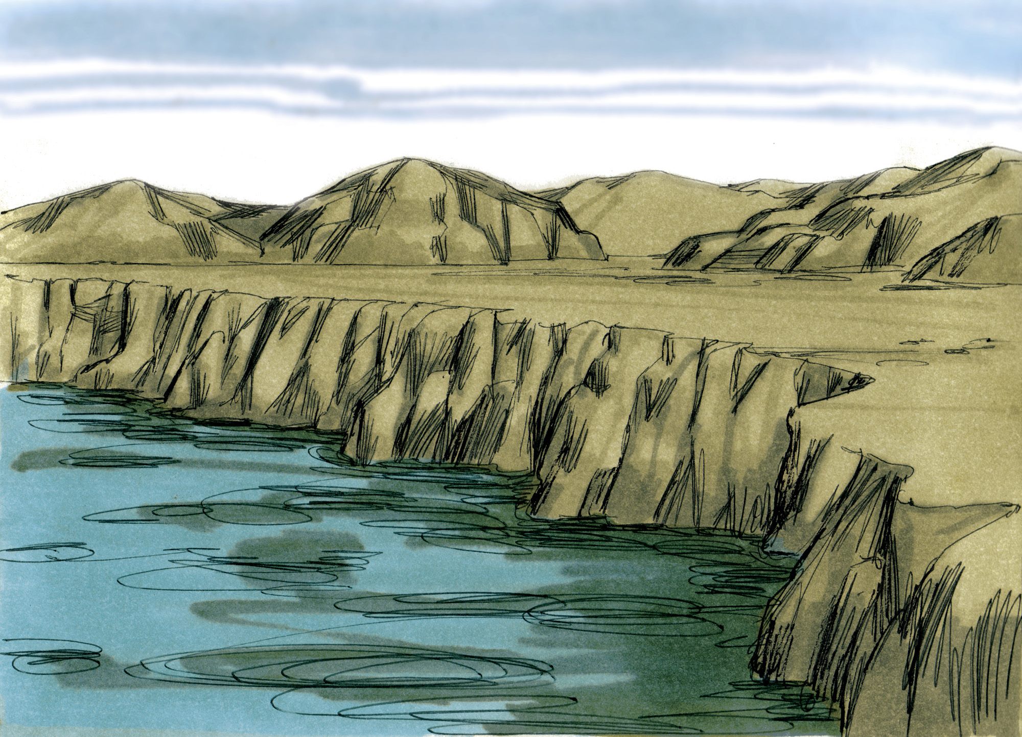

Slide 5


Slide 6
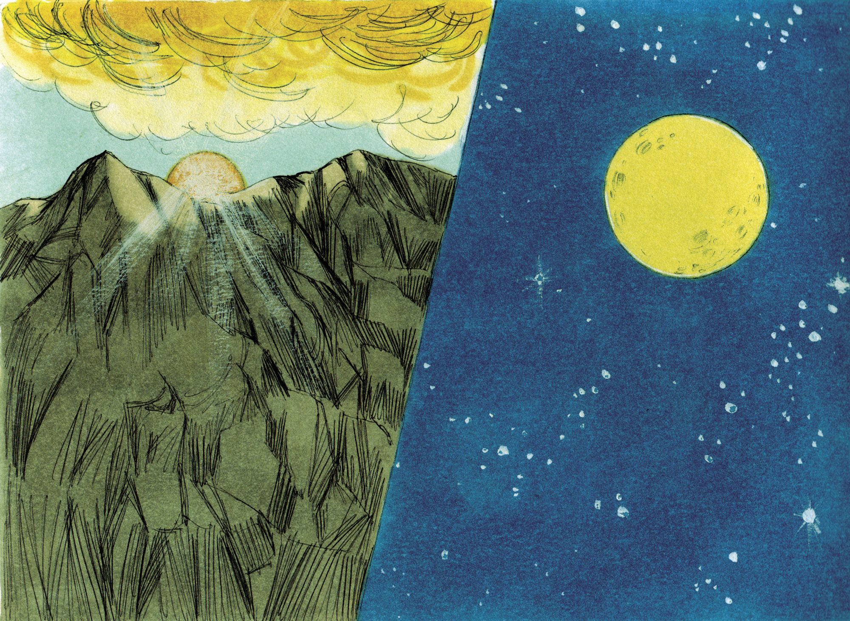

Slide 7
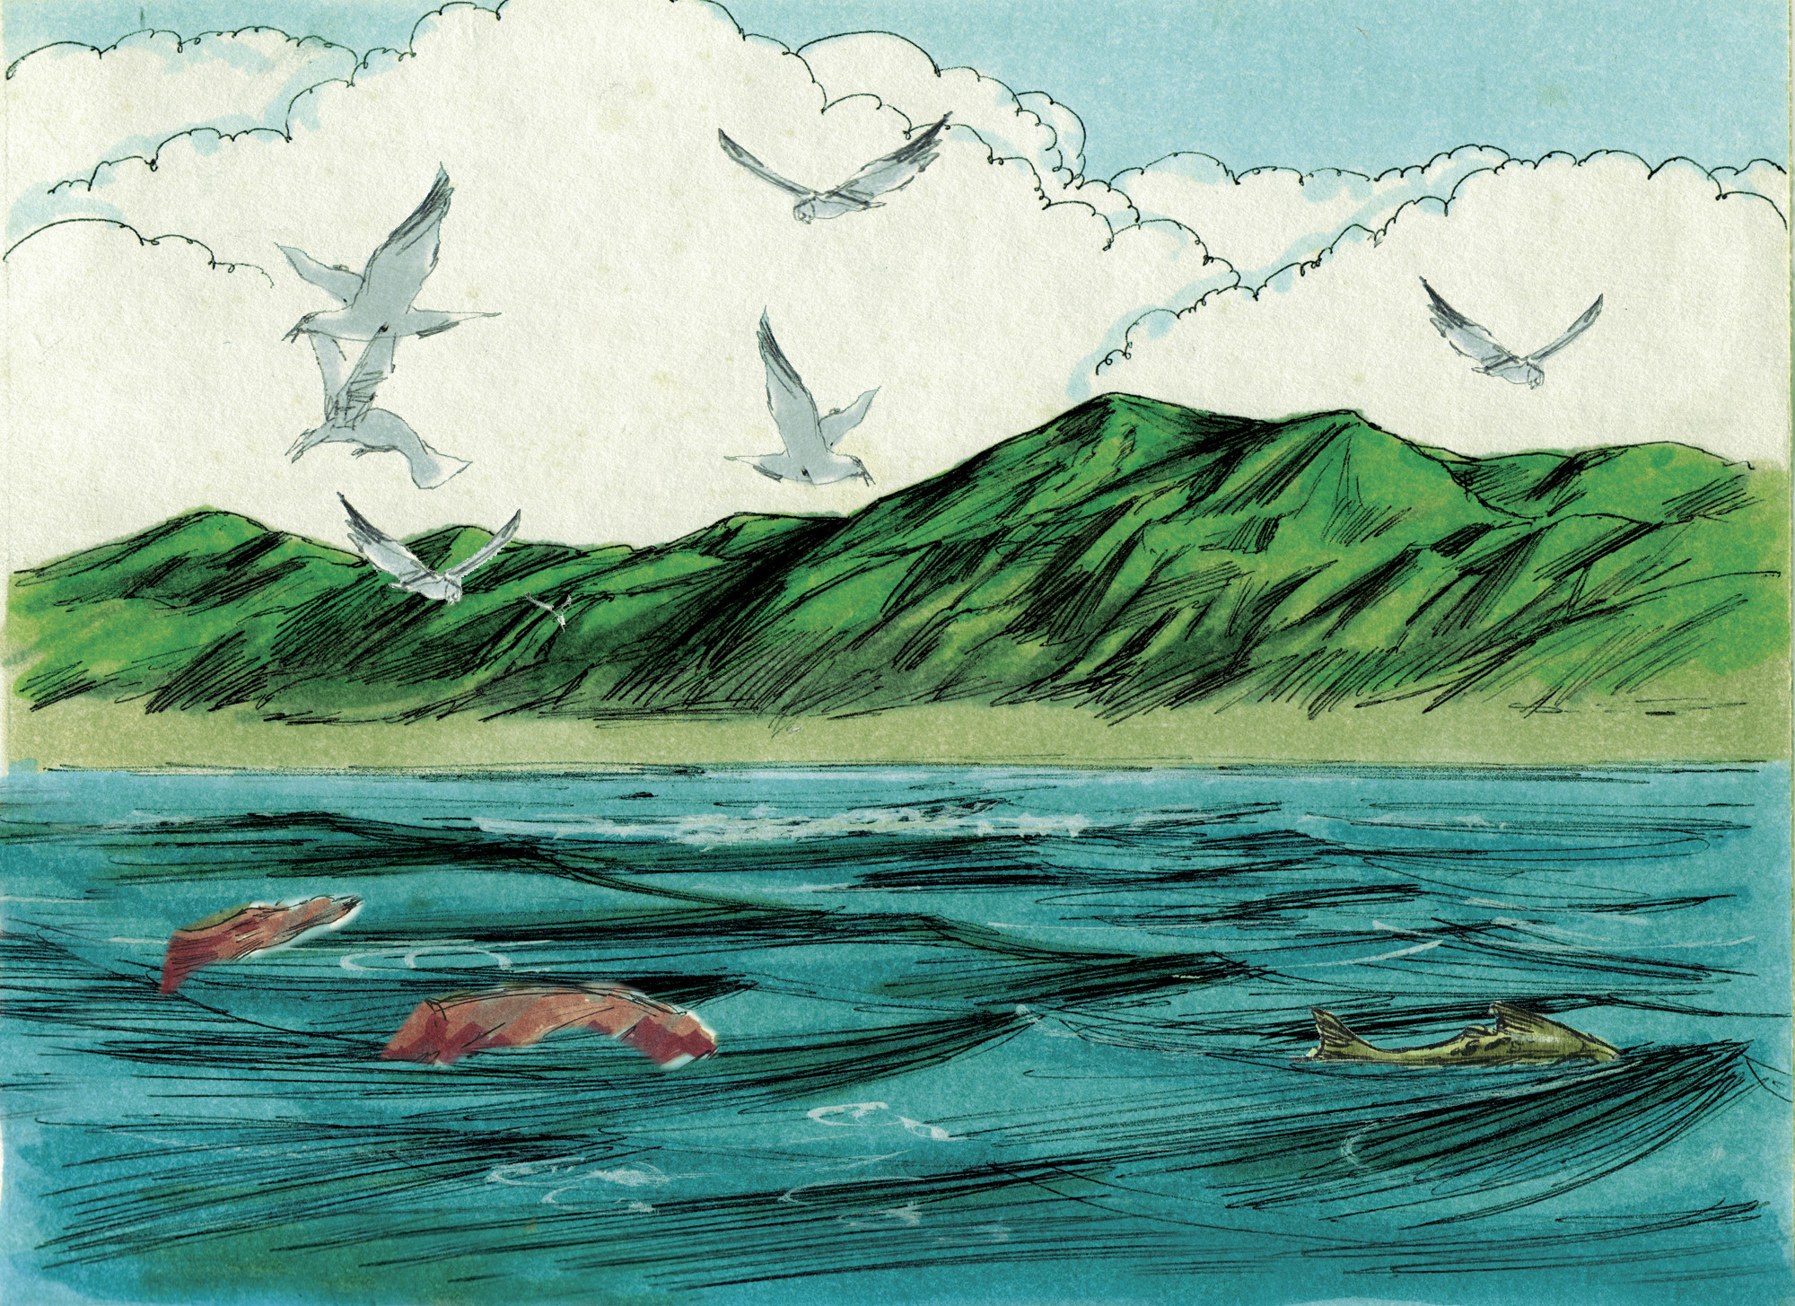

Slide 8
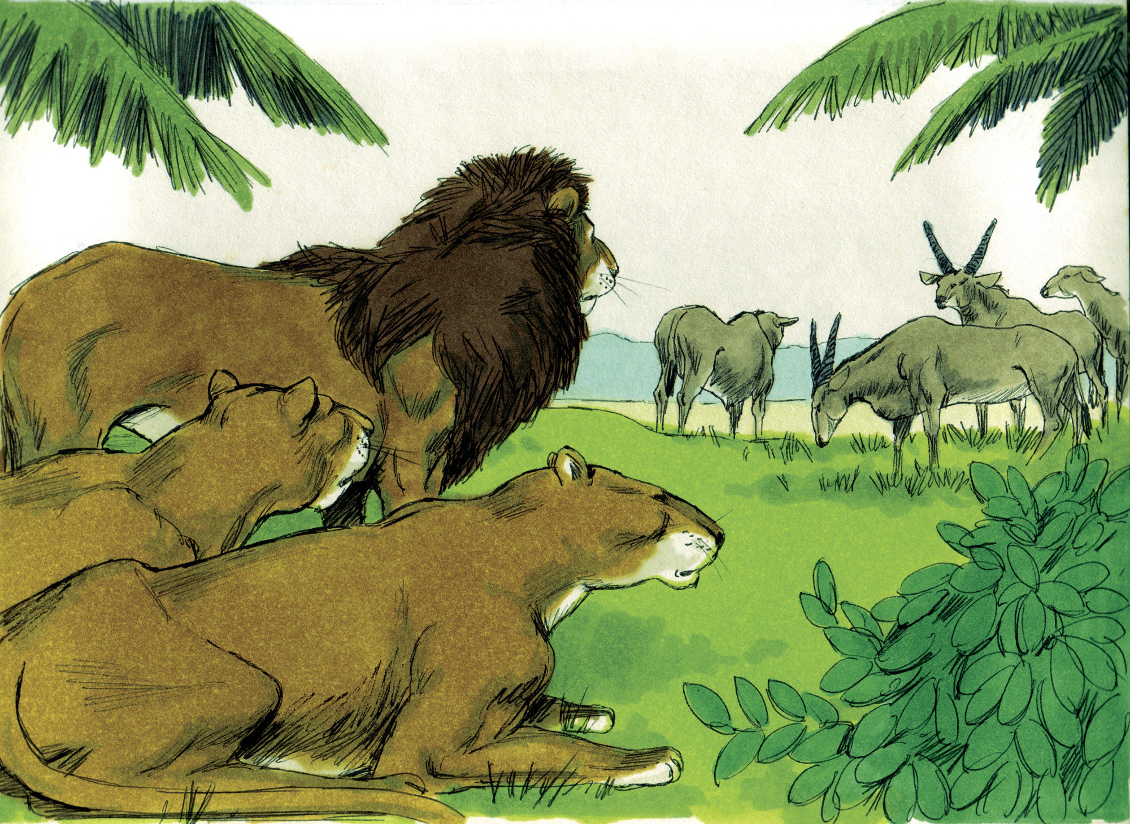

Slide 9
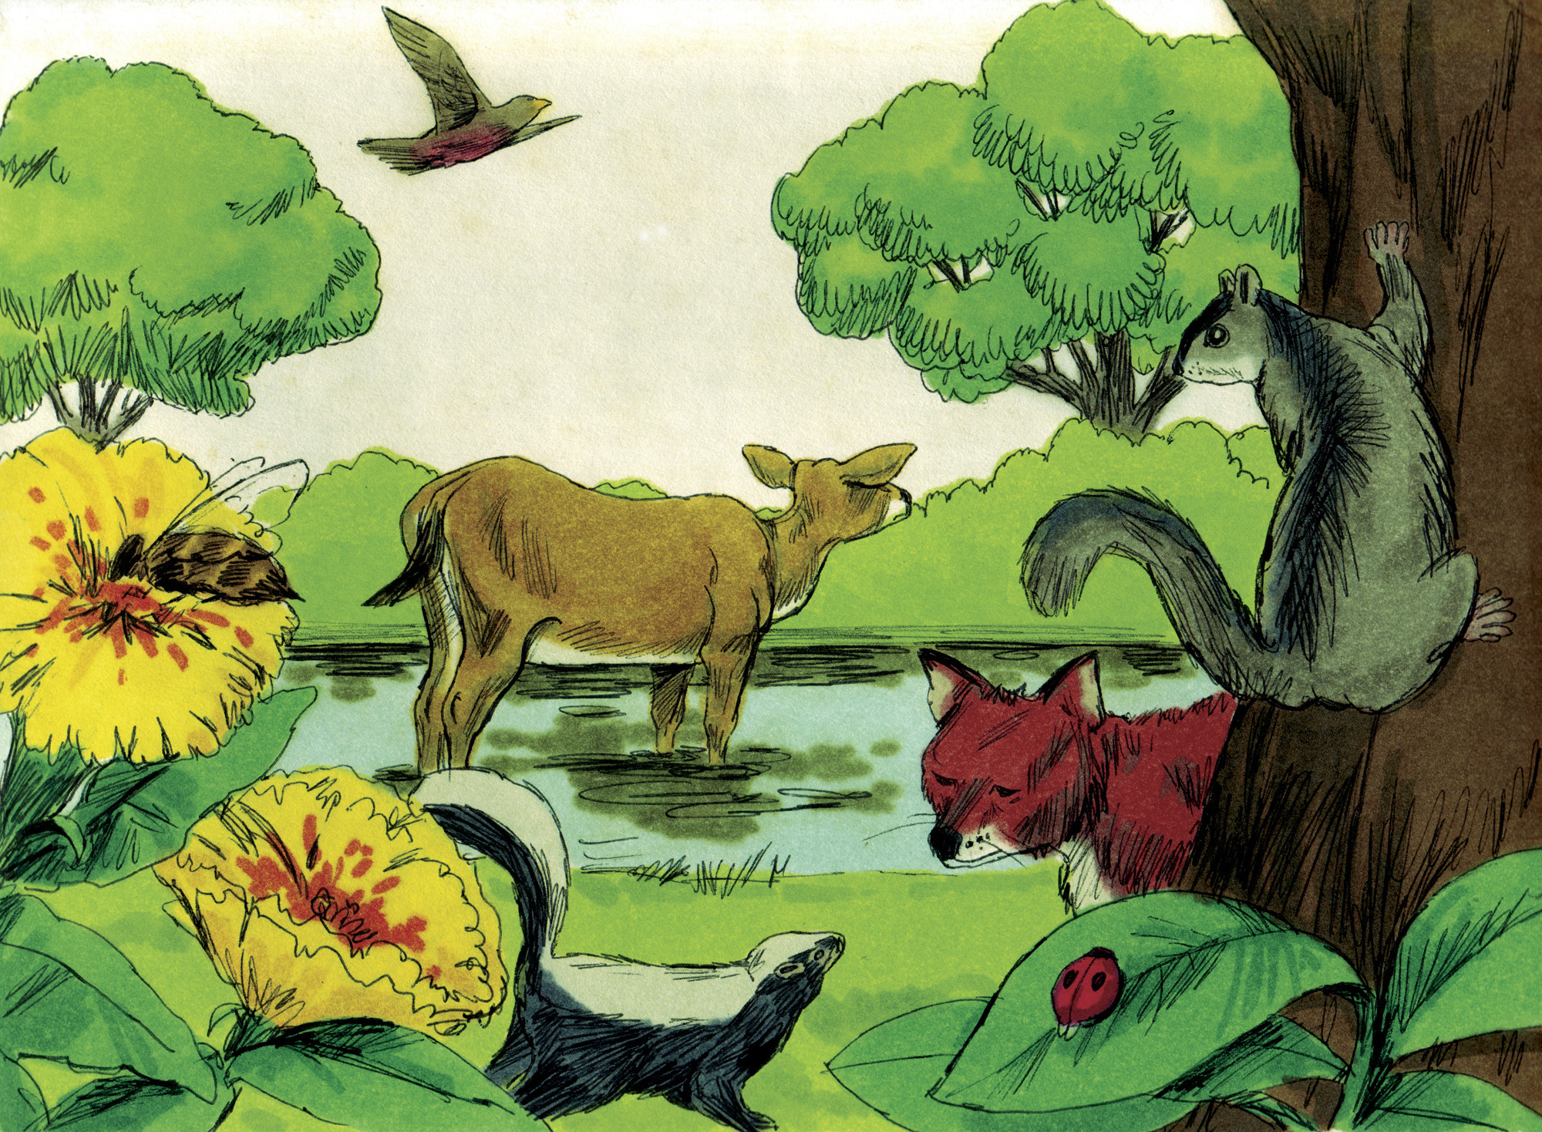

Slide 10
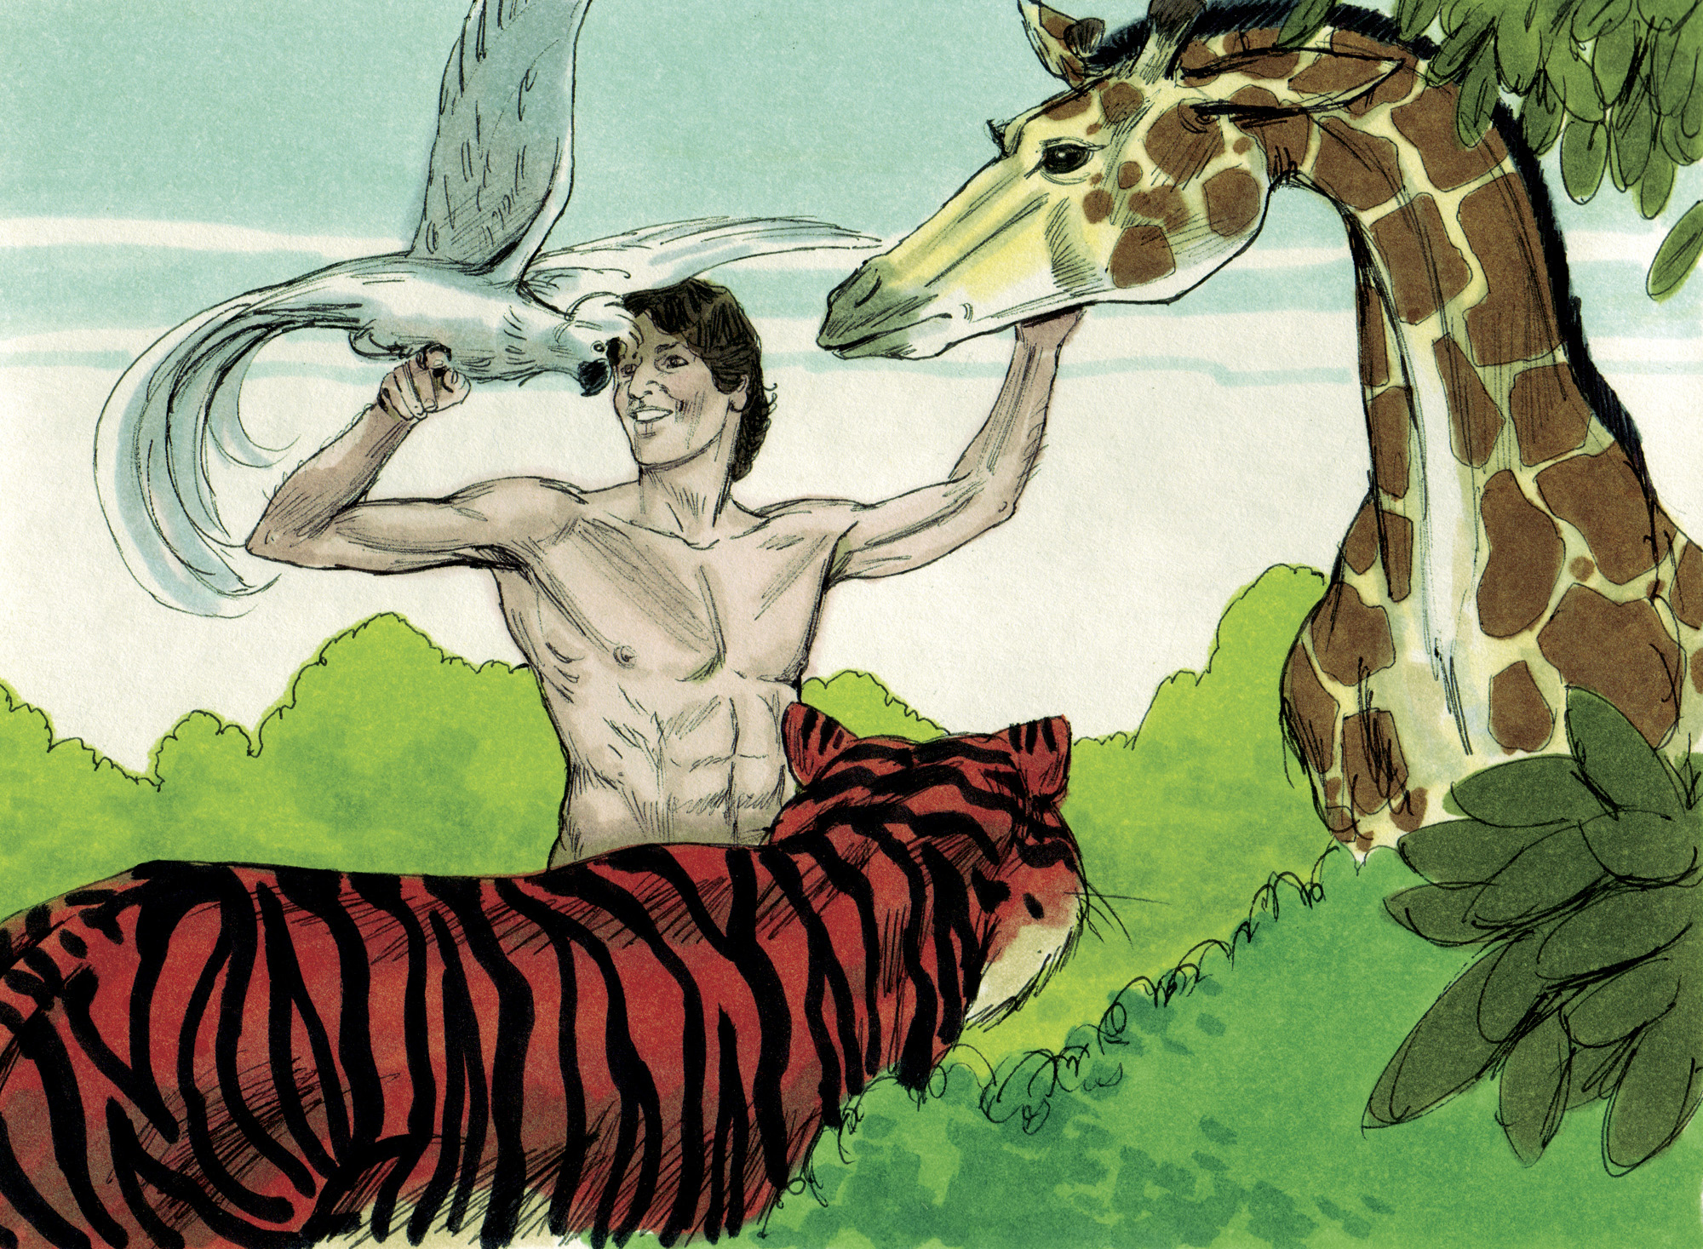

Slide 11
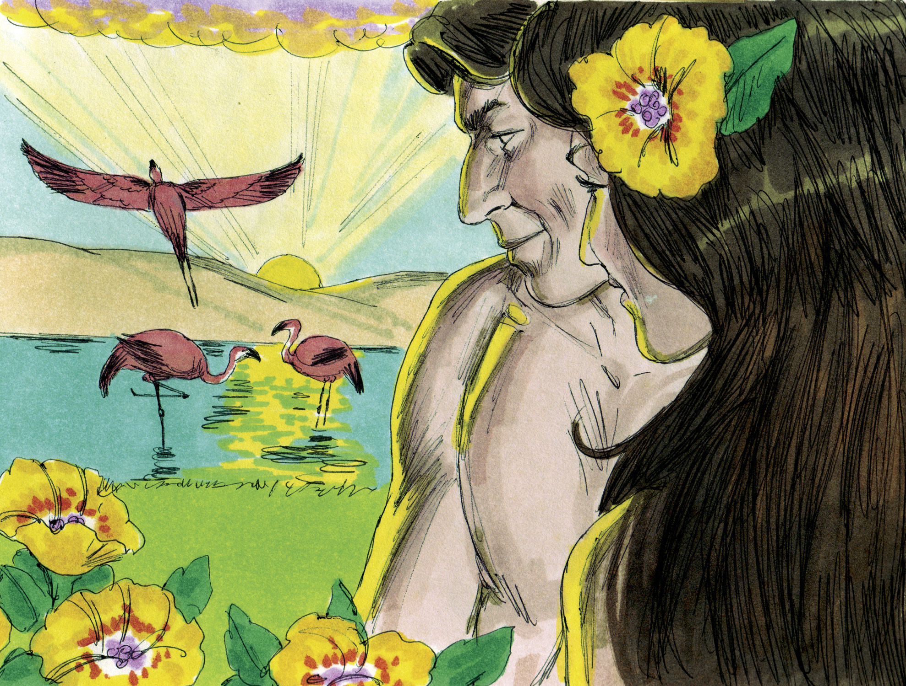

Slide 12
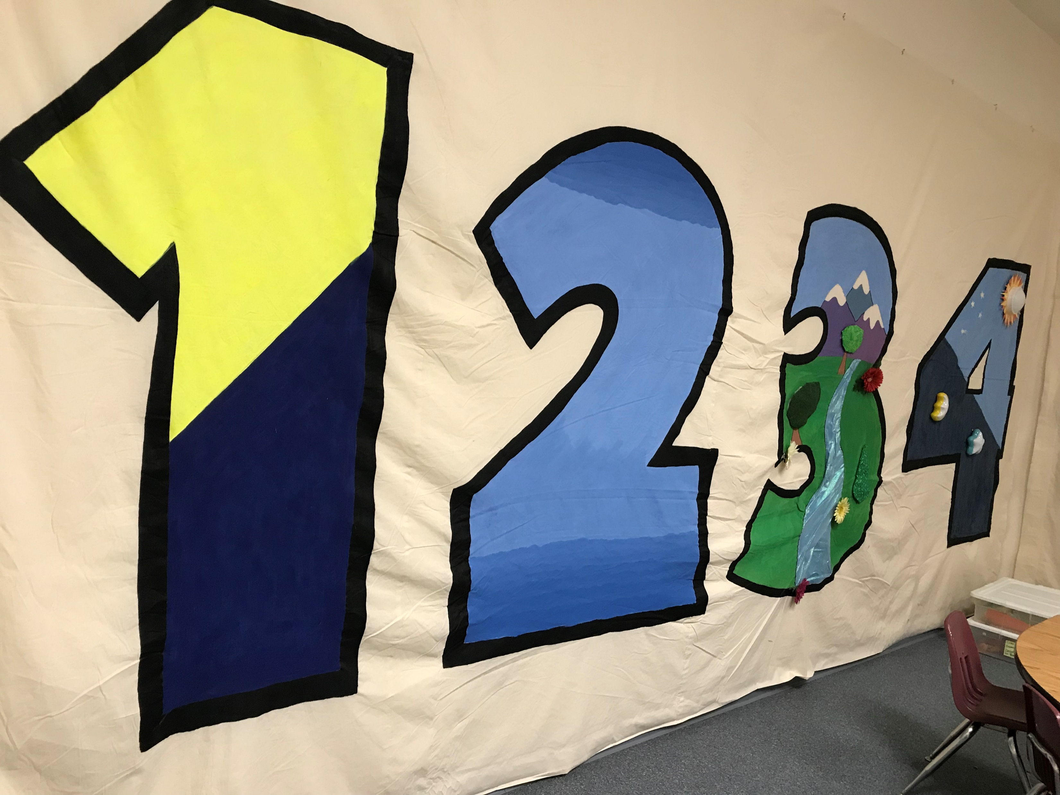

Slide 13
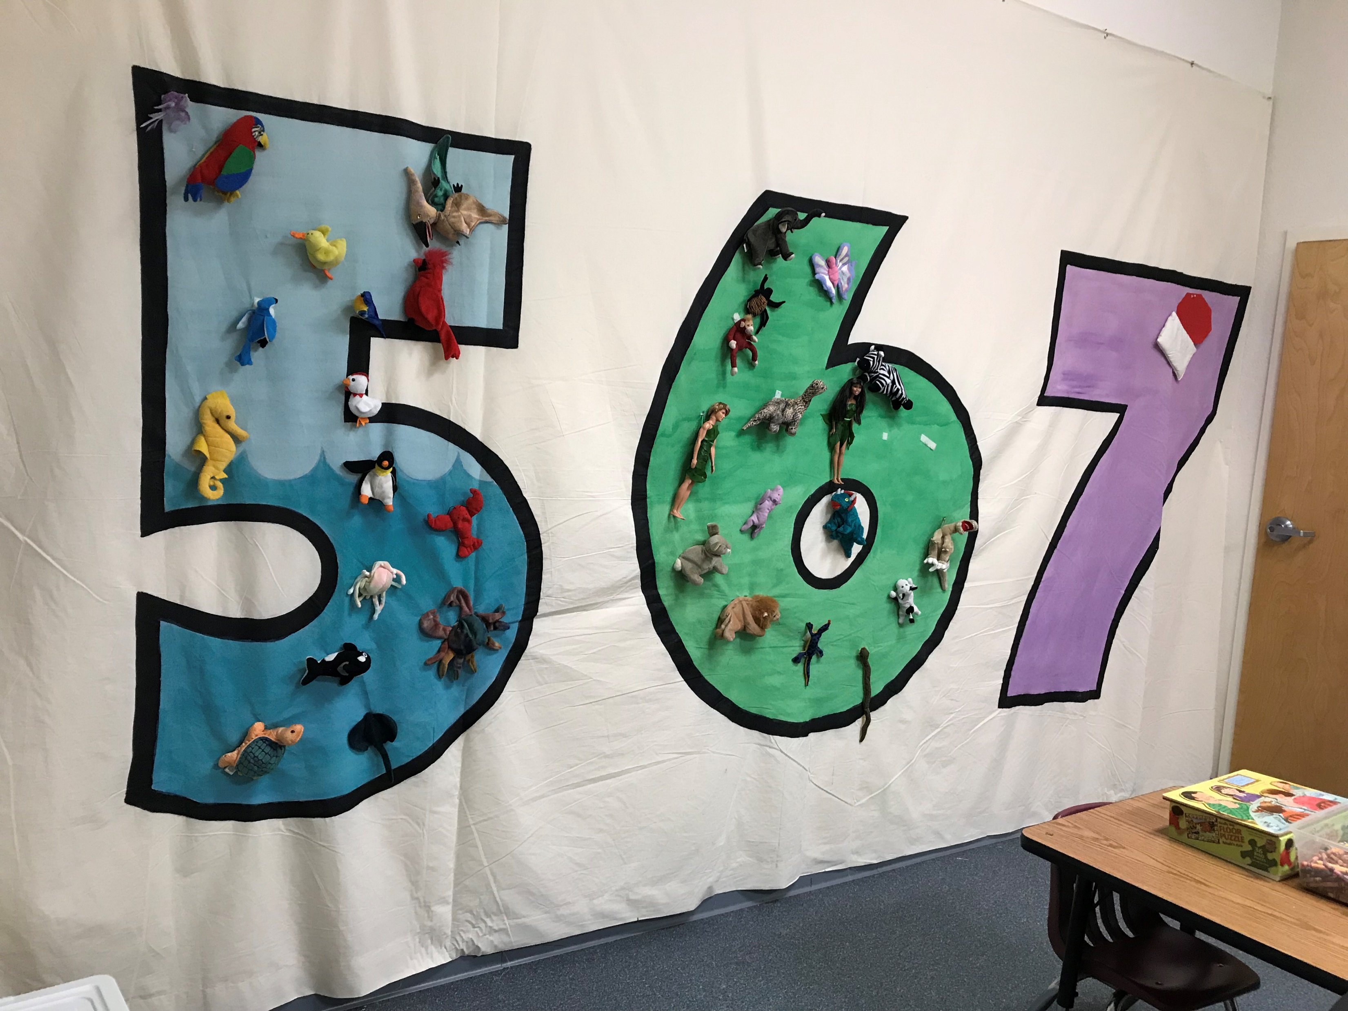

Slide 15
The word “God” is found 32 times in 31 verses
The word designates One who has great power (cf. Eph. 3:20-21)
The NT teaches that Jesus created all things (John 1:1-3; Col. 1:16)

Slide 16
Used in Scripture only of divine activity
– bringing something new into existence (1:1, 21, 27)
God “made” (1:7, 16, 25, 31; cf. Ex. 20:11)

Slide 17
He merely expressed His will and it was done
(1:3, 6, 9, 11, 14, 20, 24, 26, 28, 29)
His word had tremendous creating power (Psa. 33:6, 9)
His word has tremendous saving power (Jas. 1:21; Rom. 1:16)
His word has tremendous penetrating power (Heb. 4:12)
His word has tremendous transforming power (2 Cor. 3:18)
His word has tremendous calming power (Psa. 119:113-117)
How should we respond to “God said”?

Slide 18
Divine approval of His created world
(1:4, 10, 12, 18, 21, 25, 31)
Everything that God does is “good”
(Gen. 50:20; 1 Sam. 3:18; Rom. 8:28; Jas. 1:17)
The very nature of God is “good”
(Psa. 34:8; 100:5; 106:1; 107:1; 118:1, 29; 135:3)
Do we trust (1) God’s definition of “good” & (2) God to do what is “good”?
  Do we seek to “hold fast to that which is good” (1 Thess. 5:21)?
  Do we seek to “do what is good and right in the sight of the Lord” (Deut. 12:28)?
  Do we seek to “imitate what is…good” (3 John 11)?

Slide 19
God numbered the days = 6
(1:5, 8, 13, 19, 23, 31)
God defined the day = “the evening and the morning”
(1:5, 8, 13, 19, 23, 31)
God made a difference between days and years (1:14)
God created “all” things in SIX, 24-hour “days” (Ex. 20:8-11)

