Slide 1
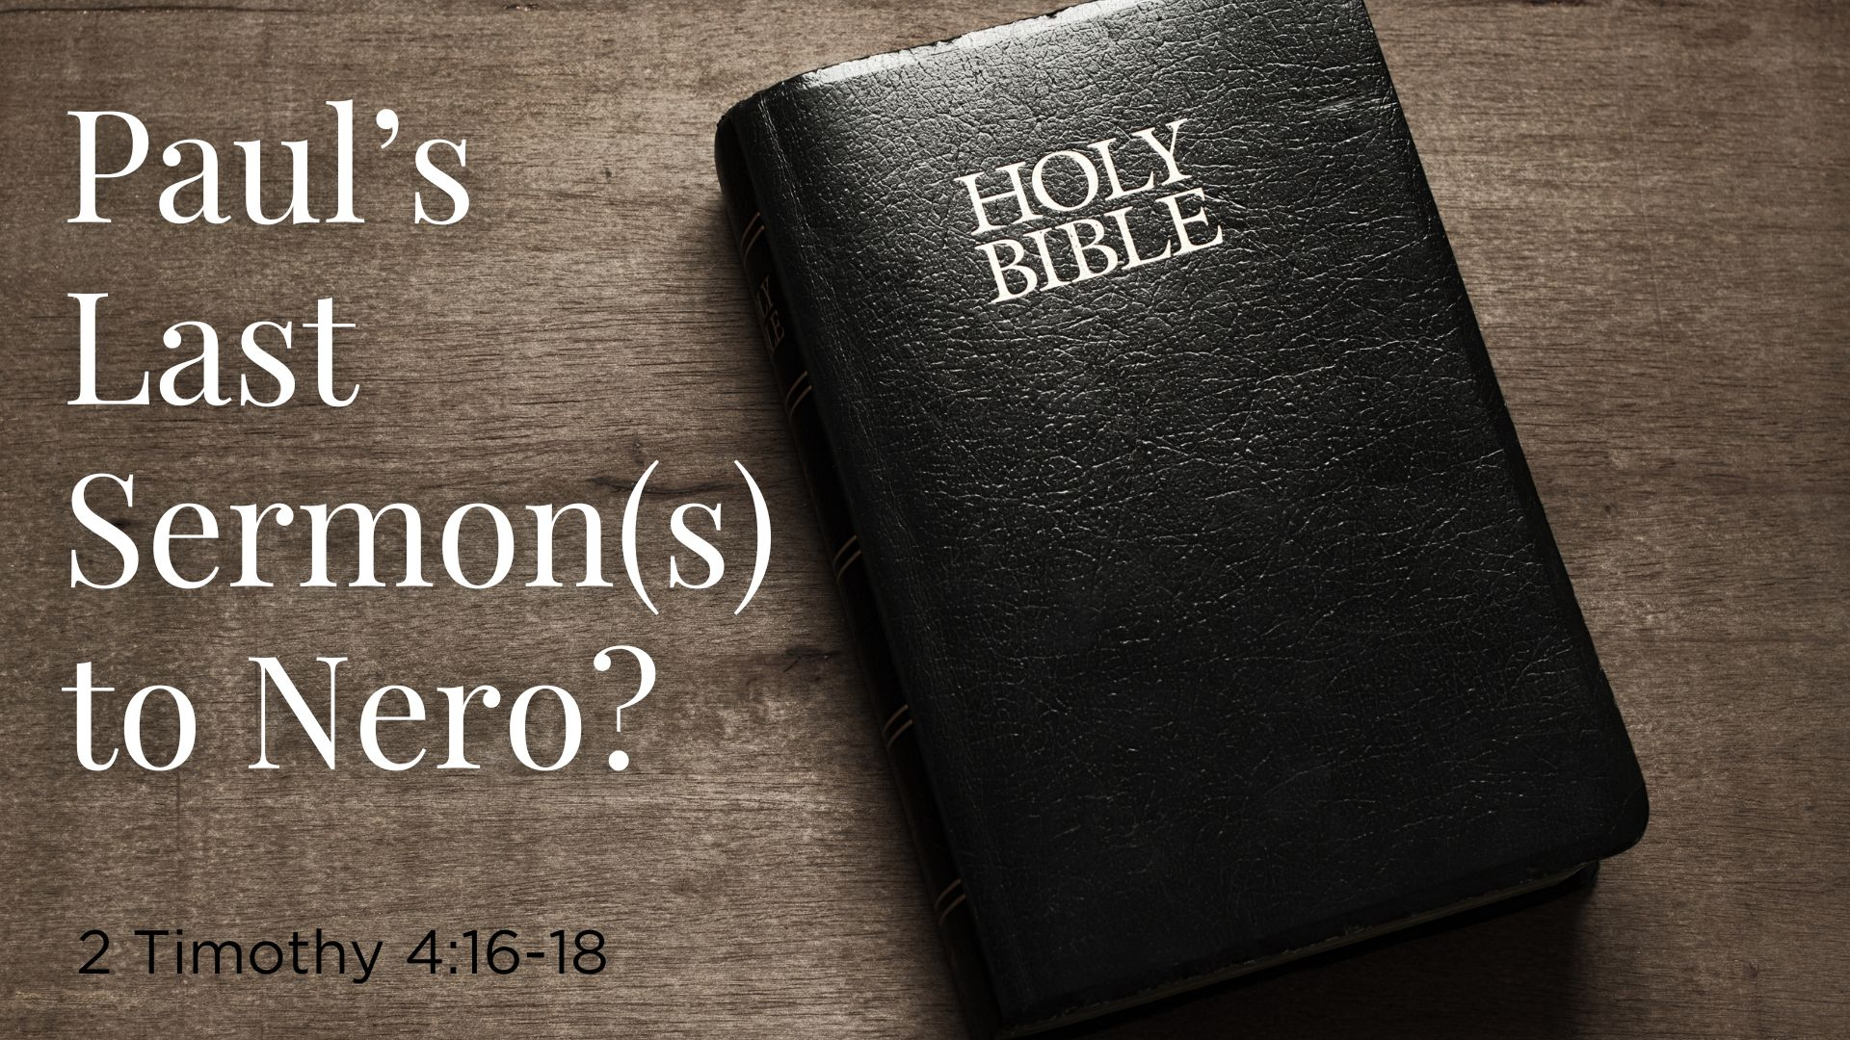
Paul’s Last Sermon(s) to Nero?
2 Timothy 4:16-18

Slide 2
The Text—2 Timothy 4:16-18
16 At my first defense no one stood with me, but all forsook me. May it not be charged against them.
17 But the Lord stood with me and strengthened me, so that the message might be preached fully through me, and that all the Gentiles might hear. Also I was delivered out of the mouth of the lion.
18 And the Lord will deliver me from every evil work and preserve me for His heavenly kingdom. To Him be glory forever and ever. Amen!

Slide 3
Background of the Text
Before discussing this text, look at the end of Paul’s life

Slide 4
Background of the Text
Before discussing this text, look at the end of Paul’s life
Headed to Jerusalem he discusses his plans: Jerusalem, then Rome, then Spain (Rom. 15:23-26). He asked the Romans to pray: “…that I may be delivered from those in Judea who do not believe, and that my service for Jerusalem may be acceptable to the saints” (v. 31).

Slide 5
Background of the Text
Before discussing this text, look at the end of Paul’s life
Headed to Jerusalem he discusses his plans: Jerusalem, then Rome, then Spain (Rom. 15:23-26). He asked the Romans to pray: “…that I may be delivered from those in Judea who do not believe, and that my service for Jerusalem may be acceptable to the saints” (v. 31).
He wrote Romans as he traveled to Jerusalem and in every church along the way the Holy Spirit “…testified…saying that chains and tribulations awaits me” (Acts 20:23)

Slide 6
Background of the Text
Before discussing this text, look at the end of Paul’s life
Headed to Jerusalem he discusses his plans: Jerusalem, then Rome, then Spain (Rom. 15:23-26). He asked the Romans to pray: “…that I may be delivered from those in Judea who do not believe, and that my service for Jerusalem may be acceptable to the saints” (v. 31).
He wrote Romans as he traveled to Jerusalem and in every church along the way the Holy Spirit “…testified…saying that chains and tribulations awaits me” (Acts 20:23)
Arriving in Jerusalem; almost killed by mob; trials before Felix, Fesus and Agrippa so he appealed to Caesar. Two years in Caesarea then the voyage to Rome; and at least two years later trial before Nero Caesar

Slide 7
The Text—2 Timothy 4:16-18
16 At my first defense no one stood with me, but all forsook me. May it not be charged against them.
17 But the Lord stood with me and strengthened me, so that the message might be preached fully through me, and that all the Gentiles might hear. Also I was delivered out of the mouth of the lion.
18 And the Lord will deliver me from every evil work and preserve me for His heavenly kingdom. To Him be glory forever and ever. Amen!

Slide 8
Tonight’s Lesson Could Be Entitled
Paul Before Caesar--101

Slide 9
Tonight’s Lesson Could Be Entitled
Paul Before Caesar--101
Paul had this one chance to preach to Nero. What could he have preached

Slide 10
Tonight’s Lesson Could Be Entitled
Paul Before Caesar--101
Paul had this one chance to preach to Nero. What could he have preached
If YOU had just one chance to teach another what would YOU preach

Slide 11
Tonight’s Lesson Could Be Entitled
Paul Before Caesar--101
Paul had this one chance to preach to Nero. What could he have preached
If YOU had just one chance to teach another what would YOU preach
If I stood before Nero (based on Paul in his trials and sermons), what would be the content of that sermon?

Slide 12
Tonight’s Lesson Could Be Entitled
Paul Before Caesar--101
Paul had this one chance to preach to Nero. What could he have preached
If YOU had just one chance to teach another what would YOU preach
If I stood before Nero (based on Paul in his trials and sermons), what would be the content of that sermon?
If I could preach one sermon to the entire would what would it be?

Slide 13
Dan (and perhaps Paul) before Caesar

Slide 14
Dan (and perhaps Paul) before Caesar
I would talk about God, the living God

Slide 15
Dan (and perhaps Paul) before Caesar
I would talk about God, the living God
The living God has spoken (Heb. 1:1-2)

Slide 16
Dan (and perhaps Paul) before Caesar
I would talk about God, the living God
The living God has spoken (Heb. 1:1-2)
The living God has come and lived on this earth

Slide 17
Dan (and perhaps Paul) before Caesar
I would talk about God, the living God
The living God has spoken (Heb. 1:1-2)
The living God has come and lived on this earth
The living God gave a New Testament when He was on the earth

Slide 18
Dan (and perhaps Paul) before Caesar
I would talk about God, the living God
The living God has spoken (Heb. 1:1-2)
The living God has come and lived on this earth
The living God gave a New Testament when He was on the earth
The living God talks about sin, judgment and deliverance from sin

Slide 19
Dan (and perhaps Paul) before Caesar
I would talk about God, the living God
The living God has spoken (Heb. 1:1-2)
The living God has come and lived on this earth
The living God gave a New Testament when He was on the earth
The living God talks about sin, judgment and deliverance from sin
The living God “died” and was raised the third day

Slide 20
Dan (and perhaps Paul) before Caesar
I would talk about God, the living God
The living God has spoken (Heb. 1:1-2)
The living God has come and lived on this earth
The living God gave a New Testament when He was on the earth
The living God talks about sin, judgment and deliverance from sin
The living God “died” and was raised the third day
The living God will be the judge who determines our destiny

Slide 21
Observation About Paul’s Second Sermon

Slide 22
Observation About Paul’s Second Sermon
Details are found at in 2 Timothy 4; the location of the text

Slide 23
Observation About Paul’s Second Sermon
Details are found at in 2 Timothy 4; the location of the text
He knew the time of his death was “at hand” (v.6)

Slide 24
Observation About Paul’s Second Sermon
Details are found at in 2 Timothy 4; the location of the text
He knew the time of his death was “at hand” (v.6)
So close that he urged Timothy to come before winter (vs. 9, 11, 21}

Slide 25
Observation About Paul’s Second Sermon
Details are found at in 2 Timothy 4; the location of the text
He knew the time of his death was “at hand” (v.6)
So close that he urged Timothy to come before winter (vs. 9, 11, 21}
God delivered Paul at his first trial and perhaps he went to Spain

Slide 26
Observation About Paul’s Second Sermon
Details are found at in 2 Timothy 4; the location of the text
He knew the time of his death was “at hand” (v.6)
So close that he urged Timothy to come before winter (vs. 9, 11, 21}
God delivered Paul at his first trial and perhaps he went to Spain
The Lord did “deliver him” the second time for he died as a martyr

Slide 27
Observation About Paul’s Second Sermon
Details are found at in 2 Timothy 4; the location of the text
He knew the time of his death was “at hand” (v.6)
So close that he urged Timothy to come before winter (vs. 9, 11, 21}
God delivered Paul at his first trial and perhaps he went to Spain
The Lord did “deliver him” the second time for he died as a martyr
We need to see our death as the Lord’s deliverance and He stands with us to deliver us in His way—either our death or His return

Slide 28
The Will of the Living God for You
Believe John 3:16
Repent Acts 17:30
Confess Faith in Him Rom. 10:10
Be Baptized Into Him Gal. 3:27
Added to His Church, His Kingdom, His Family, His One Body
Be Faithful Rev. 2:10

