Slide 2
A small city in Phrygia, in the Lycus Valley
In a tri-city area with Laodicea and Hierapolis (4:13)

Slide 3
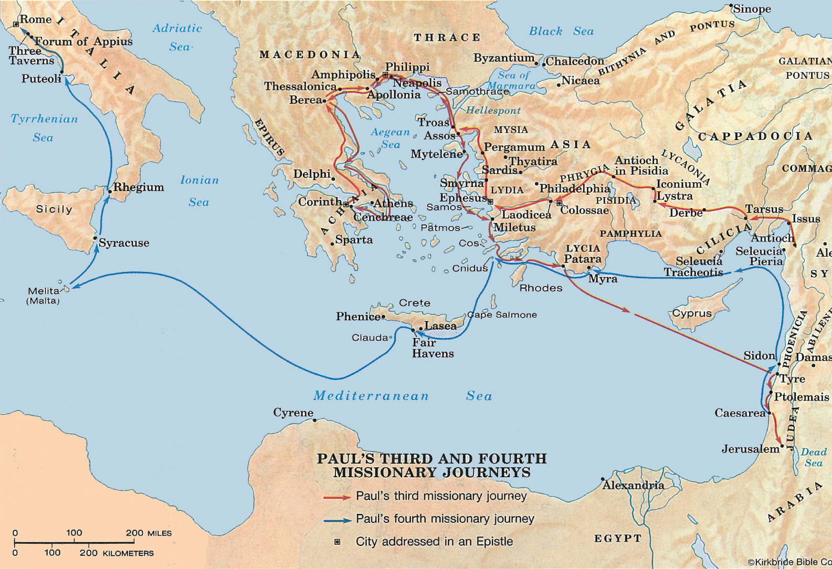

Slide 4
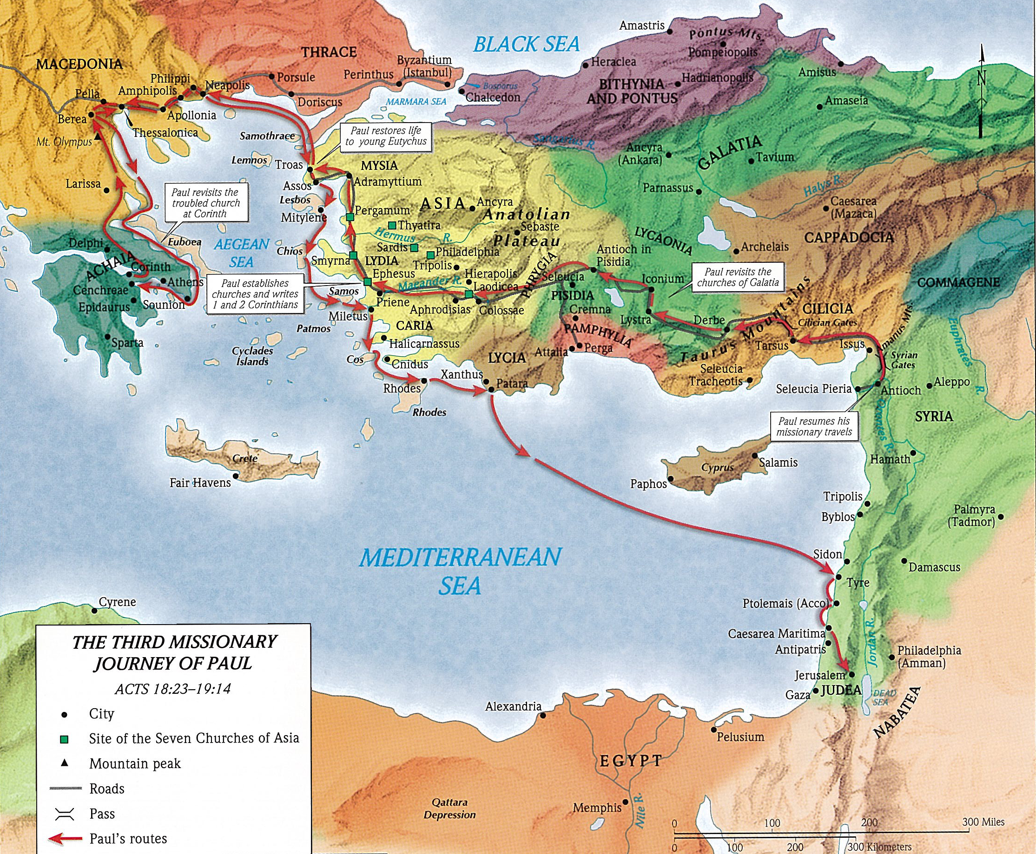

Slide 5
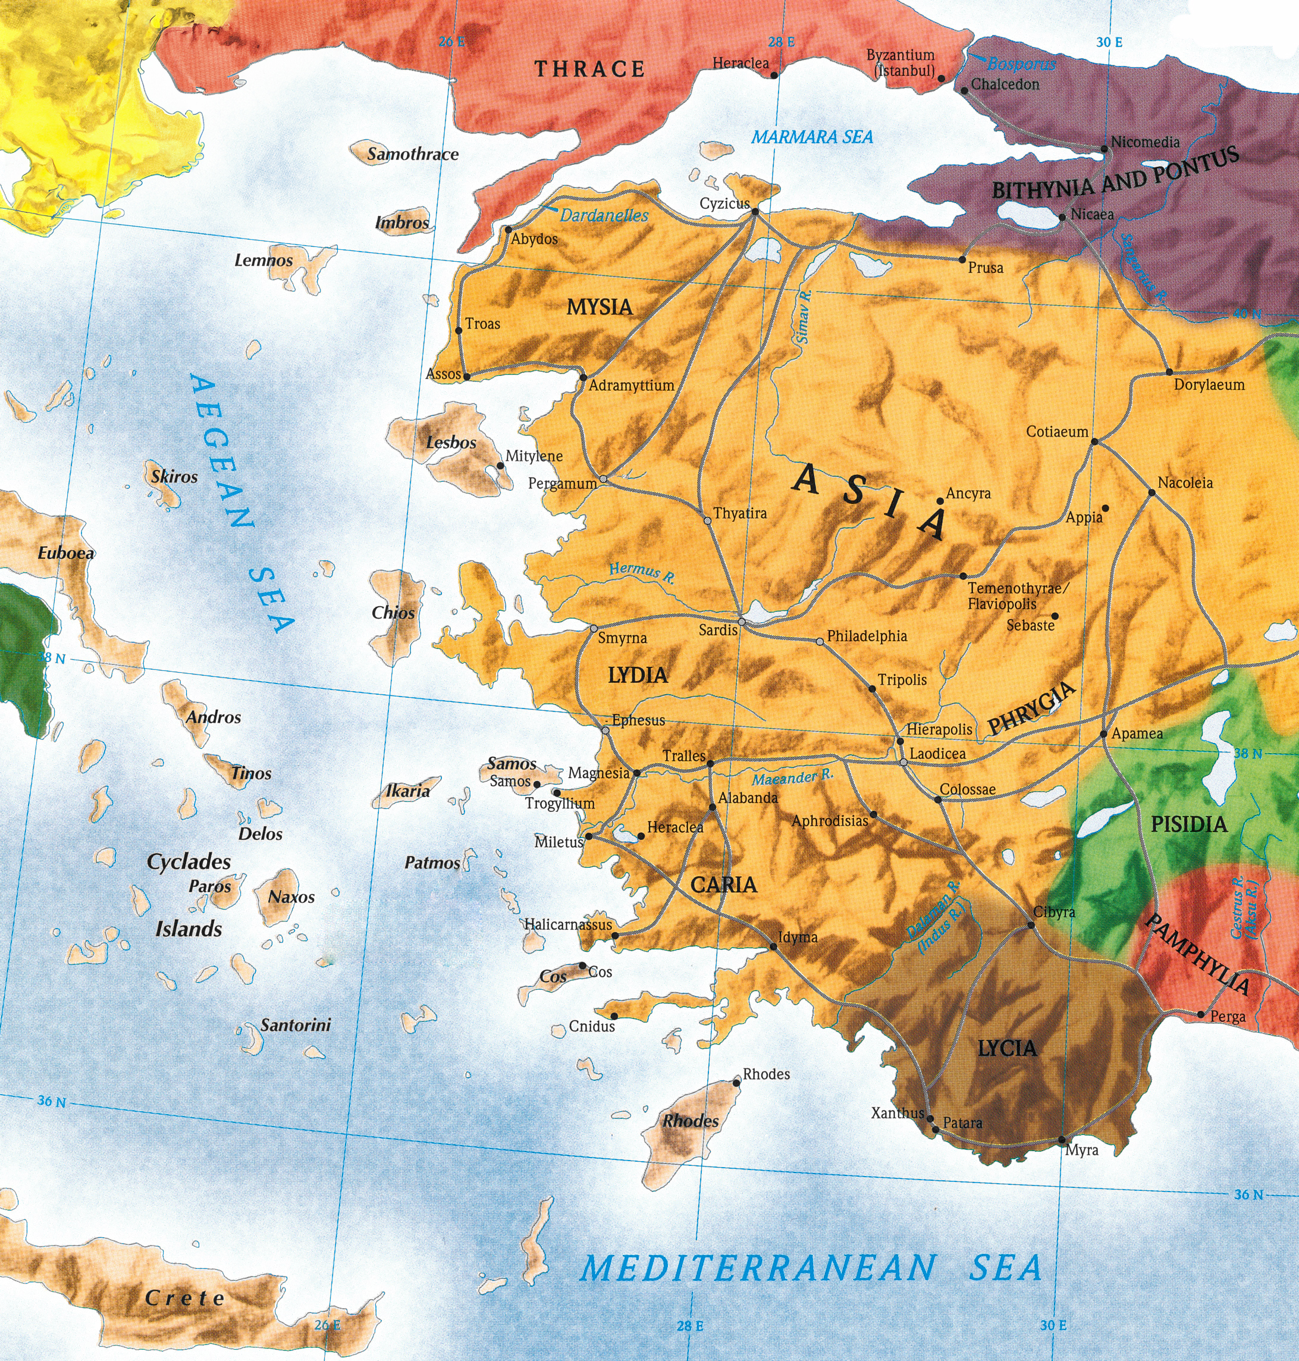

Slide 7
Some suggest that Paul had not been to Colosse (1:4; 2:1)
Some suggest that Epaphras established the church in Colosse (1:7; 4:12-13; cf. Acts 19:9-10)
There were Jews from Phrygia present in Jerusalem on Pentecost (Acts 2:10)
It is possible that Paul did establish this congregation
  Paul travelled in Phrygia (4:13) on his second missionary journey (Acts 16:6)
  Paul returned to Phrygia on his third missionary journey (Acts 18:23)
  It appears in the book of Philemon that Paul had insight into the Colossian church
The church was composed primarily of Gentiles (1:21, 27; 2:13), but also Jews

Slide 8
Paul was in prison in Rome (the first time) around 60-62 A.D. (Acts 28:30)
One of four “Prison Epistles” (Ephesians, Philippians, Colossians & Philemon)
Epaphras came from the church in Colosse to visit Paul in the Roman prison and brought word of false teaching that had infiltrated the church (1:7)
Tychicus and Onesimus carried the letter back to the church (4:7-9).

Slide 9
The false teaching threatening the church in Colosse contained elements of:
  Judaism:
  > insisted on strict observance of certain Jewish requirements (2:11, 14, 16)
  Greek philosophy:
  > a mindset of “superiority,” as “higher thought” philosophy (2:4, 8)
  Incipient Gnosticism:
  > claim to possess superior “knowledge” (Greek gnosis = “knowledge”)
  > claim all matter is essentially evil and that matter is the source of evil
These gnostic influences lead to the following erroneous conclusions:
  God and matter must be antagonistic to one another
  If matter is evil, God could not have created or governed the world
  God must have used intermediate beings to create and serve the world
  The body is evil and sinful: either must deny all fleshly desires or free to indulge
  If all flesh is evil, then Christ could not have become man
These false theories degraded the supremacy, authority and all-sufficiency of Christ

Slide 10
Ephesians and Colossians are sometimes called “Twin Epistles”
  Ephesians: Emphasizes the Church as the Body of Christ (Eph. 1:22-23)
  Colossians: Emphasizes Christ as the Head of the Church (Col. 1:18)
  Several phrases and passages are very similar and nearly identical
Colossians and Philemon are tied together (Col. 4:9, 17 + Phile. 2, 10)
  Philemon lived in Colosse, and he appeared to be a member of the Colossian church

Slide 11
The supremacy, authority and all-sufficiency of Christ is certain!
Two major sections (dividing the book in half)
  Chapters 1-2: The Doctrinal Section – Emphasizing the Supremacy of Christ
  Chapters 3-4: The Practical Section – Emphasizing Our Submission to Christ
Basic Outline
  Christ Is Preeminent in All Things (1:1-29)
  Christ Is the Answer to All Things (2:1-23)
  Christ Can and Will Change Your Life (3:1-4:18)

Slide 12
Paul’s Greeting to the Colossians (1:1-2)
Paul’s Thanksgiving for the Colossians (1:3-8)
Paul’s Prayer for the Colossians (1:9-14)

