Slide 1
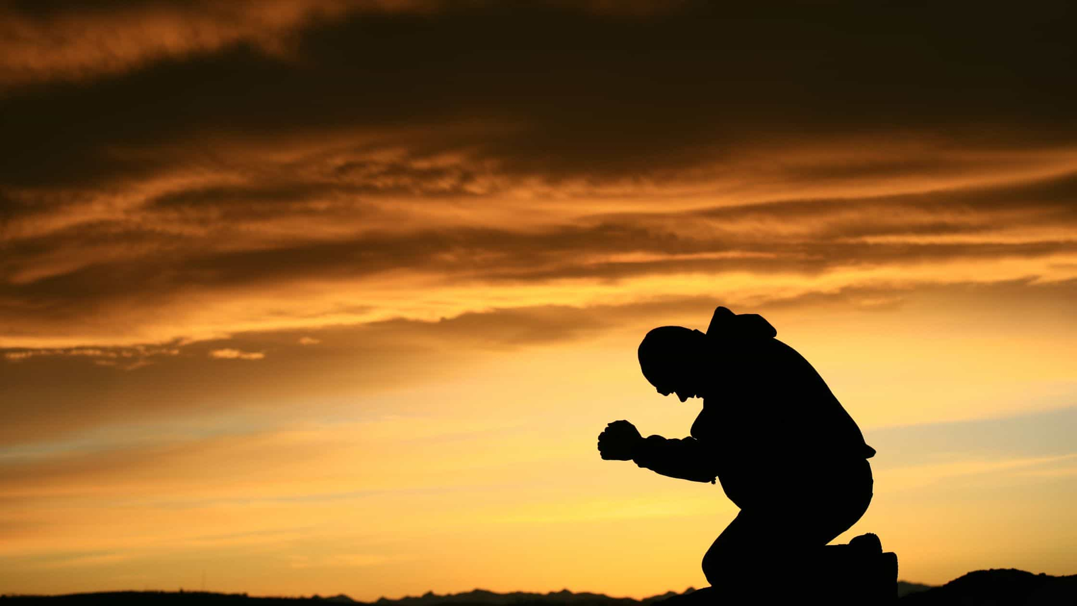
Will He Find Me…
On My Knees in Prayer?

Slide 2
What Is Prayer?

Slide 3
How Does Prayer Work?

Slide 4
What Can We Include in Prayer?

Slide 5
How Frequent Should Prayer Be?

Slide 6
Why is Prayer Important?

Slide 7
How is Your Prayer-Life?

