Slide 1
Bible Geography
Palm Beach Lakes
September-November, 2025
Dan Jenkins

Slide 2
Final Class—Overview
Bible Geography is vital to fully understanding God’s revelation of truth.
It begins in Genesis and ends in Revelation.
Our study has only been an “entry level” of study, do not let it be your last.
We have not looked at the missionary journeys of Paul and that covers so much of the New Testament.
These journeys will be part of an upcoming study at Palm Beach Lakes.
This final class will look at the geography at the destruction of Jerusalem in A.D. 70. This is a pivotal event in Bible history.

Slide 3
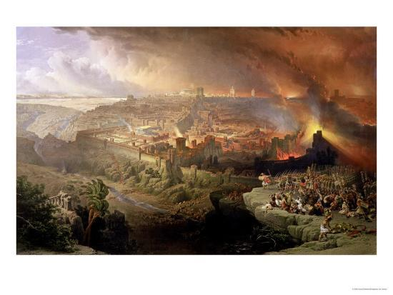

Slide 4
The Greatest Tribulation
The justice of God demands judgment against all evil. “For everyone to whom has been given, from him much will be required” (Luke 12:48).
Much was given to the descendants of Abraham. They were “the apple of His eye” and His chosen people above all others.
He prophesied what would happen to them even before they entered the Promised Land (Deut. 28).
Jesus taught that God’s extreme judgment was to come in “this generation”—the first century generation (Matt. 23:29-38)

Slide 5
The End of Jerusalem and the Temple
Matt. 23:9 "Woe to you, scribes and Pharisees, hypocrites! Because you build the tombs of the prophets and adorn the monuments of the righteous,
Matt. 23:30 and say, 'If we had lived in the days of our fathers, we would not have been partakers with them in the blood of the prophets.'
Matt. 23:31 "Therefore you are witnesses against yourselves that you are sons of those who murdered the prophets.
Matt. 23:32 Fill up, then, the measure of your fathers' guilt.
Matt. 23:33 Serpents, brood of vipers! How can you escape the condemnation of hell?
Matt. 23:34 Therefore, indeed, I send you prophets, wise men, and scribes: some of them you will kill and crucify, and some of them you will scourge in your synagogues and persecute from city to city,

Slide 6
The End of Jerusalem and the Temple
Matt. 23:35 that on you may come all the righteous blood shed on the earth, from the blood of righteous Abel to the blood of Zechariah, son of Berechiah, whom you murdered between the temple and the altar.
Matt. 23:36 Assuredly, I say to you, all these things will come upon this generation.
Matt. 23:37 "O Jerusalem, Jerusalem, the one who kills the prophets and stones those who are sent to her! How often I wanted to gather your children together, as a hen gathers her chicks under her wings, but you were not willing!
Matt. 23:38 See! Your house is left to you desolate.

Slide 7
The Great Revolt (First Jewish-Roman War)
In A.D. 66 Jews defeated Roman ruler in Jerusalem and set up Jewish government.
Nero decreed the end of Jerusalem and sent Vespasian (and his son, Titus) to bring an end to Judaism.
Nero came to Ptolemais in Galilee from Antioch and began his work.
At the first battle he captured Josephus, a commander of the Jewish army who recorded the details of the end of Jerusalem.
Roman army went from Galilee and besieged and destroyed the city—worst tribulation ever!
From Nero’s decree to the end was forty-two months (1260 days or 3½ years (cf. Revelation)

Slide 8
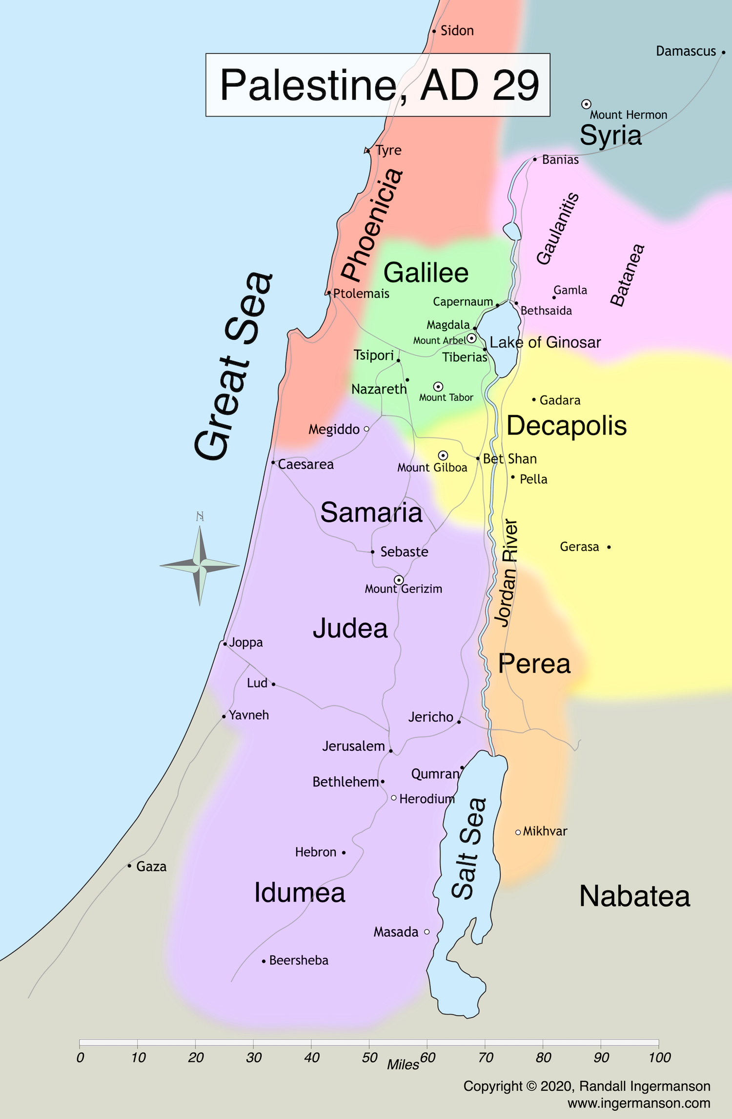
Roman Army
of Vespasian
From Ptolemais to Galilee to Jerusalem

