Slide 1
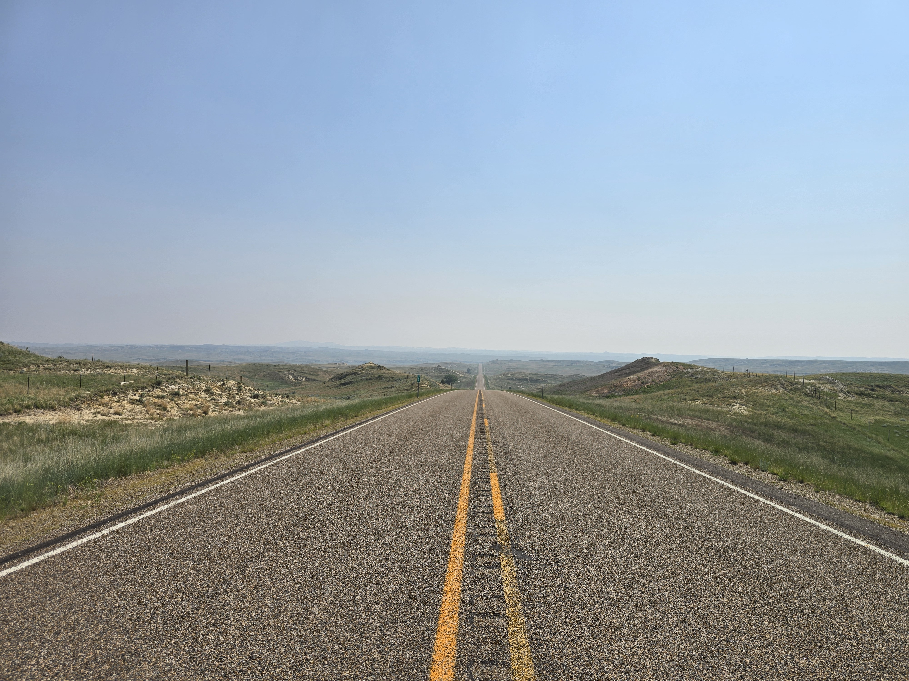
Lessons From the Road

Slide 2

The Local Church

Slide 3


The Work of the Local Church
Worship
Preaching
Maintenance
Bible Study
Evangelism
Leadership
Member Care
Activities

Slide 4

The Work of the Local Church
Worship
Preaching
Maintenance
Bible Study
Evangelism
Leadership
Member Care
Activities

Slide 5
The Strength Is Not Our Own

Slide 6
The Strength Is Not Our Own
It Never Has Been
Noah: Genesis 6:13-22
Abraham: Genesis 12:1-7
Moses: Exodus 3:1-11
Israelites: Leviticus 26:1-13
Gideon’s 300: Judges 7:1-8
The plans of God’s heart: Psalm 33:12-20

Slide 7
The Strength Is Not Our Own
It Never Will Be
The Apostles: Mat 28:16-20
Paul: 2 Tim 4:16-18; 2 Cor 12:7-10; Phil 4:13
The church: Eph 6:10-11; 2 Cor 4:7-18; 2 Thess 3:3; 1 Pt 4:11

Slide 8
The Strength Is Not Our Own
What Does That Mean For Me?
1 Peter 4:7-11
2 Timothy 1:6-8

Slide 9

The Work of the Church

