Slide 1

How to Control Your Temper and Your Words

Slide 2
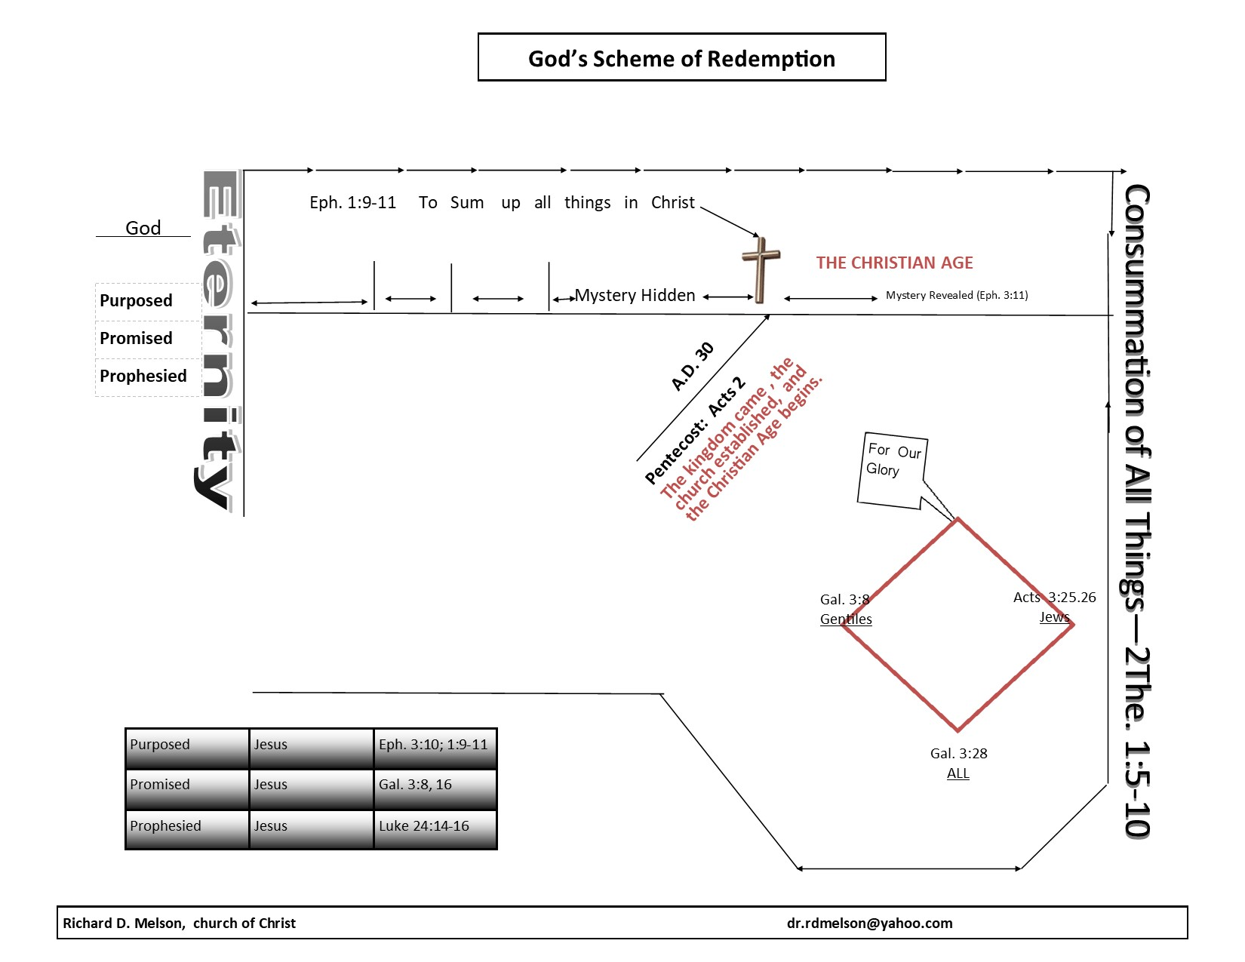

Patriarchal Law
The Promise
430 yrs
The Law of Moses
One Body

Slide 3
Beliefs
Values
Patterns
Behaviors
Our convictions; what we trust in based upon evidence.
Worth in usefulness; worthwhile
A form or mold; that which is reproducible
The action(s) that an individual does based upon the pattern developed, which is an outgrowth of the values that are rooted in certain beliefs.
Richard D. Melson
©

Slide 4
Faith / belief
Values
Patterns
Temper / The Behavior
Beliefs
Values
Patterns
Behaviors
Our convictions; what we trust in based upon evidence.
Worth in usefulness; worthwhile
A form or mold; that which is reproducible
The action(s) that an individual does based upon the pattern developed, which is an outgrowth of the values that are rooted in certain beliefs.
Richard D. Melson
©

