Slide 1


From Worry To Happiness
Lesson 4
Wednesday Night
Bible class
Palm Beach Lakes
church of Christ

Slide 2

From Worry To Happiness
Lesson 4
How to Deal with Fear

Slide 3
From Worry To Happiness
Lesson 4
Causes of Guilt
Sin
Conditioning
The Bible talks about proper conditioning
in Proverbs 22:6.
3. We can be conditioned for guilt.

Slide 4
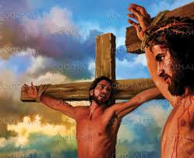
From Worry To Happiness
Lesson 4
Dealing With Regret
The thief on the cross. Luke 23:43
Did he have regrets? Did his regrets bring him to
a relationship with Jesus?

Slide 5

From Worry To Happiness
Lesson 4
What’s In Your Toolbox ?
Fruit of the Spirit
love, joy, peace, patience, kindness, goodness,
faithfulness, gentleness, and self- control.
Galatians 5:22

Slide 6
From Worry To Happiness
Lesson 4
Over Coming Worry
From the Mayo Clinic:
“The best way to control anxiety is to make use of the
opposite side of the brain. While anxious thoughts
occur in one half of our brain, thoughts of gratitude
occur in the other.”

Slide 7
From Worry To Happiness
Lesson 4
Over Coming Worry
1. Analysis
*Analize the situation you are worried about
2. Pray, pray, and pray some more
3. Action
* Take appropriate action. Plan ahead to succeed.

Slide 8
From Worry To Happiness
Lesson 4
Solution to Worry
The solution to worry comes through analysis,
prayer, action, acceptance, service, and trust.
Our lives may be permanently altered, but do not
have to be wrecked

Slide 9
From Worry To Happiness
Lesson 4
Step 2
Controllable worries (actionable)
a. Ask yourself “ What can I do about this?”
b. Gather the facts: Don’t jump to conclusions.
c. Brainstorm solutions.
d. Create an action plan: Decide a course of action

Slide 10
From Worry To Happiness
Lesson 4
Step 4
Examine your thoughts
a. Question the assumptions
b. Consider alternative perspectives
c. Assess the likelihood.

Slide 11
From Worry To Happiness
Lesson 4
Identify unhelpful thinking patterns
Catastrophizing: Expecting the worse of the worse.
Emotional reasoning: Believing that because
you feel something, it must be true.
c. Seeing things with no middle ground.

Slide 12
From Worry To Happiness
Lesson 4
Catastrophic Thinking
“Catastrophic thinking is a cognitive distortion that occurs when people have a hard time weighing the likelihood of certain outcomes and believe that terrible or catastrophic outcomes—which are highly unlikely—become, in one’s mind, salient and extremely likely,” Dr. Zaubler explained, noting “it can lead to a lot of suffering.”
Dr. Zauber , Psychiatrist, MD, MPH

Slide 13
From Worry To Happiness
Lesson 4
Catastrophic Thinking
The biology of catastrophic thinking involves overactivity in brain regions like the amygdala (fear center) and thalamus, linked to heightened threat sensitivity and pain processing, driven by neurochemical releases that create a fear/stress response, strengthening neural pathways for negative spirals, often rooted in past trauma or anxiety, making the brain learn to expect the worst.

Slide 14

From Worry To Happiness
Lesson 4
91 % of what we worry about never comes true.

Slide 15
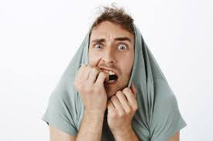
From Worry To Happiness
Lesson 4
How to Deal with Fear

Slide 16
From Worry To Happiness
Lesson 4
Certain fears have a purpose
* Fear of a car coming makes you get out of the way.
* Being fearful of a red-hot stove causes us to stay away.
* Moses instructed to “fear Jehovah” Deut. 6:2
* Eccl. 12:13.. “Fear God and keep His commandments.”
* A function of fear is to lead us away from evil or harm.

Slide 17
From Worry To Happiness
Lesson 4
Phobias
Fear of heights - Acrophobia Fear of flying - Aerophobia
Fear of clowns - Coulrophobia Fear of birds - Ornithophobia
Fear of closed spaces – Claustrophobia Fear of washing – Albutophobia
Fear of open spaces – Agoraphobia Fear of dogs - Cynophobia
Fear of flowers – Anthophobia Fear of cats –Ailurophobia
Fear of being afraid - Phobophobia

Slide 18

From Worry To Happiness
Lesson 4
The Roller Coaster Experiment

Slide 19
From Worry To Happiness
Lesson 4
Are We To Fear God ?
The fear of God has to do with wisdom. Prov. 9:10, Psalm 111:10
God’s creation is commanded to fear Him. Leviticus 25:17
We gain mercy from fear. Luke 1:50
Malachi 2:5, and Lev. 25:17, fear is “yare” in Hebrew.
Reverence, stand I awe.
- God’s expectation. Acts 9:31.

Slide 20
From Worry To Happiness
Lesson 4
Taking a Look At 1 Peter 5:7
* Casting “epiripto in the Greek”
Like a man who throws his load on a camel’s back.
* “Casting” is used in Luke 19:35
* Our God wants to do this for us.
* He cares for us. Cares: “auto melei” in the Greek.

Slide 21
From Worry To Happiness
Lesson 4
On the other hand, the Bible teaches us not to fear.
Isaiah 41:10 – Fear not , for I am with you …..
Isaiah 41:43 – Fear not, I am the one who helps you.
Joshua 1:9 – Be strong and courageous.
I John 4:18 – There is not fear in love, but perfect love drives out fear.
Psalm 23:4- I will fear no evil, for you are with me…
Philippians 4:6- Do not be anxious about anything…

Slide 22
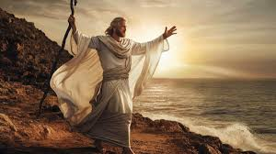
From Worry To Happiness
Lesson 4
Bible Characters Demonstrating Courage
Moses
-Faced his insecurities and fears by responding
to God’s call.
-Motivated by God’s vision of him helping
to save his people.
-His bravery is inspiring people even today.

Slide 23
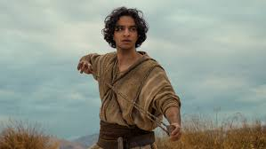
From Worry To Happiness
Lesson 4
Bible Characters Demonstrating Courage
David
- Had the courage to battle a giant.
- Steadfast confidence.
- Believed that God would protect him like many
times before.
- Was victorious with God on his side.

Slide 24
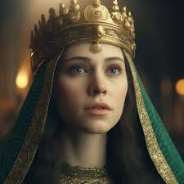
From Worry To Happiness
Lesson 4
Bible Characters Demonstrating Courage
Esther
- Risked her life to save her people.
- Believed in God’s plan.
- Believed in the power of prayer.
- Great example of faithful sacrifice.

Slide 25
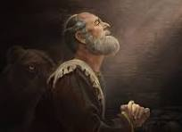
From Worry To Happiness
Lesson 4
Bible Characters Demonstrating Courage
Daniel
- Even when there was adversity, he prayed.
- Chose gratitude of God over fear of people.
- Had deep confidence in God.
- Prayed constantly, even when it was against the law.

Slide 26
From Worry To Happiness
Lesson 4
The Effects of Fear
1 John 4:18 tells us that fear torments us.
In some ways , fear is connected to bondage.
Romans 8:15 tells us we did not receive the spirit of bondage.
Fear takes initiative away. Look at Numbers 13.
Fear takes hope away.
God does not want us to be fearful. Revelation 21:8

Slide 27
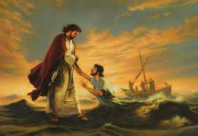
From Worry To Happiness
Lesson 4
The Causes of Fear
Foremost, Satan. Adam feared God because he
obeyed Satan.
Peter was afraid. Matthew 14:30.
How one was raised.
Personal history.

Slide 28
From Worry To Happiness
Lesson 4
Types of Fear
-Fear of Failure Matthew 25:25, 1 Cor. 15:58
-Fear of Responsibility Matthew 25:25
-Fear of Insecurity Matt. 6:24-34 Psalm 37:25 Phil. 4:19
-Fear of Social Anxiety Galatians 2: 6-21

Slide 29
From Worry To Happiness
Lesson 4
The Cure For Fear
Gain insight into what gives you fear.
If fear is a result of sin, we know we can turn away from sin.
If fear comes from your past, your problem is not with God.
Psalm 23 teaches about closeness with God.
Psalm 18:6 teaches us about the power of God.
Psalm 46 teaches us that God is our refuge.

Slide 30
From Worry To Happiness
Lesson 4
Satan wants us to fear
Diminishes our courage and cause us to retreat.
Affects our ability to do the things we need to do.
Steals our peace of mind.
Influences rational thoughts and actions in a negative way.
2 Timothy 1:7 – “For God has not given us a spirit of fear, but
of power and of a love and of a sound mind.”

Slide 31
From Worry To Happiness
Lesson 4
Satan wants to:
Stop or slow our spiritual growth.
Decrease our faith in God.
Confuse us about our purpose.
Turn from God completely.

Slide 32
From Worry To Happiness
Lesson 4
Taking a Deeper Look at Philippians 4:6
*Scripture says be anxious for nothing. (merinao)
*But God gave us anxiety to keep us away from danger.
The Greek phrase that is used - “to be pulled in several
directions at one time”. Fragmented by worries.

Slide 33
From Worry To Happiness
Lesson 4
Connection Between Faith and Fear
Even death can be attacked through faith. Mark 5:35-42
Paul faced death with faith. 2 Timothy 4:8.
Relationship between anxiety and believing. John 14:1.
Fear can be driven away. 1 John 4:18

Slide 34
From Worry To Happiness
Lesson 4
Looking At Matthew 6:19-24
My Anxiety Reveals What I Value
*We can fall into prioritizing worldly values.
*Because money, health, reputation, and relationships are valuable to us,
we become anxious when what we love becomes threatened.
*If we prioritize God’s values we will view the dangers around us
differently.

Slide 35
From Worry To Happiness
Lesson 4
My Anxiety Reflects My View of God
* ” Worry is not believing God will get it right, and bitterness is
believing God got it wrong.”
* Sometimes we seek to control our destiny and focus our attention on what we want most.
* Are we wise enough to know how are our lives should go?

Slide 36
From Worry To Happiness
Lesson 4
The Fear of the Unknown Future
*God knows the future perfectly. Romans 8:28
*God is the only one that knows the future. Isaiah 46:9-10 (Not Satan)
*We can live our lives with excitement when we trust in God.
*If we know that our future is being with Jesus in Heaven, why not
spend time meditating on this eternal thought than what will happen
tomorrow.

Slide 37

2026 !!!
Happy New Year !!

