Slide 1


Slide 2
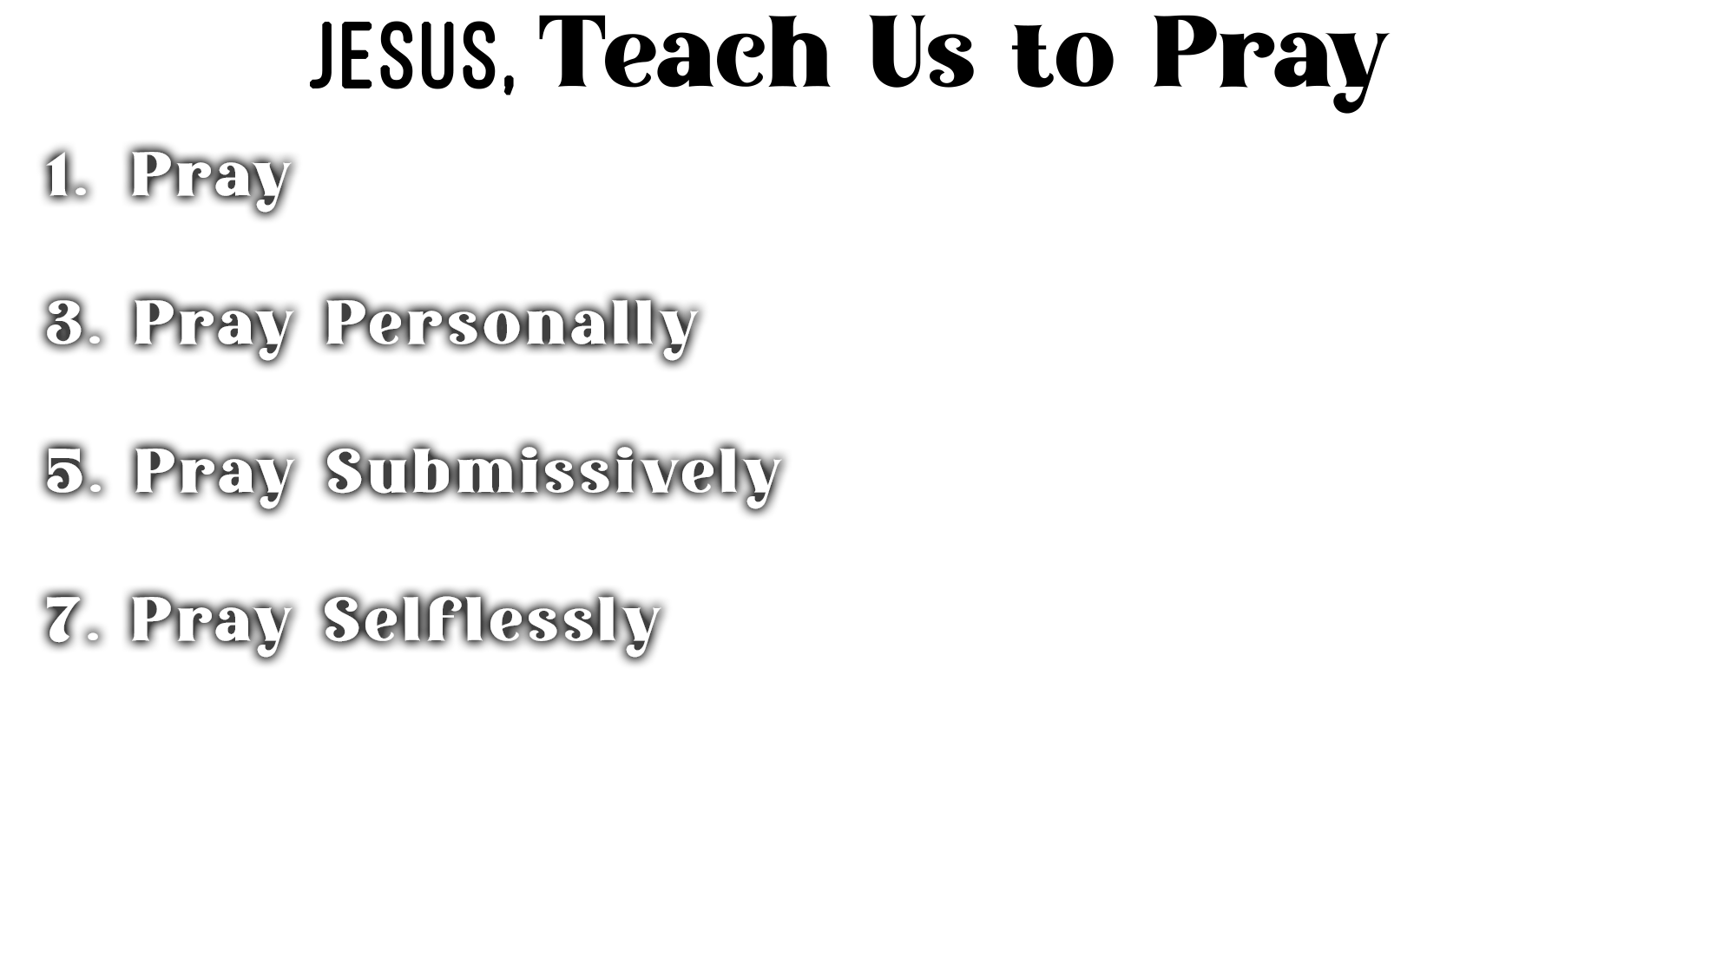
“When you pray” assumes you pray and urges you to pray (11:2)
Open your heart and talk to God simply and sincerely (Matt. 6:5-13)
We should follow the example of Jesus (Luke 5:16)

Slide 3
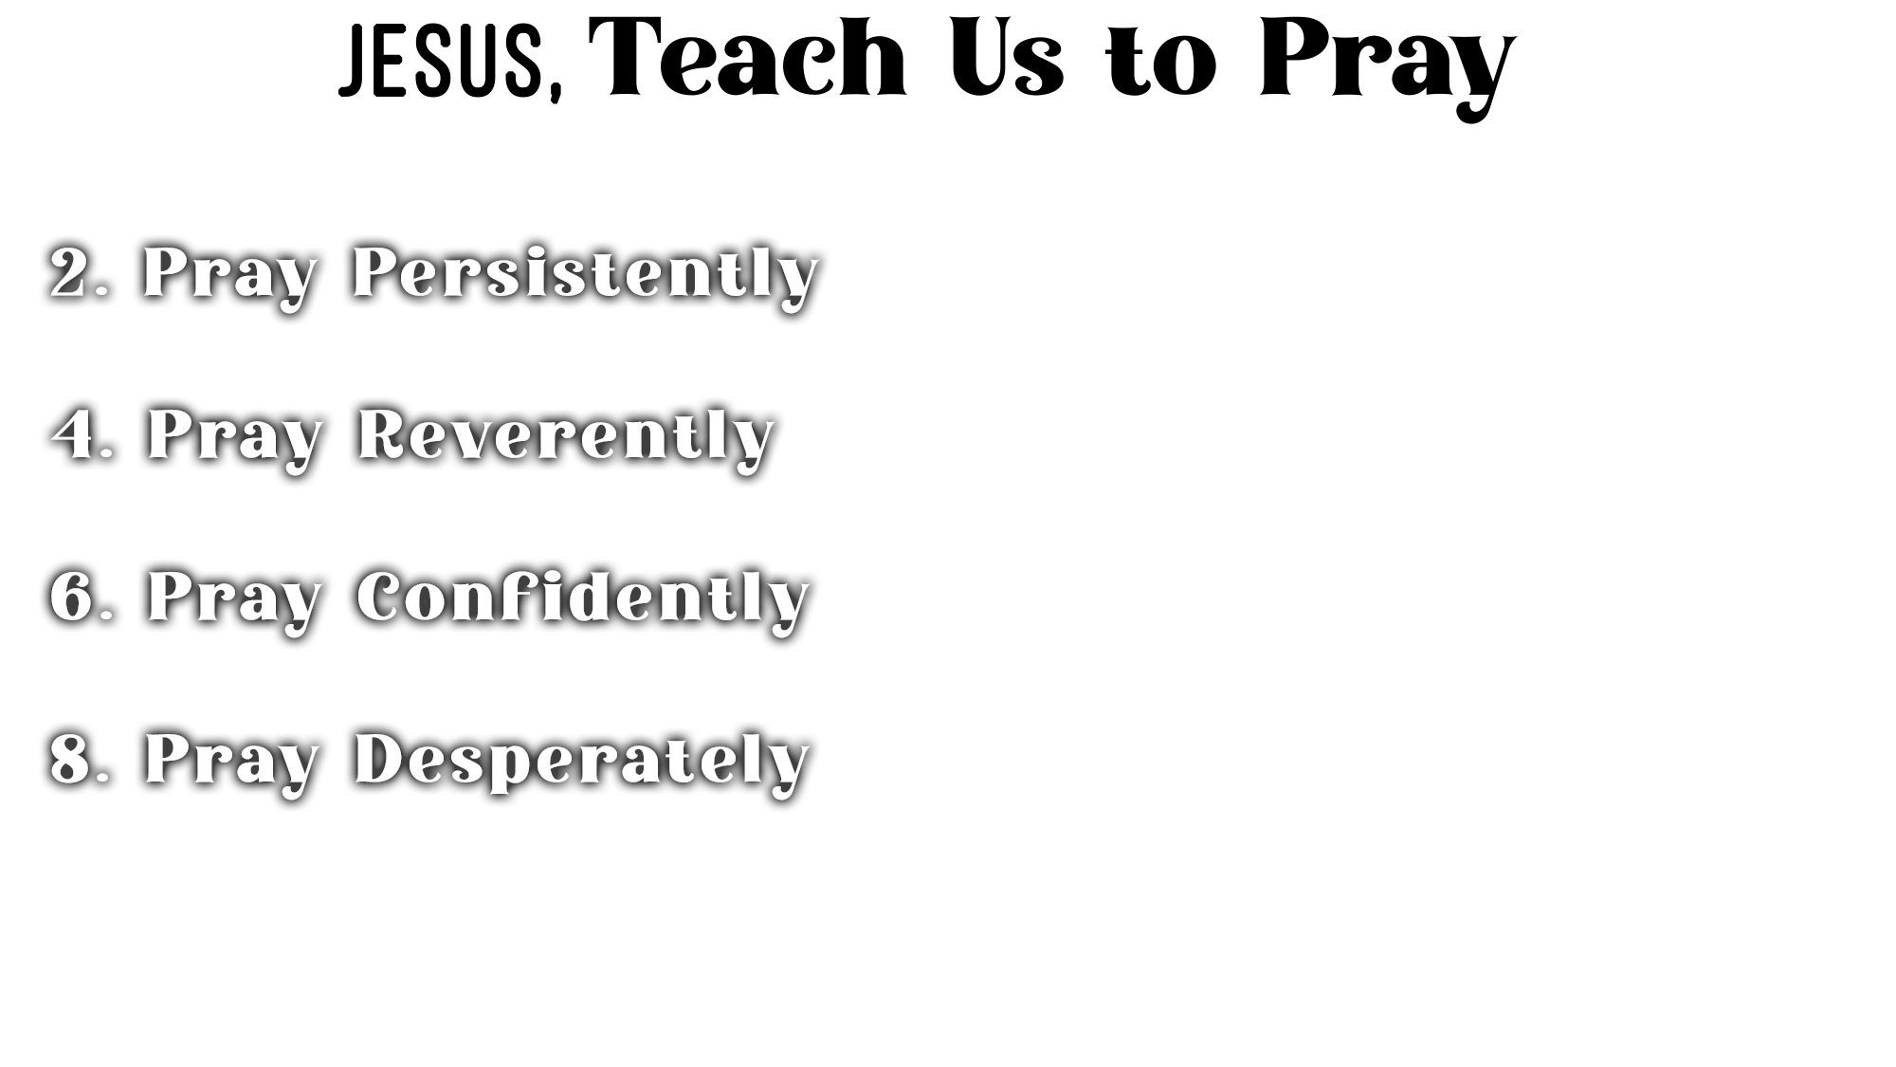
We should pray daily (11:3) and nightly (11:5)
We should pray continually and repeatedly (11:9-10; Col. 4:2; 1 Th. 5:17)
We should follow the example of Jesus (Luke 5:16)

Slide 4
We are praying to our “Father” (11:2, 13; John 15:16; 16:23)
A true Father cares and wants the best (1 Pet. 5:7)
A true Father gives the best (Luke 11:13; Matt. 7:11; Jas. 1:17)
We should follow the example of Jesus (Mark 14:36; Luke 23:34, 46)

Slide 5
“Hallowed” is a verb = “treat as holy and sacred, consecrate, reverence”
God must be approached and addressed as the One who is holy
(Isa. 6:3; Rev. 4:8; Lev. 10:1-3)
We should follow the example of Jesus (John 17:11, 25)

Slide 6
Pray for His kingdom/church, recognizing it belongs to Him (Eph. 3:9-11)
Pray with deference for His will to be done (Mt. 6:10; 1 Jn. 3:21-22; 5:14)
Pray in Jesus’ name (John 15:16; 16:23)—in harmony with His authority
We should follow the example of Jesus (Matt. 26:39-44)

Slide 7
Pray with boldness (11:3; Heb. 4:16)
Pray with absolute trust that He hears and will respond with the very best (11:3, 13; Jas. 1:5-8, 1 John 3:21-22; 5:14-15)
Pray expecting generosity—not stinginess—because God delights to give (11:11-13; Eph. 3:20; Psa. 84:11)
Whatever God says “will” happen (11:9) “will” definitely happen (11:10-13)
We should follow the example of Jesus (John 11:42)

Slide 8
The words “us” and “our” are used throughout the prayer (11:2-4)
Prayer is designed for “us” to intercede to God on behalf of others
(Jas. 5:16; Matt. 5:44; 1 Tim. 2:1-3)
We should follow the example of Jesus (John 17:1-26; Luke 23:34)

Slide 9
There is nothing we need to receive more desperately than forgiveness of sins
(11:4; Isa. 59:1-2; Psa. 51)
There is nothing we need to resist more desperately than temptation to sin
(11:4; Jas. 1:13-16; 1 Pet. 5:8; 1 Cor. 10:13; 2 Pet. 2:9)
We should follow the example of Jesus (Luke 22:44; Heb. 5:7)

Slide 10
Jesus NEVER
Taught to Pray
(i.e., a Sinner’s Prayer)
to Be Saved!

Slide 11
Believe that Jesus is the Son of God – John 8:24
Repent of your sins and turn toward God – Luke 13:3
Confess your faith in Jesus Christ – Matthew 10:32
Be immersed into Christ – Mark 16:16
  God will forgive all of your sins – Acts 2:38
  God will add you to His church – Acts 2:47
  God will register you in heaven – Hebrews 12:23
Faithfully obey your Father in heaven – Matthew 7:21

