Slide 1
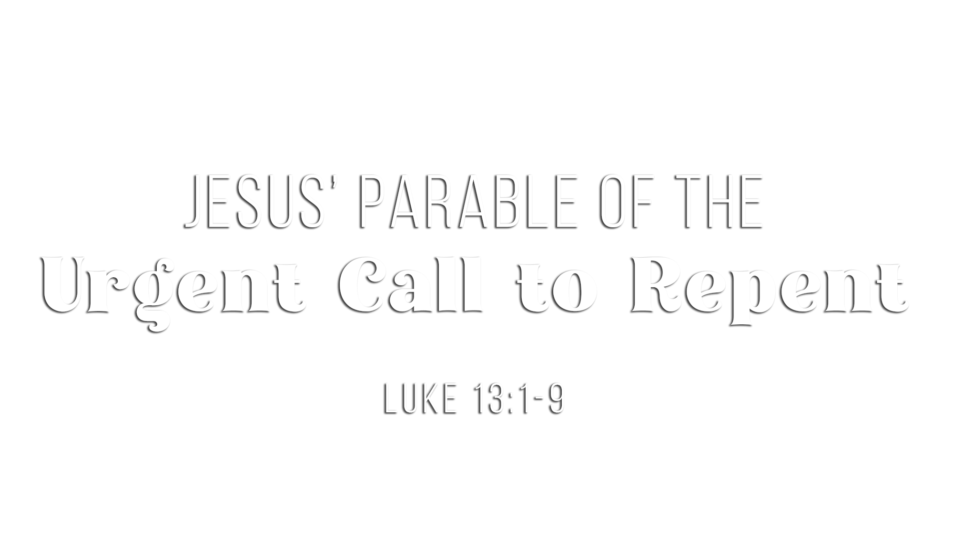

Slide 2
Earthly suffering is not always tied to personal sin
(Luke 13:1-5; John 9:1-3; Ecc. 9:11)
Eternal perishing is always tied to lack of repentance from sin
(Isa. 59:1-2; Rom. 2:5-9)
Our loving God deeply desires that we repent, so He:
  Defines what repentance is (2 Cor. 7:10; Matt. 21:28-32)
  Draws us to repent through His goodness and severity (Rom. 2:1-16)
  Demands with urgency that we repent of our sin (Luke 13:3, 5; Acts 17:30)
Many today need to repent:
  Of misplaced priorities (Matt. 6:33)
  Of ungodly behaviors and speech (Eph. 4:25-32; Gal. 5:19-21)
  Of failing to do what God commands (Jas. 4:17; Mark 16:15)
  Of worshiping in ways God has not authorized (Lev. 10:1-3; John 4:23-24)
  Of involvement in manmade religion and doctrine (Matt. 7:21-23; 15:1-20)

Slide 3
God “seeks” and expects to “find” fruit on trees that He plants (Luke 13:6-7)
  Fruit trees have one purpose = produce fruit
  Christians have one purpose = produce fruit for Christ (Rom. 7:4; John 15:1-8)
  Fruit is “find”-able in our lives through our attitudes of heart (Gal. 5:22-23)
  Fruit is “find”-able in our lives through our good works (Eph. 2:10; Col. 1:10)
  Fruit is “find”-able in our lives through our converts to Christ (1 Cor. 3:5-15; Col. 1:6)
God will not tolerate fruitlessness in His trees (Luke 13:6-7)
  To God, a tree/Christian that bears no fruit…
    Is useless (Matt. 5:13; John 15:1-5)
    Is a waste of space (Luke 13:7; Heb. 6:7-8)
    Is subject to eternal hell (Matt. 3:10; 7:19; John 15:6)

Slide 4
God’s justice demands punishment for sin
(Luke 13:7b; Heb. 10:26-31; Nah. 1:3; Rom. 3:23)
Jesus lovingly intercedes
(Luke 13:8; Heb. 7:25; 1 John 2:1-2; Rom. 8:34)
God is longsuffering
(Luke 13:7; 2 Pet. 3:9, 15; Ezek. 33:11; Rom. 2:4)
God has a limit to His tolerance of sin
(Gen. 6:3-7; 15:16; Luke 19:41-44; Heb. 3:7-19)
God’s judgment may be delayed but it is certain
(Luke 13:7; 2 Pet. 3:1-10; 2 Cor. 5:10; Acts 17:31)

Slide 5
Believe that Jesus is the Son of God – John 3:16
Repent of your sins and turn toward God – Luke 13:3
Confess your faith in Jesus Christ – Romans 10:9
Be immersed into Christ – Acts 22:16
  God will forgive all of your sins – Acts 2:38
  God will add you to His church – Acts 2:47
  God will enroll you in heaven – Hebrews 12:23
Faithfully bear fruit to Christ – John 15:1-8

