Slide 1


God still sees
Exodus 2:23–25

Slide 2


The Context

Slide 3

The new king
Enslavement (Ex 1:11)
Genocide (Ex 1:16)
The death of the new king
Change of government usually implies change of treatment
Things did not change (1 Kings 19:4)

Slide 4

The Cry

Slide 5
They groaned
Lam 1:11; Joel 1:18
They cried out
Ps 42:3
Their cry for mercy
Ps 34:15
Their groaning
Ezek 30:24

Slide 6



The covenant

Slide 7
God does not forget us
Memory is a bringing to mind (Gen 15:16)
God keeps his promises
Abraham (cf. Heb 10:23)
Trust is tough (Josh 1:5–6)

Slide 8

The condition

Slide 9
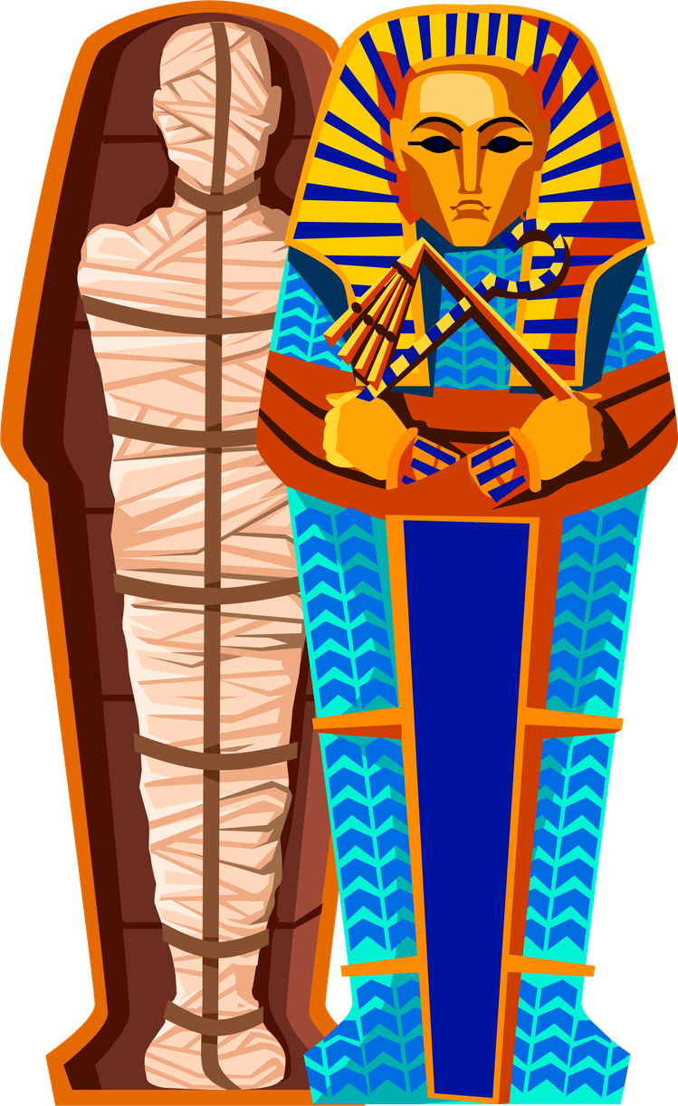
God is provident
Gen 16:13
God is aware
Heb 6:10

Slide 10

God still sees
God still hears
God still remembers
God still knows

