Slide 1
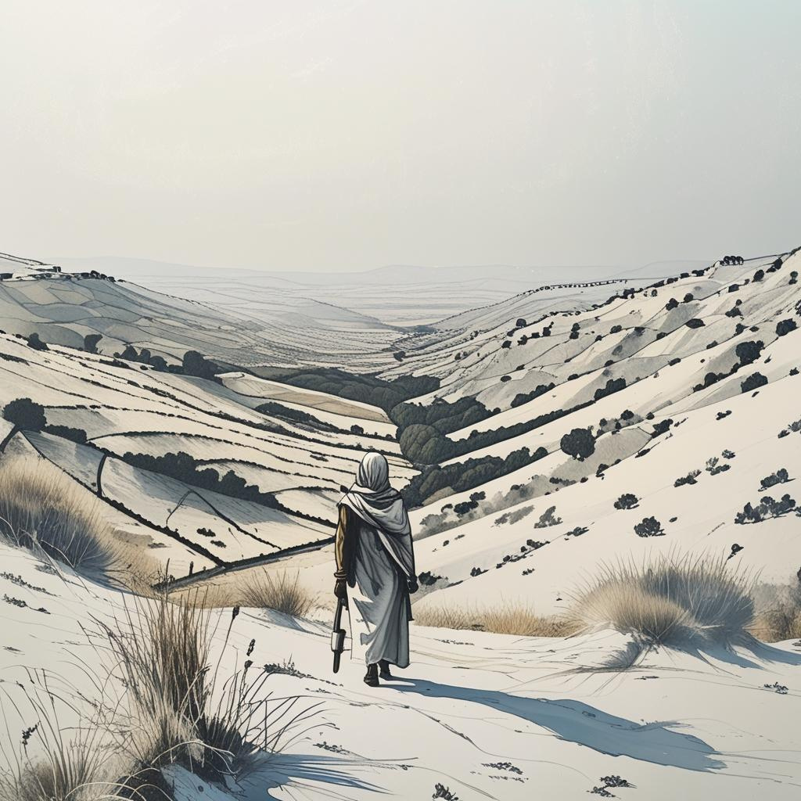
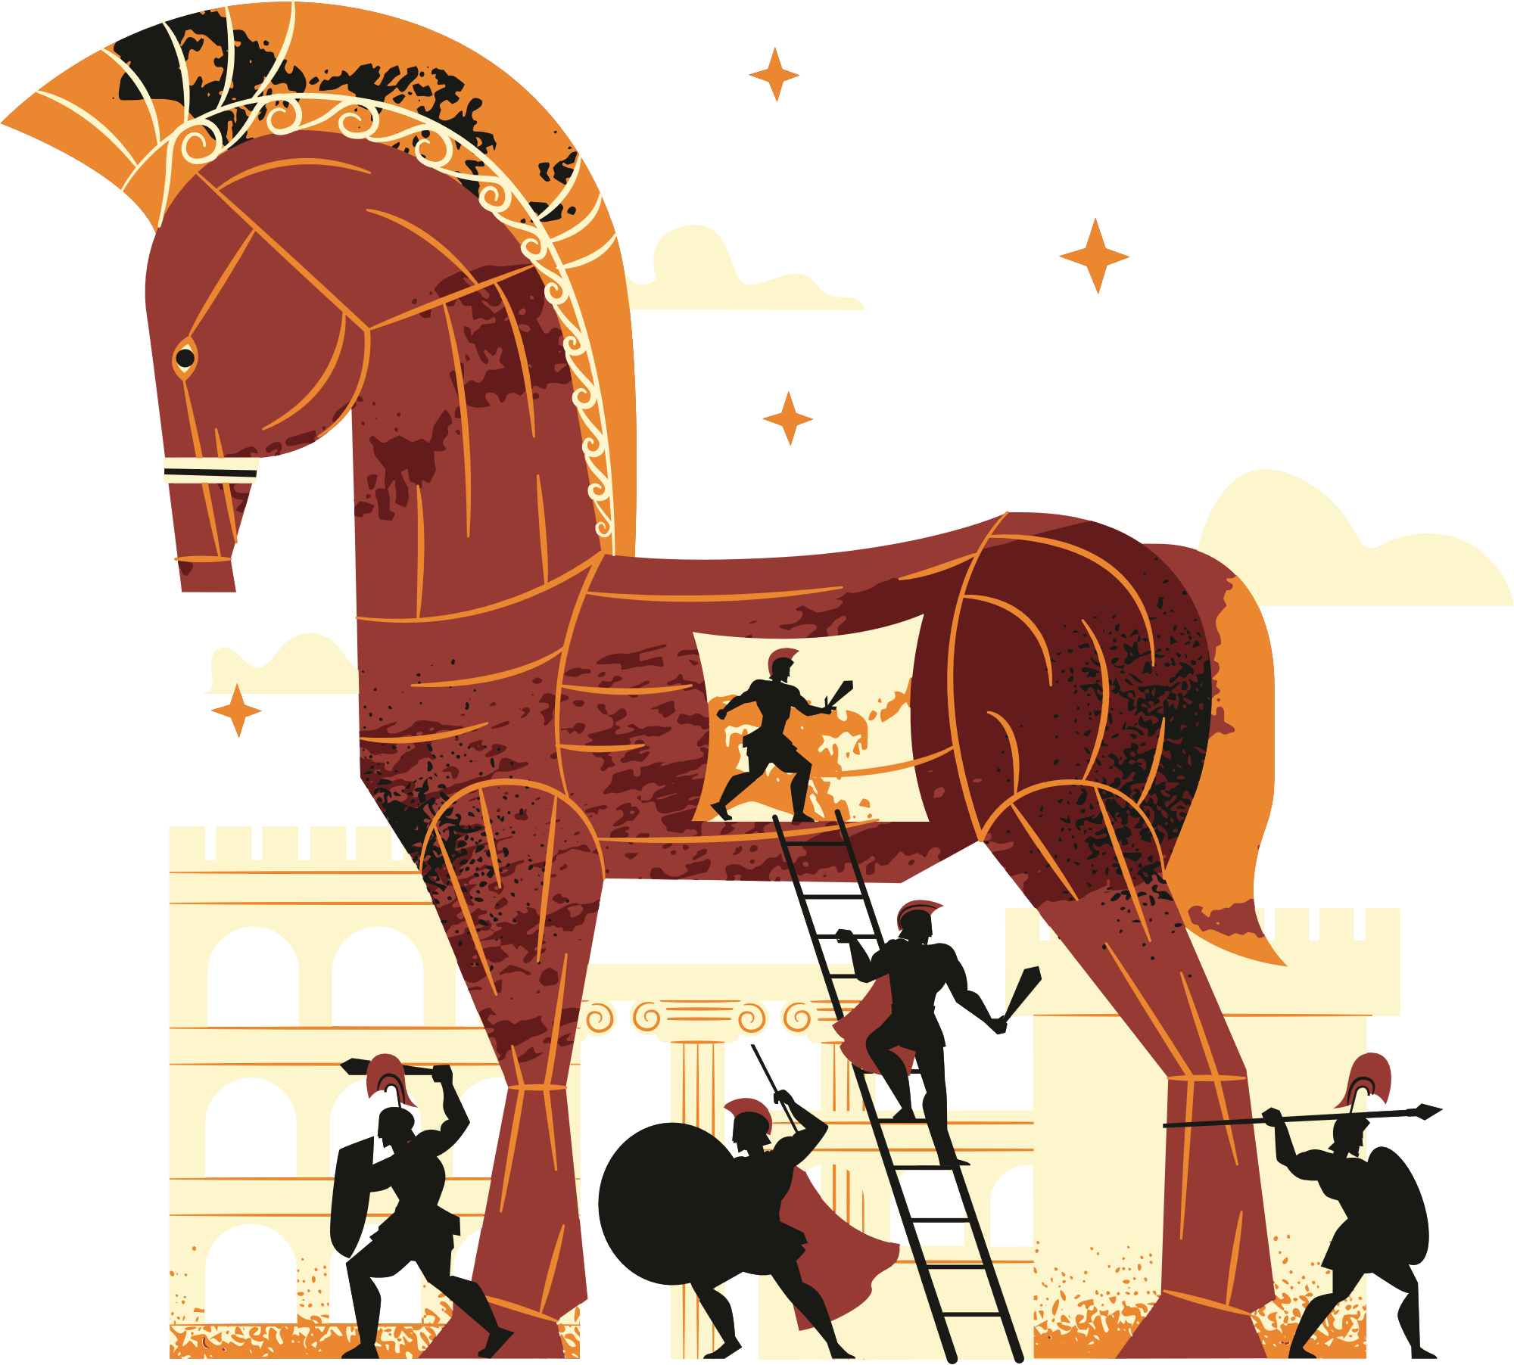

God Still Shows
Judges 6:33–40

Slide 2
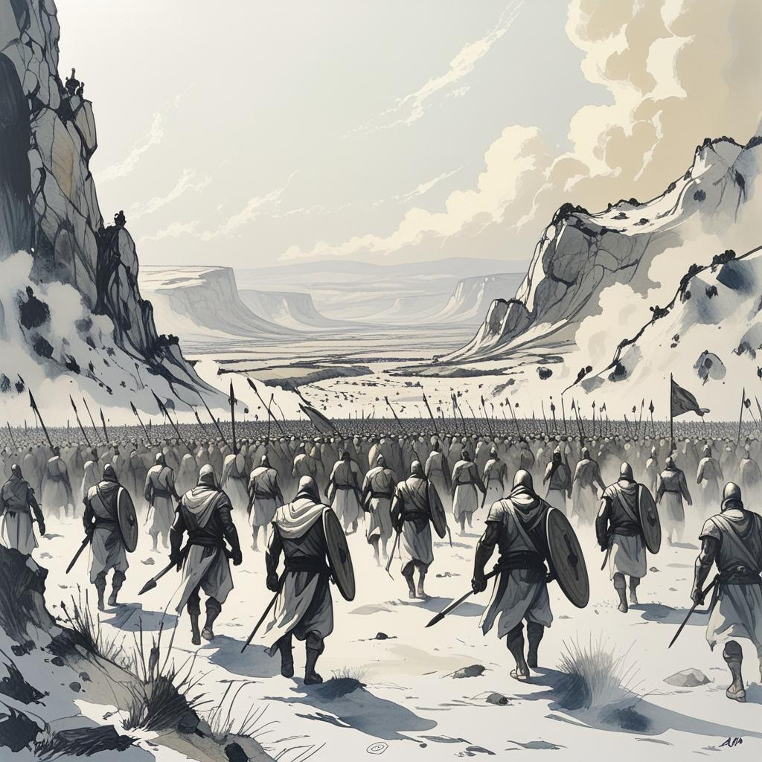
Three Facts
I. The enemy is great
Do not dismiss your doubts
Do not surrender to your doubts

Slide 3
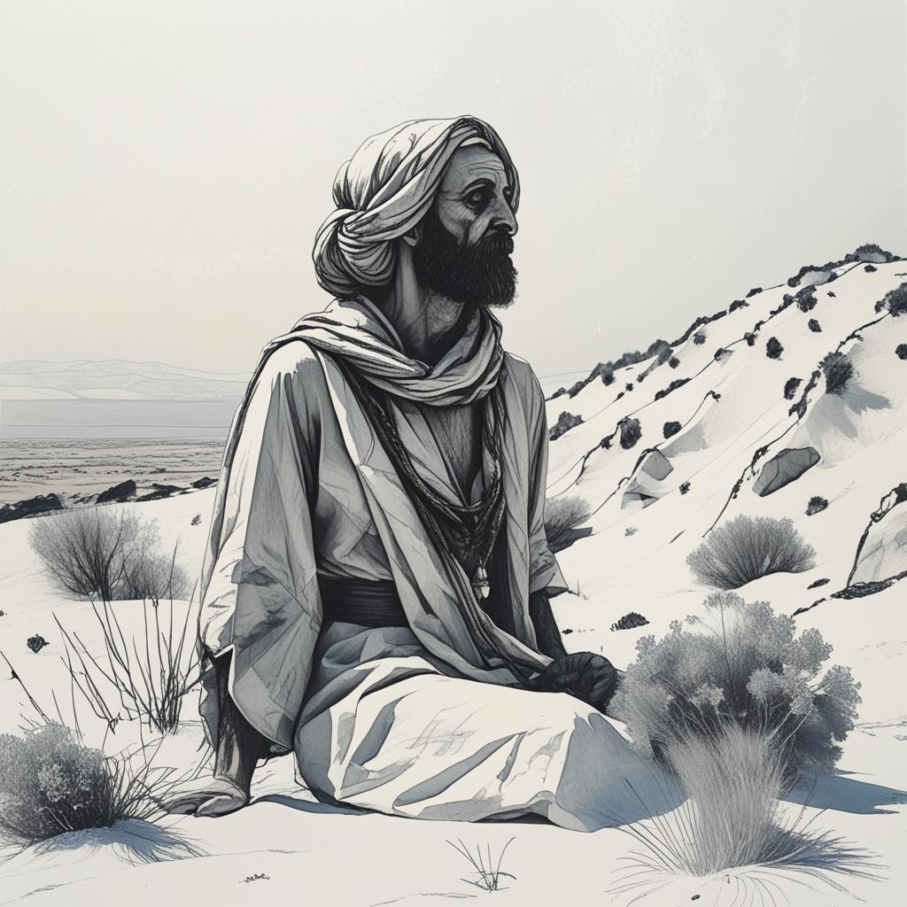
Three Facts
II. God is with us
God is not afraid of the skeptic (1 John 4:1)
III. Ask for help

Slide 4
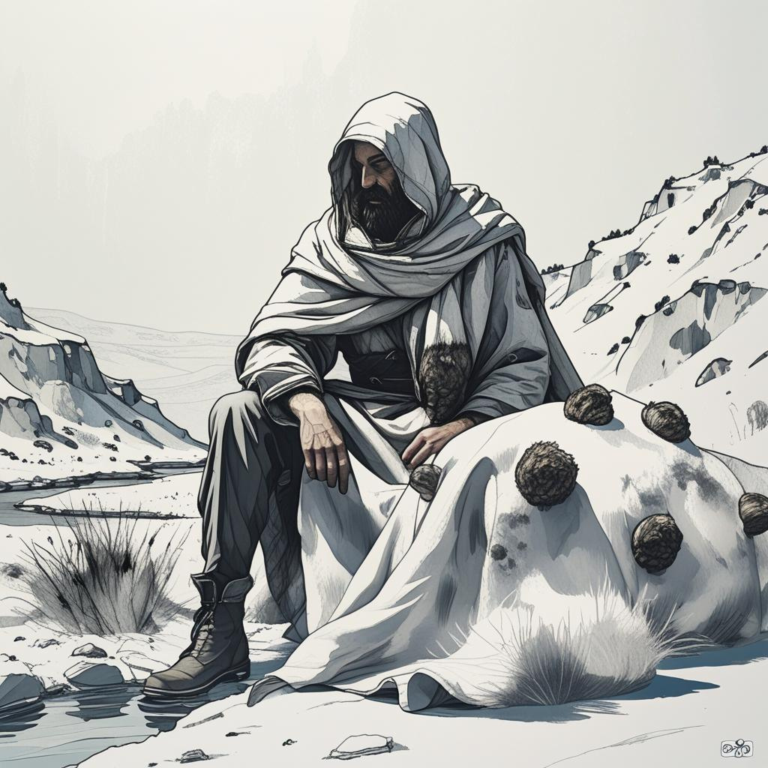
Two Fleeces
Recognize who is in charge
God has answers; we do not (Rom 11:33)
Listen to God

Slide 5
Two Fleeces
Test God in trust
Moses says “No” (Deut 6:16), but Malachi says “Yes” (3:10)
God is strong enough for our questions (Jer 20:7)

Slide 6
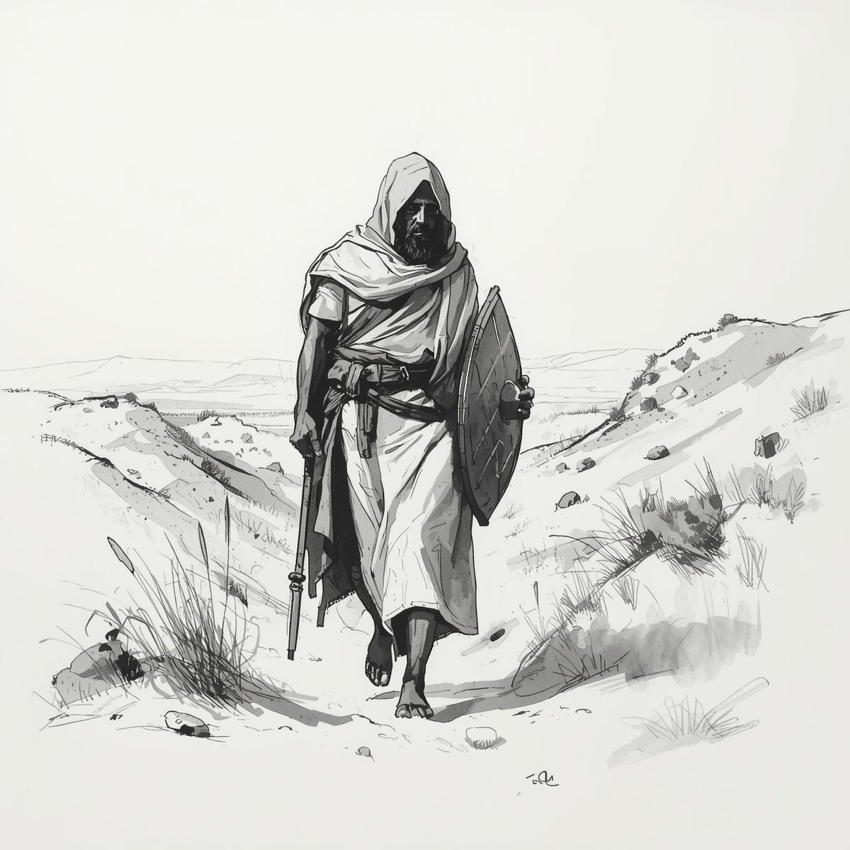
Conclusion
It is good to have questions (that means you’re studying
God is not threatened by your questions
Bring your questions to him

