Slide 1

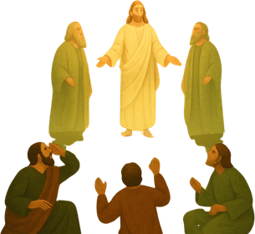

God Still Speaks
Matthew 17:1–8

Slide 2
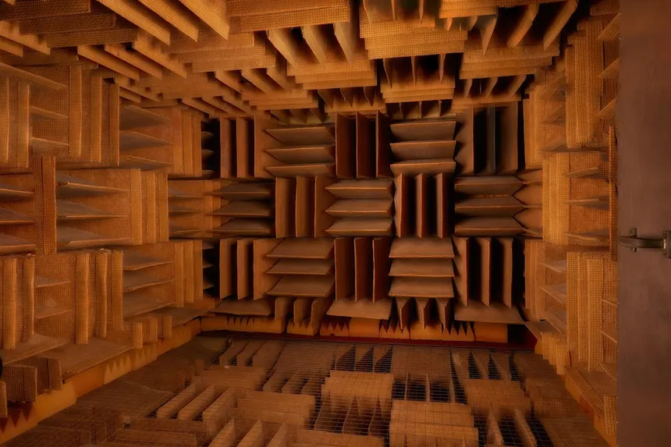

Slide 3

Failure to Listen

Slide 4
Peter spoke when he ought to have listened
He answered when no one asked
1 Pet 4:11; Jer 23:21
Peter put the focus on himself
He had to be the star
Phil 2:4

Slide 5
Reminder to Listen

Slide 6
God declares who Jesus is
Jesus is God’s son (John 20:30–31; 1 John 4:15)
God is pleased with his son (Matt 3:17; Isa 42:1)
God expects us to listen to his son (John 8:47)

Slide 7
Jesus speaks with authority
Jesus’ words will be the basis of judgment (Luke 9:26)
Jesus’ words are the Father’s words (John 14:24)

Slide 8
Silence in His Presence

Slide 9
Fear
Speech always turns to silence before the Lord (Job 40:3–5; Rev 1:17)
Loss
We miss blessings when we try to bless ourselves (Matt 14:31)

Slide 10
Let God speak
Listen when God speaks
Keep silence before him

