Slide 1

God Still Saves
1 Timothy 1:12–16

Slide 2
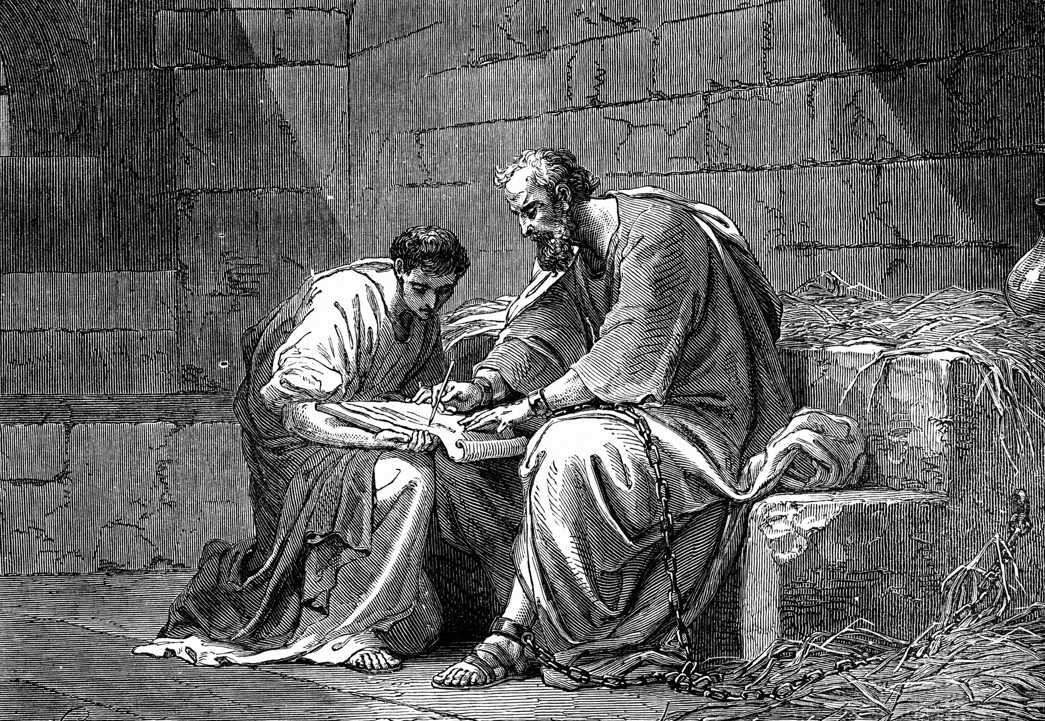
The Example of Paul’s Life
Paul had confidence
He was empowered by Christ (2 Cor 12:9)
He was esteemed faithful (1 Cor 4:1–2)
He was employed for service (2 Cor 4:5)

Slide 3
The Example of Paul’s Life
Though he had a past
He was a blasphemer (Lev 24:10–16)
He was a persecutor (Acts 8:3)
He was an opponent (Acts 22:4)

Slide 4
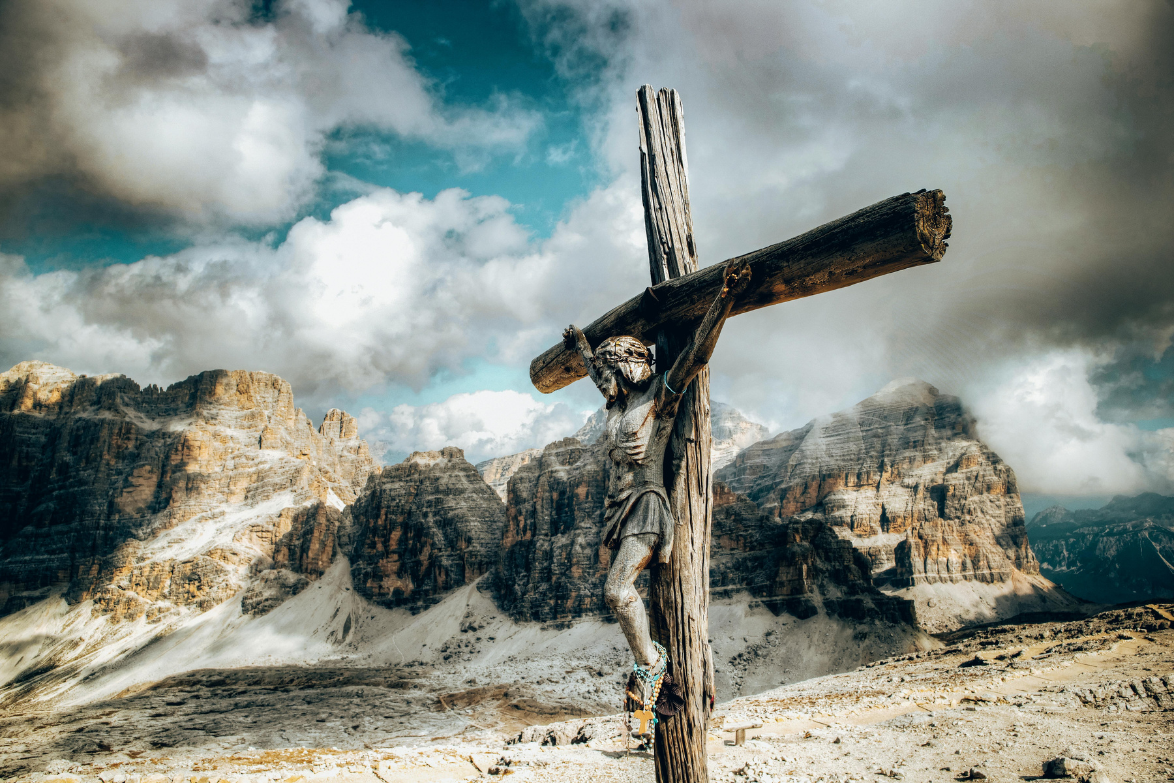
The Power of Christ’s Mercy
The chief of sinners became the example of sinners’ salvation
Sincerity matters in the search, but not in salvation (Acts 23:1; Rom 10:1–3)
Paul received salvation (Acts 4:12; Rom 5:8)

Slide 5
The Power of Christ’s Mercy
The chief of sinners became the example of sinners’ salvation
Paul was shown longsuffering (2 Pet 3:9)
Paul became an example (1 Cor 11:1)

Slide 6

God still saves
God can forgive, if we will allow it

