Slide 1

God Still Strengthens
Phil 4:11–13

Slide 2
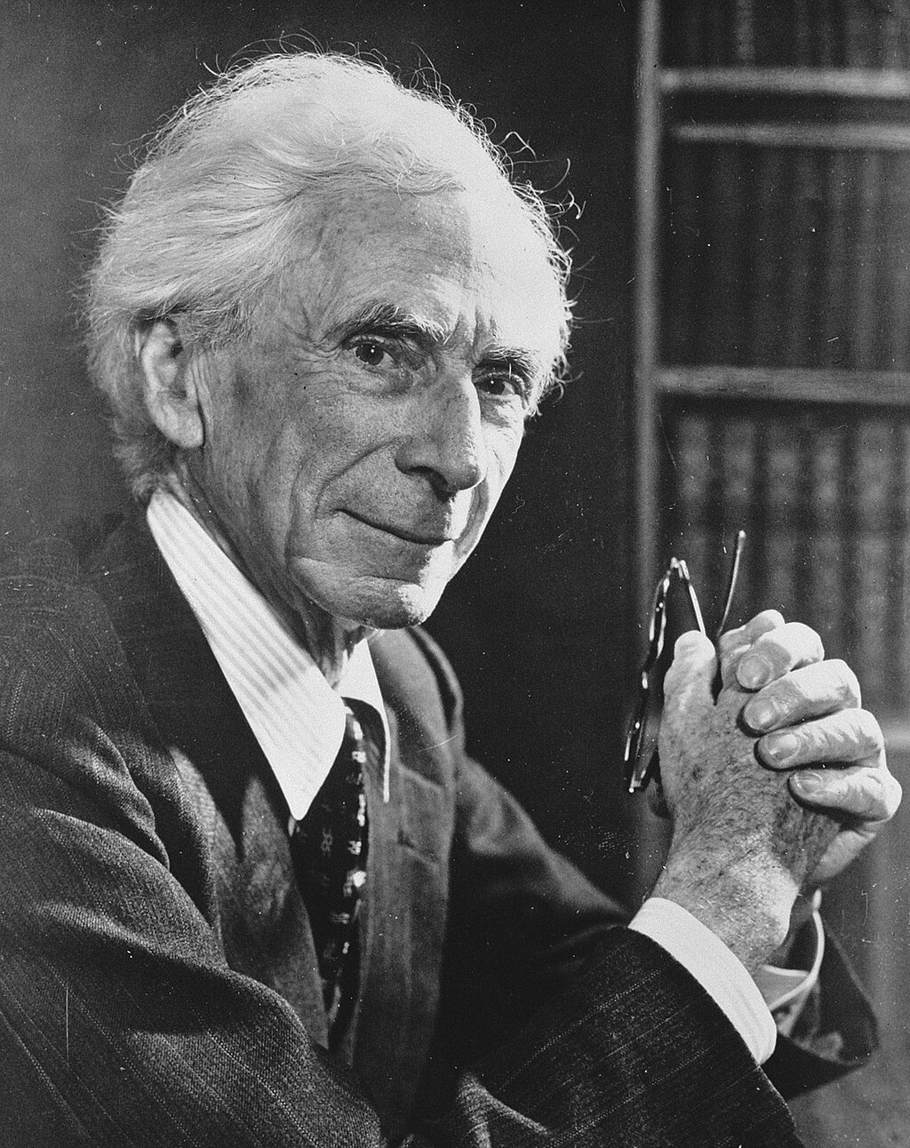
8 Reasons People are Unhappy
Self-infatuation
Struggle for success
Fear of boredom
Obsession with one’s problems
Envy
Guilt
Victim mentality
Fear of judgment
Bertrand Russell

Slide 3

Contentment is a matter of quality not quantity
“Wealth is like sea-water; the more we drink, the thirstier we become”
–Schopenhauer
Contentment is Learned

Slide 4
Contentment can change our perspective (Matt 6:19-21)
It’s not a matter of assets, but of attitude
Mark 10:17–22
Contentment is Learned

Slide 5
Contentment is a matter of inner stability rather than external circumstance
The crucial issue is attachment (Heb 13:5-6)
“Whoever, then, wants to be free, let him neither desire nor decline anything which depends on other people. Otherwise, he will be a slave”–Epictetus
Contentment is Lived

Slide 6
We have responsibility
We have capability
The Lord provides (Ps 28:7)
We receive (1 Cor 7:17)
Contentment is Leaning on Jesus

Slide 7
“The secret to satisfaction is not to increase our haves ... The secret is to manage our wants”—Arthur C. Brooks
Real satisfaction means we surrender our haves and our wants to Christ

