Slide 1
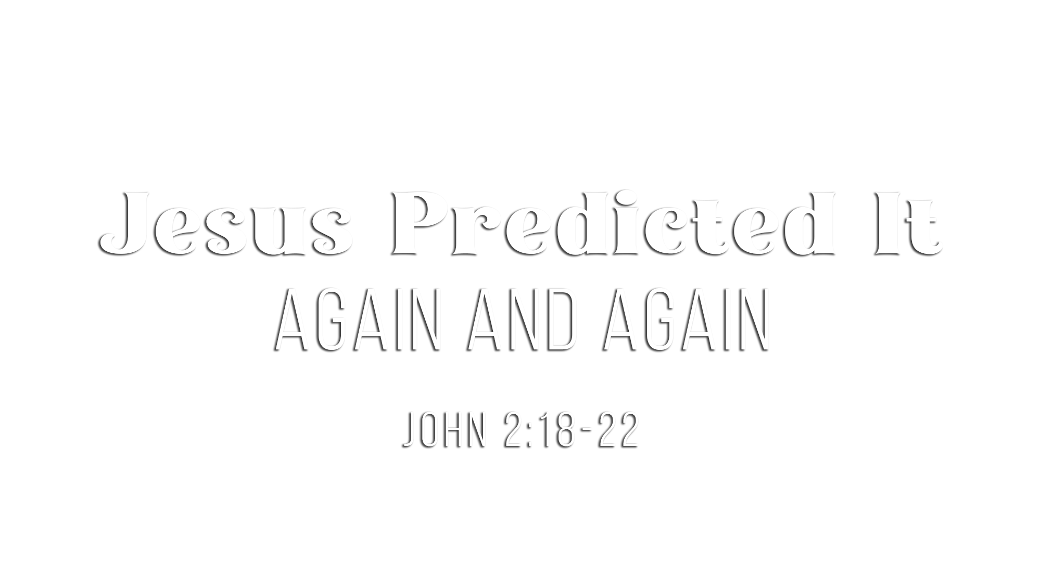

Slide 2
He made direct, unmistakable predictions
(Matt. 16:21; 17:22-23; 20:18-19)
His disciples were “exceedingly sorrowful” (Matt. 17:23)
and didn’t understand (Luke 18:34)

Slide 3
Like destroying a temple and then raising it up
(John 2:18-21)
Like Jonah being three days and three nights in the great fish (Matt. 12:38-40)
Like a seed being planted and producing fruit
(John 12:23-24)
Like sorrow that is turned into joy
(John 16:16-22)
Even when given in pictures, the disciples didn’t understand
(John 2:22; 16:17-18)

Slide 4
“I lay down my life that I may take it again” (John 10:17-18)
“Because I live, you will live also” (John 14:19)
“…until the Son of Man had risen from the dead” (Mark 9:9)
“After I have been raised…” (Matt. 26:32)
Disciples were “questioning what the rising from the dead meant” (Mark 9:10)

Slide 5
The Jews remembered at His trial and His crucifixion
(Mark 14:58; 15:29-30)
The Pharisees remembered after His death
(Matt. 27:62-64)
The angels reminded His disciples after His resurrection
(Luke 24:5-8)
The disciples remembered after He arose from the tomb
(John 2:22; Luke 24:8)
Jesus reminded His disciples of His teaching before His ascension (Luke 24:44-46)

Slide 6
The resurrection of Jesus is a FAITH-BUILDING CERTAINTY!
He said plainly and repeatedly the tomb would be empty, and IT WAS!
He rose from the dead so you could RISE FROM YOUR SINS (Rom. 6:2-6)!
He lives again so you can live a NEW LIFE FOR HIM (Rom. 6:4)!
He rose again so you can rise and LIVE FOREVER (1 Cor. 15:20-57)!
He predicted His resurrection, so you could TRUST YOUR SALVATION!
  Believe that He was raised from the dead (Rom. 10:9)
  Repent of your sins from the assurance of Him being raised (Acts 17:30-31)
  Confess that Jesus is Lord because of His resurrection (Rom. 10:9)
  Be baptized to be saved through His resurrection (1 Pet. 3:21; Rom. 6:3-6)
  Live faithfully based upon the certainty of His resurrection (1 Cor. 15:58)

