Slide 1
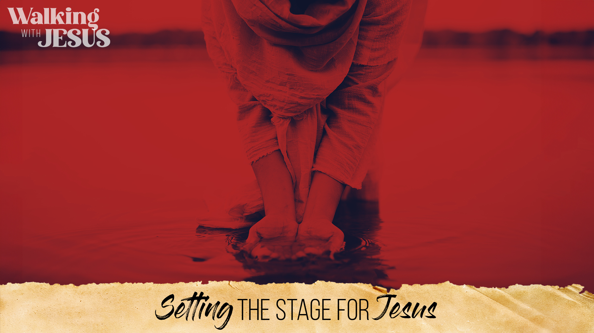
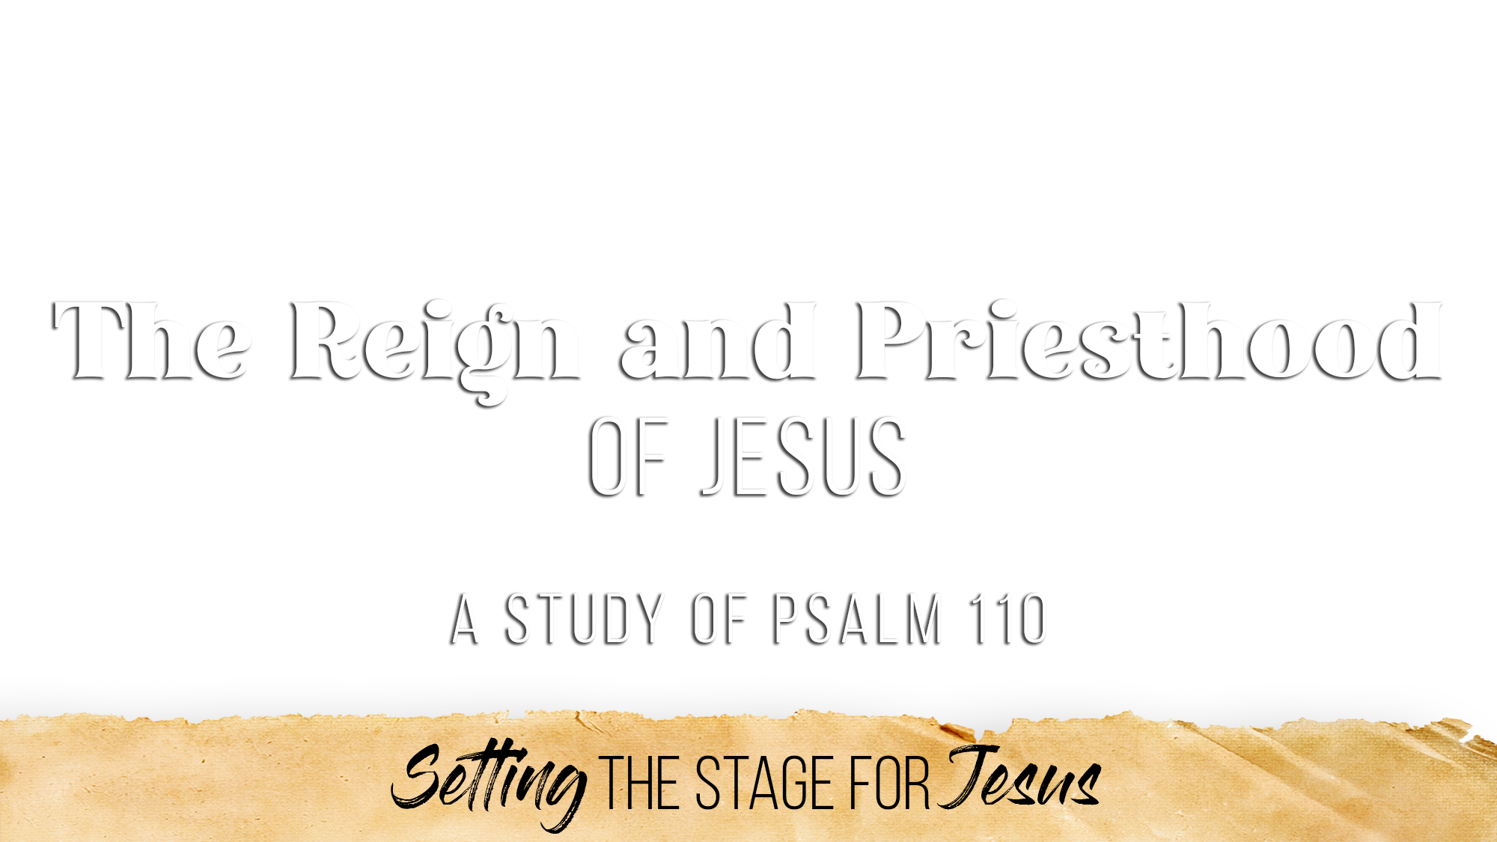

Slide 2
David recognizes Him as his Lord – “The LORD said to my Lord”
David was king, but there was one greater (Matt. 22:41-46)
Before Jesus was David’s descendant, He was David’s Lord (Rev. 22:16)
God enthrones Him at His right hand – “Sit at My right hand”
The right hand is the place of honor and authority and rule
This is where Jesus sat upon His ascension (Dan. 7:13-14; Luke 22:69)
Fundamental in N.T. (Acts 2:34-36; Eph. 1:20-23; Heb. 1:3, 13; 8:1; 10:12; 12:2)
God subdues His enemies for defeat – “…Your enemies Your footstool”
“Footstool” is a picture of complete subjection (cf. Josh 10:24)
All enemies will face certain defeat (Eph. 1:22; Heb. 10:12-13; 1 Cor. 15:24-27)
Enemies exist: Satan, sin, unbelief, rebellion, death—But NONE will win!

Slide 3
His rule goes forth from Zion – “the rod of Your strength out of Zion”
The rod/scepter is a symbol of kingship, authority, power
His rule over His kingdom/church through His Word would begin and go forth from Zion/Jerusalem (Isa. 2:2-3; Luke 24:46-49; Acts 1:8; 2:1-47; Heb. 12:22-23)
His reign is set among enemies – “Rule in the midst of Your enemies”
Christ is reigning and will fulfill His mission in spite of the opposition of Satan and the world (John 18:36; Rev. 1:5-6; 1 Cor. 15:25)
His people offer themselves willingly – “Your people shall be volunteers…”
His people are willing, eager, devoted, glad to belong to Him and fight for and with Him (2 Cor. 8:5; Rom. 12:1; John 10:27; Jas. 4:10)
His people are marked by holiness and freshness – “In the beauties of…”
His people are set apart for serving the King (Eph. 5:25-27; 1 Pet. 2:9; Tit. 2:14)
“From the womb of the morning” – they are eager from the beginning
“The dew of Your youth” – they are fresh, vigorous, plentiful, spiritually alive

Slide 4
It is sworn by divine oath – “The LORD has sworn and will not relent”
Christ’s priesthood is certain, permanent, unchangeable, unquestionable (Heb. 6:17-20; 7:20-22)
It is settled forever – “You are a priest forever”
Jesus lives forever, remains forever, intercedes forever (Heb. 7:23-25; 9:24; 10:11-14)
It is superior in every way – “According to the order of Melchizedek”
Melchizedek was “king of Salem” and “the priest of God Most High” (Gen. 14:18)
The Hebrews’ writer focused heavily on the high priesthood of Jesus (cf. Heb. 5-7)
Jesus is both King and High Priest simultaneously (Zech. 6:12-13; Rom. 8:34; Heb. 8:4)
It is exactly what we need
He intercedes for us (Heb. 7:25)
He represents us to God (Heb. 9:24)
He gives us access to the Father (Heb. 4:14-16; 10:19-22)
He sympathizes with our weakness (Heb. 4:15)

Slide 5
His conquest is inevitable and overwhelming (v. 5)
The Messiah acts in full divine authority and favor
NO ruler, NO power, NO authority, NO force can stand against Him (Psa. 2:1-12; Matt. 28:18; Eph. 1:20-22; Rev. 17:14)
His judgment is universal and certain (v. 6)
This is global dominion – Lord over ALL (1 Pet. 5:11; 4:11; Jude 25; Rev. 1:6)
He triumphs completely over every enemy (Psa. 2; 68:21; Hab. 3:13)
His saving word has gone throughout the earth (Mk. 16:15; Ro. 10:18; Ep. 6:17)
His victory is sustained and unwearied (v. 7)
Christ presses forward in victorious strength and will not falter or fail
His kingdom will stand forever (Dan. 2:44; Mt. 16:18; Isa. 55:10-11; Phil. 2:9-11)

Slide 6
Believe that Jesus is the Son of God – John 8:24
Repent of your sins and turn toward God – Luke 13:3
Confess your faith in Jesus Christ – Matthew 10:32
Be immersed into Christ – Mark 16:16
God will forgive all of your sins – Acts 2:38
God will add you to His church – Acts 2:47
God will register you in heaven – Hebrews 12:23
Walk faithfully with the King – Revelation 2:10

