Slide 1
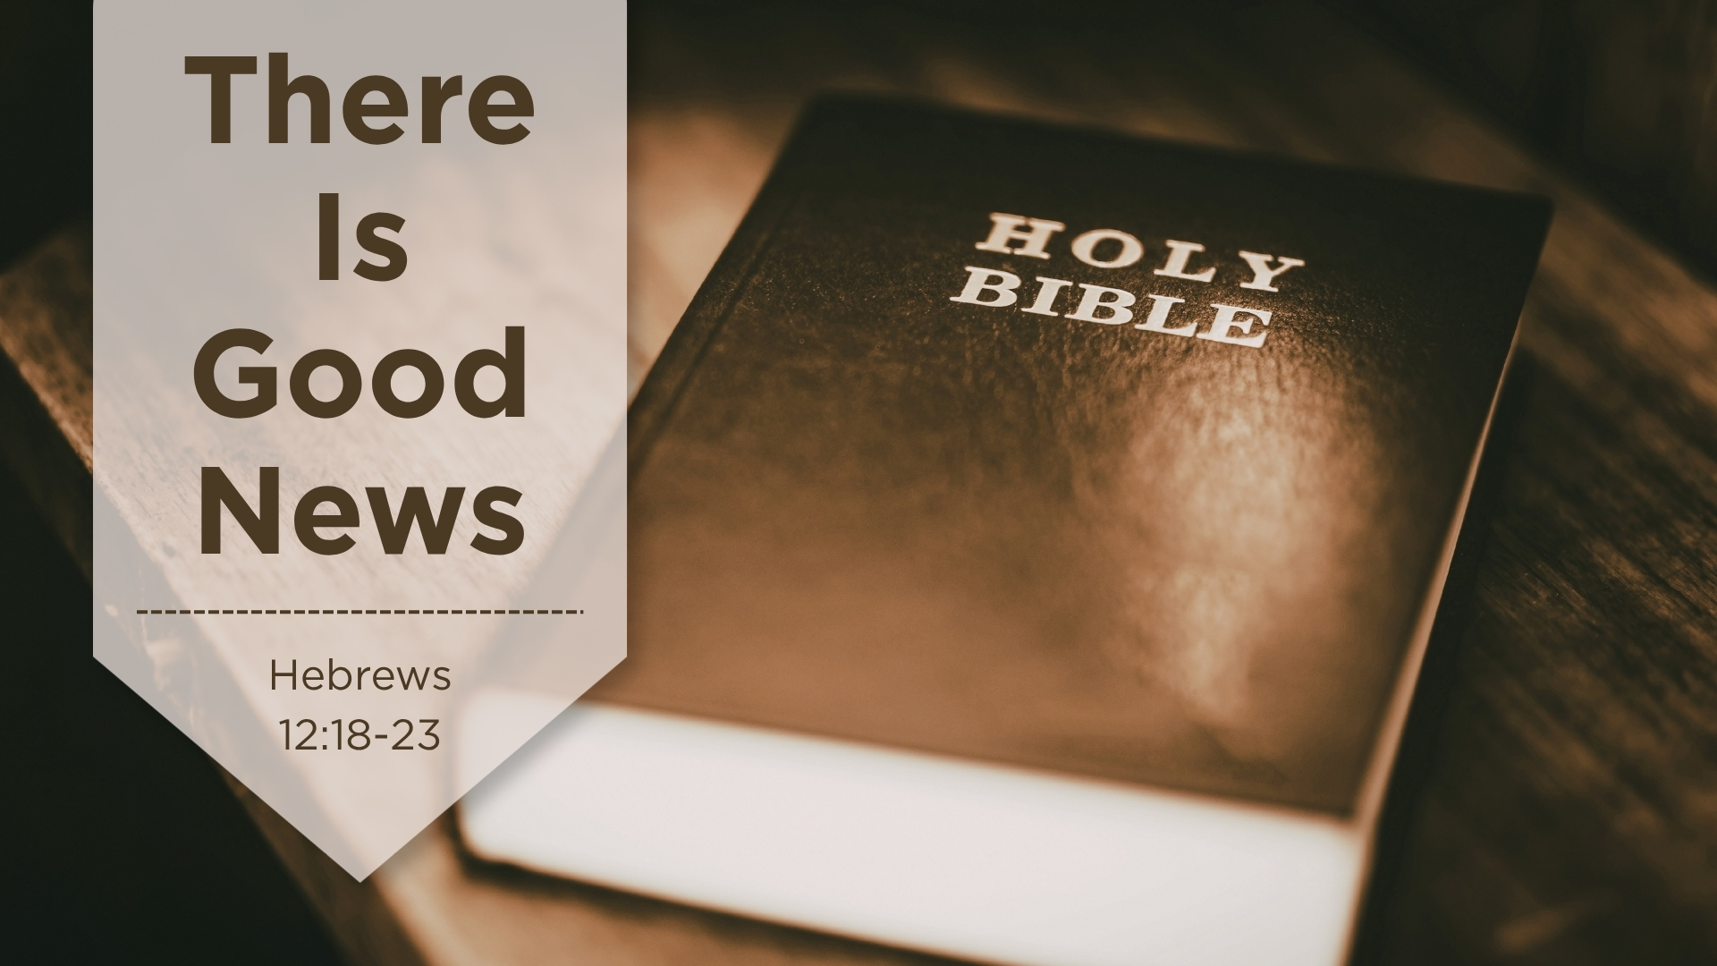
There is Good News
Hebrews 12:18-23

Slide 2
Hebrews 12:18-23
18 For you have not come to the mountain that may be touched and that burned with fire, and to blackness and darkness and tempest,
19 and the sound of a trumpet and the voice of words, so that those who heard it begged that the word should not be spoken to them anymore.
20 (For they could not endure what was commanded: "And if so must as a beast touches the mountain, it shall be stoned or show with an arrow."
21 And so terrifying was the sight that Moses said, "I am exceedingly afraid and trembling.”)
22 But you have come to Mount Zion and to the city of the living God, the heavenly Jerusalem, to an innumerable company of angels,
23 to the general assembly and church of the firstborn who are registered in heaven, to God the Judge of all, to the spirits of just men made perfect

Slide 3
Introduction
Who remembers Gabriel Heatter?

Slide 4
Introduction
Who remembers Gabriel Heatter?
Who remembers the phrase he used in his broadcast

Slide 5
Introduction
Who remembers Gabriel Heatter?
Who remembers the phrase he used in his broadcast
Everyone knew him in WW2; but almost everyone now is gone

Slide 6
Introduction
Who remembers Gabriel Heatter?
Who remembers the phrase he used in his broadcast
Everyone knew him in WW2; but almost everyone now is gone
He began his broadcast, “There is good news tonight”

Slide 7
Introduction
Who remembers Gabriel Heatter?
Who remembers the phrase he used in his broadcast
Everyone knew him in WW2; but almost everyone now is gone
He began his broadcast, “There is good news tonight”
Our lesson today is, “There is good news, today.”

Slide 8
The Good News

Slide 9
The Good News
The Messiah has come

Slide 10
The Good News
The Messiah has come
The Messiah has built the church, a part of God’s plan

Slide 11
The Good News
The Messiah has come
The Messiah has built the church, a part of God’s plan
That church is eternal and cannot be changed

Slide 12
The Good News
The Messiah has come
The Messiah has built the church, a part of God’s plan
That church is eternal and cannot be changed
That church is on the earth today

Slide 13
The Good News
The Messiah has come
The Messiah has built the church, a part of God’s plan
That church is eternal and cannot be changed
That church is on the earth today
Finding that church is much harder today

Slide 14
Becoming Part of God’s Plan
Believing, Trusting Heb. 11:6
Repenting, Deciding and Changing Acts 17:30-31
Confessing Your Faith in Jesus Rom. 10:9
Baptizing, Immersion in Water Mark 16:16
You are Now Part of His Plan with Your Name Registered
Continuing to Believe Until Death Rev. 2:10

