Slide 1
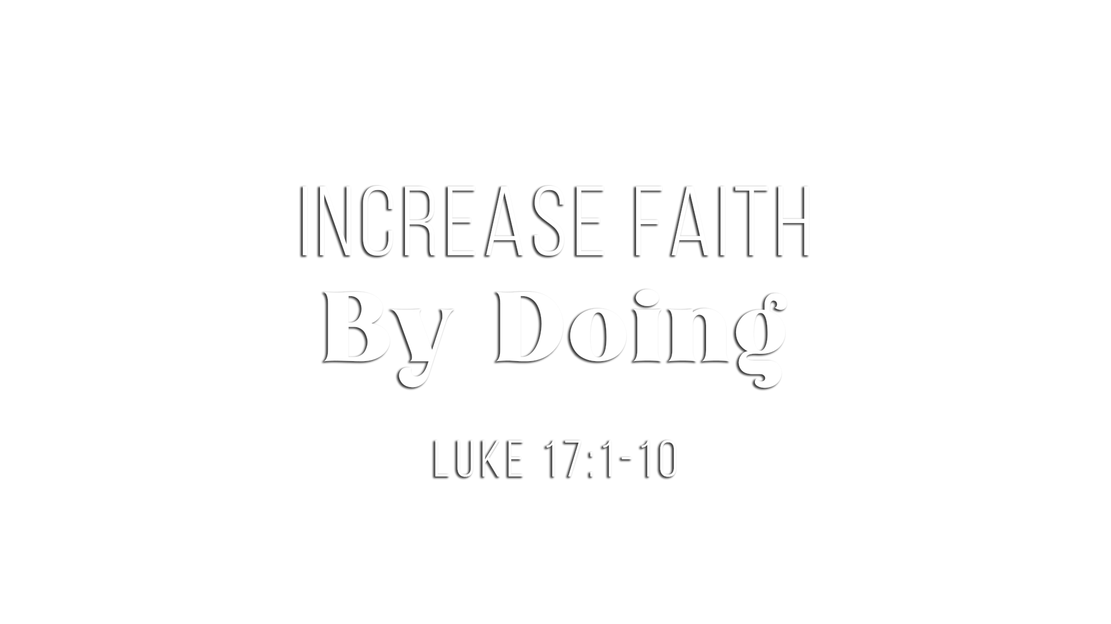

Slide 2
The mustard seed was used proverbially for significant growth (Matt. 13:31-32)
Jesus had rebuked the disciples many times for “little faith” (Matt. 6:30; 8:26; 14:31; 16:8)
Jesus emphasized the need for that small faith to grow (Matt. 8:26; Heb. 5:12)
Building real faith is a life-long learning and growing experience (2 Pet. 1:5-11)

Slide 3
Even the smallest faith can be powerful in the life of God’s child (Matt. 17:20)
Faith is in God, not in self – in God who can do great things (Eph. 3:20)
We must have full confidence that God is able to do what He has promised (Matt. 9:28; Heb. 10:23; 11:11; Tit. 1:2; 1 Kgs. 8:56)
It is the strength of God that makes all things possible (Eph. 6:10; Phil. 4:13; Mark 9:23)

Slide 4
Faith in God is essential to please Him (Heb. 11:6)
A strong, growing faith is essential to please Him (2 Thess. 1:3)
Jesus emphasized that one must “hear” (Mark 4:15, 16, 18, 20)
A saving faith requires “hearing the word of God” (Rom. 10:13-17)

Slide 5
True faith “DOES” more than just “hear” (Jas. 1:22-25; Mt. 7:24-27)
Faith is fortified in the DOING of one’s faith (Luke 17:6-10)
God commands us to DO many things toward others
Encourage others (1 Thess. 5:11; Heb. 3:13)
Serve others (Gal. 5:13; 1 Pet. 4:9)
Bear one another’s burdens (Gal. 6:2)
Forgive others (Eph. 4:32)
Teach others (2 Tim. 2:2; Heb. 5:12-14)
As servants of God, we are “unworthy servants” (17:10; 1 Cor. 4:2)
Our faith fortifies stronger and stronger as our obedience moves from “have to” to “want to” (Heb. 8:10; Gal. 2:20)
Weak faith: “I have to”
Growing faith: “I ought to”
Strong faith: “I want to”

Slide 6
You must believe that Jesus is the Son of God (John 8:24)
You must repent of your sins and turn toward God (Luke 13:3)
You must confess your faith in Jesus Christ (Romans 10:9)
You must be immersed into Christ (Mark 16:16)
God will forgive you of all sins (Acts 2:38)
God will add you to His church (Acts 2:47)
God will register you in heaven (Hebrews 12:23)
You must faithfully obey the commands of God (Matthew 7:21)

