Slide 1
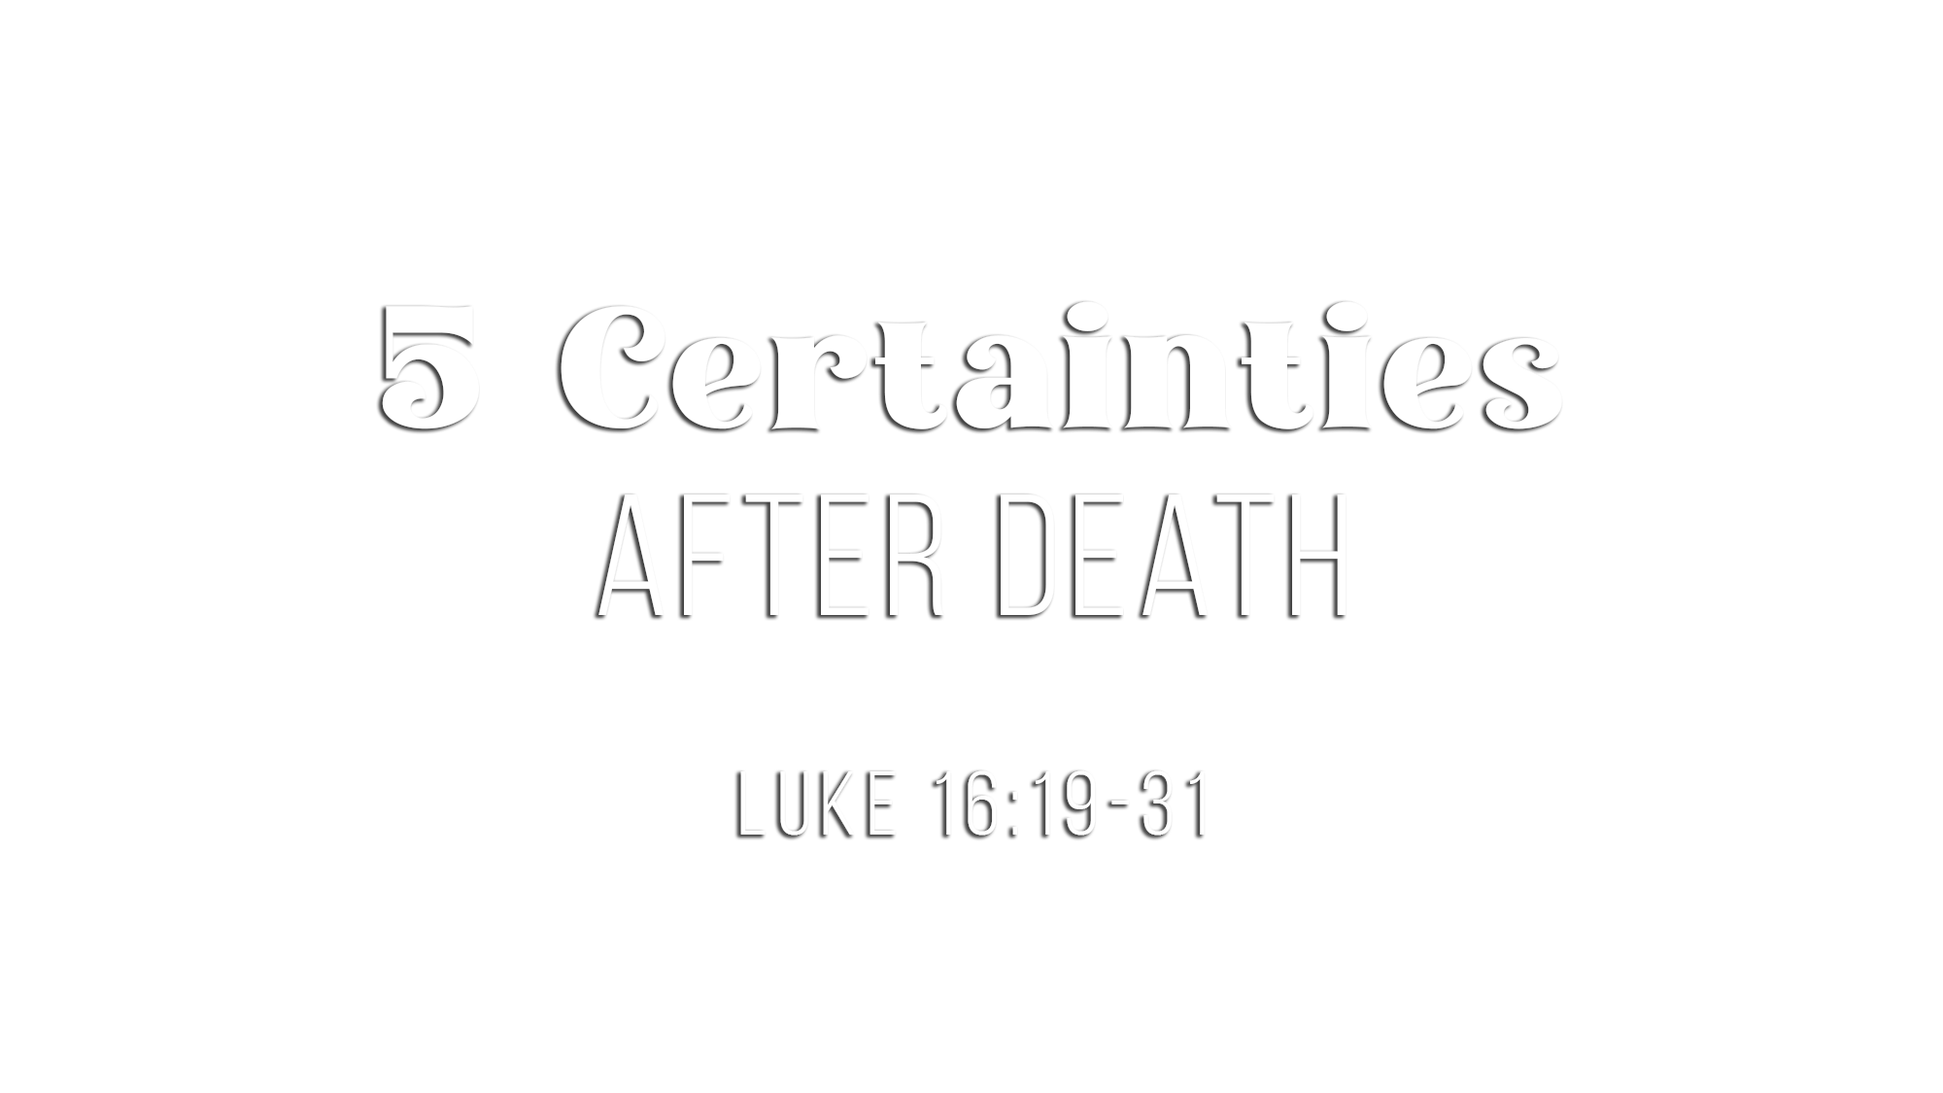

Slide 2
“Death” is separation
  Spiritually (Gen. 2:17; Isa. 59:2; Eph. 2:1)
  Physically (Jas. 2:26)
We must not confuse the body with the person
  Only the body is in the grave (Ecc. 12:7a)
  The spirit/person goes to the realm beyond (Ecc. 12:7b)

Slide 3
The dead are in a conscious existence elsewhere
The spirit does not die, cease to exist or sleep
While the body dies, the spirit (the person) is perpetually conscious and aware (Matt. 17:1-3; Rev. 6:9-11)

Slide 4
In heaven or in hell, we will know and recognize those we have known before
There is and will be something recognizable about us apart from our bodies (Matt. 17:1-3; 8:11; 1 Thess. 2:19-20)
Recognizing one another after death:
  Will make heaven – “heaven”
  Will make hell – “hell”

Slide 5
“Remember in your lifetime” (16:24-25)
  Able to remember what this life was like
  Able to remember how you lived your life
  Able to give an account of self (2 Cor. 5:10)
  Able to recall hardships endured (Rev. 6:9-11)
  Able to remember opportunities to obey
  Able to recollect every work brought into judgment (Ecc. 12:14)
Remembered his family and the lives they were living (16:27-28)

Slide 6
#1: Realization that God meant exactly what He said!
#2: Realization of my eternal destiny and that it is fixed
(Matt. 25:46; Luke 16:26)!
  The day of judgment will be the time for eternal sentencing
  (Matt. 25:21b, 23b, 30, 34, 41)
  The day of judgment will reveal why we are saved or lost
  (Matt. 25:21a, 23a, 26-27, 35-40, 42-45; 7:23)

Slide 7
Believe Jesus is God’s Son – John 3:16
Repent of your sins – Acts 2:38
Confess your faith in Jesus – Romans 10:9
Be immersed into Christ – Mark 16:16
  God will forgive all of your sins – Acts 2:38
  God will add you to His church – Acts 2:47
  God will enroll you in heaven – Hebrews 12:23
Be faithful unto death – Revelation 2:10

