Slide 1
The Power of the Unseen: Faithful People Who Changed the Story
Notes:
---

Slide 2
Introduction and Big Idea
Notes:
The Power of the Unseen, Key Idea: Faithfulness Over Status

Slide 3

The Power of the Unseen
Unseen Biblical Figures
  Many pivotal biblical moments involve unnamed or lesser-known individuals who demonstrate faith and courage.
Faith Over Prominence
  Significance in God's kingdom depends on faithfulness, not social status or visibility.
Encouragement for Believers
  Believers who feel overlooked are encouraged that small, faithful actions have eternal impact.
Notes:
This lesson introduces the central idea that God frequently works through people who are not the main characters in biblical narratives. While Scripture often focuses on well-known figures such as Moses, David, Elijah, Jesus, or Paul, many pivotal moments depend on individuals who appear briefly, remain unnamed, or hold no social power. These people are often servants, children, women, or foreigners, yet their faith, courage, and obedience become turning points in God’s work. By examining these supporting characters, we are reminded that significance in God’s kingdom is not determined by visibility or position, but by faithfulness. This theme is especially encouraging for believers who may feel overlooked or unqualified. The lesson challenges the assumption that impact requires prominence and instead emphasizes that God values willing hearts. As the class begins, learners are invited to reflect on their own roles in God’s story and consider how small, faithful actions can have eternal consequences. This perspective aligns well with the biblical truth that God chooses the weak things of the world to shame the strong, and it sets the tone for exploring several examples where seemingly minor individuals made a major spiritual difference.

Slide 4
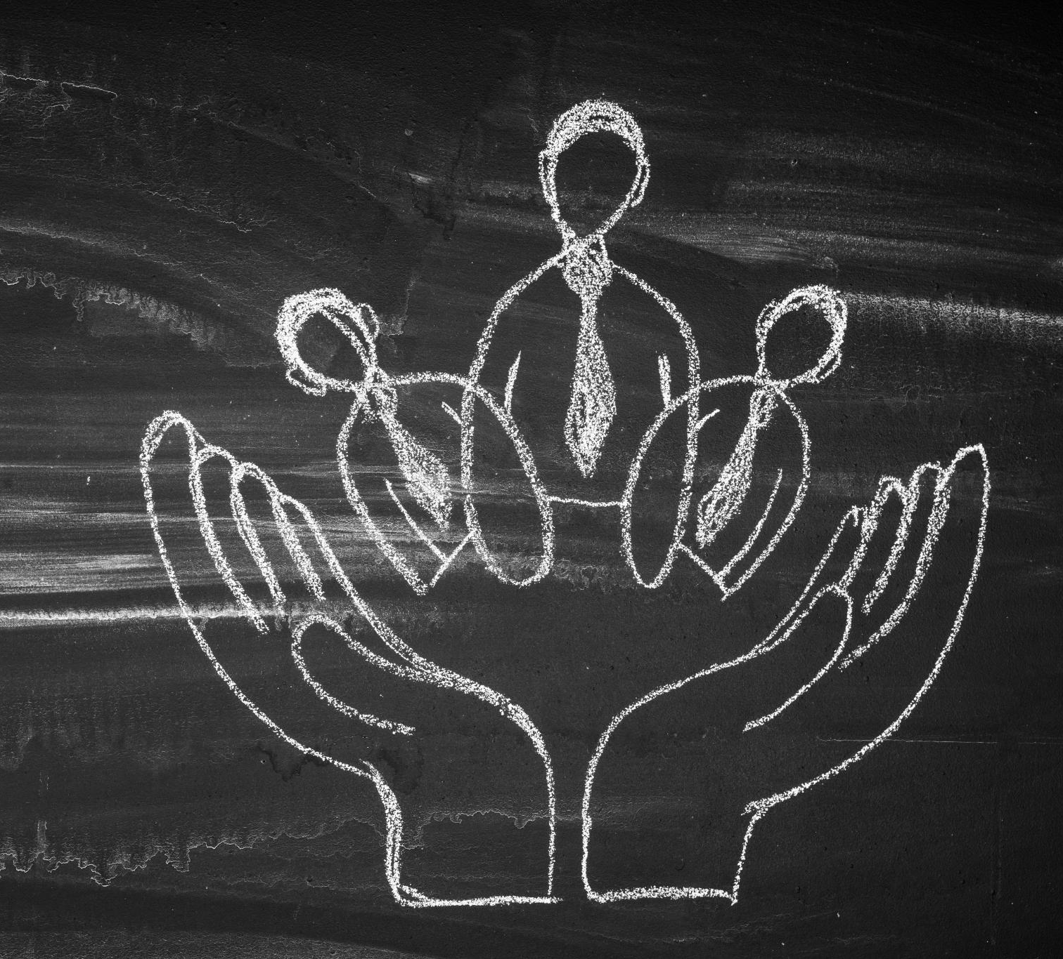
Key Idea: Faithfulness Over Status
Faithfulness Over Hierarchy
  God values faithfulness and obedience above human titles or status. Trust and act faithfully in all circumstances.
Small Acts, Profound Impact
  Small faithful acts like speaking truth or supporting others lead to meaningful spiritual outcomes.
Encouragement for Believers
  This idea encourages humility, perseverance, and confidence that God values every faithful act.
Notes:
At the heart of this class is the principle that faithfulness matters more than status. God’s purposes are not limited by human hierarchies, titles, or recognition. Throughout Scripture, we see that God delights in using people who simply trust Him and act in obedience, even when they do not fully understand the outcome. This key idea reframes how believers view their daily opportunities to serve God. Instead of waiting for a prominent role, Christians are called to be attentive and faithful in the circumstances they are already in. The Bible repeatedly shows that small acts—speaking a word of truth, offering what little one has, or supporting another person’s faith—can lead to profound results. This concept helps learners see that their influence is not measured by applause or acknowledgment, but by obedience to God. Emphasizing this truth encourages humility, perseverance, and confidence that God sees and values every act done in faith.

Slide 5
Unseen Individuals in the Old Testament
Notes:
Naaman’s Wife’s Servant Girl (2 Kings 5:1–3), Jonathan’s Armor-Bearer (1 Samuel 14:6–7)

Slide 6
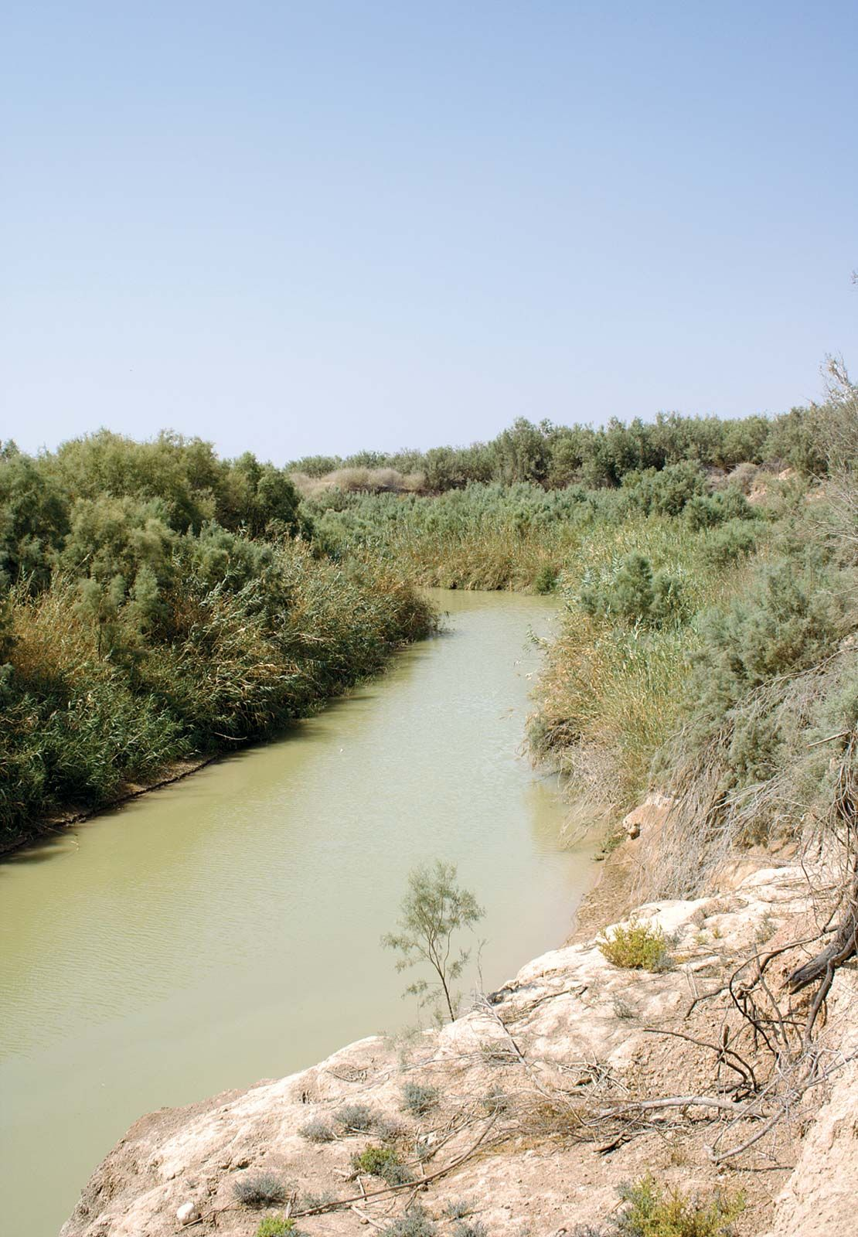
Naaman's Servants
2 King 5:1-14
Vs. 1-5
Captured servant girl in Syria
Showed compassion to her master
Directed Naaman to Elisha
Vs. 9-14
Servants of Naaman
Saw Naaman’s rage
Challenged Naaman
2 Kings 5:2–3 (NKJV): And the Syrians had gone out on raids, and had brought back captive a young girl from the land of Israel. She waited on Naaman’s wife. Then she said to her mistress, 'If only my master were with the prophet who is in Samaria! For he would heal him of his leprosy.'

Slide 7
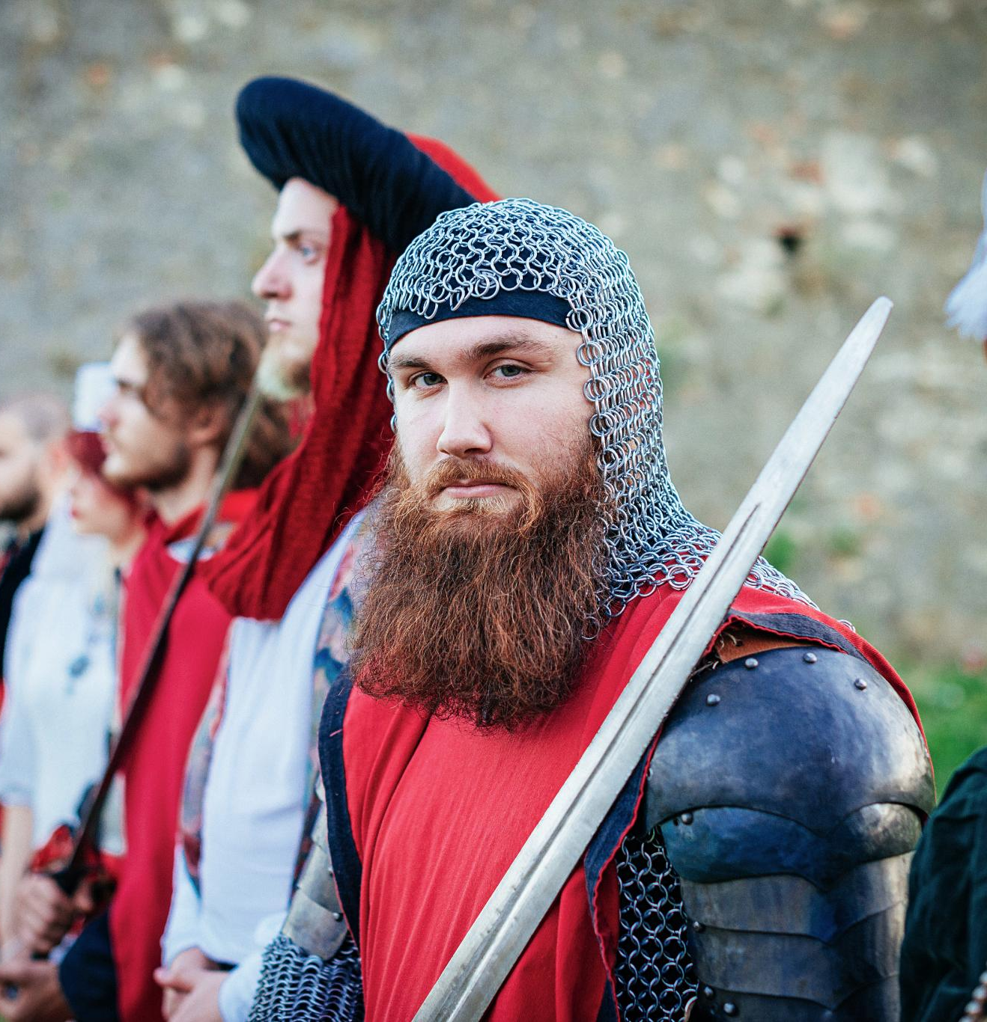
Jonathan’s Armor-Bearer (1 Samuel 14:6–7)
Supporting Role in Faith
  Jonathan’s armor-bearer exemplified faithful support, standing beside Jonathan with complete trust and courage.
Partnership and Encouragement
  Encouragement and partnership are vital; not all lead, but all can strengthen others’ faith through loyalty.
Empowering Bold Faith
  The armor-bearer’s loyalty empowered Jonathan’s decisive actions, leading to victory and faith encouragement.
1 Samuel 14:6–7 (NKJV): Then Jonathan said to the young man who bore his armor, 'Come, let us go over to the garrison of these uncircumcised; it may be that the Lord will work for us.' ... So his armor-bearer said to him, 'Do all that is in your heart. Go then; here I am with you, according to your heart.'
Notes:
Jonathan’s armor-bearer is another example of a supporting character whose faith played a critical role in God’s deliverance. While Jonathan is remembered as the bold warrior, his armor-bearer’s response is remarkable: “Do all that is in your heart… I am with you heart and soul.” This unnamed individual did not initiate the plan, but he fully supported it with trust and courage. His loyalty and shared faith enabled Jonathan to act decisively, resulting in a victory that encouraged Israel. The armor-bearer teaches an important lesson about the value of encouragement and partnership in faith. Not everyone is called to lead, but everyone can strengthen the faith of others. By standing beside Jonathan without hesitation, the armor-bearer demonstrated that supporting roles are essential in God’s work. This example challenges believers to consider how their encouragement, loyalty, and willingness to stand with others can empower bold acts of faith.

Slide 8
The Widow of Zarephath (1 Kings 17:8–16)
Faith in Scarcity
The widow trusted God’s promise despite her desperate situation during a severe famine.
Obedience and Trust
She obeyed Elijah’s request, prioritizing faith over fear and scarcity.
God’s Provision
God miraculously provided, sustaining her resources throughout the famine.
1 Kings 17:13–14 (NKJV): And Elijah said to her, 'Do not fear; go and do as you have said, but make me a small cake from it first... For thus says the Lord God of Israel: The bin of flour shall not be used up, nor shall the jar of oil run dry, until the day the Lord sends rain on the earth.'
Notes:
The widow of Zarephath appears briefly in Scripture, yet her faith provides a profound lesson in trust and obedience. She was a Gentile widow living in poverty during a severe famine, gathering sticks to prepare what she believed would be her final meal. When Elijah asked her to make him food first, the request seemed unreasonable and risky. However, Elijah reassured her with God’s promise of provision. The widow chose to trust the word of the Lord over her fear and scarcity. As a result, her jar of flour and jug of oil did not run dry throughout the famine. This story demonstrates that faith is often tested in moments of desperation. The widow was not wealthy, influential, or prominent, yet her obedience became a testimony to God’s sustaining power. Her example teaches believers that faith sometimes means acting on God’s promises even when resources appear insufficient. God honors trust that places His word above visible circumstances, and He uses such faith to demonstrate His care and faithfulness.

Slide 9
Unseen Individuals in the New Testament
Notes:
Servants at the Wedding in Cana (John 2:5–9), The Boy with the Loaves and Fish (John 6:8–11), Paul’s Nephew (Acts 23:16–22)

Slide 10
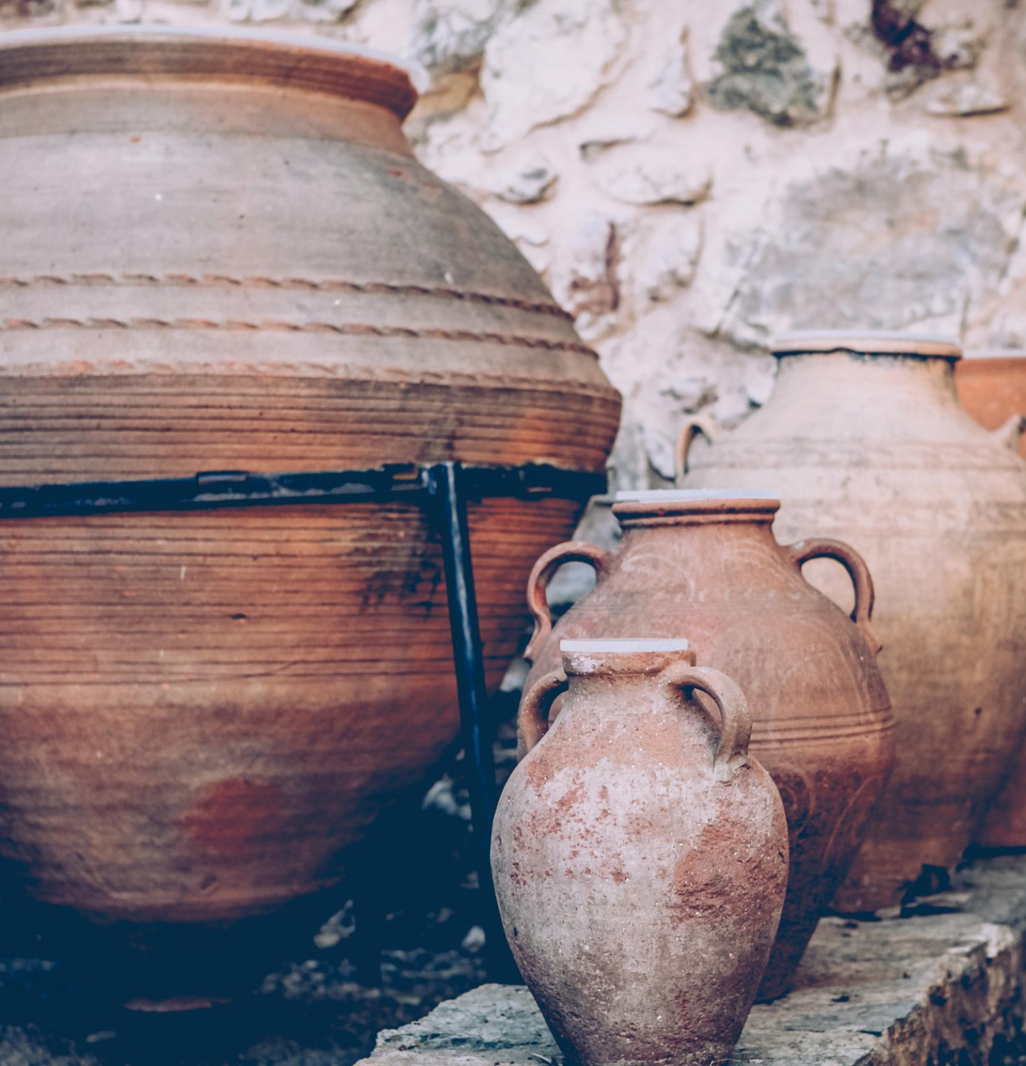
Servants at the Wedding in Cana (John 2:5–9)
Quiet Faithful Obedience
  The servants obeyed Jesus without question, demonstrating humble faith and trust in His command.
Witness to a Miracle
  Their obedience positioned them uniquely to witness the transformation of water into wine.
Encouragement in Obedience
  The story encourages trusting God’s instructions even if the purpose is not immediately clear.
John 2:7–9 (NKJV): Jesus said to them, 'Fill the waterpots with water.' And they filled them up to the brim. And He said to them, 'Draw some out now, and take it to the master of the feast.' And they took it. When the master of the feast had tasted the water that was made wine...
Notes:
The servants at the wedding in Cana occupy a quiet but meaningful place in the story of Jesus’ first miracle. They are not named, and they ask no questions, yet they obey Jesus’ unusual command to fill large jars with water. Their obedience placed them in the unique position of witnessing the transformation of water into wine. While the guests and the master of the feast enjoyed the result, the servants knew exactly what had happened. This story illustrates that obedience, even when it seems impractical or confusing, positions believers to see God’s power at work. The servants did not seek recognition, but their faithfulness allowed the miracle to unfold. This account encourages Christians to trust Christ’s instructions, even when the purpose is not immediately clear, and reassures them that God often reveals His work to those who quietly obey.

Slide 11

The Boy with the Loaves and Fish (John 6:8–11)
Value of Willingness
  The boy’s small offering shows that God values willingness over the size of the gift.
Miraculous Multiplication
  When given to Jesus, the small meal was multiplied to feed thousands, demonstrating divine provision.
Faith Over Resources
  This story teaches that faith and trust in God matter more than possessing abundant resources.
Encouragement to Give
  Believers are encouraged to offer what they have, trusting God to multiply their gifts beyond expectations.
John 6:9–11 (NKJV): 'There is a lad here who has five barley loaves and two small fish, but what are they among so many?' Then Jesus said, 'Make the people sit down.' ... And Jesus took the loaves, and when He had given thanks He distributed them to the disciples, and the disciples to those sitting down; and likewise of the fish, as much as they wanted.
Notes:
The boy who offered his loaves and fish demonstrates how God values willingness over abundance. In the face of a massive crowd and overwhelming need, his small meal seemed insignificant. Yet when placed in Jesus’ hands, it became more than enough. The boy is not quoted, named, or praised, but his simple act of giving made the miracle possible. This story teaches that God does not require believers to have everything figured out or to possess great resources. Instead, He asks for what we have. When believers offer their time, abilities, or possessions to God, He is able to multiply them far beyond human expectations. This account reassures Christians that no gift is too small when given in faith and challenges them to trust God with what they might otherwise withhold.

Slide 12

Rhoda and Answered Prayer (Acts 12:13–15)
Faith and Prayer
  The church prayed fervently for Peter’s release, demonstrating sincere faith and reliance on God.
Rhoda’s Recognition
  Rhoda recognized Peter’s voice and ran to share the news without opening the door, showing joy and eagerness.
Human Doubt and Belief
  Despite fervent prayer, the initial disbelief of others highlights human struggle to accept answered prayers.
God’s Power at Work
  Rhoda’s story reminds believers that God answers prayers often in surprising ways, using imperfect faith.
Notes:
Rhoda’s brief appearance in Acts provides both a memorable and instructive moment. As the church prayed fervently for Peter’s release from prison, Rhoda answered the door and recognized Peter’s voice. Overcome with joy, she ran to tell the others without opening the gate. Though her report was initially dismissed, Rhoda was the first to recognize that God had answered their prayers. Her story highlights the human tendency to pray faithfully yet struggle to believe when prayers are answered. Rhoda’s excitement and imperfect response do not diminish her role; instead, they make her relatable and genuine. This account reminds believers that God responds to prayer, sometimes in ways that surprise us. Even those with childlike or imperfect faith can be used to bear witness to God’s power at work.

Slide 13
Paul’s Nephew (Acts 23:16–22)
Brave Warning
Paul’s nephew courageously warned of a plot to kill Paul despite potential risks, showcasing bravery.
Impact on Ministry
His warning led to Paul’s protection, allowing God’s mission through Paul to continue and thrive.
Faith-Driven Action
The nephew’s decisive, faith-inspired action highlights that anyone can be used to advance God’s purposes.
Notes:
Paul’s nephew appears only briefly in the book of Acts, yet his actions had a profound impact on the apostle’s life and ministry. Upon learning of a plot to kill Paul, the young man chose to speak up and report the danger, even though doing so may have been intimidating. His courage led to Paul’s protection and ensured that God’s mission through Paul would continue. This story highlights the importance of acting decisively in critical moments. The nephew was not a preacher or leader, but he was attentive, brave, and willing to do what was right. His example reminds believers that God can use anyone, regardless of age or position, to protect His people and advance His purposes. Silence could have led to tragedy, but faith-driven action preserved life and ministry.

Slide 14
Key Themes and Application
Notes:
Key Themes: God Uses the Overlooked, Closing Thought: No Insignificant People

Slide 15

Closing Thought: No Insignificant People
Every Believer's Value
  No person is insignificant; each believer has meaningful opportunities to act in faith and obedience.
Call to Faithful Action
  Believers are encouraged to be attentive to God's call to speak, give, encourage, or act at any moment.
Purpose in the Unseen
  Faithfulness in unseen acts has purpose, enabling God to work through believers for His glory.
Notes:
The lesson concludes with a powerful reminder: in God’s story, there are no insignificant people. Each believer has opportunities, often unnoticed by others, to act in faith and obedience. These biblical examples challenge Christians to be attentive to moments where God may be calling them to speak, give, encourage, or act. While not everyone will be a main character, everyone can be a turning point. This closing thought invites reflection and application, encouraging learners to leave with confidence that their faithfulness matters. By embracing the truth that God works through the unseen, believers can find purpose and motivation in serving Him wherever they are, trusting that He is able to use their obedience for His glory.

