Slide 1


Slide 2

It wants to be noticed (14:7)
It invites humiliation (14:8-9, 11a)
It chooses and is satisfied with
the low place (14:10, 11b)
He humbled Himself for the undeserving (Phil. 2:6-8)
Take a lower, less-prominent place
and let God do the exalting at His discretion

Slide 3
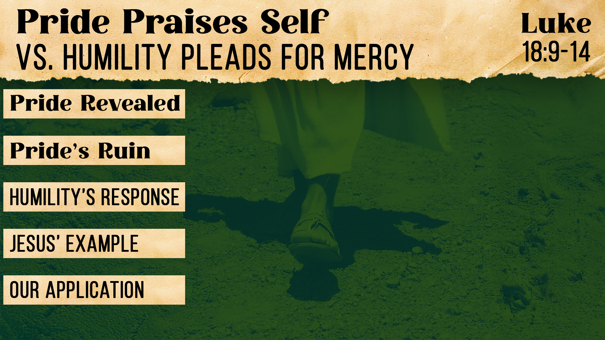
It trusts in its own goodness (18:9, 11-12)
It blinds us to our own sin,
leaving us unjustified before God (18:9, 14)
It cries for mercy (18:13)
He humbly showed mercy to others (Luke 5:29-32)
Stop comparing against others—
compare against Jesus and stand honestly before God

Slide 4

It craves position (10:35-38a)
It creates resentment and competition (10:41)
It becomes a servant (10:42-44)
He served and gave His life a ransom (10:45)
Stop asking, “Who will serve me?”
and start asking, “Whom can I serve?”

Slide 5
Believe Jesus is God’s Son – Hebrews 11:6
Repent of your sins – 2 Peter 3:9
Confess your faith in Jesus – Matthew 10:32
Be immersed into Christ – Romans 6:3
  God will forgive all of your sins – Acts 2:38
  God will add you to His church – Acts 2:47
  God will enroll you in heaven – Hebrews 12:23
Walk humbly with your God every day – Micah 6:8

