Slide 1


Slide 2
HIS HOUR HAD COME
  Jesus had been saying that His “hour” had not yet come (2:4; 7:6, 30; 8:20)
  The hour for Him to be crucified had come (12:32; cf. 3:14-15; 8:28-29)
  The hour for Him to be glorified had come (12:23; cf. John 13:31-32; 17:1)
  The hour for Him to fulfill His purpose had come (12:24, 27-28; cf. Mark 10:45; Heb. 2:9-10)
THE HOUR OF HIS CRUCIFIXION WOULD ACCOMPLISH THREE THINGS
  Bring judgment upon the sin of the world (12:31a; cf. 3:19; Rom. 8:3)
  Destroy the power of the devil (12:31b; cf. Gen. 3:15; 1 John 3:8; Heb. 2:14-15)
  Draw people of every nation to Himself and salvation (12:32b; cf. Eph. 2:13-18; Tit. 2:11; Heb. 2:9; Acts 10:34-35)

Slide 3
JESUS IS “THE TRUE LIGHT” OF TRUTH
  He came to “give light to every man” (John 1:9)
  He came to show the way to salvation (John 8:12; cf. John 14:6; Acts 4:12)
  He came only for a short time (John 12:35-36; 7:33; 9:4-5)
  He came to lead men out of darkness (John 12:35, 46; cf. Col. 1:13)
THE LIGHT OF HIS TRUTH DEMANDS THREE THINGS
  Value eternal life above life in this world (12:25; cf. Mt. 10:37-39; Col. 3:1-4)
  Continually obey and serve the Lord through trials (12:26; cf. Luke 9:23)
  Continually and confidently walk in His truth (12:35-36; cf. Eph. 5:8-11)

Slide 4
JESUS HAS FULL AND FINAL AUTHORITY
  Jesus reveals the Father and speaks with His full authority
  (12:44-45, 49-50; cf. John 1:1; 5:17-19; 10:30; Col. 2:9; Matt. 28:18; Eph. 1:22-23)
  Jesus came first to save rather than condemn (12:47; cf. John 3:16-18; 2 Pet. 3:9)
  Jesus will judge all mankind in the last day
  (12:48; cf. John 9:39; 5:22, 27; Acts 17:30-31; 2 Cor. 5:10; Matt. 25:31-32)
  The revealed Word will be the standard of judgment
  (12:48-50; cf. Matt. 7:21-23; Rom. 2:16; Rev. 20:12)
PREPARATION FOR JUDGMENT CALLS FOR THREE THINGS
  Love the approval of God more than the approval of men
  (12:42-43; cf. John 5:44; Gal. 1:10; 1 Thess. 2:4)
  Receive, respect and obey the all-authoritative Word of Christ
  (12:48; cf. 1 Thess. 2:13; Jas. 1:21-25; 1 Cor. 1:10; 4:6; Rev. 22:18-19)
  Speak only what God has revealed in His Word
  (12:49-50; cf. 1 Pet. 4:11; Ezek. 3:26-27; 2 Tim. 1:13; 4:2)

Slide 5
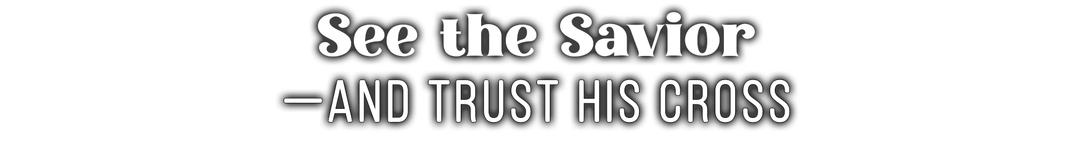
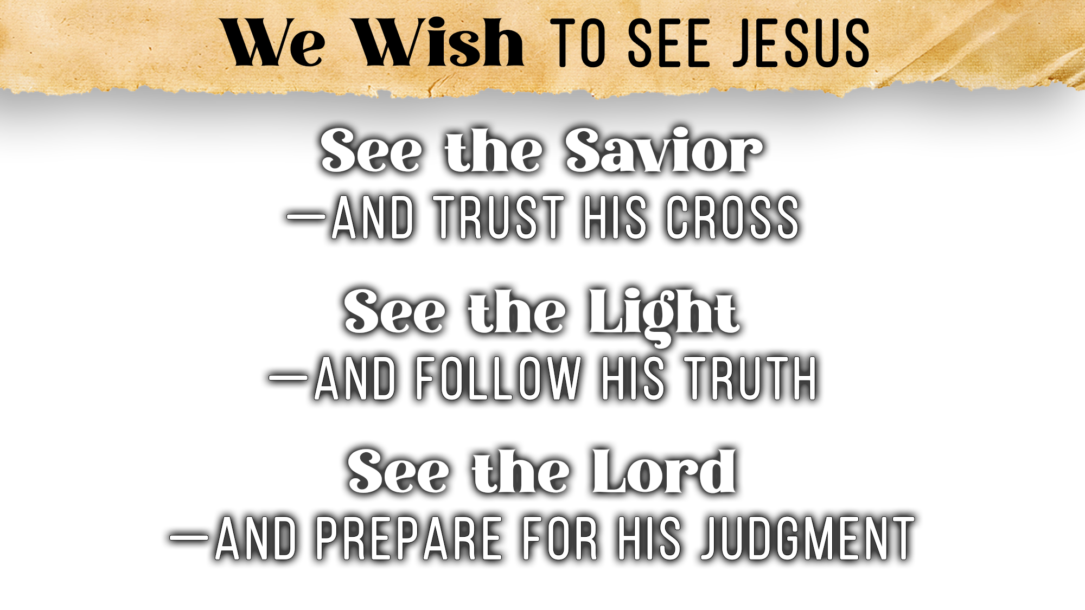

Slide 6
Believe Jesus is the Son of God – John 3:16
Repent of your sins and turn toward God – Luke 13:3
Confess your faith in Jesus Christ – Romans 10:9
Be baptized into Christ – Galatians 3:27
  God will forgive all of your sins – Acts 2:38
  God will add you to His church – Acts 2:47
  God will register you in heaven – Hebrews 12:23
Live faithfully to Him – Revelation 2:10

