Slide 1


Slide 2


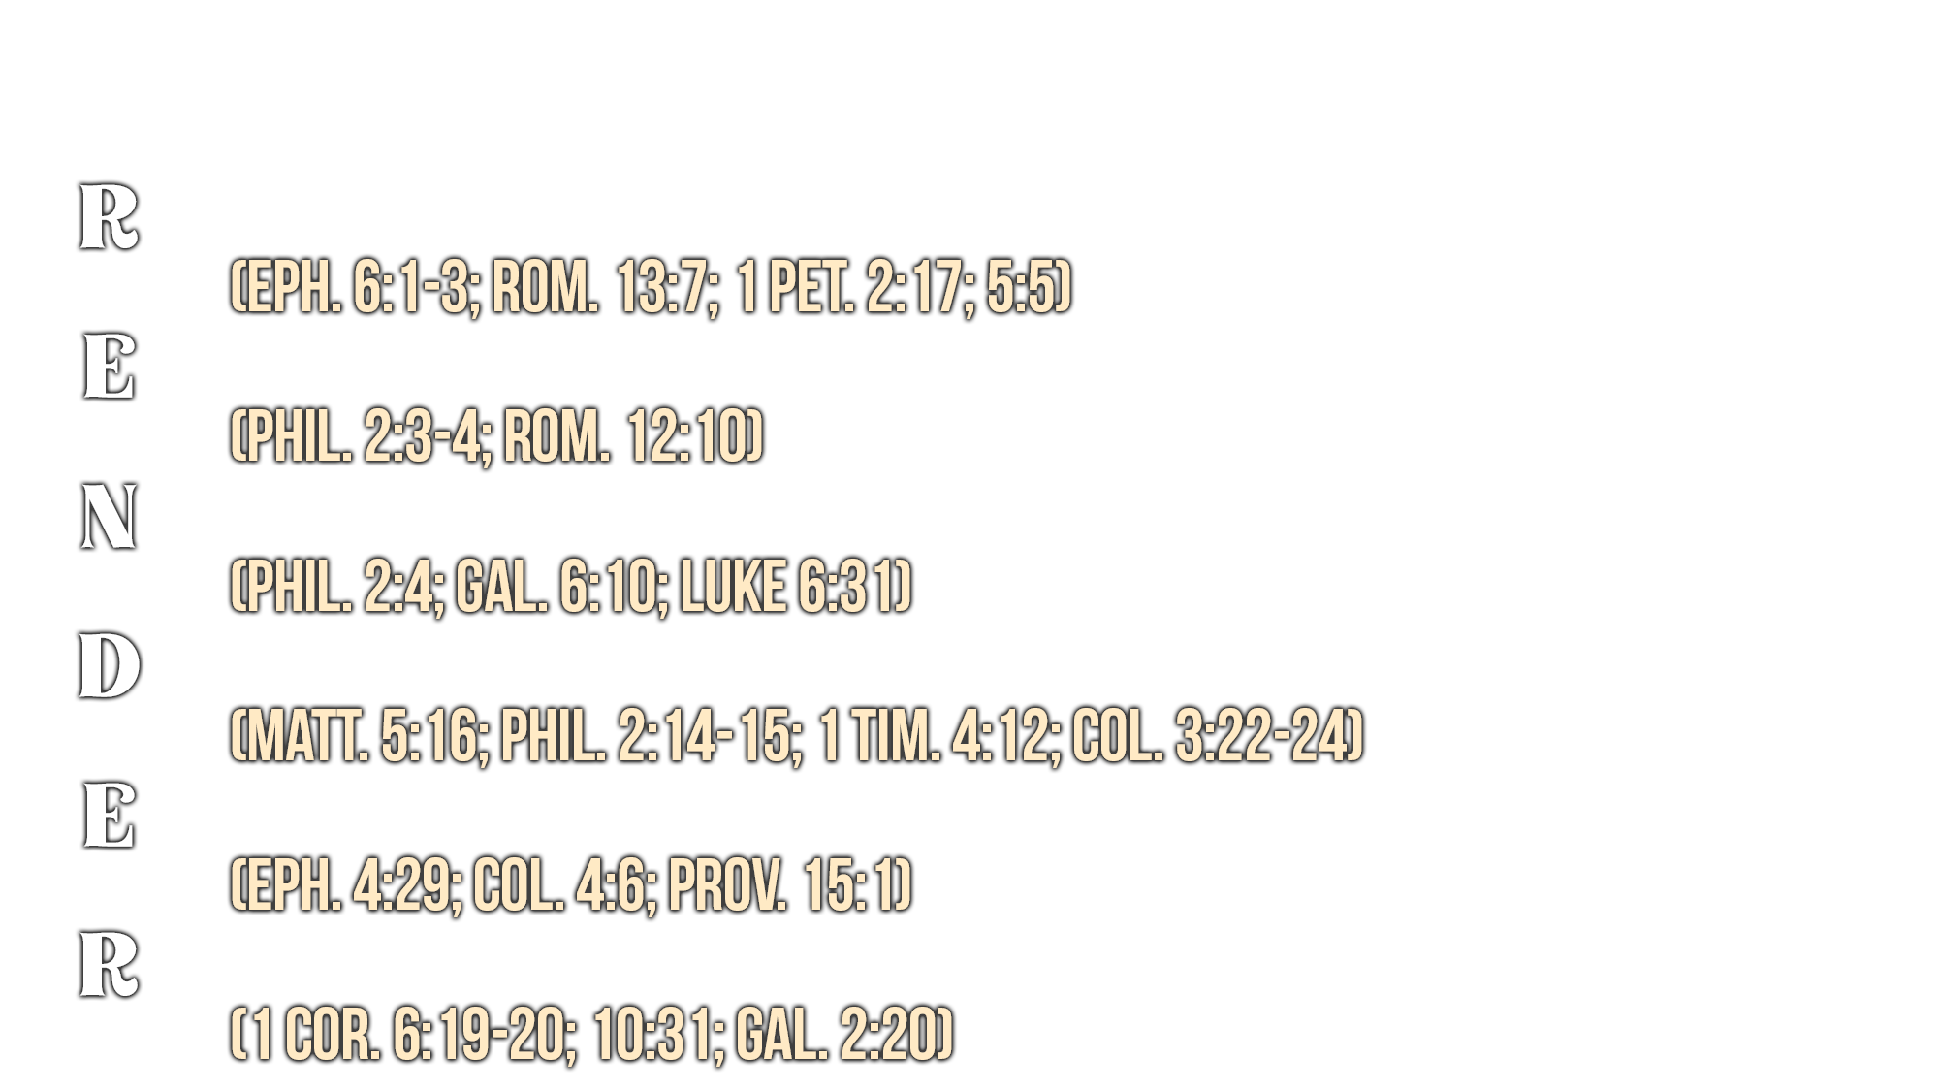

Slide 3
Believe Jesus is the Son of God – Acts 16:31
Repent of your sins and turn toward God – Acts 17:30
Confess your faith in Jesus Christ – Romans 10:9
Be baptized into Christ – Galatians 3:27
  God will forgive all of your sins – Acts 2:38
  God will add you to His church – Acts 2:47
  God will enroll you in heaven – Hebrews 12:23
Faithfully give yourself to the Lord each day – 1 John 1:7

