Slide 1
I Have Heard of a Land
The magnificent reward that awaits us in heaven

Slide 2
“But as it is written: ‘Eye has not seen, nor ear heard, nor have entered into the heart of man the things which God has prepared for those who love Him.’” – 1 Cor. 2:9

Slide 3
Where We Never Grow Old
VERSE ONE
1 Cor. 15:42-49

Slide 4
Verse 1 lyrics
I have heard of a land on the far away strand.
Tis a beautiful home of the soul.
Built by Jesus on high, where we never shall die.
Tis a land where we never grow old.

Slide 5
The fear of aging
Failing strength.
Failing beauty.
Failing health.

Slide 6
An incorruptible home built by Jesus
“…we also eagerly wait for the Savior, the Lord Jesus Christ, who will transform our lowly body that it may be conformed to His glorious body, according to the working by which He is able even to subdue all things to Himself.” – Phil 3:20-21
Jesus prepared this place for us — Jn. 14:1-4.
We will have a spiritual body just like His – 1 Cor. 15:42-49.
These bodies never grow sick or weak – Ps. 16:8-11.

Slide 7
Let’s live like we will never grow old
Let’s use all our strength to do the will of God.
Let’s seek to proclaim the beauty of the gospel.
Let’s tell others of the eternal life free of sickness awaiting us in heaven.

Slide 8
Where We Never Shall Die
VERSE TWO

Slide 9
Verse 2 lyrics
In that beautiful home where we’ll never more roam, we shall be in the sweet by and by.
Happy praise to the king through eternity sing.
Tis a land where we never shall die.

Slide 10
The fear of death
Will it be painful?
Will I die alone?

Slide 11
The fear of death is cast away
“And God will wipe away every tear from their eyes; there shall be no more death, nor sorrow, nor crying. There shall be no more pain, for the former things have passed away.” -Rev. 21:4.
We await a true paradise — Lk. 23:43.
Our heavenly bodies are preserved forever — 2 Cor. 5:1.

Slide 12
Let’s live like we never will die — Mt. 16:24-27
The death of our bodies is not the death we should fear.
Eternal separation from God is.
If we cast our fears of this life aside and strive to do God’s will.

Slide 13
Where Our Loved Have Gone on Before
VERSE THREE

Slide 14
Verse 3 lyrics
When our work here is done and the life-crown is won, and our troubles and trials are o’er.
All our sorrow will end, and our voices will blend.
With the loved ones who’ve gone on before.

Slide 15
The sorrow of loss
Loss of friends.
Loss of family.
Loss of brothers and sisters.

Slide 16
We await the greatest reunion
“…And the dead in Christ will rise first. Then we who are alive and remain shall be caught up together with them in the clouds to meet the Lord in the air. And thus we shall always be with the Lord.” – 1 Thess. 4:13-17
All who have died in Christ will be brought back together.
Not just together, but with our Lord.
Who do you long to see in heaven?

Slide 17
Let’s live as those awaiting the greatest reunion
If we really believe heaven is where we will meet, that changes how we live.
I must think differently — Col. 3:2.
I must live differently — Mt. 6:19-21.

Slide 18
I Have Heard of a Land
The magnificent reward that awaits us in heaven

Slide 19
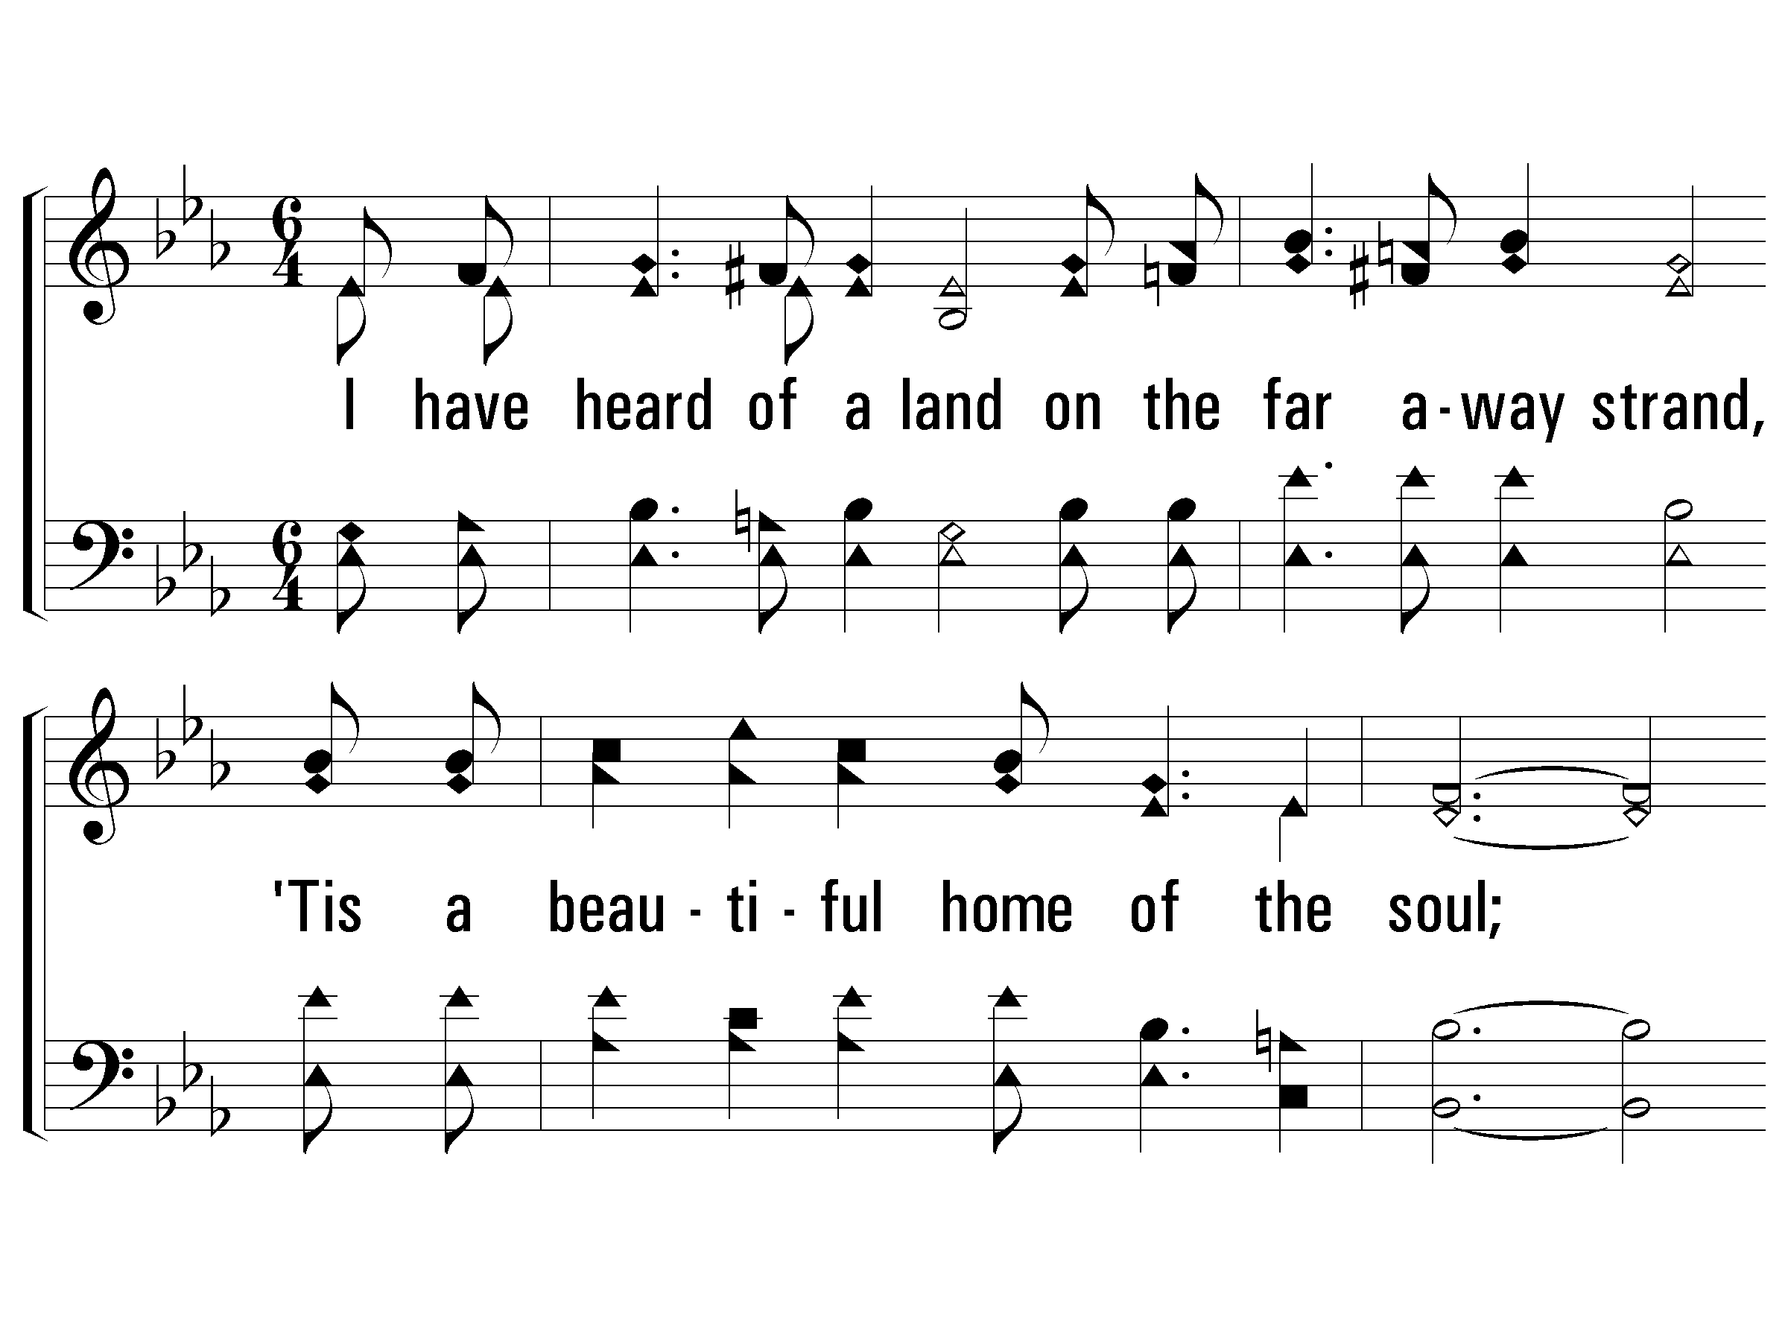
Verse 1
#277 – I Have Heard of a Land
1.
I have heard of a land on the far away strand,
'Tis a beautiful home of the soul;
Built by Jesus on high, where we never shall die,
'Tis a land where we never grow old.

Slide 20
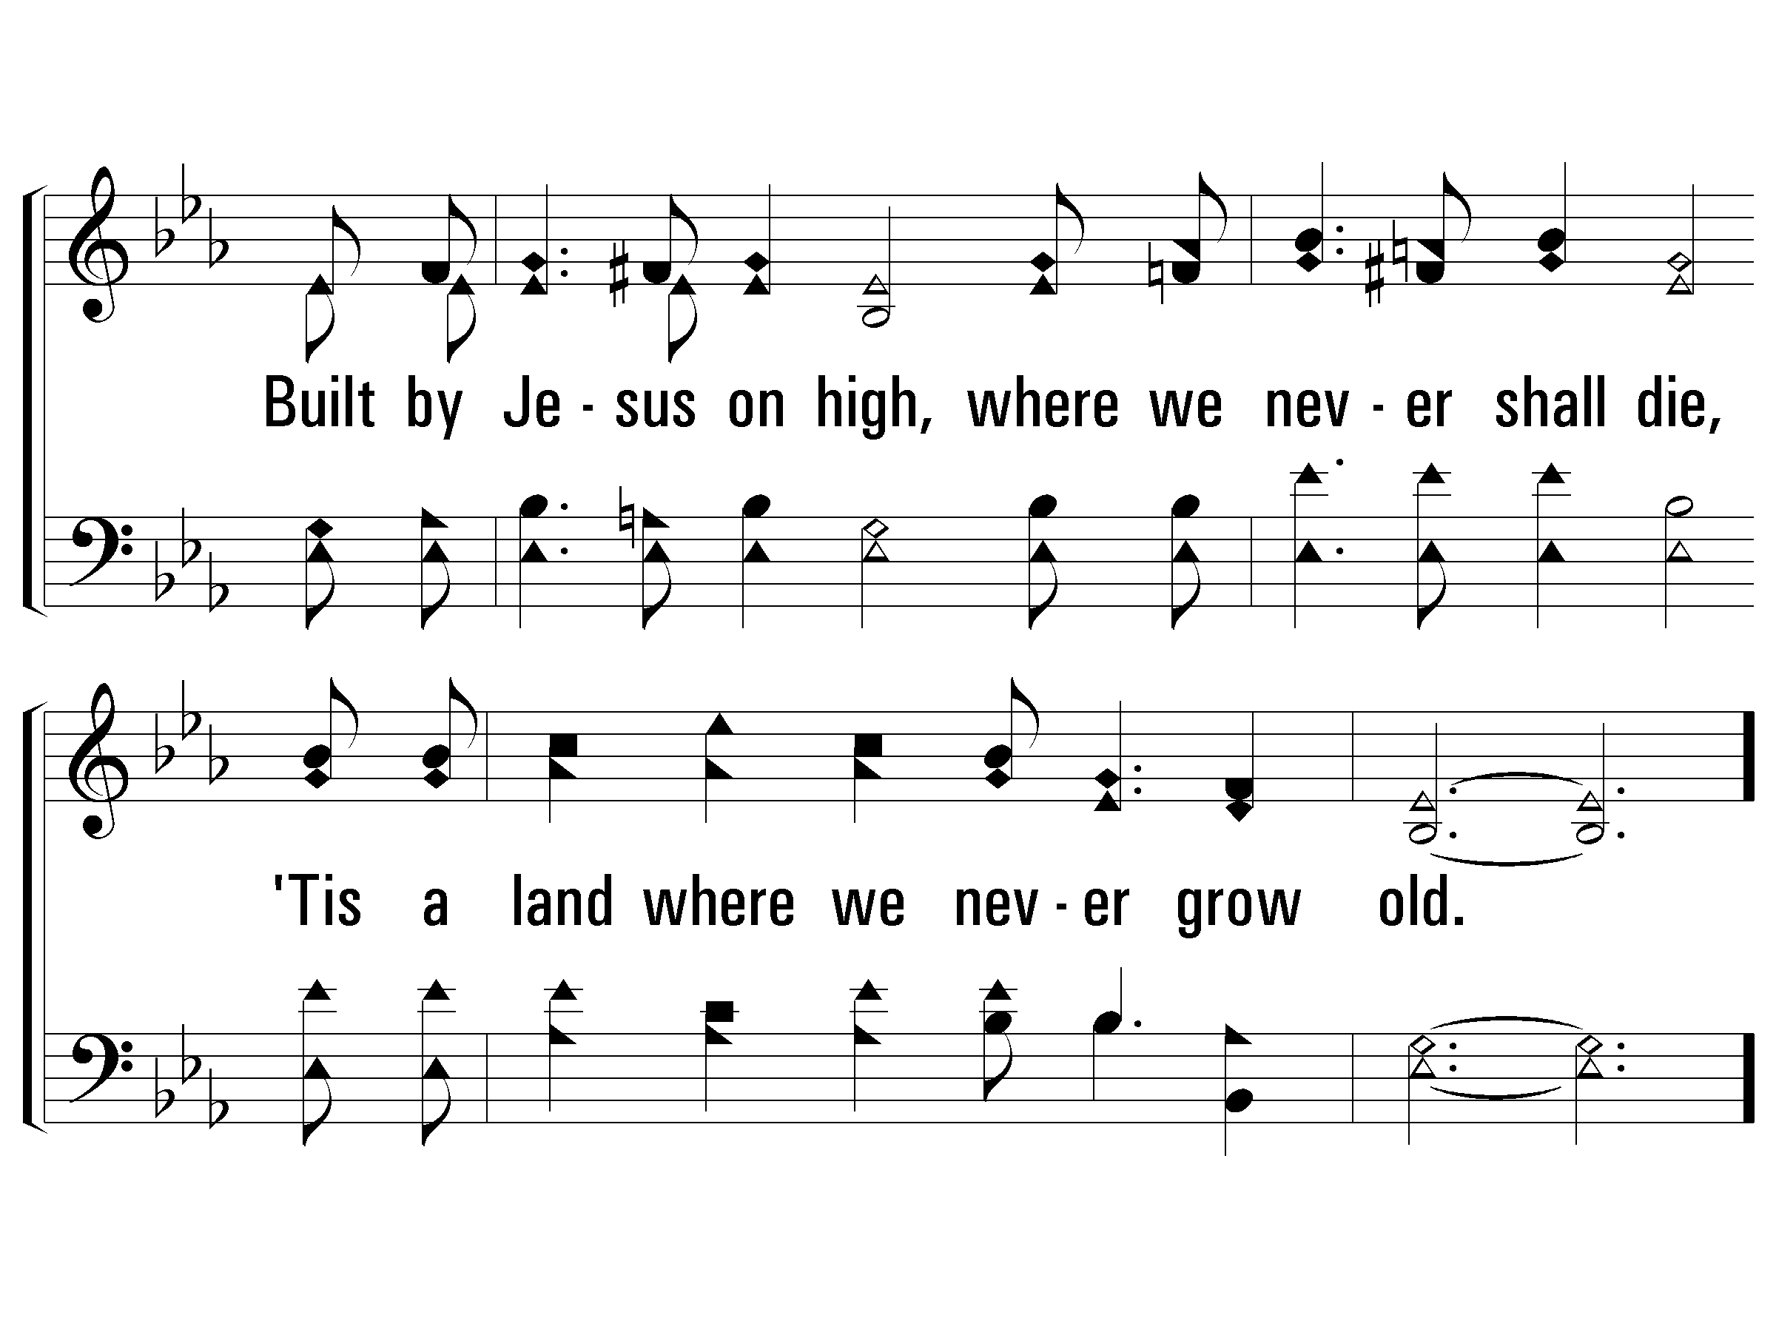
Verse 1
#277 – I Have Heard of a Land

Slide 21
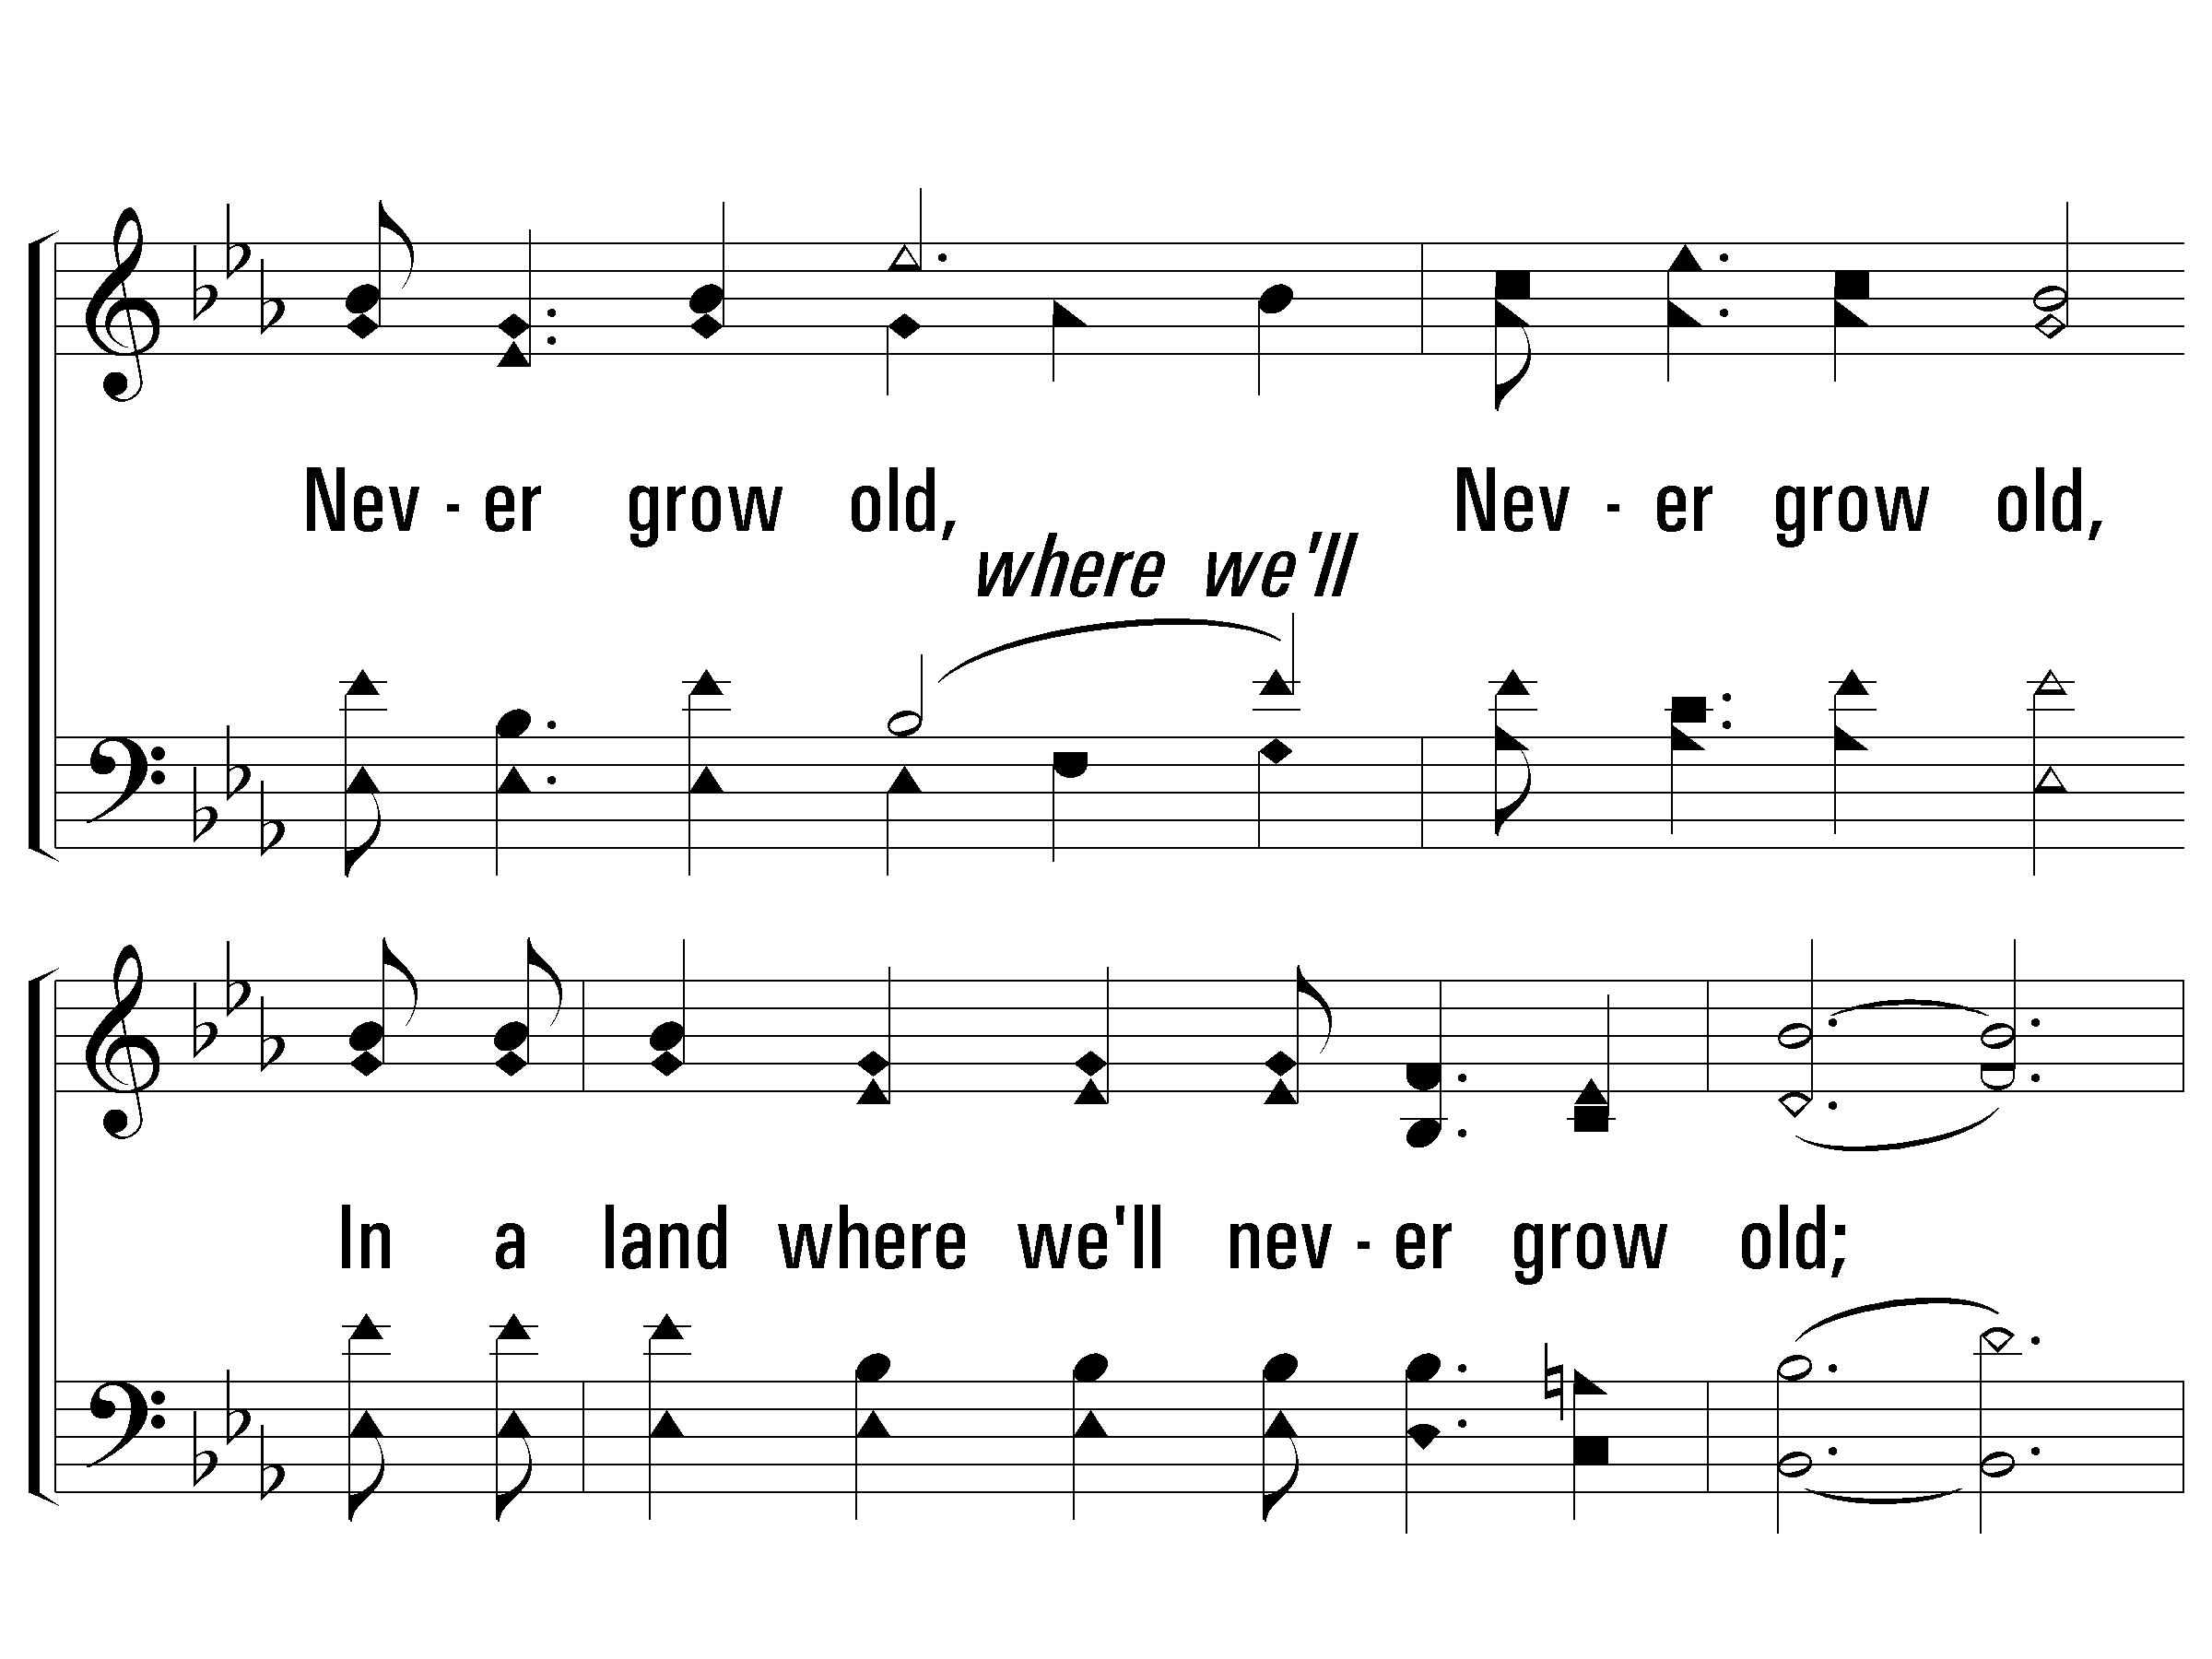
Chorus
#277 – I Have Heard of a Land
Never grow old,
Never grow old,
In a land where we'll never grow old;
Never grow old,
Never grow old,
In a land where we'll never grow old.

Slide 22
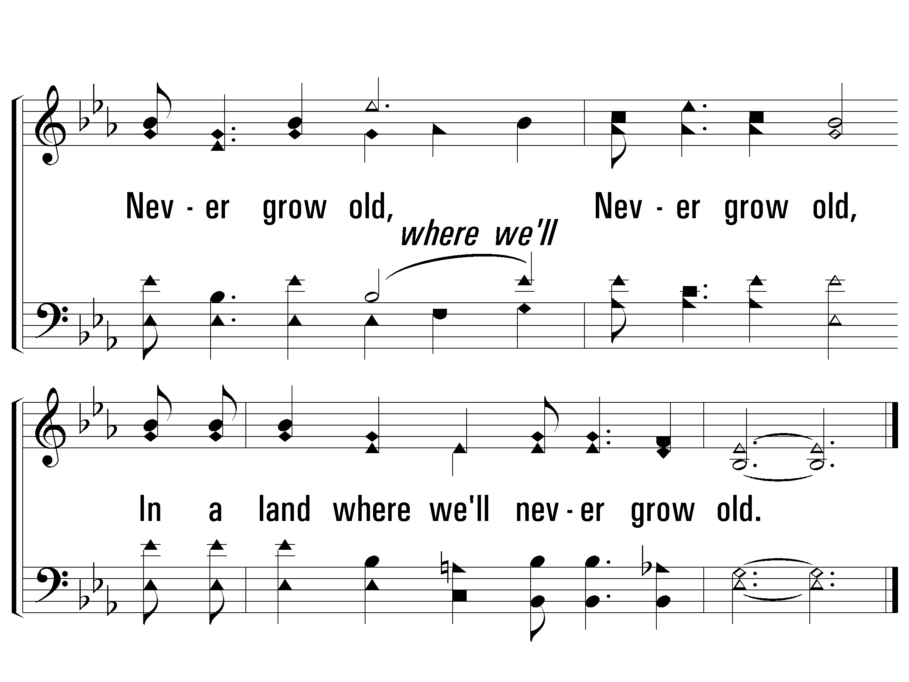
Chorus
#277 – I Have Heard of a Land

Slide 23
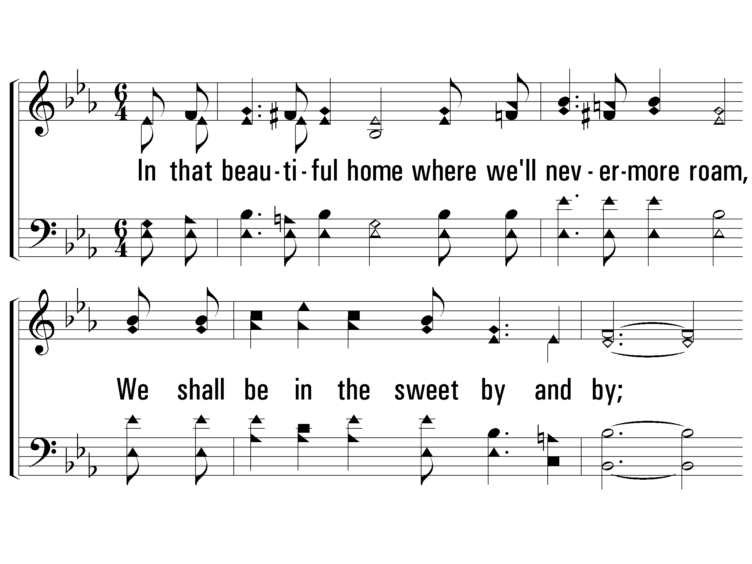
Verse 2
#277 – I Have Heard of a Land
2.
In that beautiful home where we'll nevermore roam,
We shall be in the sweet by and by;
Happy praise to the King through eternity sing,
'Tis a land where we never shall die.

Slide 24
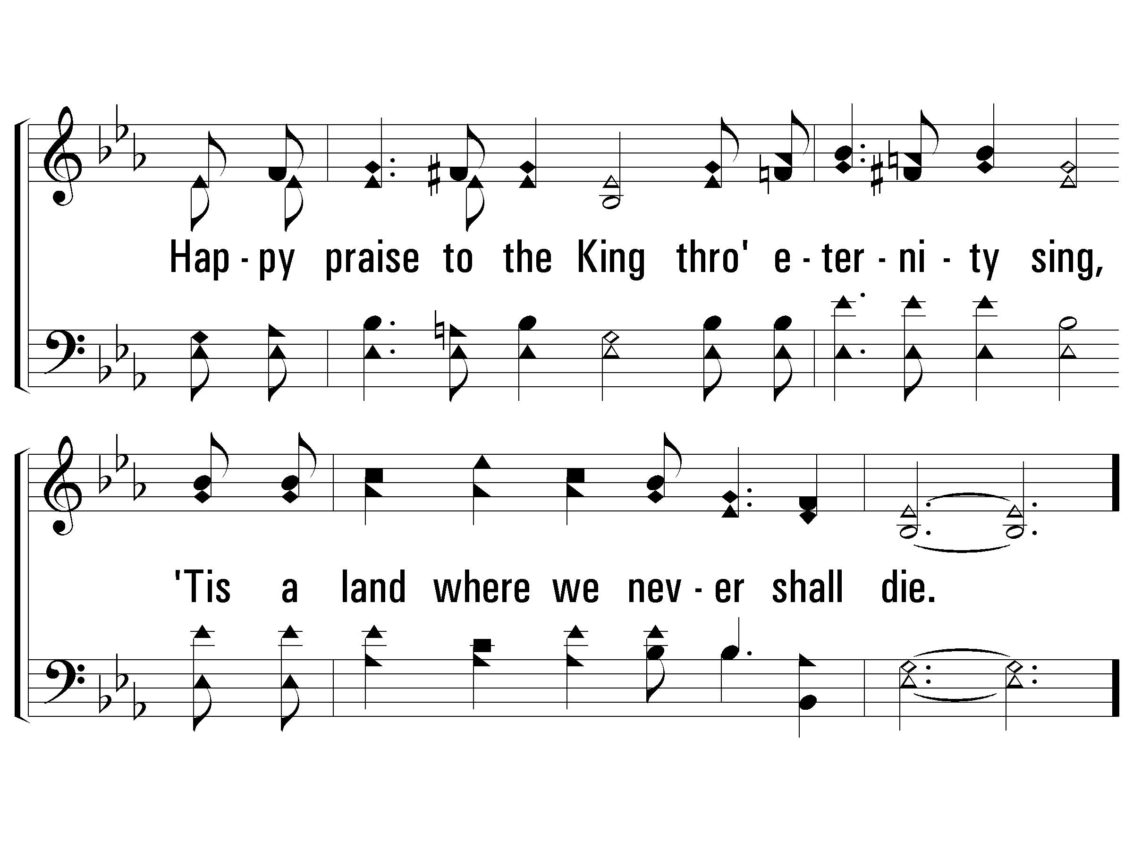
Verse 2
#277 – I Have Heard of a Land

Slide 25
Chorus
#277 – I Have Heard of a Land
Never grow old,
Never grow old,
In a land where we'll never grow old;
Never grow old,
Never grow old,
In a land where we'll never grow old.

Slide 26
Chorus
#277 – I Have Heard of a Land

Slide 27
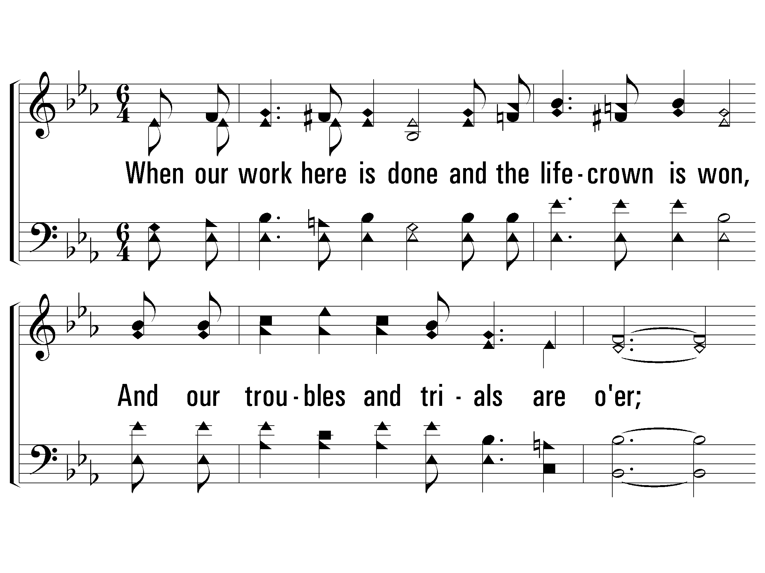
Verse 3
#277 – I Have Heard of a Land
3.
When our work here is done and the life-crown is won,
And our troubles and trials are over;
All our sorrow will end, and our voices will blend,
With the loved ones who've gone on before.

Slide 28
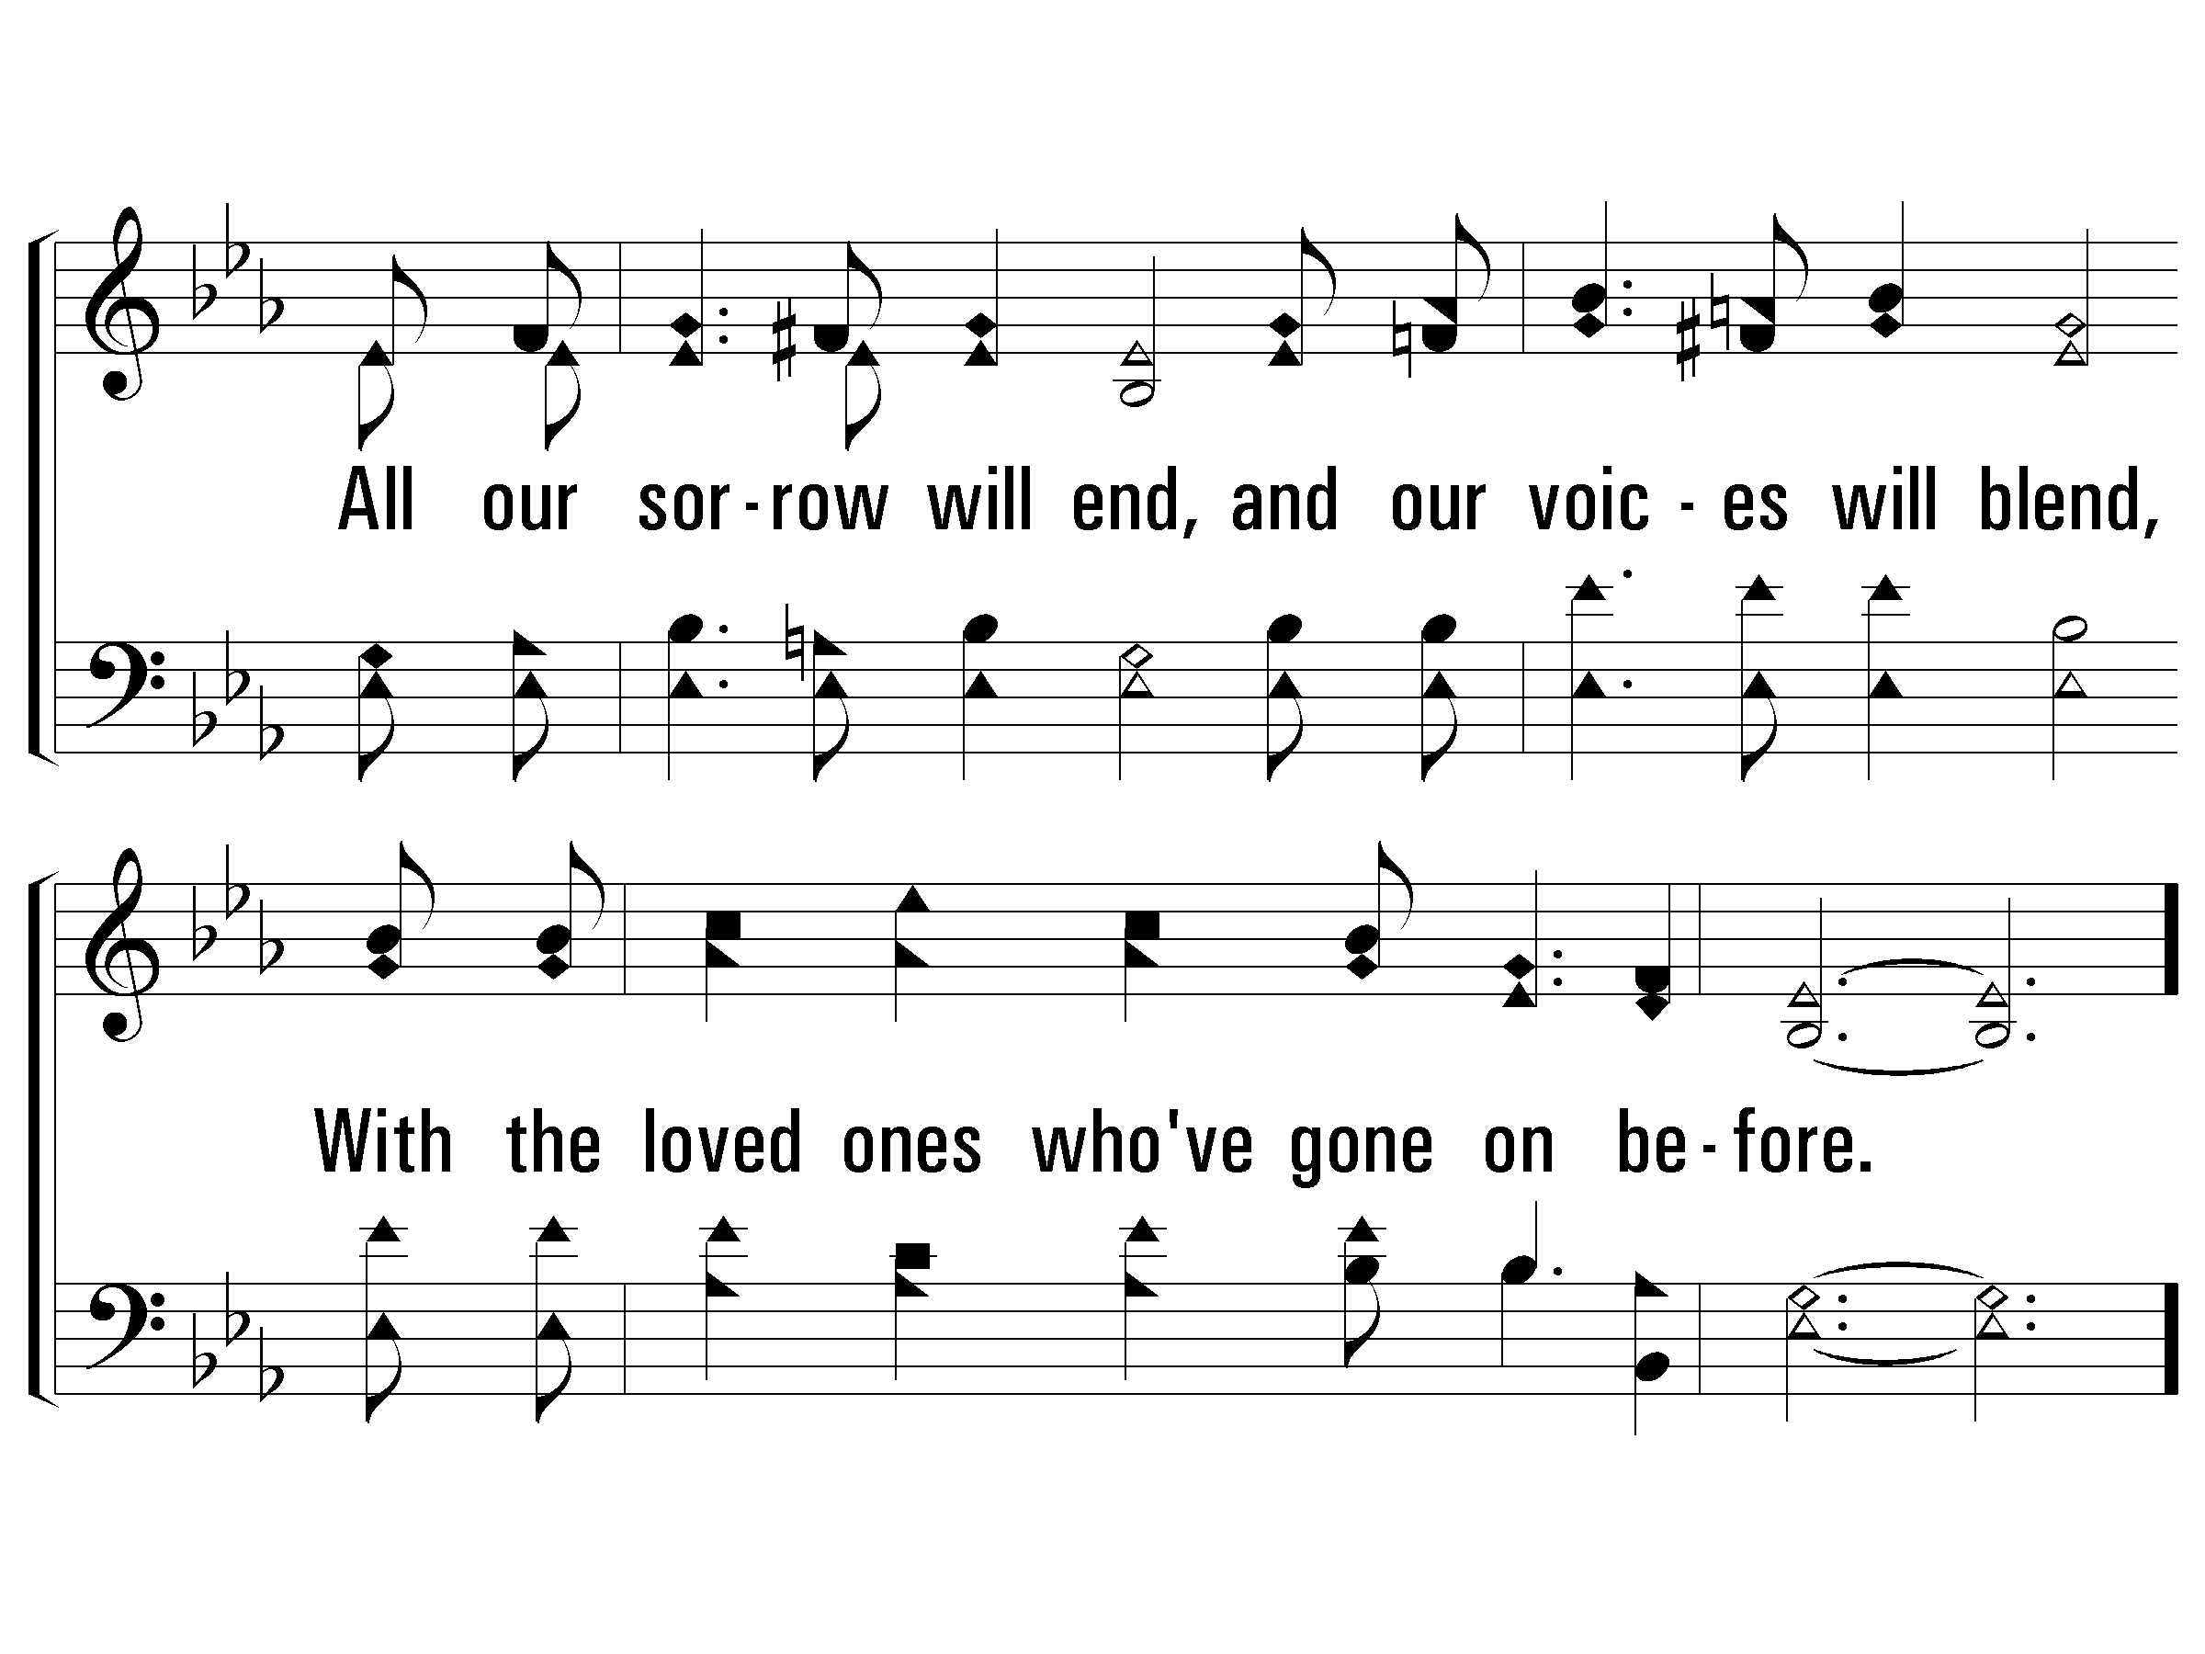
Verse 3
#277 – I Have Heard of a Land

Slide 29
Chorus
#277 – I Have Heard of a Land
Never grow old,
Never grow old,
In a land where we'll never grow old;
Never grow old,
Never grow old,
In a land where we'll never grow old.

Slide 30
Chorus
#277 – I Have Heard of a Land

Slide 31
I Have Heard of a Land
The magnificent reward that awaits us in heaven

Slide 32
The Lord’s Invitation
Do you want to go to that land?
Believe
Jn. 3:16
Repent
Acts 2:38
Confess
Rom. 10:10
Be Baptized
Mk. 16:16
Live Faithfully
Rev. 2:10

