Slide 1
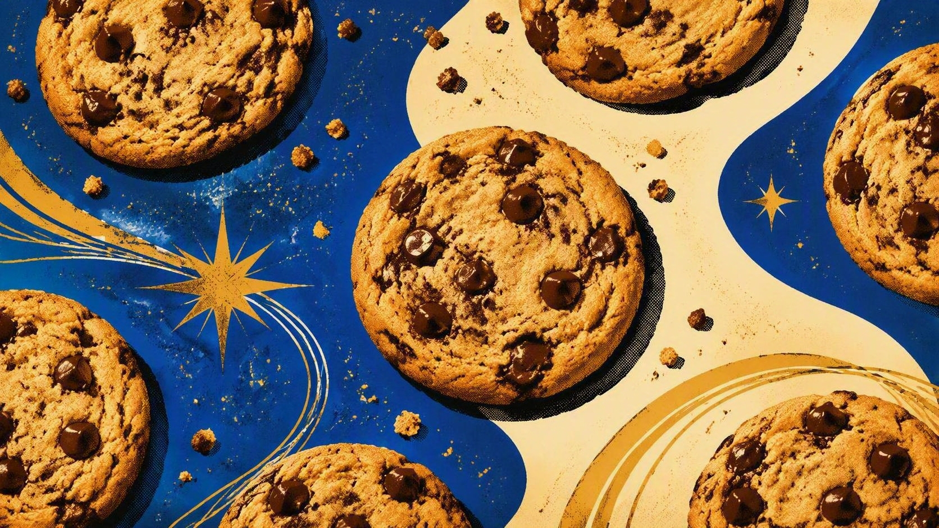
THE MORE FAMOUS AMOS
Bite-Size Truth. Big Justice.
Notes:
Introduce the theme in one sentence: Amos gives us bite-size truth about big justice. Summarizes the prophet’s message with one word—justice. Amos does not separate worship from public conduct. He addresses idolatry, greed, immorality, oppression of the poor, dishonest courts, and indifference among the wealthy. The repeated question is not simply whether Israel is religious, but whether its life reflects the character of the God it claims to worship. As we move through the book, notice how Amos begins with other nations, turns toward Israel, tightens the warning through sermons and visions, and still ends with hope.

Slide 2
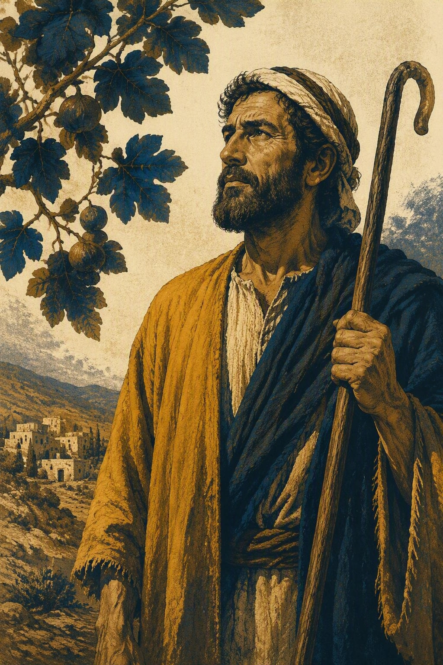
MEET THE PROPHET
INTRODUCTION
The shepherd who carried a heavy message
01
From Tekoa
Six miles south of Bethlehem. A place of wise people.
02
Herdsman + grower
Sheepbreeder and tender of sycamore fruit – Amos 7:14.
03
A name with weight
“Amos” means “to bear,” “to place a load upon,” or “burden-bearer.”
Notes:
Amos came from Tekoa, about six miles south of Bethlehem and twelve miles south of Jerusalem. He was a herdsman and a dresser of sycamore trees; the dresser pricked the fruit so it would ripen. He was not a professional prophet or a member of a prophetic school. In Amos 7, he explains that the Lord took him from his work and sent him to speak to Israel. His name can mean “to bear,” “to place a load upon,” or “burden-bearer,” which fits the weight of his message.

Slide 3
THE HISTORICAL BATCH
931–586 BC
Amos speaks during a boom—just before collapse
931 BC
874 BC
c. 765–750 BC
722 BC
586 BC
THE GREAT SPLIT
AHAB + ELIJAH
AMOS WARNS
ISRAEL FALLS
JUDAH FALLS
Israel and Judah divide.
Baal worship brings a prophetic crisis.
Prosperity masks injustice and hollow worship.
Assyria takes Samaria; exile begins.
Babylon destroys Jerusalem and the Temple.
The warning lands before exile: prosperity cannot cover injustice.
Notes:
The divided-kingdom period.
Between 765 and 750 BC, during the reigns of Uzziah in Judah and Jeroboam II in Israel, near the close of Jeroboam’s reign.
The kingdom had divided after Solomon,.
Amos preached to a northern kingdom enjoying strength and prosperity while decaying morally.
His warned that injustice, idolatry, and contempt for God’s word would bring national judgment.
Led to the destruction of Samaria in 722–721 BC.

Slide 4
AMOS IN ONE BITE
JUSTICE
Prosperity and worship mean little when the poor are crushed and truth is traded away.
I · 1:3–2:16 JUSTICE AGAINST THE NATIONS
II · 3:1–5:27 JUSTICE AGAINST ISRAEL
III · 6:1–6:14 WOES TO ZION AND SAMARIA
IV · 7:1–9:10 VISIONS OF AMOS
V · 9:11–15 ORACLES OF HOPE
Notes:
Use this slide as the map for the whole book. First, Amos announces judgment against the surrounding nations, then Judah, and finally Israel in chapters 1–2. Second, chapters 3–5 contain three “Hear this word” discourses that expose Israel’s responsibility, refusal to return, and need to seek the Lord. Third, chapter 6 pronounces woe on those at ease in Zion and Samaria. Fourth, chapters 7–9 present five visions: locusts, fire, the plumb line, summer fruit, and the struck altar or fallen structure. Finally, Amos 9:11–15 closes with hope—the fallen house of David raised and blessing pictured in overflowing harvest.

Slide 5
THE OPENING SWEEP
AMOS 1–2
Judgment starts far away—and lands at home
DAMASCUS • GAZA • TYRE • EDOM • AMMON • MOAB
JUDAH
ISRAEL
The audience agrees with every verdict—until Amos names their own injustice.
Notes:
Amos begins where his audience is comfortable: with judgment on six neighboring nations—Damascus, Gaza, Tyre, Edom, Ammon, and Moab.
“For three transgressions…and for four,” expressing a full measure of guilt. Their sins include cruelty, slave trading, betrayal, and violence.
Amos turns to Judah for rejecting the law of the Lord. Only after the audience has agreed with every verdict does he name Israel. Israel’s sins include selling the needy for a pair of sandals, crushing the poor, sexual immorality, corrupt worship, greed, and silencing prophets.

Slide 6
CAUSE AND CONSEQUENCE
AMOS 3
The lion roars: judgment has a cause
LION ROARS
→
PREY IS NEAR
TRAP SPRINGS
→
THE SNARE WAS TRIGGERED
TRUMPET SOUNDS
→
DANGER IS REAL
Greater grace brings greater responsibility. (Amos 3:2)
Notes:
Chapter 3 opens the first of three major discourses with “Hear this word.”
Israel’s privilege increases its responsibility.
“The more God gives, the more God expects.”
Amos then uses a chain of rhetorical questions.
A lion roars because prey is near – v. 3-6
A trap springs because something triggered it.
A trumpet sounds because danger is present.
In the same way, coming judgment has a cause—Israel’s own sin—and the prophetic warning demands a response. The Lord has revealed his counsel to the prophet, so Amos cannot remain silent: “The lion has roared; who will not fear? The Lord has spoken; who can but prophesy?” – v. 8

Slide 7
THE REPEATED REFRAIN
AMOS 4
Five warnings; one unchanged response
1
FAMINE
“Cleanness of teeth” — nothing to eat.
2
DROUGHT
Rain withheld when the crops needed it most.
3
BLIGHT
Scorching wind, mildew, and locusts.
4
PLAGUE
Disease, war, sword, and the stench of loss.
5
OVERTHROW
Cities burned; a firebrand barely rescued.
“Yet you have not returned to me.”
Notes:
Amos 4 reviews 5 chastisements intended to bring Israel back:
1. Famine—“cleanness of teeth” and lack of bread. – v. 6.
2. Drought, with rain withheld when crops needed it most – v. 7-8.
3. Blight, mildew, and locust damage to gardens and orchards – v. 9.
4. Plague, war, and the stench of death – v. 10.
5. Overthrow and burning of cities, leaving Israel like a firebrand pulled from the flames – v. 11.
After each warning comes the same heartbreaking refrain: “Yet you have not returned to me.”
The point is not merely that disaster occurred; it is that repeated correction produced no repentance.
“Prepare to meet your God” – vv. 12-13.

Slide 8
THE OPEN INVITATION
AMOS 5
Seek the Lord and live
SEEK ME
LIVE
Return to the Lord—not to religious places that have become empty symbols.
SEEK GOOD
The threat is real—yet repentance remains possible.
Hate evil. Love good. Establish justice in the gate.
Notes:
Chapter 5 is both a funeral song and an invitation.
Amos speaks as though Israel has already fallen, yet the Lord still says, “Seek me and live,” “Seek the Lord,” and “Seek good” – v. 4, 6, 14.
The answer is not found in religious centers such as Bethel, Gilgal, or Beersheba when those places have become substitutes for obedience – v. 5.
Amos identifies what seeking good looks like: hate evil, love good, and establish justice in the gate—the place where legal decisions were made – v. 14-15.
The powerful had turned justice into wormwood, taken bribes, and pushed aside the needy – v. 7-13.
The open door is real, but it calls for a changed life, not confidence in prosperity or false religiosity.

Slide 9
THE HEART OF THE BOOK
AMOS 5:21–24
Worship without justice is just noise
Feasts can continue while the heart drifts.
Offerings can be right while neighbors are exploited.
Beautiful songs can still miss what God desires.
“Let justice roll on like a river, and righteousness like a never-failing stream.”
AMOS 5:24
Notes:
Amos 5:21–24 is the theological center of the book. The Lord rejects festivals, offerings, and songs because worship has been separated from righteousness.
This is an “anti-cultus” passage—not a rejection of worship itself, but a condemnation of hypocritical worship. Music offered without devotion becomes noise.
Sacrifice cannot compensate for injustice toward one’s neighbor.
Amos then states the book’s great theme: “Let justice roll on like a river and righteousness like a never-failing stream.” Emphasize that justice is not an occasional act or a temporary program. Amos pictures it as a continuous, life-giving current running through the community.

Slide 10
WOES TO ZION AND SAMARIA
AMOS 6
COMFORT
COMPASSION
Ivory beds
“They do not grieve over the ruin of Joseph.”
Choice food
Fine oils + music
Ease becomes dangerous when it makes suffering invisible.
Notes:
Aimed at those at ease in Zion and secure in Samaria.
Amos is trying to jolt the idle rich. He describes ivory-inlaid beds, reclining couches, choice lambs and calves, music, bowls of wine, and the finest oils. None of those items is the central issue by itself.
The indictment is that the privileged “do not grieve for the ruin of Joseph” – v. 6.
Their comfort has insulated them from the suffering of God’s people and from the violence that supports their lifestyle. They put the day of accountability far away, but exile will end their revelry.
The application is clear: ease becomes spiritually dangerous when it makes the pain of others invisible.

Slide 11
THE FINAL MOVEMENT
AMOS 7–9
Five visions tighten the message
1
2
3
4
5
LOCUSTS
FIRE
PLUMB LINE
SUMMER FRUIT
STRUCK ALTAR
Amos intercedes.
He pleads again.
Israel fails the measure.
The end is ripe.
False refuge falls.
Mercy delays judgment; it does not erase God’s standard.
Notes:
5 visions:
1. Locusts consume the land, and Amos intercedes because Jacob is small; the Lord relents – 7:1-3.
2. A consuming fire threatens the land, Amos pleads again, and the calamity is averted – 7:4-6.
3. The Lord holds a plumb line against Israel and exposes how crooked the nation has become; this time the judgment advances – 7:7-9.
4. A basket of summer fruit—a wordplay signaling that Israel is ripe and the end is near – 8:1-14.
5. The Lord stands by the altar and the false structure collapses – 9:1-10.
The sequence moves from intercession and delay to measurement, ripeness, and unavoidable judgment.

Slide 12
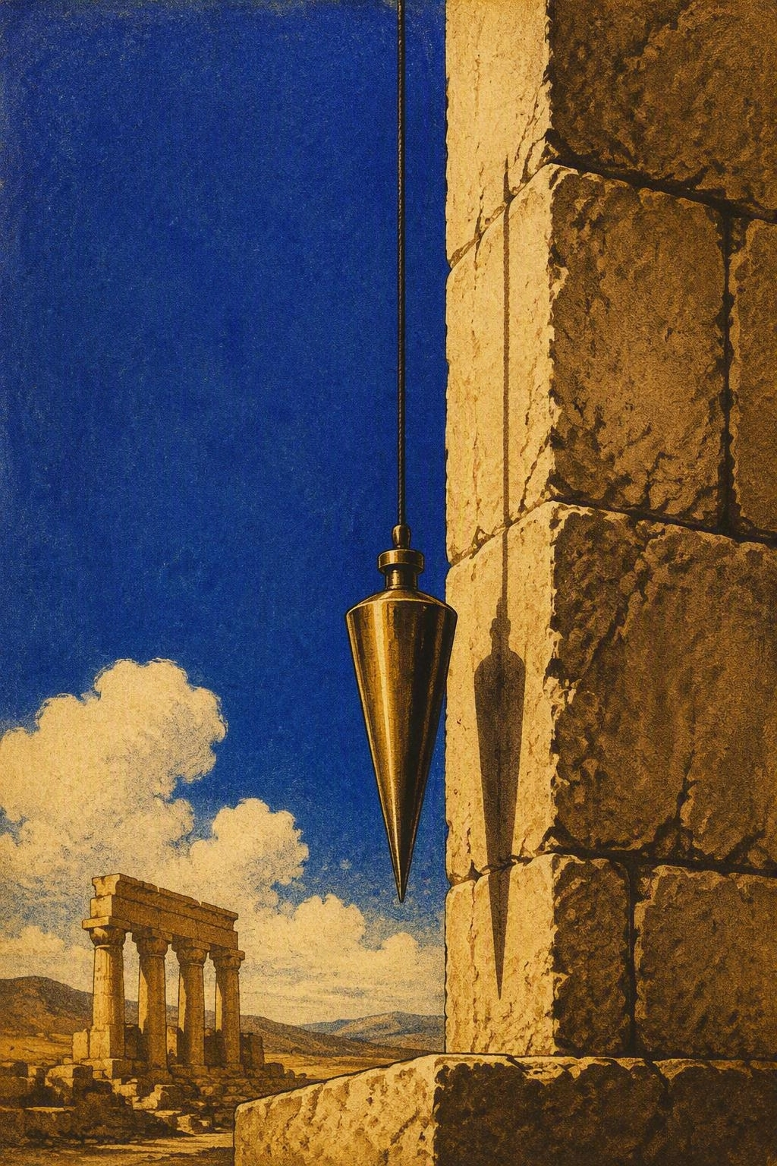
VISION THREE
AMOS 7:7–9
The plumb line reveals what is crooked
God’s standard is straight.
Israel’s life and worship are out of line.
This time Amos does not intercede: the measure is final.
What standard are we using?
Notes:
A plumb line tests whether a wall is truly vertical.
In Amos 7:7–9, the Lord uses that picture to show how far Israel’s life has departed from what is upright.
The nation is crooked and unbalanced; the sanctuaries and high places will not survive the measurement.
In the first two visions Amos interceded and judgment was delayed. Here he does not intercede, and the Lord says he will not “pass by” the people again.
The standard has not moved—Israel has. Use the closing question personally and communally: Are we measuring faithfulness by comfort, popularity, and prosperity, or by God’s straight standard of justice and righteousness?

Slide 13
VISION FOUR
AMOS 8
Ripe fruit. Rigged scales. Empty hearing.
RIPE
RIGGED
RARE
The nation is ready for judgment; the end is near.
Small measures. Heavy prices. The needy sold for sandals.
A famine—not of bread, but of hearing the word of the Lord.
When truth is ignored long enough, its absence becomes a judgment.
Notes:
The basket of summer fruit shows a nation ripe for judgment; the Hebrew wordplay connects “summer fruit” with “end.”
Amos exposes rigged commerce. Merchants resent holy days because they want to resume cheating; they make the measure small, the price weight large, and use dishonest scales. Their greed impoverishes people until the needy are sold for trivial sums and receive only inferior grain.
Because Israel rejected the prophetic word, a famine is coming—not a famine of bread, but of hearing the word of the Lord. People will search for a message and not find it. Rejected truth eventually becomes unavailable truth.

Slide 14
VISION FIVE
AMOS 9:1–10
NO HIDING
Depths • heights • Carmel • sea • exile
And yet…
A REMNANT REMAINS
The people are sifted among the nations; the good kernel is not lost.
Notes:
The fifth vision opens with the Lord beside the altar and the building shaking apart.
Amos 9:2–4 emphasizes that there is no place to hide: not the depths, the heights, Mount Carmel, the sea, or exile. God’s searching judgment reaches every false refuge.
Yet Amos 9:8–10 introduces an important distinction.
The sinful kingdom will be destroyed, but the house of Jacob will not be erased.
The people will be sifted among the nations like grain in a sieve; the chaff is judged, while the good kernel is preserved.
This is the remnant theme: judgment is real and thorough, but it does not cancel God’s purpose for a faithful people.

Slide 15
ORACLES OF HOPE
AMOS 9:11–15
Amos ends with rebuilding, not rubble
FALLEN
RAISED
OVERFLOWING
The house of David is pictured as a collapsed shelter.
God promises to repair and restore what has fallen.
Plowing, harvest, and blessing overlap in a picture of abundance.
Judgment is not Amos’s last bite. Hope is.
Notes:
Amos does not end with rubble. In 9:11–15 the Lord promises to raise the fallen shelter of David and repair its ruins.
Messianic Prophecy – cf. Acts 15.
James uses it to explain the inclusion of the Gentiles among God’s people. The restored rule of David reaches beyond one nation.
Amos then pictures abundance so great that plowing, harvesting, and planting overlap; the hills drip with blessing.
These images are spiritual figures of the fullness enjoyed under the Messiah.
The final movement is therefore not denial of judgment, but restoration after judgment—God rebuilds, gathers, and extends hope to the nations.

Slide 16
PACK THESE FOR THE ROAD
TAKEAWAYS
Four bite-size truths to take home
1
God cares how power treats people.
2
Worship and justice cannot be separated.
3
Repeated warnings are invitations to return.
4
God’s story moves through judgment toward restoration.
Notes:
Summarize the book with four truths.
1. God cares how power treats people. Amos repeatedly condemns violence, bribery, dishonest trade, and oppression of the poor.
2. Worship and justice cannot be separated; songs and sacrifices become noise when daily life contradicts God’s character.
3. Repeated warnings are invitations to return. Famine, drought, blight, plague, and overthrow were meant to awaken Israel, yet the people would not return.
4. Judgment is not the final word. A remnant remains, the fallen house of David is raised, and blessing reaches beyond Israel. These truths move Amos from ancient history into present discipleship and community life.

Slide 17

PICKING THE CRUMBS
Where have we mistaken comfort for faithfulness?
What would justice “rolling like a river” look like here?
Which warning in Amos is easiest for us to ignore?
Where do we see God’s promise to rebuild and restore?
Amos 5:14–24 • Amos 9:11–15
Notes:
Use the questions to move from explanation to response.
When discussing comfort, recall Amos 6: the wealthy were condemned because they did not grieve over the ruin of Joseph.
When discussing justice, return to Amos 5:24 and ask what a continuous river of righteousness would change in our relationships, decisions, and institutions.
When naming ignored warnings, remember the repeated refrain of Amos 4: “Yet you have not returned to me.”
Finally, ground hope in Amos 9:11–15: God raises what has fallen and creates a people that extends beyond old boundaries. Encourage the group to read Amos 5:14–24 and 9:11–15 aloud before answering.

