Slide 1

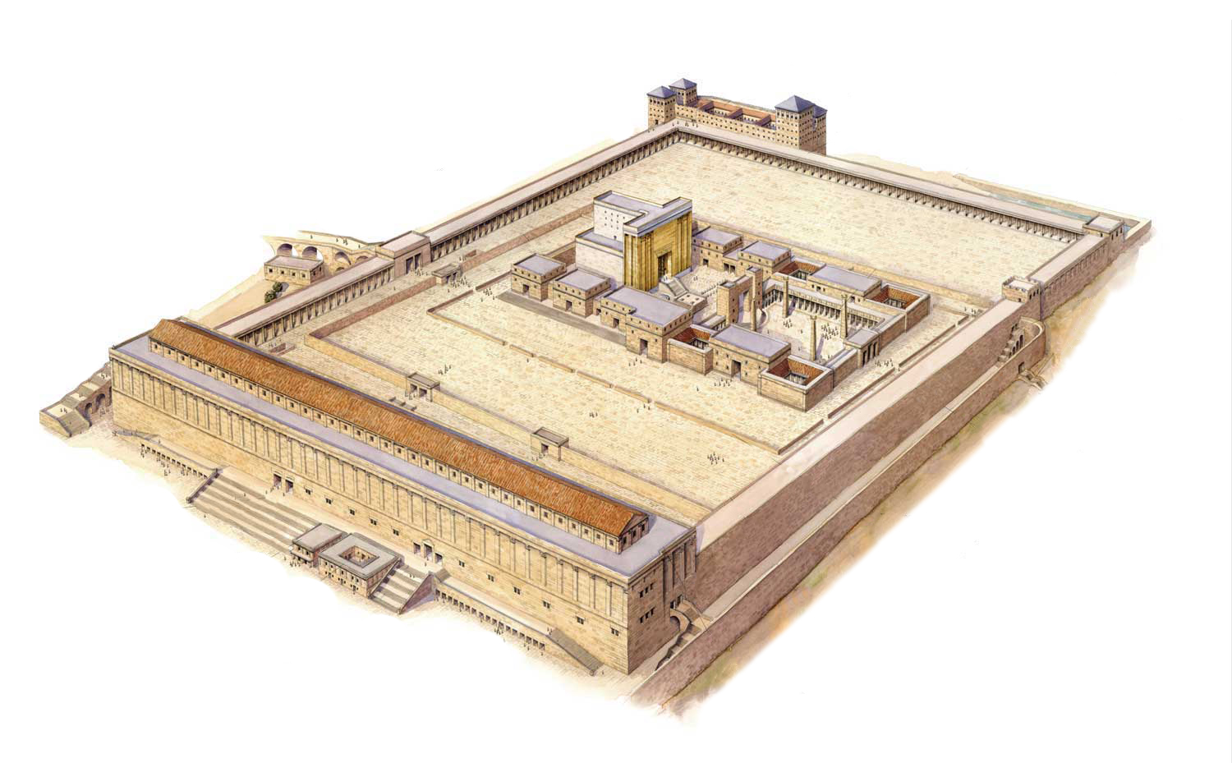
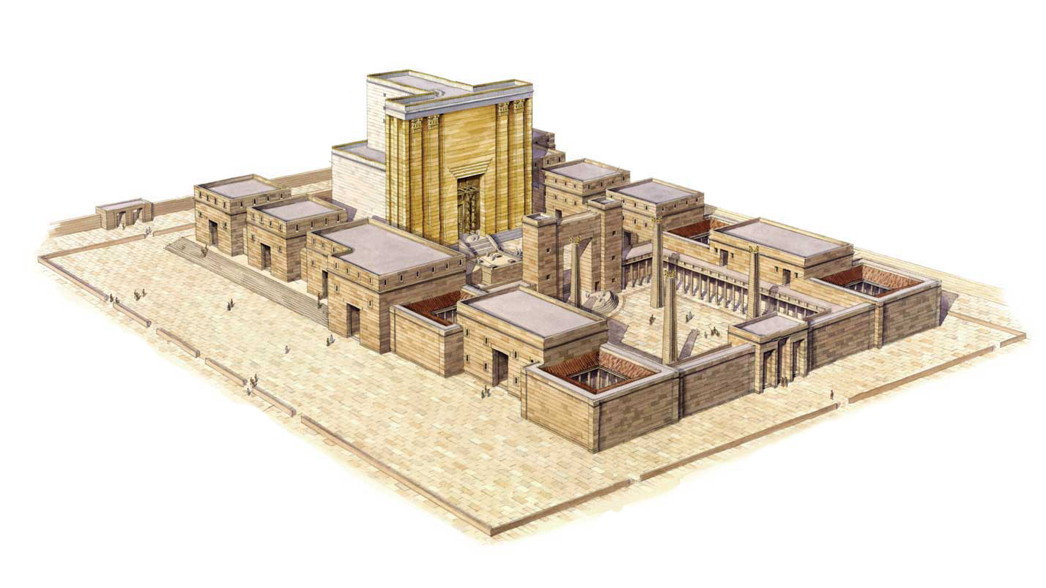
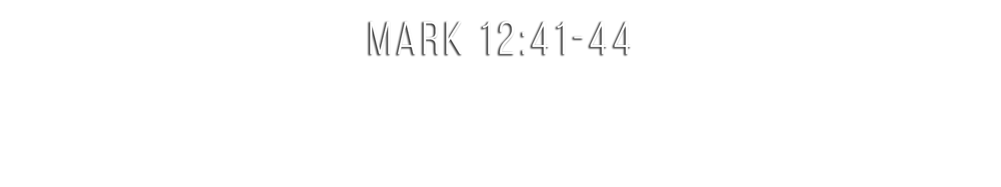
TURN TO

Slide 2
The coins were almost worthless—the sacrifice was enormous
  A mite was their smallest copper coin—two mites = 1/4 cent, 1/64 day’s wage
  Man could count what she put in—Jesus could measure what it cost (12:44)
  It wasn’t merely the higher percentage—she gave herself to God (2 Cor. 8:2-5)
Her whole heart showed in sacrifice, humility and obedience
  She was not seeking attention or announcing herself
  She did not quibble about “how much to give”
  Jesus saw where the gift came from—a heart given to God (Rom. 12:1; 2 Cor. 9:7)

Slide 3
She had every earthly reason to be afraid
  A “poor widow” describes real destitution—no husband, no resources
  She gave “all she had to live on” (NASB) and placed herself in God’s care
Her trust was not misplaced—God has always cared for widows
  The Bible repeatedly reveals God’s concerns for widows (Ex. 22:22-23; Deut. 24:19-21; 1 Tim. 5:3-16; Jas. 1:27)
  And God’s Son was there watching her, knowing everything about her
Your God knows you and cares for you (Matt. 6:32-33; 1 Pet. 5:7)

Slide 4
Jesus stopped His disciples so they would not miss her (12:43a)
What nobody else may have noticed, Jesus never forgot
  God sees what nobody else sees and doesn’t forget (Matt. 6:4; Heb. 6:10)
  Christian faithfulness often occurs while nobody notices
  People may never know what it costs you, but Jesus does
Jesus ensured that this moment of genuine devotion would always be remembered

Slide 5
Believe Jesus is the Son of God – John 3:16
Repent of your sins and turn toward God – Acts 17:30
Confess your faith in Jesus Christ – Romans 10:9
Be baptized into Christ – Mark 16:16
  God will forgive all of your sins – Acts 2:38
  God will add you to His church – Acts 2:47
  God will enroll you in heaven – Hebrews 12:23
Commit yourself fully to Him – Romans 12:1-2

