Slide 1


Slide 2
Jesus already announced judgment on “this generation” (23:29-36)
  23:36 and 24:34 are the contextual bookends of this text
Jesus grieved over the Jerusalem that He was about to judge (23:37)
Jesus declared their house “desolate” (23:38)
Jesus walked out of the temple (24:1)
“Assuredly, I say to you, all these things will come upon this generation.” (23:36)
“Assuredly, I say to you, this generation will by no means pass away till all these things take place.” (24:34)

Slide 3
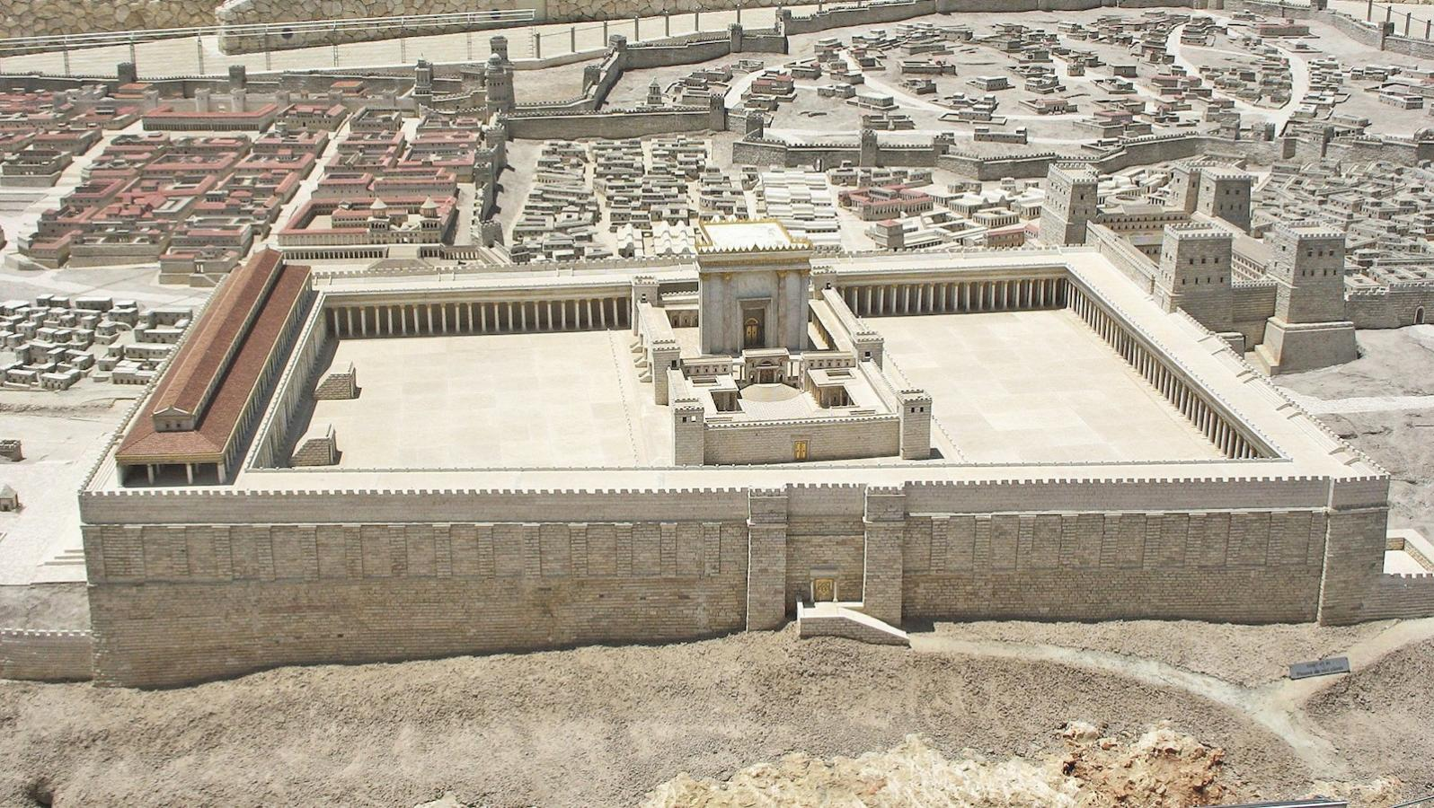

Slide 4
Jesus already announced judgment on “this generation” (23:29-36)
  23:36 and 24:34 are the contextual bookends of this text
Jesus grieved over the Jerusalem that He was about to judge (23:37)
Jesus declared their house “desolate” (23:38)
Jesus walked out of the temple (24:1)
Jesus predicted the destruction of the temple (24:1-2)
“Assuredly, I say to you, all these things will come upon this generation.” (23:36)
“Assuredly, I say to you, this generation will by no means pass away till all these things take place.” (24:34)

Slide 5
Notice WHERE the conversation occurs
  After leaving the temple, Jesus sat on the Mount of Olives opposite the temple
Notice WHO asks the question “privately”
  Peter, James, John, Andrew (Mark 13:3) = “you” throughout the context
Notice WHAT they ask
  “Tell us, when will these things be? And what will be the sign of Your coming, and of the end of the age?”
Let Mark and Luke help us understand Matthew’s wording
  “Tell us, when will these things be? And what will be the sign when all these things will be fulfilled?” (Mark 13:4)
  “Teacher, but when will these things be? And what sign will there be when these things are about to take place?” (Luke 21:7)
Understand “the end of the age”
  The Greek aion is not talking about the end of the earth/world (see 24:34)
  “Age” notes the end of the Jewish dispensation (cf. Heb. 9:26; 1 Cor. 10:11)

Slide 6
Jesus warns them not to be deceived (24:4-5)
Some dramatic events would happen—but “the end is not yet” (24:5-8)
The disciples themselves would experience persecution – “you” (24:9-13)
  They needed to endure (24:13) – “end” = the destruction of Jerusalem
One thing had to happen before “the end will come” (24:14)
  The gospel was preached in all the world before A.D. 70 (Col. 1:6, 23; Rom. 1:8; 10:18)
Jesus then gives them a LOCAL warning that could save their lives (24:15-28)
Jesus uses difficult language but keeps it inside the same time frame (24:29-31)
Like the fig tree, the signs would let them KNOW the event was near (23:32-33)
This judgment would be: Observable, Recognizable, Approaching, Escapable

Slide 7
Jesus identifies the generation (24:34)
  “I say to YOU” – Peter, Andrew, James and John
  “THIS GENERATION” – Jesus’ contemporaries (11:16; 12:41, 42, 45; 23:36)
  “ALL THESE THINGS” (23:36; 24:2, 3, 8, 33, 34)
  Any difficult statements are understood in light of Jesus’ clear statement
Notice the bookends again (23:36+24:34)
Jesus guarantees that His prophecy will not fail (24:35)
“Assuredly, I say to you, all these things will come upon this generation.” (23:36)
“Assuredly, I say to you, this generation will by no means pass away till all these things take place.” (24:34)

Slide 8
It does not give us signs by which to calculate the Second Coming
  Jesus located “all these things” in “this generation”
  They could “KNOW” the time was “near” (24:33),
  but the time of the second coming of Christ “NO ONE KNOWS” (24:36)
  The destruction of Jerusalem could be recognized by signs,
  but the second coming of Christ CANNOT be predicted at all (24:42, 44)
Matthew 24 gives us powerful evidence that Jesus is exactly who He claimed to be
  He predicted events 40 years in advance with remarkable specificity
  And they happened

Slide 9
Believe that Jesus is the Son of God – John 8:24
Repent of your sins and turn toward God – Luke 13:3
Confess your faith in Jesus Christ – Romans 10:9
Be baptized into Christ – Mark 16:16
  God will forgive you of all sins – Acts 2:38
  God will add you to His church – Acts 2:47
  God will enroll you in heaven – Hebrews 12:23
Obey Jesus and walk with Him faithfully – 1 John 1:7

