Slide 1
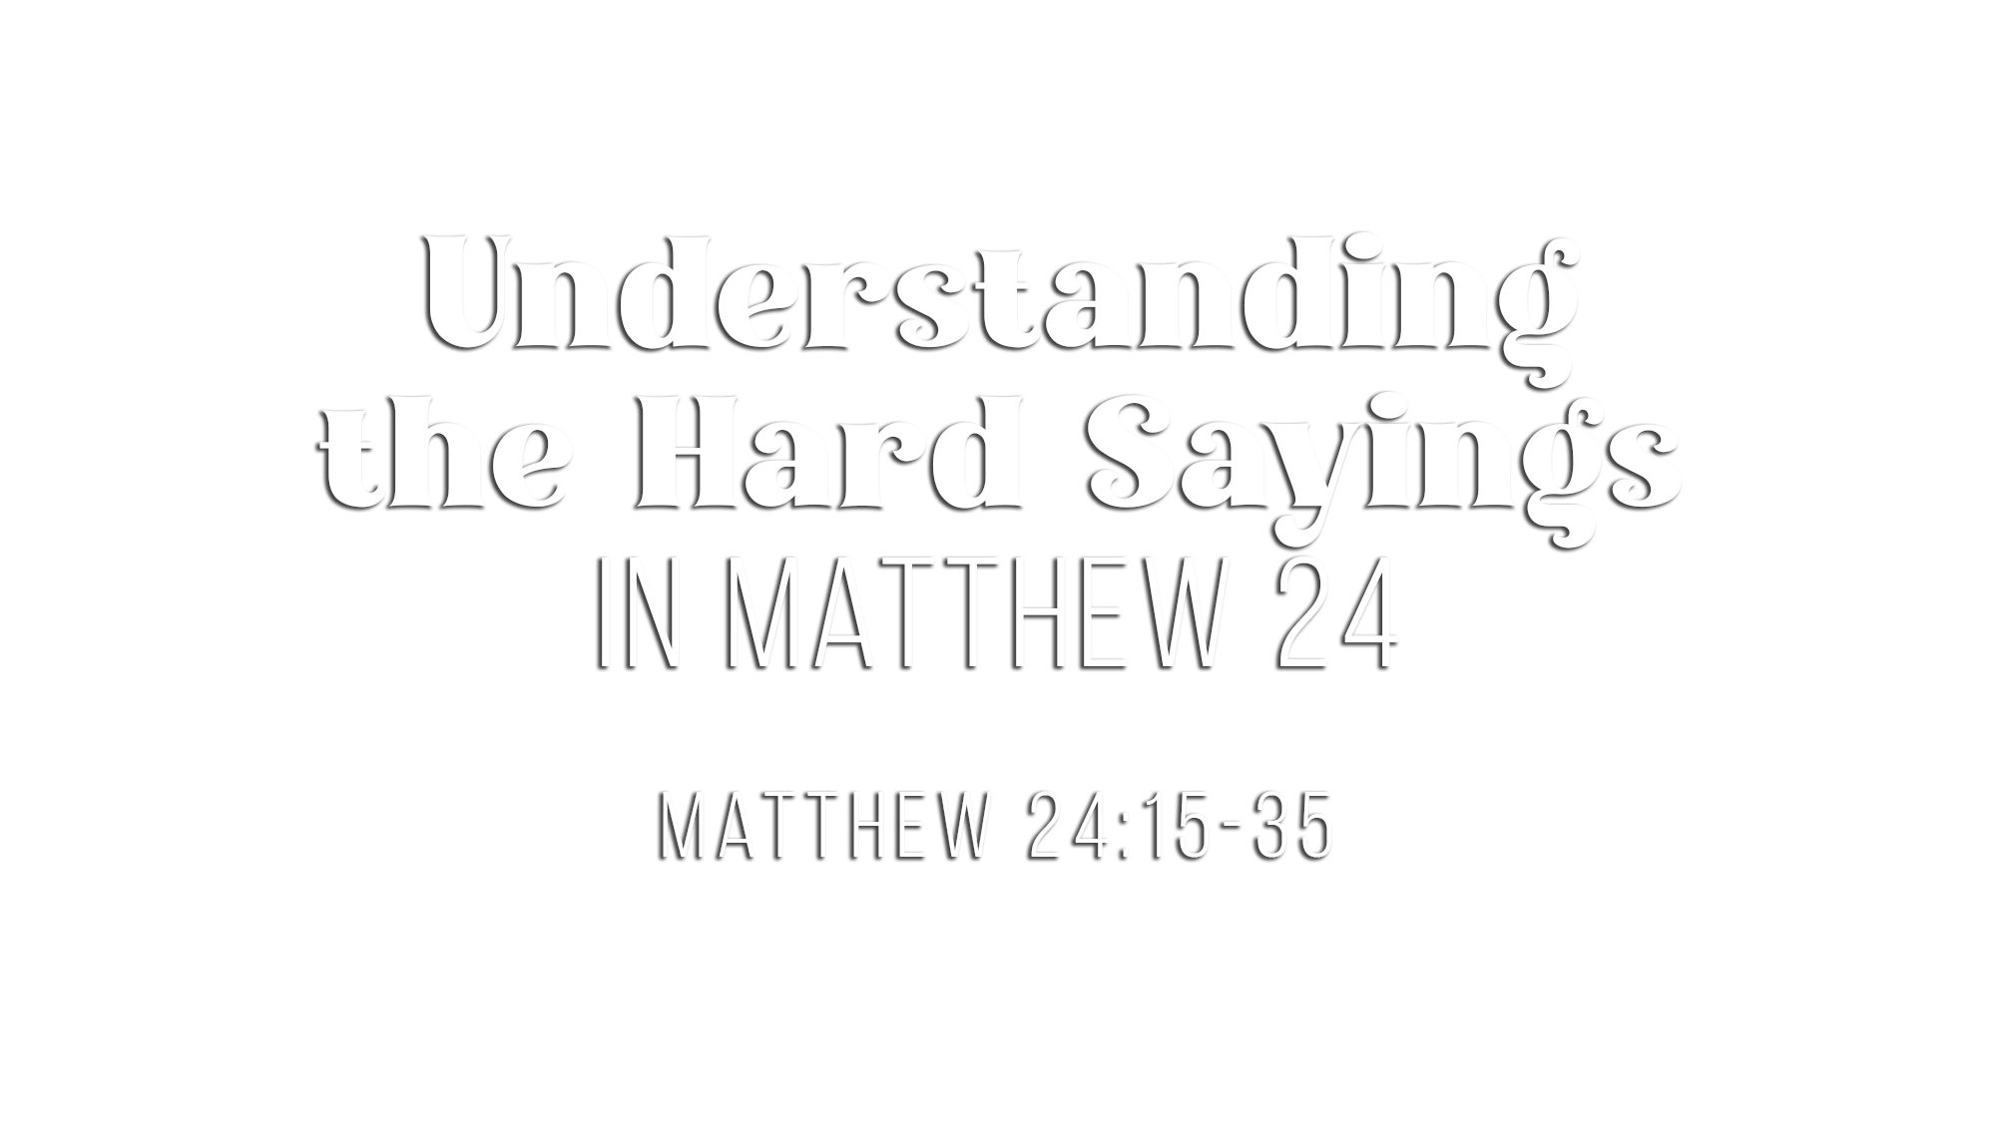

Slide 2
Jesus spoke of the “abomination of desolation” (24:15)
  It had been prophesied by Daniel (Dan. 9:24-27; cf. Matt. 23:38)
  It was something these disciples could “SEE”
  Jesus expected it to be understood and taken seriously
Luke identifies the practical meaning (Luke 21:20-21)
  When Jerusalem is surrounded by armies, its desolation is near
The response proves it was a local event (24:16-18)
  These are EMERGENCY evacuation orders
The practical obstacles prove the same thing (24:19-20)

Slide 3
The tribulation belongs to the same flight Jesus has just described (24:21)
  Notice the connective: “For THEN there will be a great tribulation”
Jesus used such extreme language because of the worst tribulation ever (24:21)
  There is unparalleled GUILT involved (Matt. 23:32-36; Luke 21:22)
  There is unparalleled SUFFERING involved (Luke 21:23-24)
  “Nor ever shall be” shows history continues afterward
The days would be shortened for the elect (24:22)
  God’s providence was at work for His people in the midst of His judgment
The danger of deception intensifies during the crisis (24:23-26)
Jesus contrasts those local claims with His actual return (24:27)
  When Jesus actually returns, nobody will have to tell you where He is
The carcass and eagles return us immediately to Jerusalem (24:28)
  The invading forces gathering upon the doomed, spiritually dead nation

Slide 4
Jesus Himself used an important time word: “IMMEDIATELY” (24:29)
The OLD TESTAMENT used cosmic language for the fall of nations (24:29)
  The fall of BABYLON (Isa. 13)
  The fall of EDOM (Isa. 34:4-5)
  The fall of EGYPT (Ezek. 32:7-8)
The OLD TESTAMENT also explains “coming on the clouds” (24:30)
  Divine “coming” in judgment “in a cloud” occurred against Egypt (Isa. 19:1)
The destruction would be a “SIGN”: the Son of Man is reigning in heaven (24:30)
  A.D. 70 visually demonstrated His reigning authority as Lord and Christ (Acts 2:30-36)
“All the tribes…will mourn” (24:30)
The GOSPEL would involve angels, a trumpet and gathering (24:31)
  “Angels” can simply mean “messengers” (Mt. 11:10; Mk. 1:2; Lk. 7:24; 9:52; Jas. 2:25)
  A trumpet of judgment (Isa. 18:3; 27:13; Hos. 8:1) or of “Jubilee” at liberty (Lev. 25)
  His elect are gathered from every direction, from all nations (v. 14; Mk. 16:15; Ac. 1:8)

Slide 5
Jesus’ use of the fig tree shows the signs would be recognizable (24:32-33)
  “Seeing” the signs indicates “nearness”
Jesus’ sharp contrast of “know” and “no one knows” is critical (24:33, 36)
  There were signs before the destruction of Jerusalem
  There will be NO signs before the final coming of Christ
Jesus’ emphasis of “THIS generation” identifies WHEN (24:34)
  YOU = Peter, Andrew, James, John
  THIS GENERATION = their contemporaries
  ALL THESE THINGS = everything Jesus had just discussed (incl. vss. 29-31)
Jesus’ encompassing “ALL these things” will not allow vss. 29-31 to be cut loose
Jesus’ own authority is the reliability behind the prophecy (24:35)

Slide 6
The problem was never that Matthew 24 is impossible to understand
Much of the problem has been that people have:
  ignored the parallel accounts
  detached verses from their local context
  read figurative Old Testament language literally
  and allowed difficult imagery to overrule Jesus’ plain time statement
The DIFFICULT LANGUAGE does NOT overturn the CLEAR CONTEXT!
Just let THE BIBLE EXPLAIN THE BIBLE!
The precise fulfillment of Jesus’ precise prophecy about Jerusalem fortifies our confidence in His promise to come again in final judgment

Slide 7
Believe that Jesus is the Son of God – John 8:24
Repent of your sins and turn toward God – Luke 13:3
Confess your faith in Jesus Christ – Romans 10:9
Be baptized into Christ – Mark 16:16
  God will forgive you of all sins – Acts 2:38
  God will add you to His church – Acts 2:47
  God will enroll you in heaven – Hebrews 12:23
Obey Jesus and walk with Him faithfully – 1 John 1:7

