Slide 1

Are You a Stale Christian?
Rev 3:14-22

Slide 2
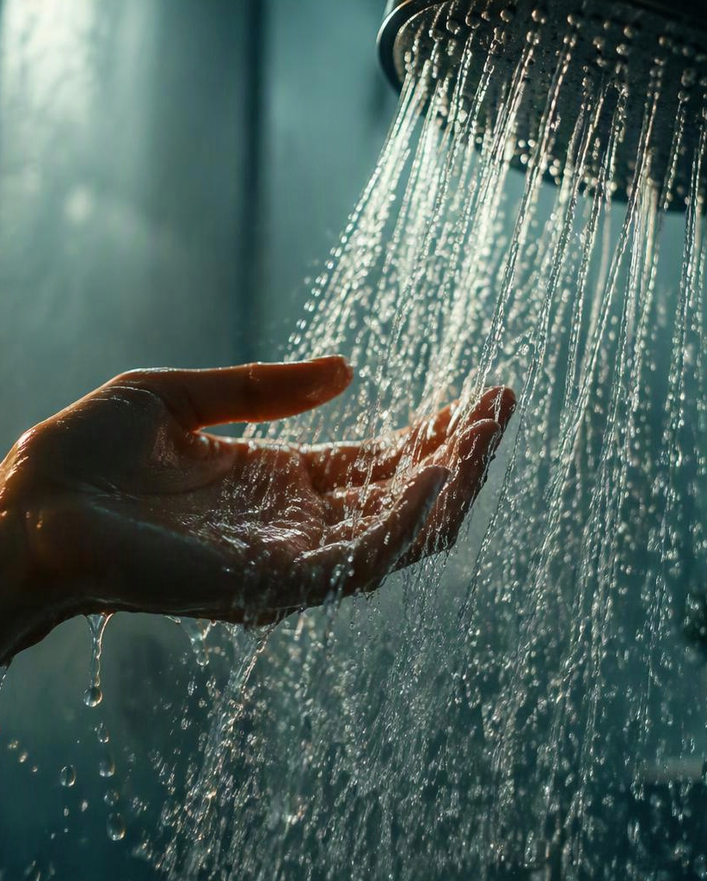
COMFORT CAN QUIETLY
BECOME COMPROMISE
We spend time getting the water temperature just right.
Not too hot.
Not too cold.
Just comfortable.
What happens when a church becomes too comfortable?

Slide 3

Are You a Tasteless Christian? – Rev 3:15-16.
• Jesus calls us to be REFINED – v. 18.
• Jesus offered real wealth.
• Jesus covered our nakedness.
• Christians must be DISTINCT.
• We are salt – Mt. 5:13a.
• We stand out – Mt. 5:13b.

Slide 4
Different Temperatures, Different Uses
HOT
LUKEWARM
COLD
Lukewarm water isn’t used for anything.
Warming up.
Cleaning.
Cooling off.
Keeping food fresh.

Slide 5
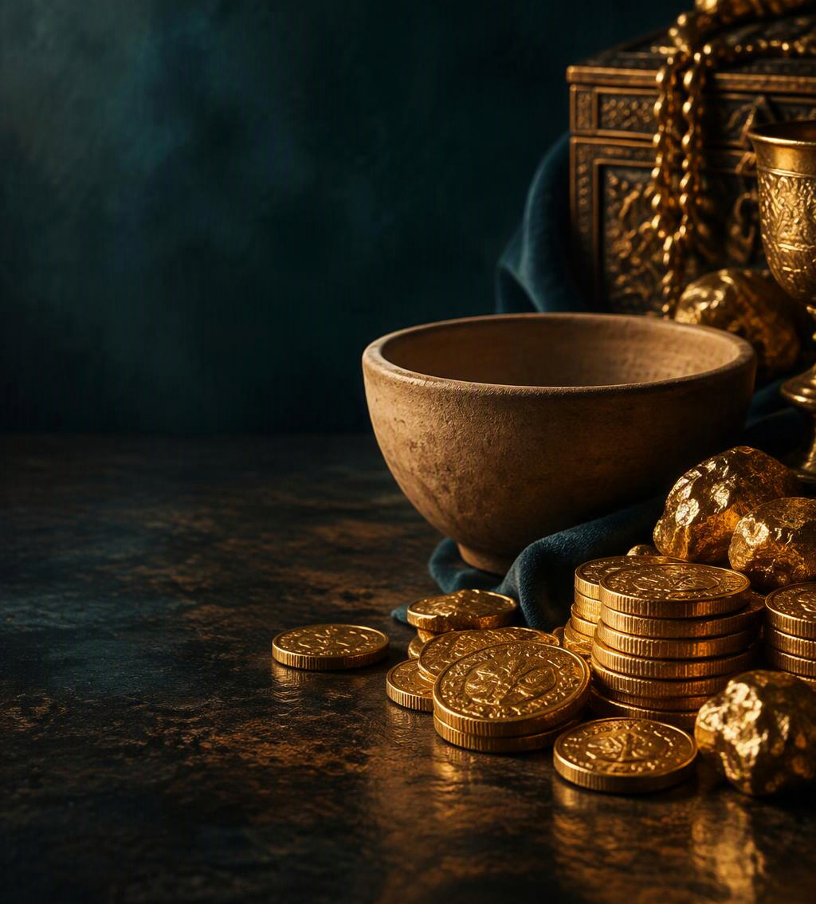
Are You a Useless Christian?
• Laodicea was content with worldly riches – v. 17.
• Believed they had need of nothing.
• But, they were wretched, miserable, poor, blind, and naked.

Slide 6
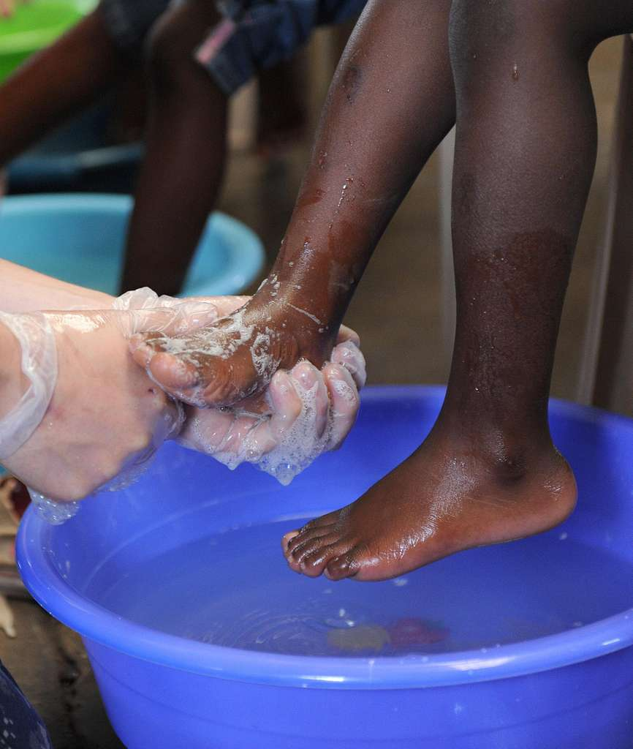
Are You a Useless Christian?
• Christians are called to be useful.
• We are God’s workmanship, created for good works – Eph. 2:10.
• Pure and undefiled religion is caring for the needy – Jas. 1:27.
• If we are not seeking to do good works, we have become useless to God.

Slide 7

A lukewarm Christian will be vomited out – v. 16.
• Stale water will turn the stomach.
• Jesus will not stomach a stale Christian.

Slide 8

A lukewarm Christian will be vomited out.
They disgust Him – 2 Pet. 2:20-21.
“For if, after they have escaped the pollutions of the world through the knowledge of the Lord and Savior Jesus Christ, they are again entangled in them and overcome, the latter end is worse for them than the beginning. For it would have been better for them not to have known the way of righteousness, than having known it, to turn from the holy commandment delivered to them.”
They cannot be forgiven while continuing in sin – Heb. 6:4-6.
“For it is impossible for those who were once enlightened, and have tasted the heavenly gift, and have become partakers of the Holy Spirit, and have tasted the good word of God and the powers of the age to come, if they fall away, to renew them again to repentance, since they crucify again for themselves the Son of God, and put Him to an open shame.”

Slide 9
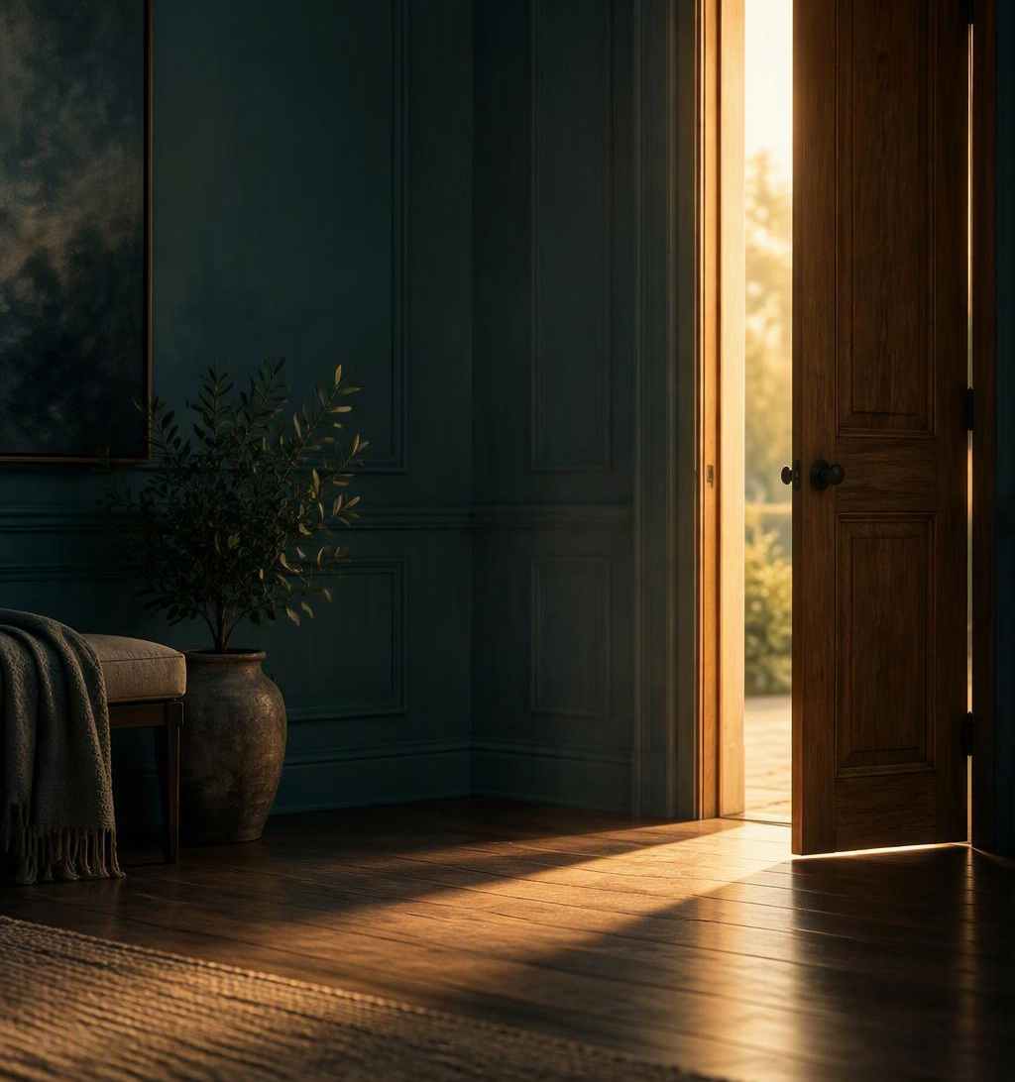
A stale Christian can be refreshed – v. 19-20.
• Renew your love for the work of God.
• Repent of worldliness.
• Open the door to Christ and let Him back into your life.

Slide 10
Are You a Stale Christian?
• The church at Laodicea became lukewarm.
• They got comfortable.
• They fell back into carnal living.

Slide 11

Get Your Flavor Back!
• Have you become indistinct from the world?
• Do you feel useless in the church?
• It is time to stop being a stale Christian and be zealous.
• Christ is calling for you do something outstanding: repent.
• He’s knocking at the door. Will you answer Him?

Slide 12
Have You Tasted Salvation?
Believe – John 3:16.
Repent – Luke 13:3.
Confess – Romans 10:9-10.
Be Baptized – 1 Peter 3:21.
Live Faithfully – Revelation 2:10.

